Slide 1
REA AWS Training
Day 3
It's turtles all the way down …

Slide 2

Day 3: All aboard!
Logistics, housekeeping
Phones, etc
Pacing and breaks
Questions

Slide 3

Day 3: Agenda
ElastiCache
– BREAK –
RDS
– LUNCH –
DynamoDB
KMS
– BREAK –
Open Hack, or re-visit topics on demand

Slide 4
REA AWS Training
ElastiCache

Slide 5

Introduction to ElastiCache
In-memory cache
Managed service – automatic patching, etc.
Different engines, multiple versions:
  Memcached, Redis
Parameter groups for fine grained configuration
Cross-AZ for resilience
Reserved Nodes, no Dedicated

Slide 6

ElastiCache: Security
No username/password auth – security groups only
EC2-Classic
  security group membership only
VPC
  security group membership or CIDR
  located based on cache subnet groups

Slide 7

ElastiCache: Memcached
Engine versions 1.4.5 and 1.4.14
Elastic – add/remove/reboot nodes on the fly
  potential performance impact
Auto Discovery via config endpoint
  updates every minute (clients must poll)
  requires AWS ElastiCache client (Java, PHP, .NET)
  3rd-party clients for Ruby, Python, Node, etc
Lots of good CloudWatch metrics

Slide 8

ElastiCache: Redis
Engine versions 2.6.13, 2.8.6, and 2.8.19
  2.8.6 brings psync, quorum writes, Redis pub-sub
  2.8.19 brings HyperLogLog, lex range queries, safer master → slave sync
Replication groups: up to 5 async read replicas
  intra-region only
  node promotion in case of master failure
Snapshots for backup – automatic or manual
  performance impact of snapshots
No AutoDiscovery

Slide 9

ElastiCache: Redis continued
Provision from RDB snapshot in S3
Take snapshots from any read replica
Some Redis commands unavailable
In-memory only by default
  appendonly/appendfsync in custom parameter group
  certain node sizes only
  cannot protect against all failure modes

Slide 10
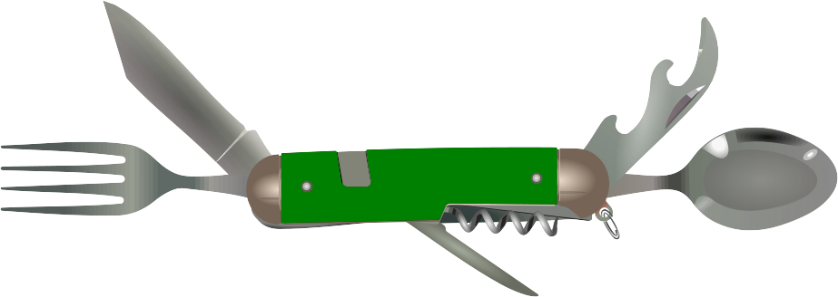
ElastiCache: Hands on
Create cluster (memcached or Redis)
Play with features
Explore failure modes
Clean up

Slide 11
BREAK
Break!

