Slide 1
REA AWS Training
Lambda

Slide 2

What is Lambda?
Serverless compute
Low cost
Low administration
Highly scalable

Slide 3

What is Lambda?
General availability (most regions)
Not Functional Programming (so term “lambda” may mislead)
Execution time limit. Maximum 5 minutes
Execution memory limit must be determined ahead of time
Code in Node.js, Python, Java & C#

Slide 4
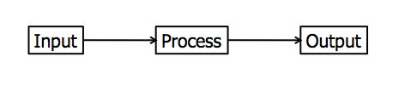

What is Lambda?
S3 Bucket
VPC
Security Group
Input
Processing
Output
success?
json
event
context
IAM role
Cloudwatch Logs

Slide 5
Lambda: What is an Input?
S3 (upload/change/delete)
DynamoDB Streams
Kinesis Streams
SNS topics
SES events
CloudWatch Events
custom event invocations from client code
API Gateway
Cognito (user management)
CloudFormation
CloudWatch Logs
CloudWatch Events (API Call)
Scheduled Events (cron)
Alexa
Lex
Invoke (manual)

Slide 6

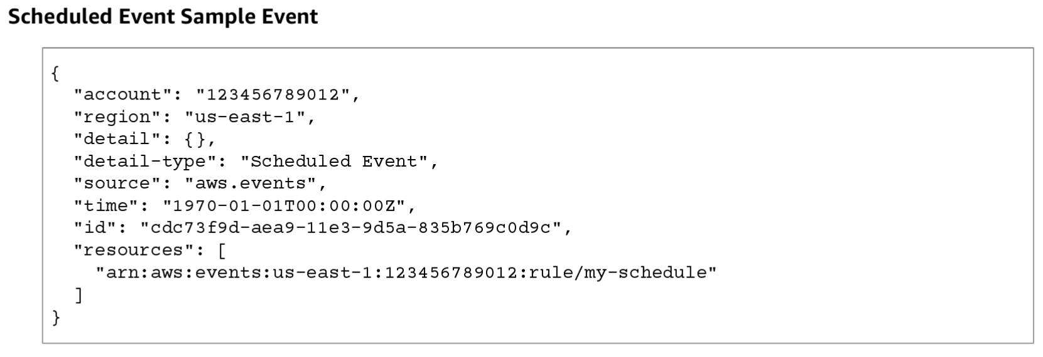
Lambda: input format
json
Each event source has it's own structure

Slide 7
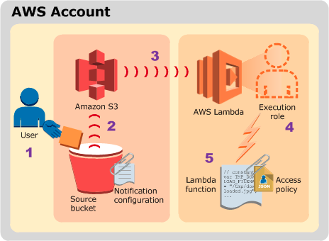
Lambda: hands on
Create a lambda and
invoke it
lambda/hands-on.md

Slide 8
Lambda: behind the curtain
Lambda runs on EC2. AMI is available
It has an environment. Inspect with lambdash
It has some disk space – not shared
It does not have a fixed UID
The environment may be frozen and thawed – watch for memory leaks

Slide 9
Lambda: a free ride?
First 1 million requests per month are free
$0.20 per 1 million requests thereafter ($0.0000002 per request)
$0.00001667 for every GB-second used (RAM * 100ms)
data transfer costs (data out)
S3 costs
database costs
$0.67 per GB ingested Cloudwatch logs
$0.033 per GB archived per month***
data transfer costs (data out)

