Slide 1
REA AWS Training
CloudTrail

Slide 2
CloudTrail
Logging of API calls into S3
Includes:
  Timestamps & unique event Ids
  Identity of invoker (may be AWS service), User Agent, source IP
  Service & API call (with parameters)
All REA accounts log CloudTrail into a central bucket
REA use Lambda Funtion and Kinesis to deliver CloudTrail logs to Splunk

Slide 3
CloudTrail
REA use Lambda Funtion and Kinesis to deliver CloudTrail logs to Splunk

Slide 4
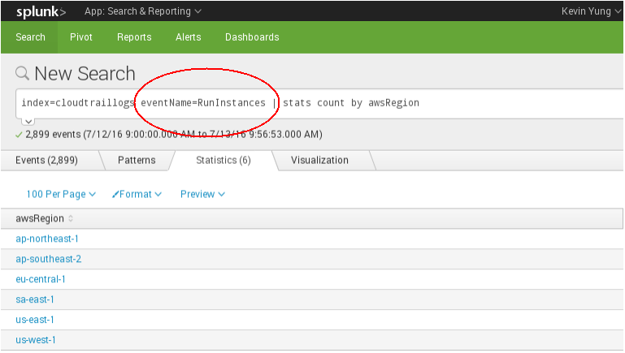
CloudTrail event example (Splunk)
https://splunk.skynet.realestate.com.au
Search & Report
Query: index=cloudtraillogs *

