Slide 1
REA AWS Training
Route53

Slide 2
What is DNS
The Domain Name System is a heirachical, decentralised naming system for the internet.
DNS maps names to IP addresses (and vice-versa).
Domain name resolvers determine the name servers responsible for the domain in question by a sequence of queries starting from the root.
Root servers are well known and ran by large ISPs under the supervision of ICANN.

Slide 3
Heirachy
The root name servers are responsible for delegating authority over all top level domains (such as com, net, au) to their respective registry.
These registries are then responsible for that namespace and may delegate the duties of name registration to one or more commercial registrars (almost all do).
Depending on the domain, you can then register your own name at the second level (eg: something.com) or at a lower level
(eg: something.com.au).
Authority for this domain is now yours, you must provide your own name servers (minimum of two) which will answer for the records you create (eg: test.something.com).

Slide 4
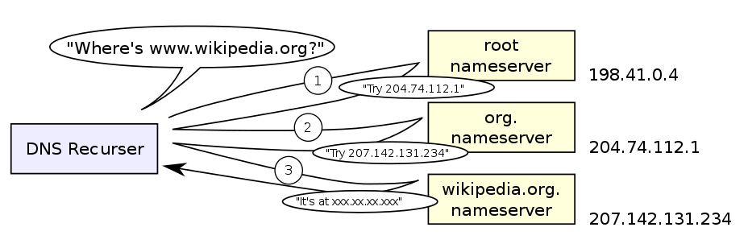
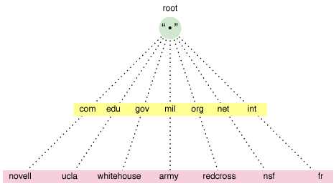
Pictures

Slide 5
Record Types (Most Common)
A – Maps name to IP address (IPv4).
AAAA – Maps name to IP address (IPv6).
CNAME – Maps a name to another name.
MX – Maps a name to the IP of a mail transfer agent.
NS – Delegates authority of a zone to a name server.
SOA – Specifies information about a zone.
TXT – Arbitrary text (often used for authentication).
PTR – Maps IP address back to Name.

Slide 6
Dig
Tool for doing DNS lookups, read the man page.
[$] dig +short google.com
172.217.25.46

Slide 7

Route 53
Global DNS service (many locations worldwide)
Public or non-delegated zones (internal to a VPC)
Health check capability – traffic routing
  HTTP, HTTPS, TCP connection
Domain registration (most TLDs)
Routing policies
  Simple, Weighted, Latency, Failover, Geolocation

Slide 8


Route53 and CloudFormation
Cannot register domains via CloudFormation
Can create record sets via CloudFormation
Best way to register CNAMEs for your ELBs
Some advanced Route53 functionality
  Geo-IP routing
  Failover
  Weighting

