Slide 1
Media Intelligence Report
Selected Period: 2025-12-08 00:00:00
Total Mentions: 2888
Mentions in Period: 710
Insight: ⚠️ Coverage spike detected during 2025-12-08 00:00:00. Dominant sentiment: Neutral.

Slide 2
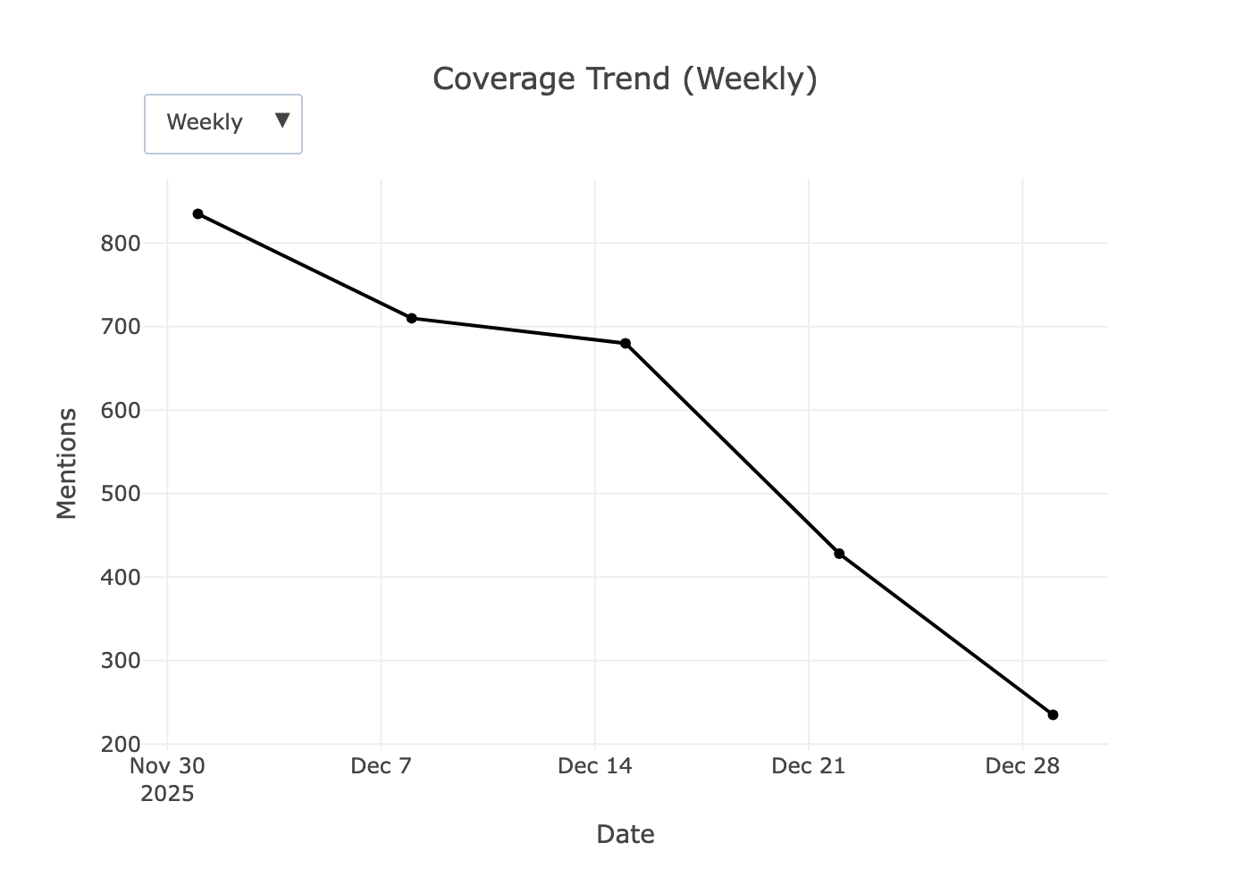
Coverage Trend

Slide 3
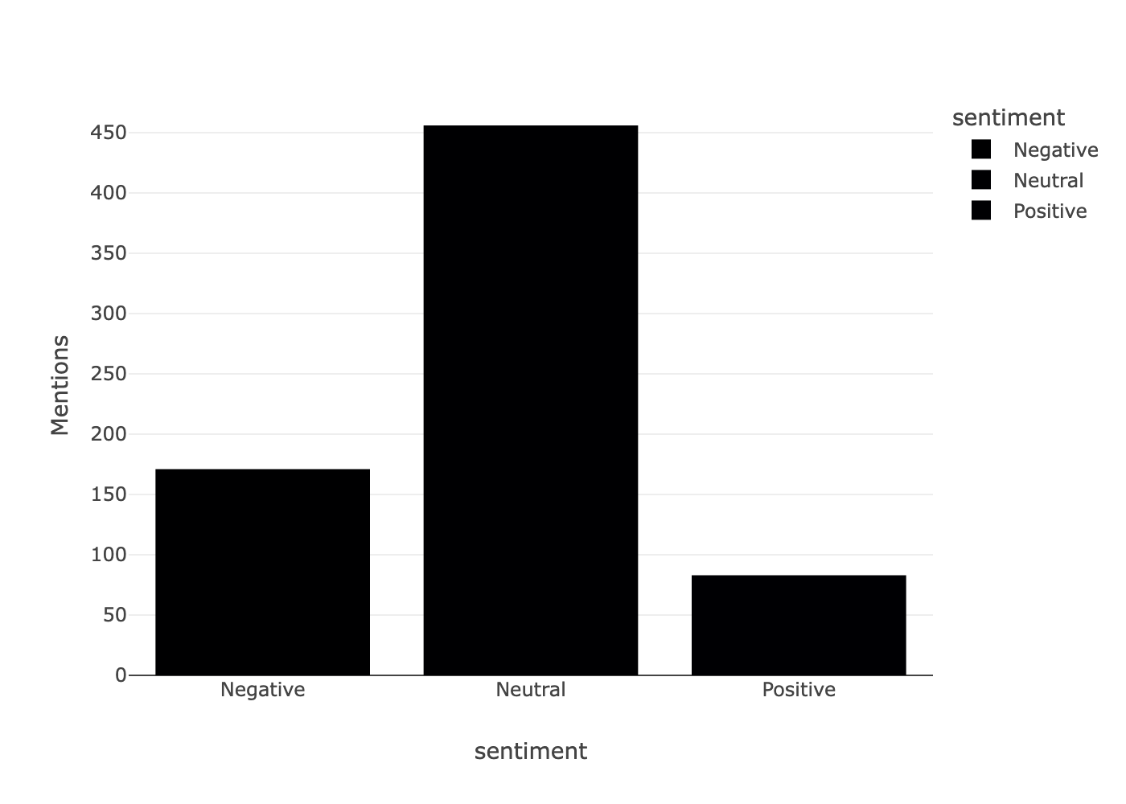
Sentiment Distribution

Slide 4
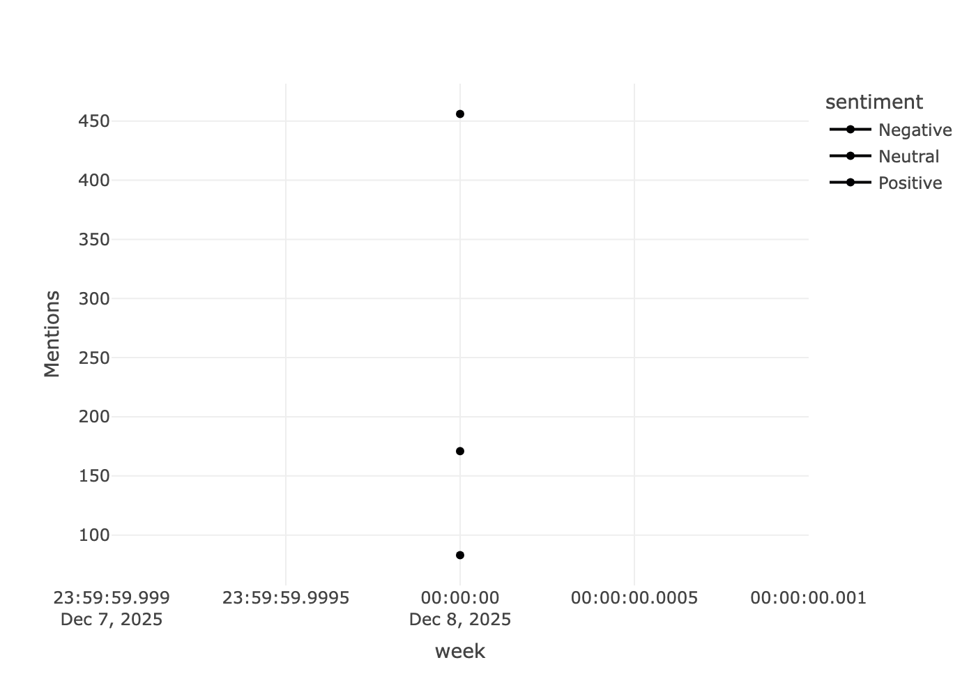
Sentiment Trend Over Time

Slide 5
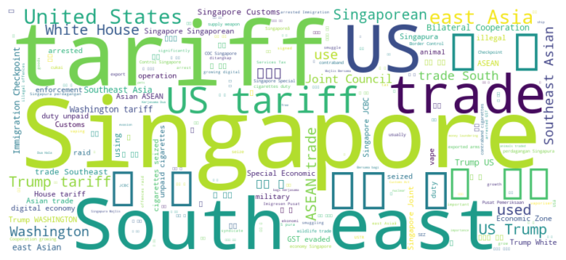
Key Themes

Slide 6
Top Sources in 2025-12-08 00:00:00
The Straits Times: 114
CNA 93.8FM SGP: 94
Yahoo! Singapore: 77
Lianhe Zao Bao - PDF: 52
The Business Times: 46

Slide 7
Top Headlines in 2025-12-08 00:00:00
Neutral: வெண்கலம் வென்ற சிங்கப்பூர் ஆண்கள் டி20 கிரிக்கெட் அணி
Positive: SG, China akan bincang usaha tingkatkan pelaburan, perdagangan: Gan Kim Yong
Neutral: CNA 93.8FM SGP - Sun, 14 Dec 2025 08:30:00
Neutral: ‘Shui’ (tax) voted Malaysia’s Chinese character of the year
Neutral: Thailand declares curfew along coast as border clashes with Cambodia enter second week
Negative: Thai premier Anutin’s support declines as election looms
Positive: Vietnam switches on first LNG-fired power plants, plans 20 more by 2035
Negative: Thailand’s election gamble stalls US trade talks, reform push
Negative: Thailand’s election gamble stalls US trade talks, reform push
Negative: Thailand confirms first civilian killed in week of Cambodia fighting

