Slide 1
Monthly Media Performance Report
Total Mentions: 3011
Peak Day: 2025-12-05
MoM Change: 0.00%

Slide 2
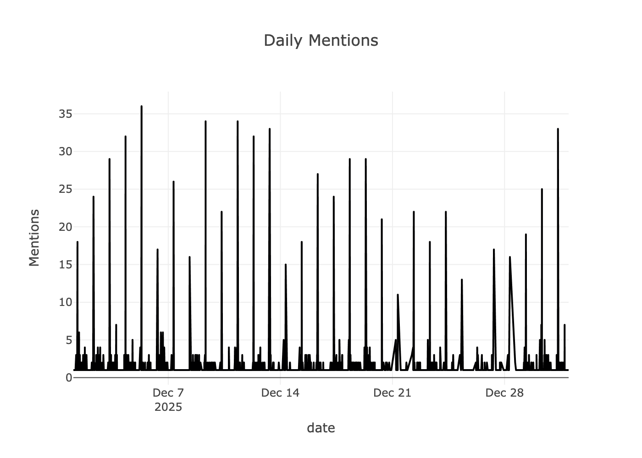
Coverage Trend

Slide 3
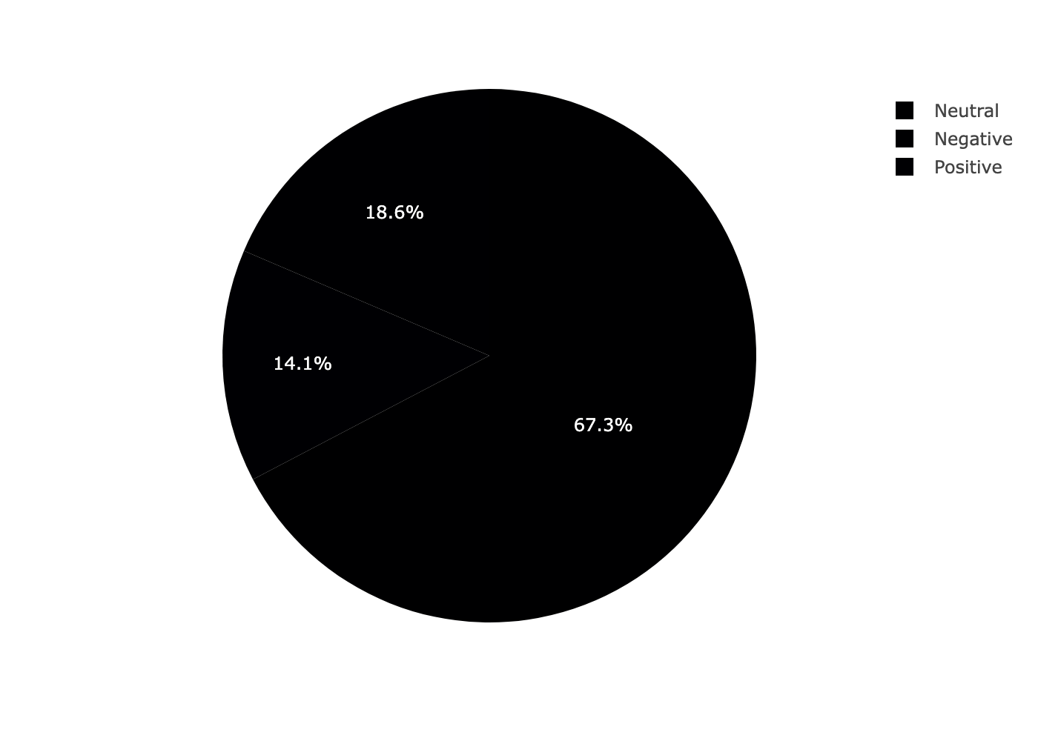
Sentiment Breakdown

Slide 4
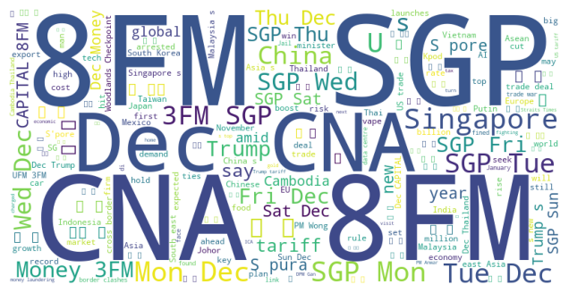
Key Media Themes

