Slide 1


Client 1
미정
Media Server
Signaling
Server
DB
Client 2
WebRTC

Slide 2
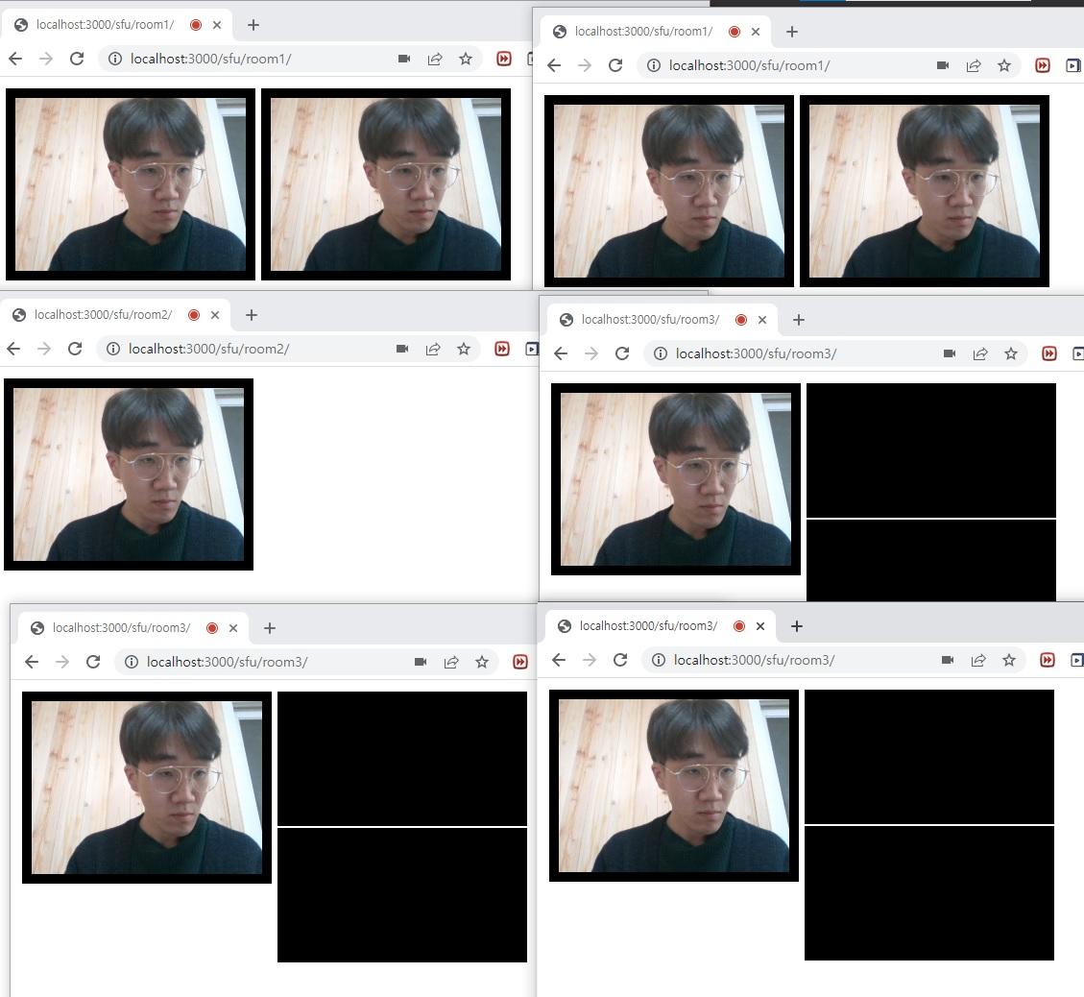

Room 1
Room 2
Room 3

