Slide 1
Frontend

Slide 2
Summary
The philosophy
The onion layers
The devil is in the details
Angular
The advent of reactive movement
Redux with ngrx store
The structure of an application

Slide 3
Philosophy
Context is everything
There is only one context per view
There is no ambiguity

Slide 4
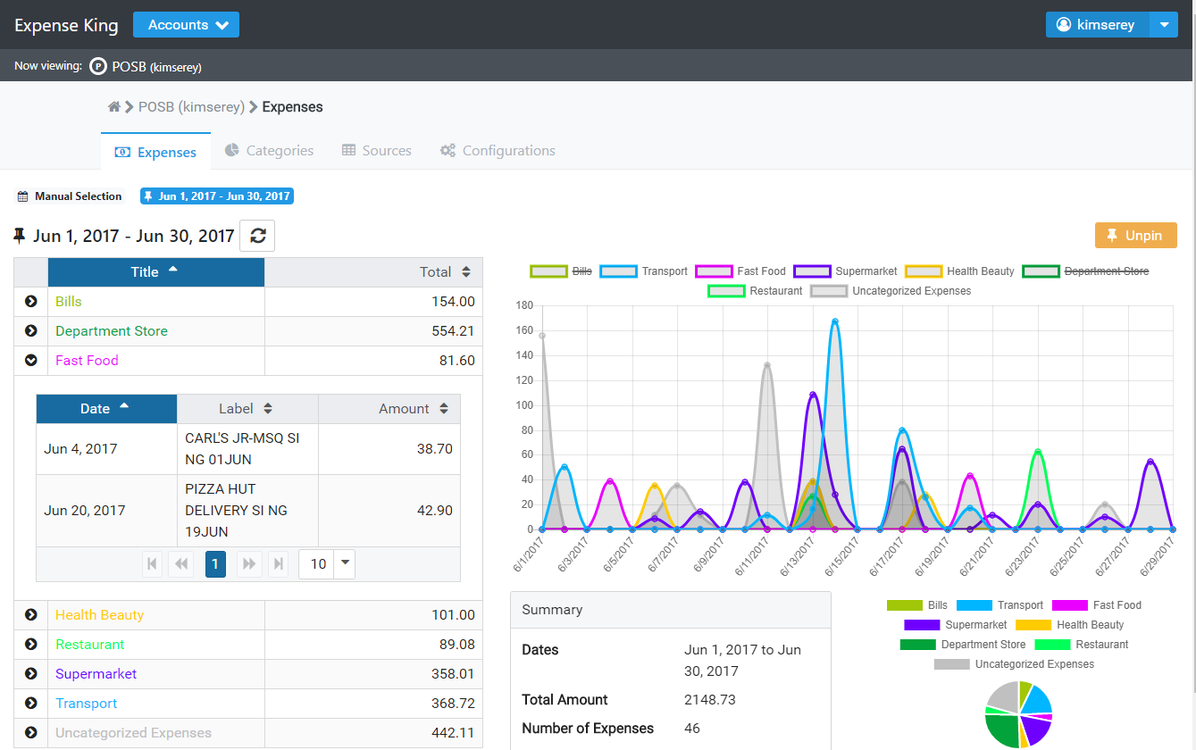
The onion layers

Slide 5
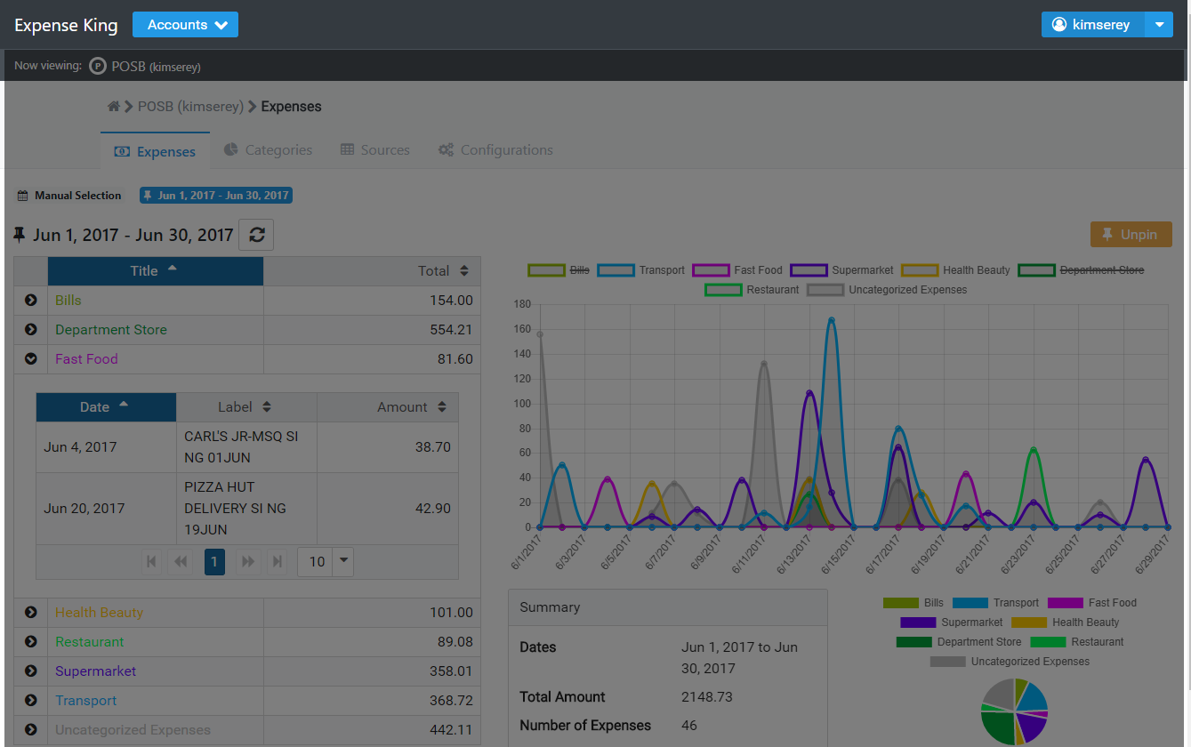
The onion layers

Slide 6
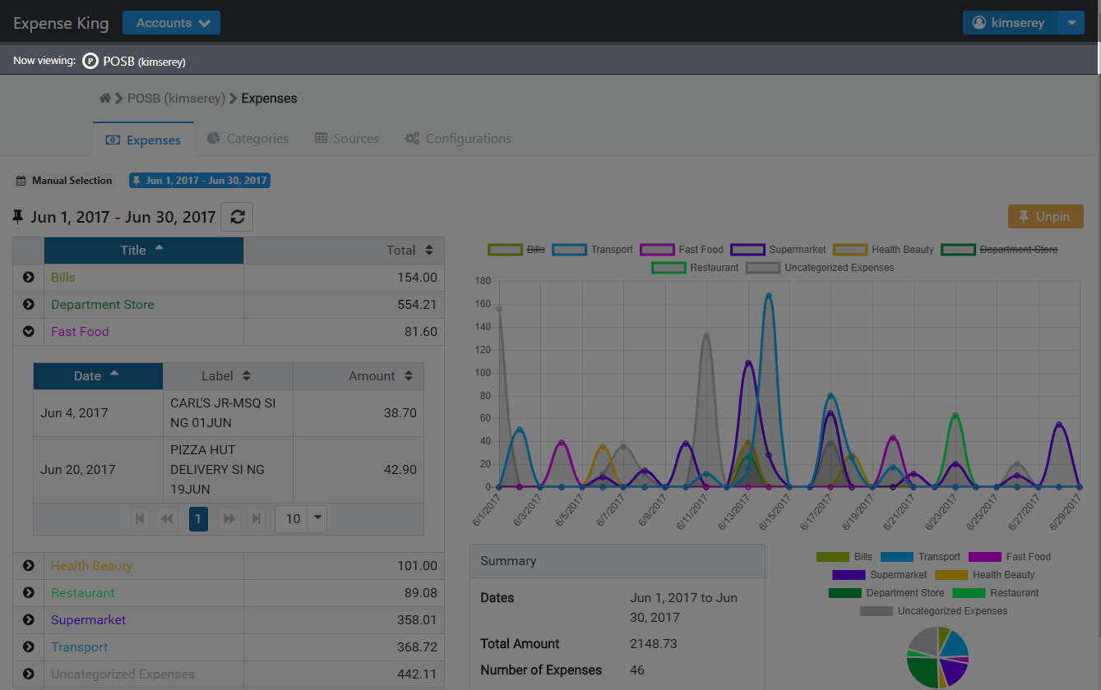
The onion layers

Slide 7
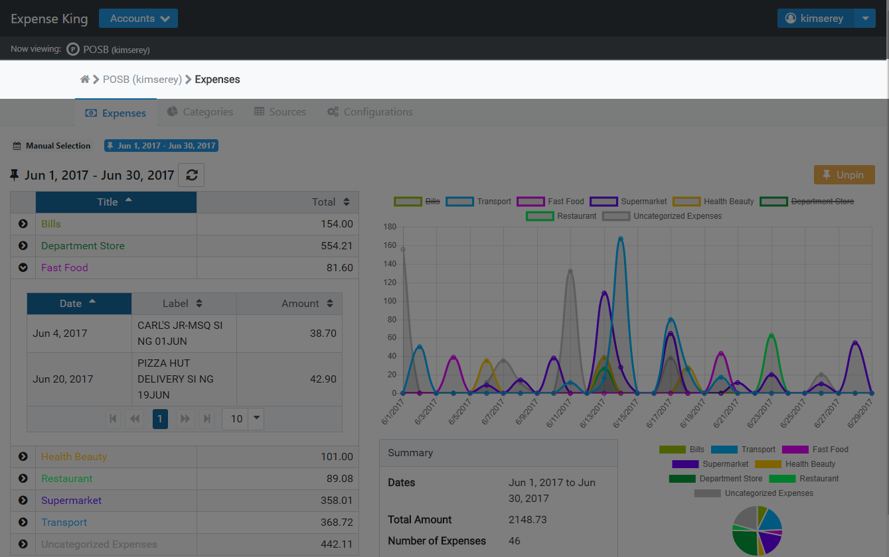
The onion layers

Slide 8

The onion layers

Slide 9
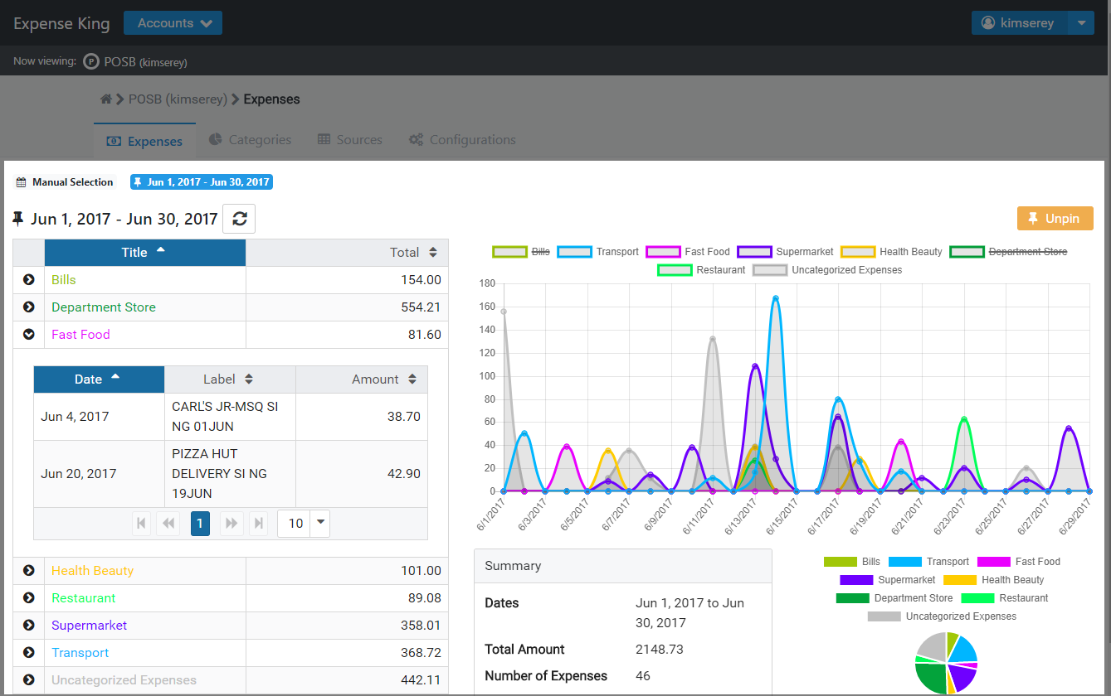
The onion layers

Slide 10
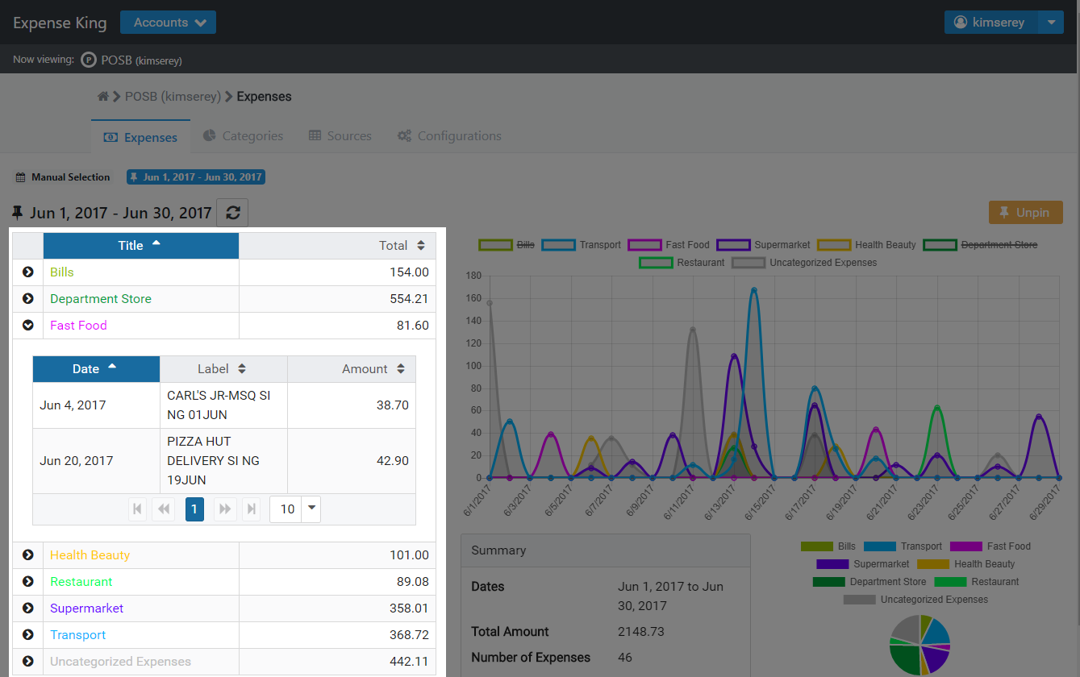
The onion layers

Slide 11
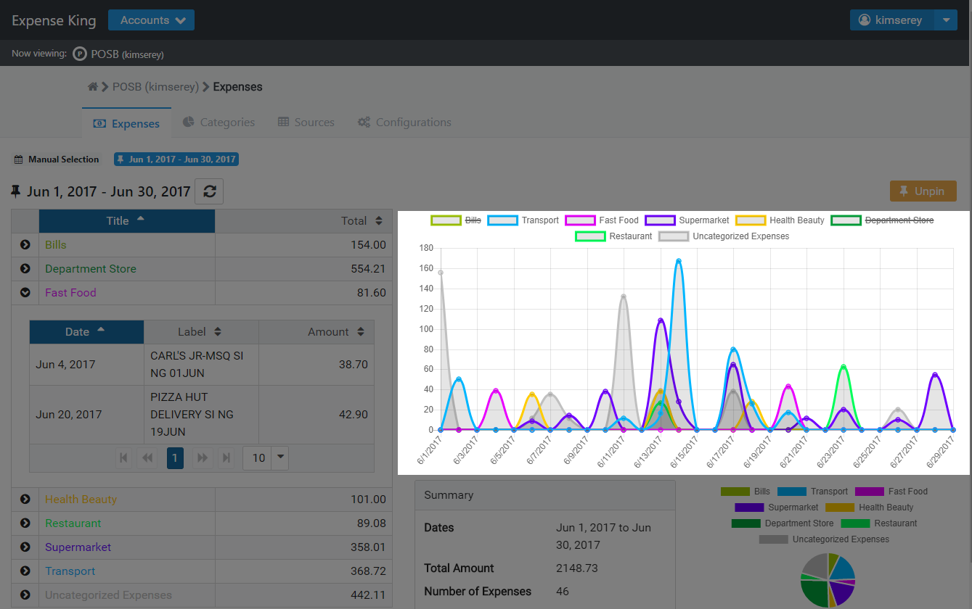
The onion layers

Slide 12
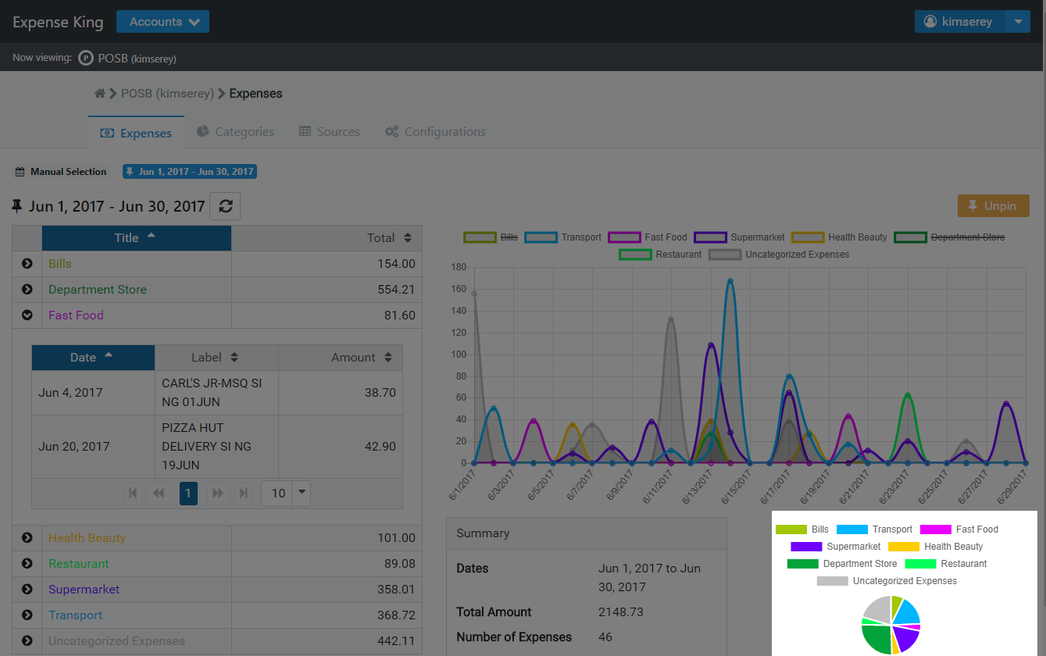
The onion layers

Slide 13
The onion layers
Page
Layout
Container
Component

Slide 14
The devil is in the details
Ensure user is logged in
Know which account is selected
Have the user categories loaded
Know which date range is selected
Have the expenses loaded

Slide 15
The devil is in the details
Ensure user is logged in
Know which account is selected
Have the user categories loaded
Know which date range is selected
Have the expenses loaded
This is the context of the page

