Slide 1
Frontend

Slide 2
Summary
The philosophy
The onion layers
The devil is in the details
Angular
The advent of the reactive movement
Redux with ngrx store
Structure
Environments
Publishing

Slide 3
Philosophy
Context is everything
There is only one context per view
There is no ambiguity

Slide 4
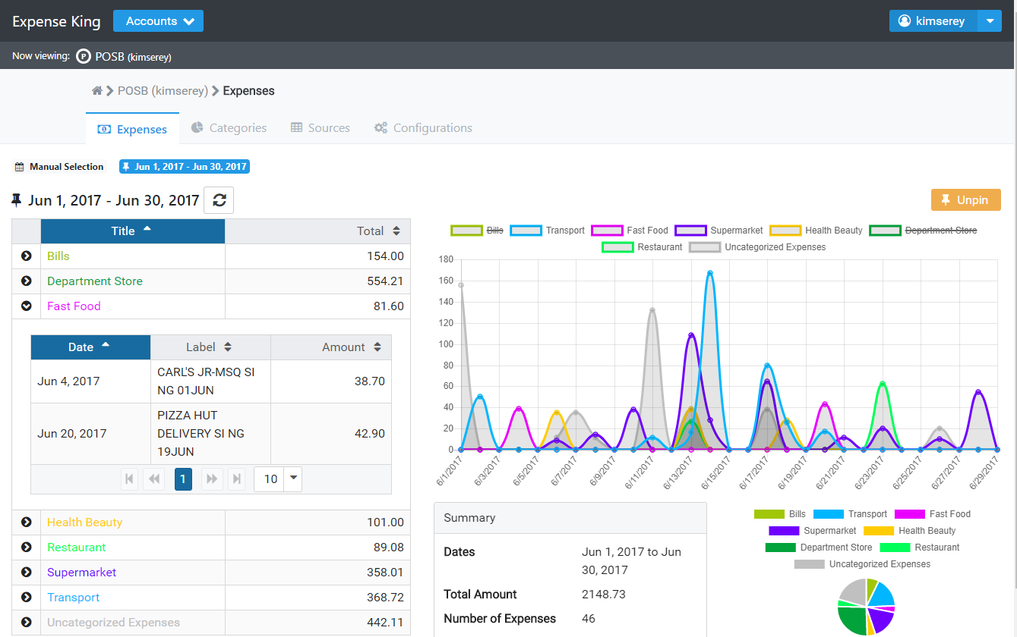
The onion layers

Slide 5
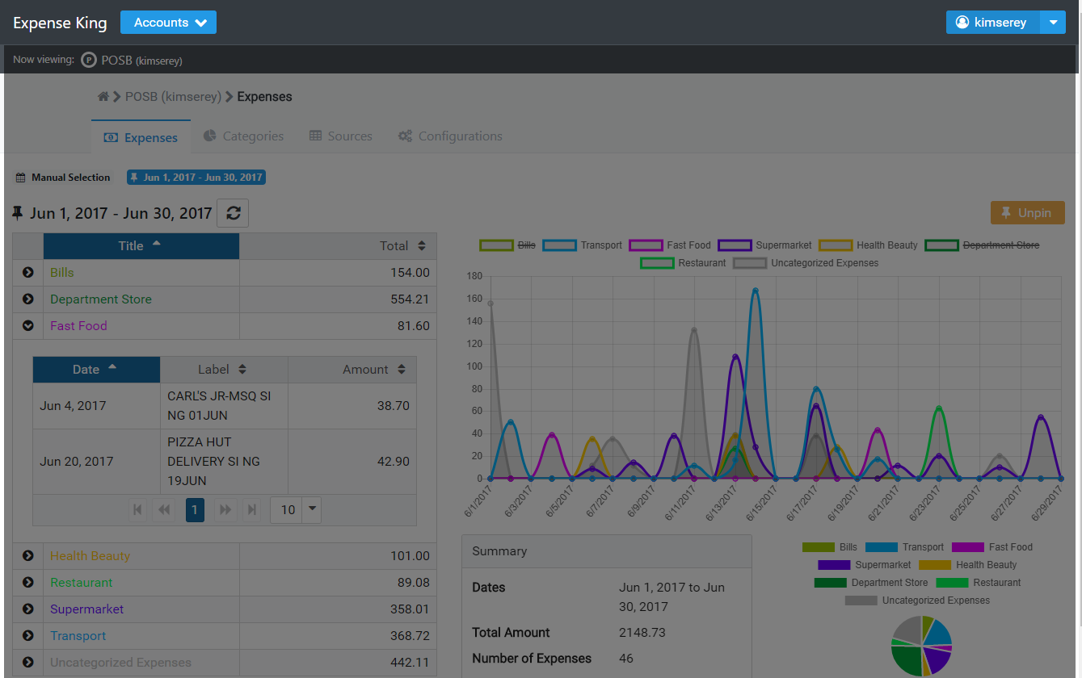
The onion layers

Slide 6
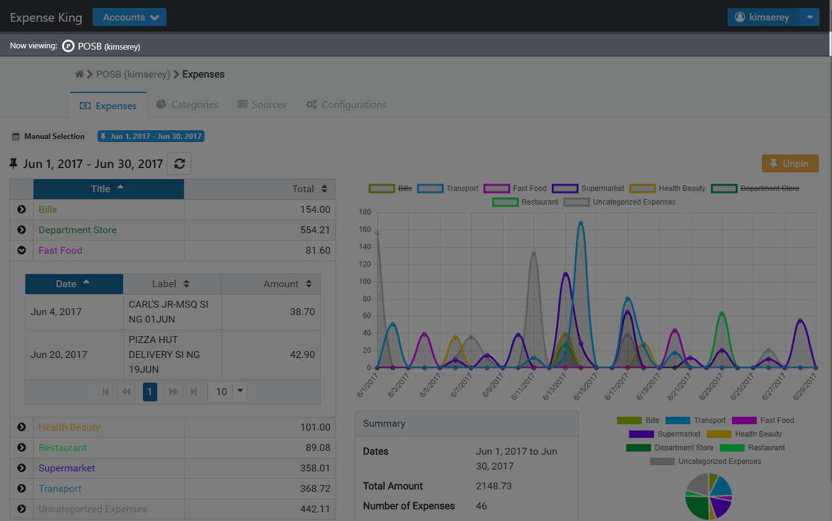
The onion layers

Slide 7
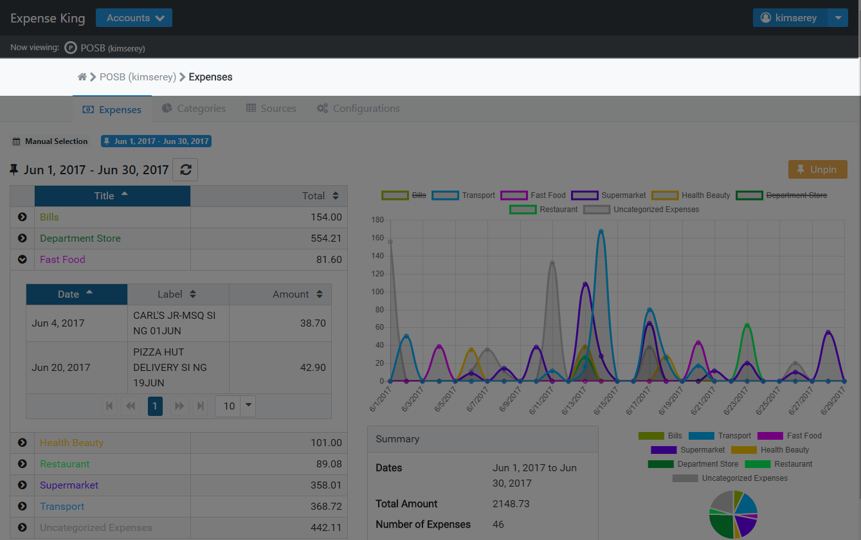
The onion layers

Slide 8

The onion layers

Slide 9
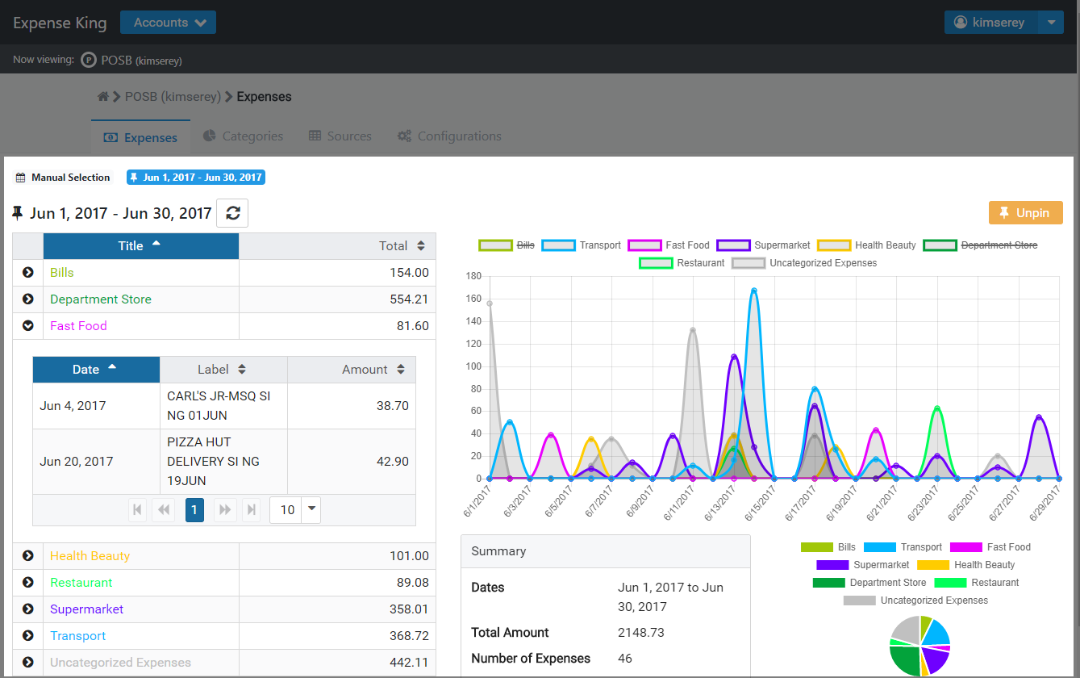
The onion layers

Slide 10
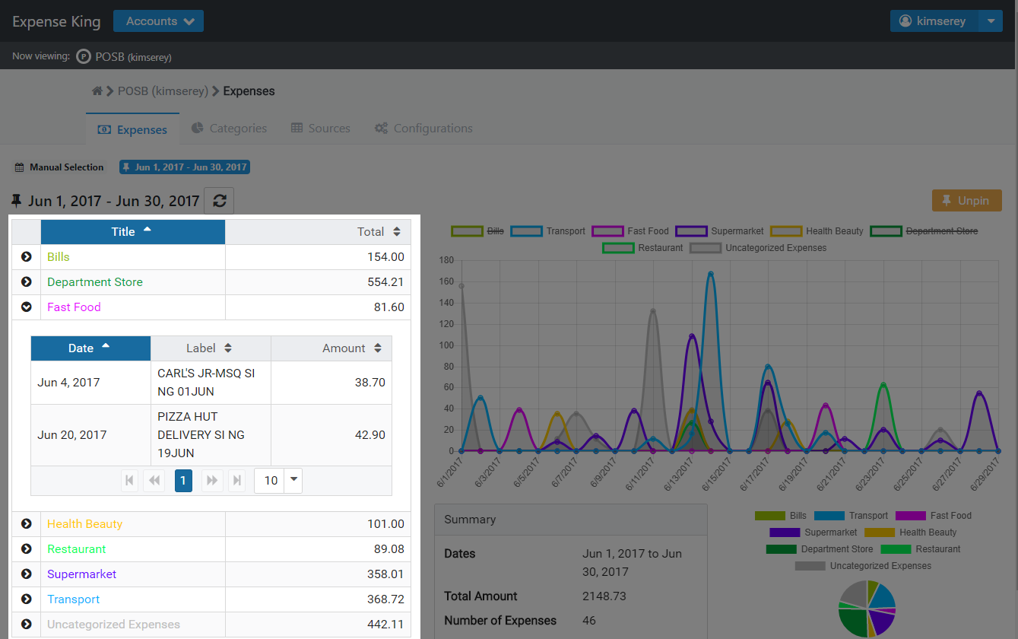
The onion layers

Slide 11
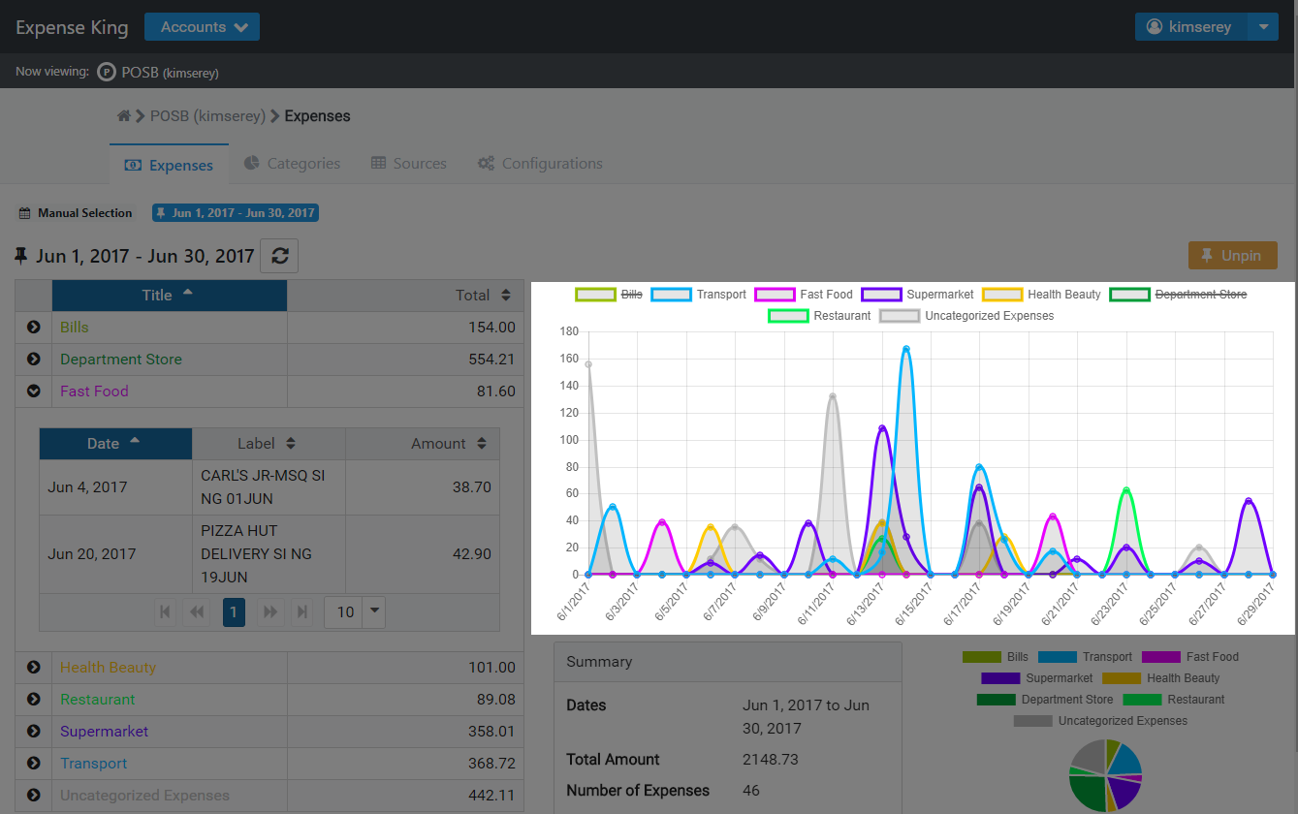
The onion layers

Slide 12
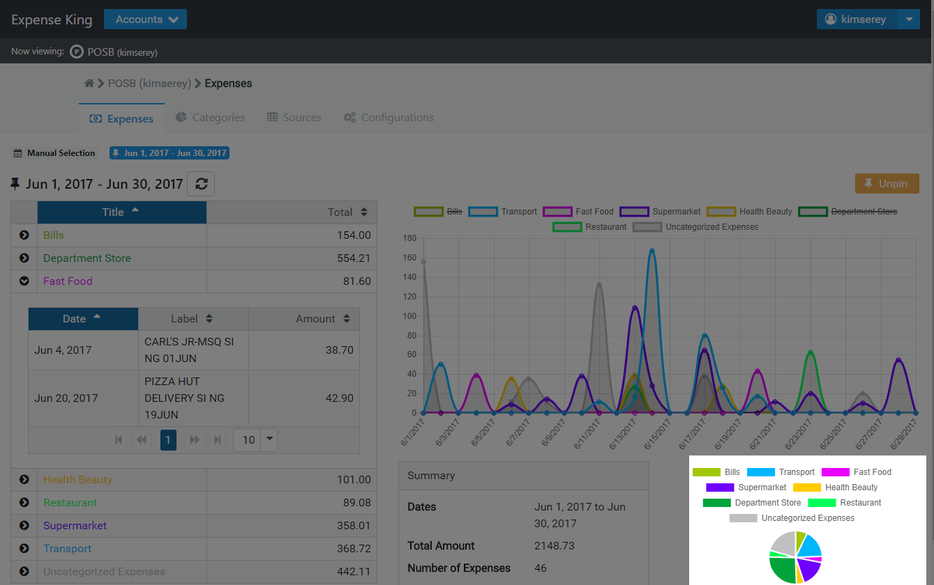
The onion layers

Slide 13
The onion layers
Page
Layout
Container
Component

Slide 14
The devil is in the details
Ensure user is logged in
Know which account is selected
Have the user categories loaded
Know which date range is selected
Have the expenses loaded

Slide 15
The devil is in the details
Ensure user is logged in
Know which account is selected
Have the user categories loaded
Know which date range is selected
Have the expenses loaded
This is the context of the page

Slide 16
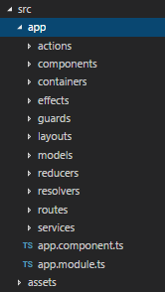
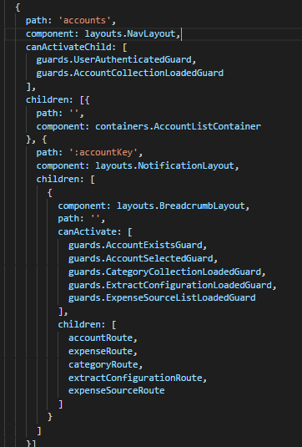
Angular
Onion layers
Angular component
Layouts
Containers
Components
Ensure validity of the context
Angular guards
Angular router

Slide 17
The advent of the reactive movement
Rxjs
Reactive combinators
Async pipe
{{ data$ | async }}
Reactive variables – Observable
Redux and ngrx Store
Segregation Read/Write
Update of application State
Propagation of State changes

Slide 18
Redux with ngrx store
Global State
Effects
Subscribe to changes
Actions
Component
Component
Container
READ
WRITE

Slide 19
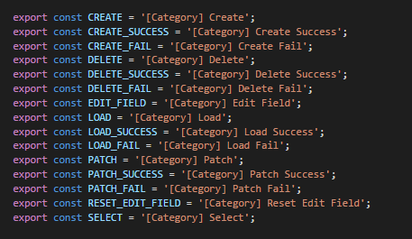
Redux with ngrx store
Action

Slide 20
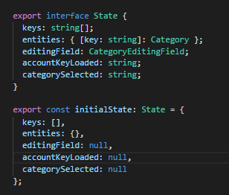
Redux with ngrx store
Reducer
State represents what the view needs
At each stage, the context can be viewed in the State

Slide 21
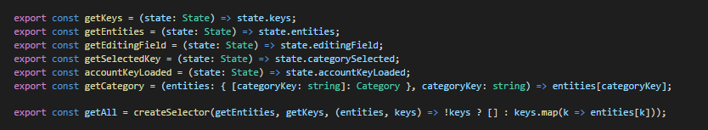
Redux with ngrx store
Selectors
Category reducer selectors
Common reducer from root

Slide 22
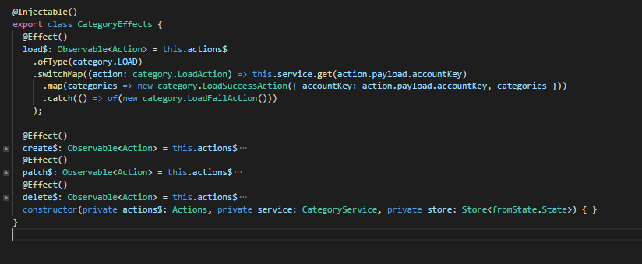
Redux with ngrx store
Effects

Slide 23
Redux with ngrx store
Global State
Effects
Subscribe to changes
Actions
Component
Component
Container
READ
WRITE

Slide 24

Redux with ngrx store
Global State
Effects
Subscribe to changes
Actions
Component
Component
Container
READ
WRITE

Slide 25
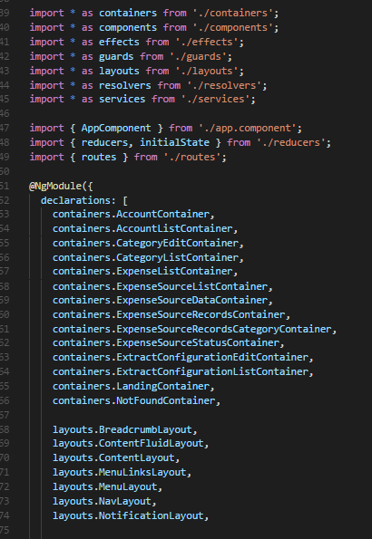
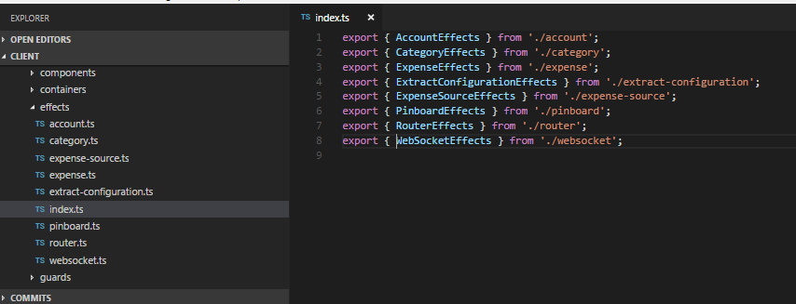
Structure
Barrel index.ts
Break into module only when it makes sense
Use barrels to organise import per sections

Slide 26
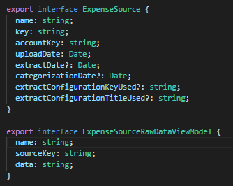
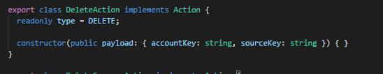
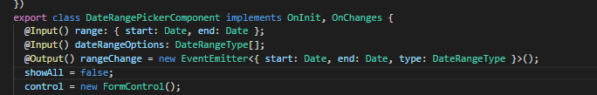
Structure
Only create interfaces for meaningful models
Use inline signature for the rest

Slide 27
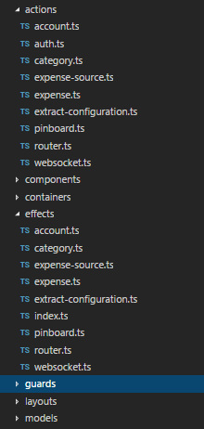
Structure
There is no need for prefix or postfix
Reuse same name under different folder

Slide 28
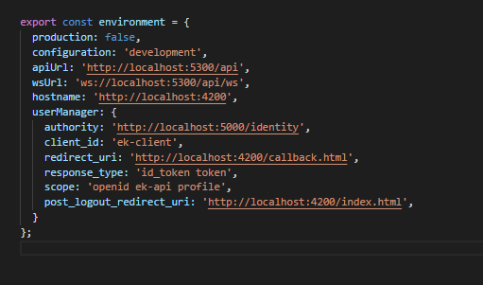

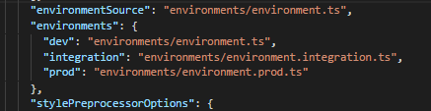
Environments
Setup multiple environments
Development
Integration
Production
Configure Angular CLI
Serve with a configuration

Slide 29
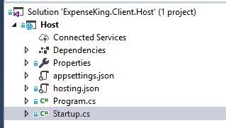

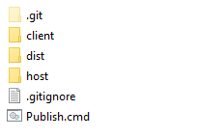
Publishing
Host with ASP Net Core
Serve static files
Build NG app for a particular environment

Slide 30
Conclusion
Modular application
Reactive model
Folder and file convention
Environment and publishing

