Slide 1
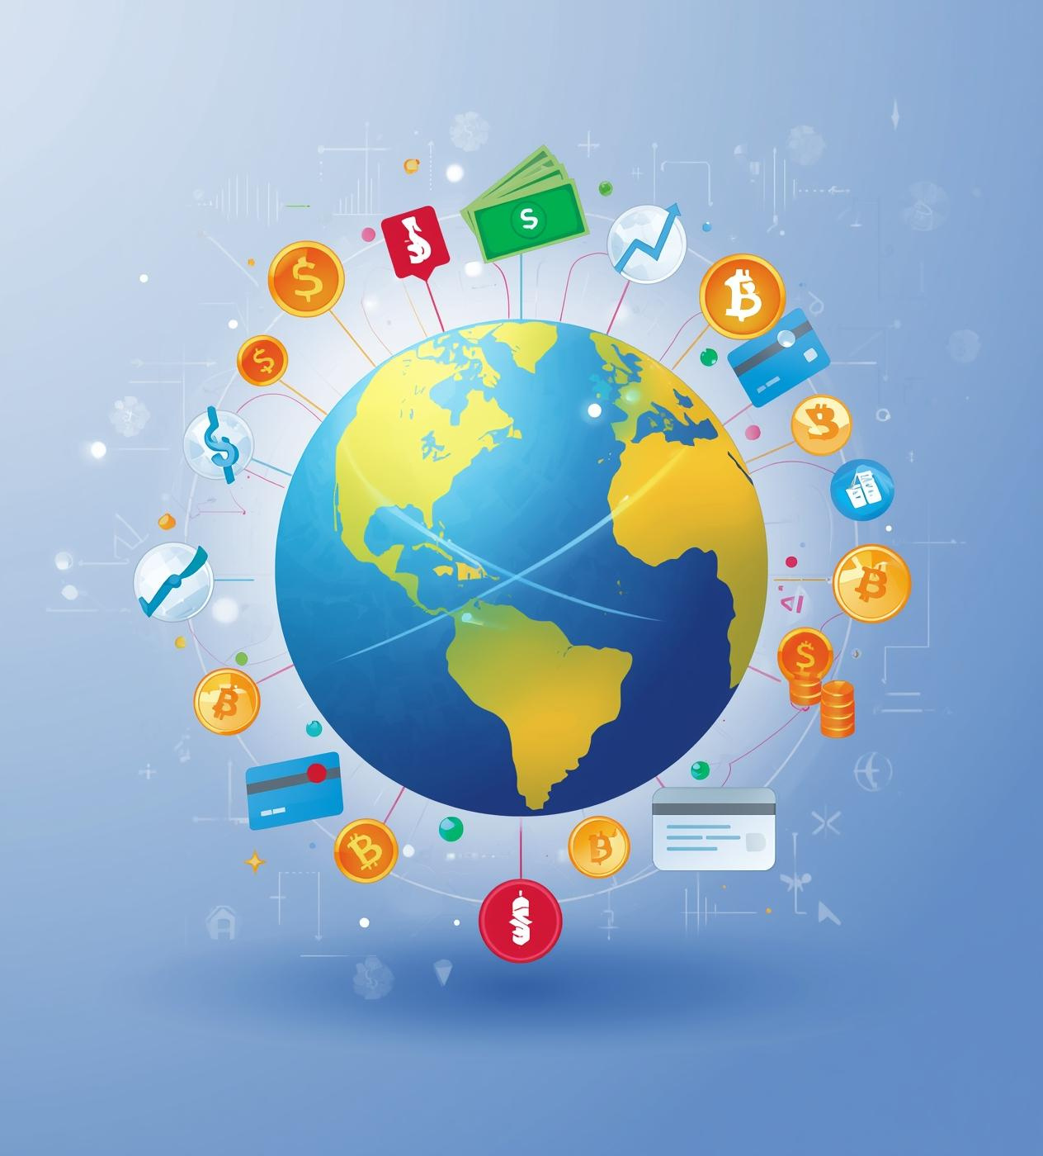

FinTech
Financial Inclusion
KIMUTAI KEVINE
2025/2026

Slide 2

Why It Matters
UNDERSTANDING FINANCIAL INCLUSION'S IMPACT
Financial inclusion is crucial for economic growth, enabling participation in markets, reducing inequality, and fostering sustainable development. It empowers individuals and communities to improve their financial well-being.

Slide 3
42%
58%
Adults Financially Included
Adults Financially Excluded
This statistic highlights that only 42% of adults worldwide have access to essential financial services, limiting their economic opportunities.
Conversely, 58% of adults remain excluded from financial services, emphasizing significant barriers to inclusion and economic participation.

Slide 4
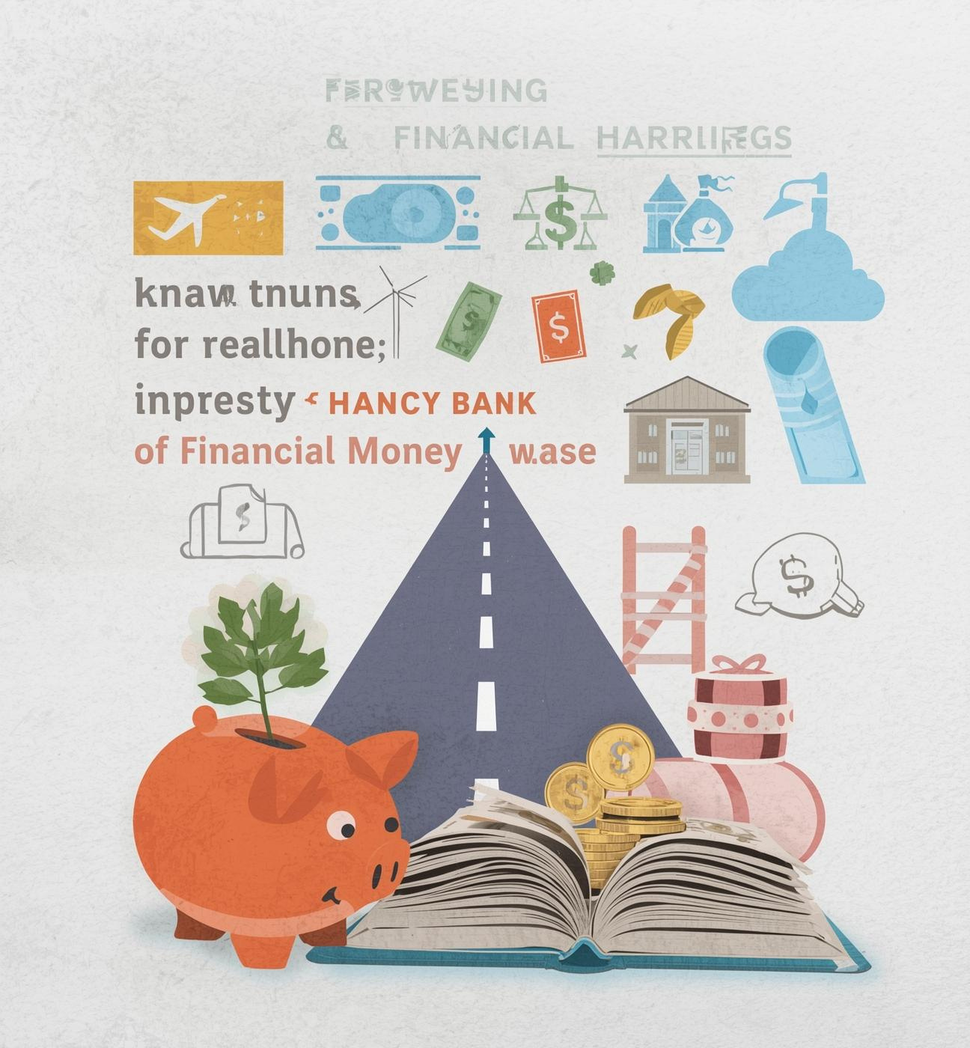
Barriers to Access
Financial access remains hindered by significant barriers. Low income prevents 41% of individuals from participating in banking services, while 33% face challenges due to distance from financial institutions. Additionally, 26% of the population struggles with literacy, further complicating access to essential services.

Slide 5
Project Objectives and Goals
Inclusion Drivers
Trend Analysis
Access Prediction
Identify factors that enhance financial access opportunities.
Analyze data patterns to inform effective strategies.
Predict future trends in financial inclusion rates.
Policy Formation
Action Initiatives
Inform policies that promote equitable financial services.
Take action to close existing access gaps.

Slide 6
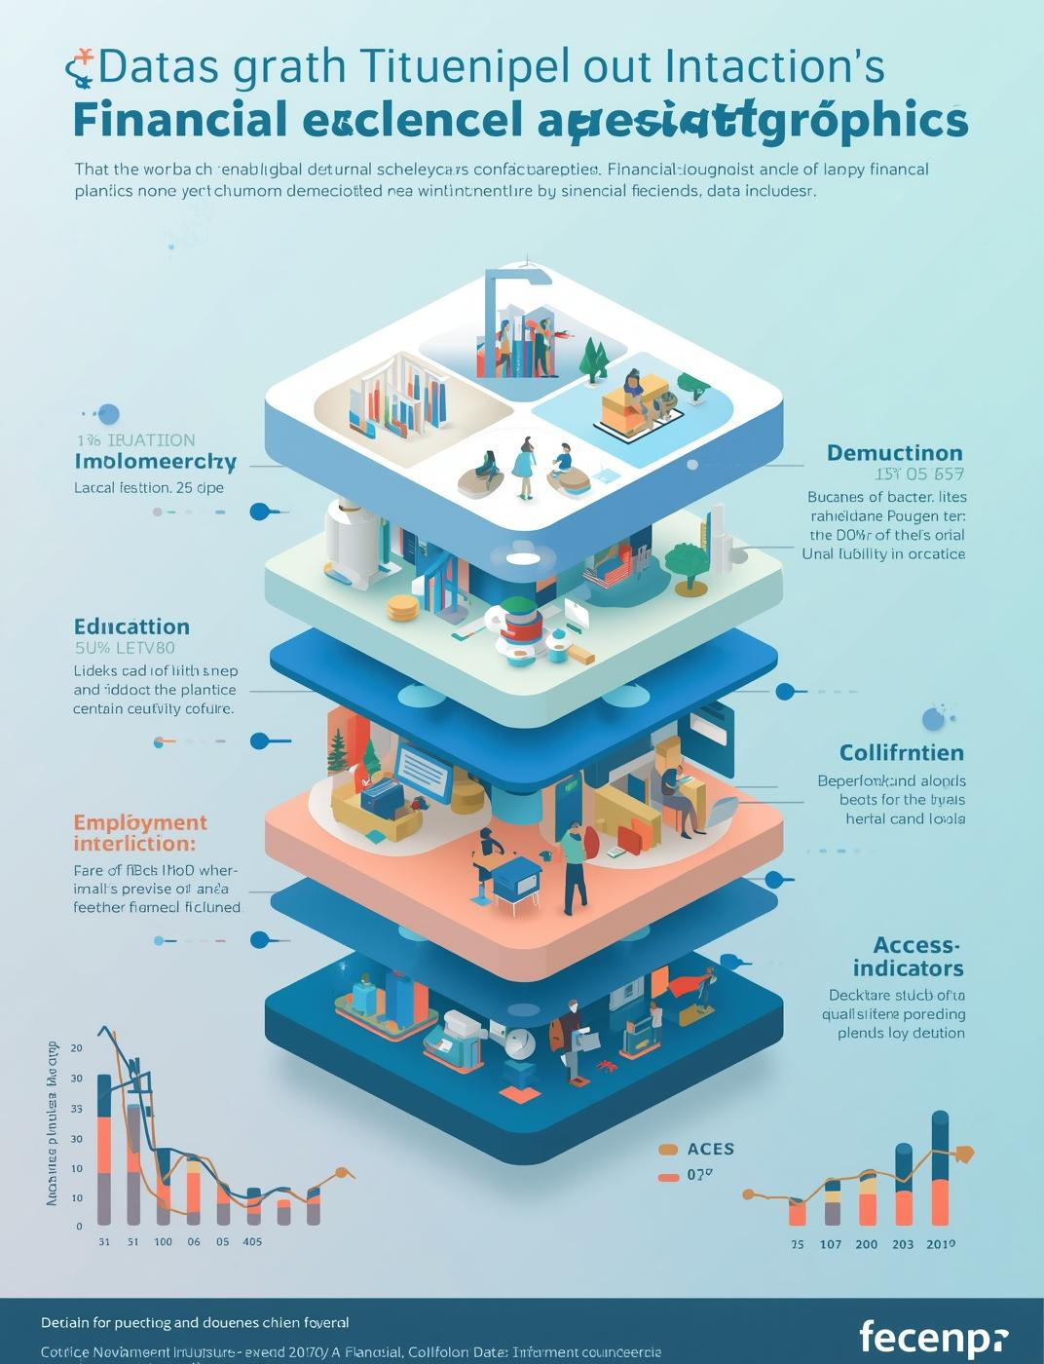
Dataset Overview
Key Dimensions for Analysis
This dataset encompasses critical dimensions including demographics, income, education, employment, and access indicators, providing a comprehensive view of financial inclusion barriers and opportunities.

Slide 7
Analytical Methodology
Feature Engineering
Data Cleaning
Data Exploration
Ensuring high-quality data through removal of inaccuracies and inconsistencies.
Analyzing datasets to uncover patterns and insights for better understanding.
Creating new variables that enhance model performance and predictive accuracy.

Slide 8
Analytical Methodology
Modeling
Evaluation
Results
This phase constructs predictive models using selected features and training data sets.
Performance metrics are calculated to assess the model's accuracy and effectiveness.
Final predictions are generated and validated against real-world outcomes for reliability.

Slide 9
Demographic Inclusion Patterns
Male
Female
48% of men have access to financial services.
36% of women are included in financial systems.
Youth
Adults
Only 33% of youth participate in financial services.
51% of adults have access to financial services.

Slide 10

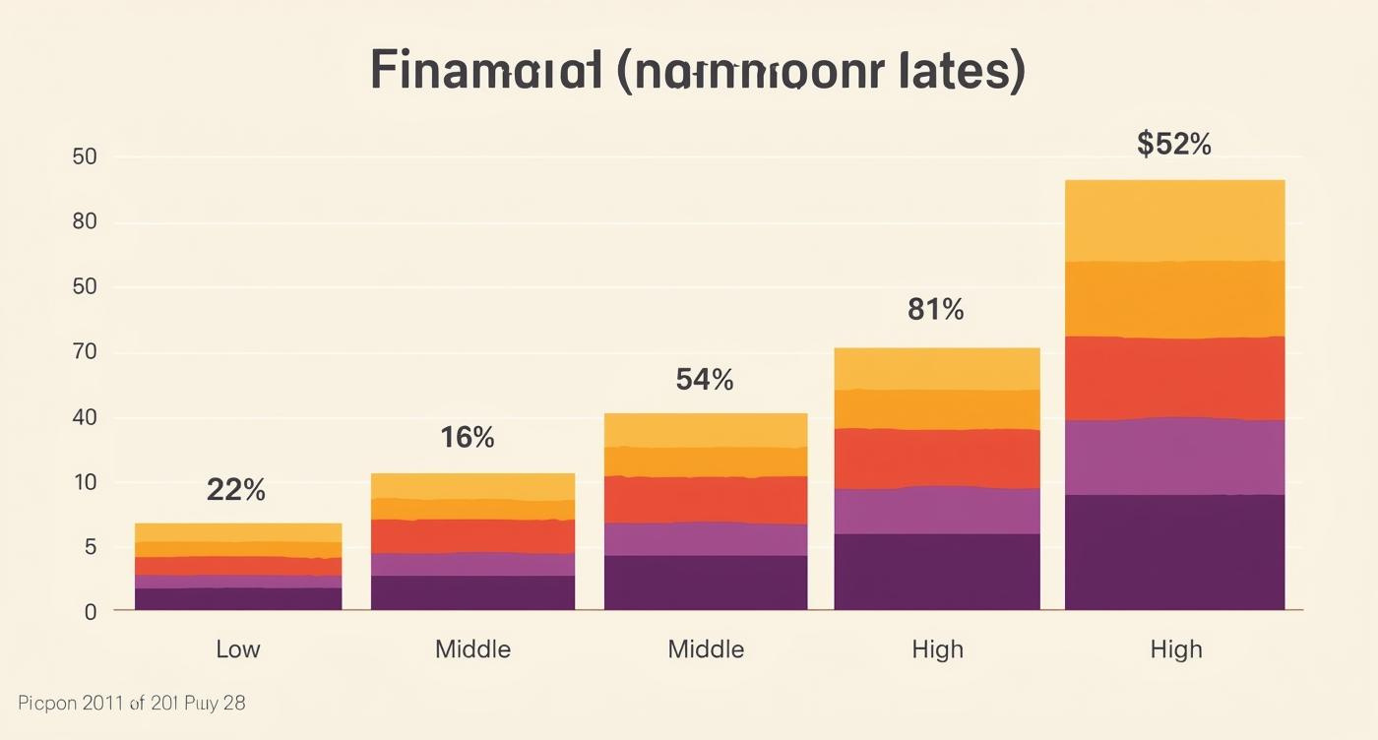
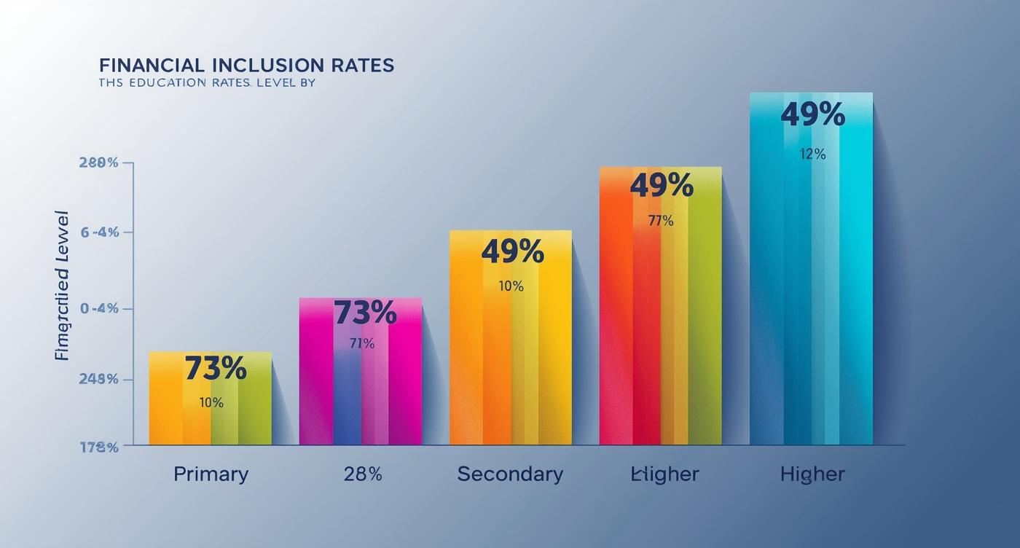
Income and Education Impact
How economic status and education drive inclusion

Slide 11
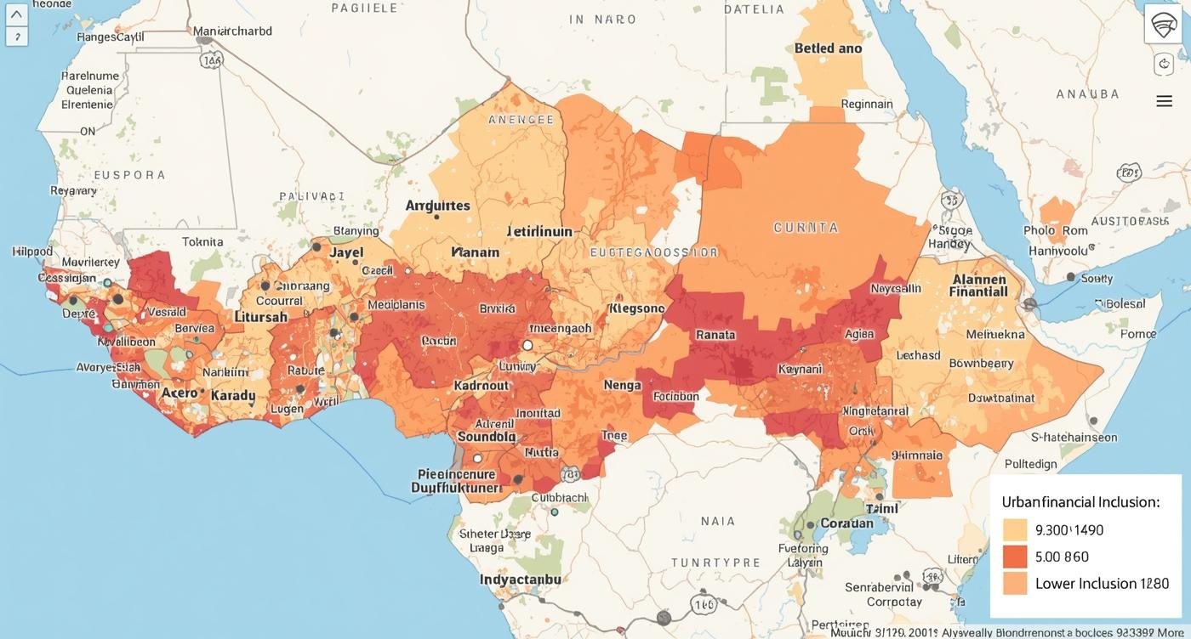
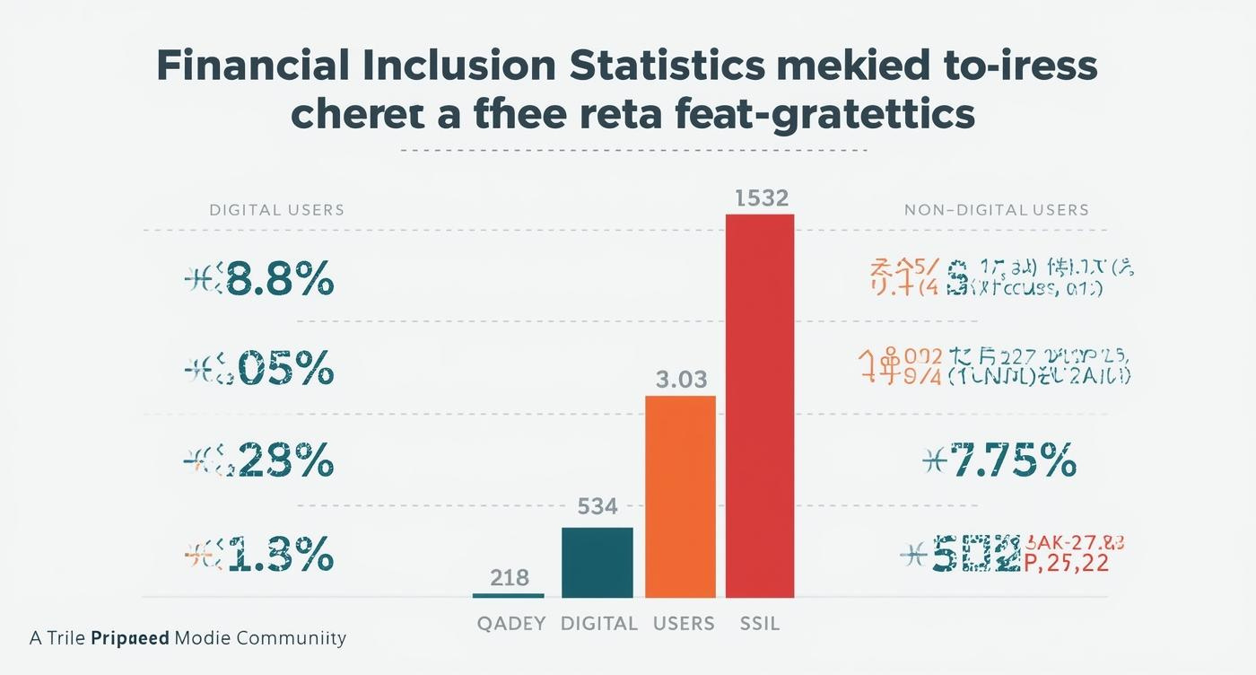
Geographic & Digital Divide
Exploring disparities in access and inclusion

Slide 12

Employment Impact
An analysis of employment types reveals significant disparities: 76% of individuals are formally employed, while 39% work informally, and 17% remain unemployed. This distribution highlights the critical role of formal employment in ensuring economic stability and fostering financial inclusion across communities.

Slide 13
82%
79%
Model Accuracy Rate
Model Precision Rate
This high accuracy indicates the model's effectiveness in predicting financial inclusion outcomes based on various socioeconomic factors.
A precision rate of 79% signifies the model's reliability in correctly identifying individuals who are financially included in the dataset.

Slide 14

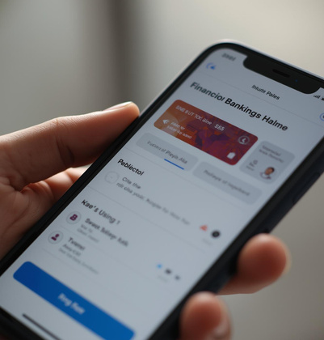


Key Findings on Financial Inclusion
Education
Digital Access
Empowers individuals to engage financially and socially.
Increases opportunities for many underserved communities.
Rural Barriers
Employment Stability
Continue to hinder financial participation and growth.
Enhances engagement and financial security for individuals.

Slide 15
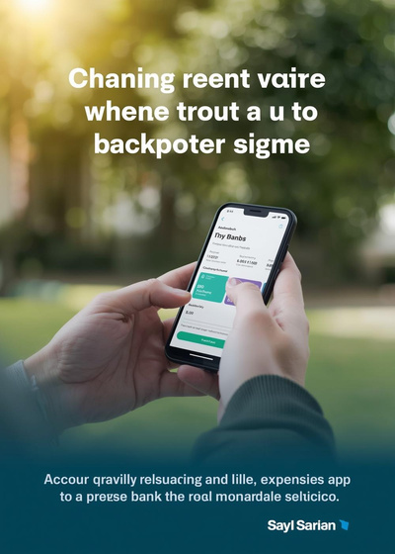


Key Policy Opportunities for Financial Inclusion
Digital Banking
Microfinance
Financial Education
Expanding access to financial services for everyone.
Supporting small businesses and local economies effectively.
Enhancing knowledge for better financial decision-making.

