Slide 1
Presentation

Slide 2
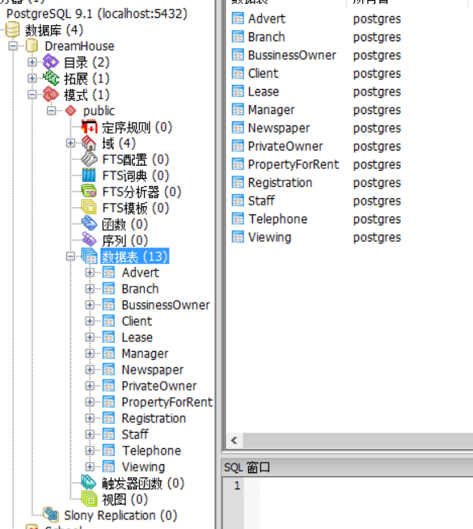
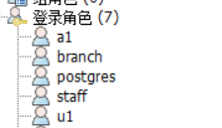
1、Create a DreamHouse Database
I choose the case DreamHouse in Appendix A.
I use a create script file database.txt to create the database and insert some data by using pgAdmin III.
And I create two users “branch” for password 1234 and “staff” for password 5678.

Slide 3

2、About configure IDEA-IU environment (JDBC)
I downloaded the tomcat7.0 and configure the environment variable.
I update my idea-iu version.

Slide 4
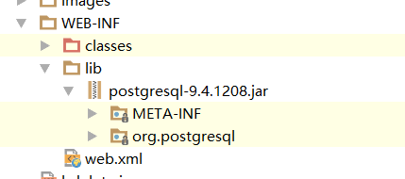
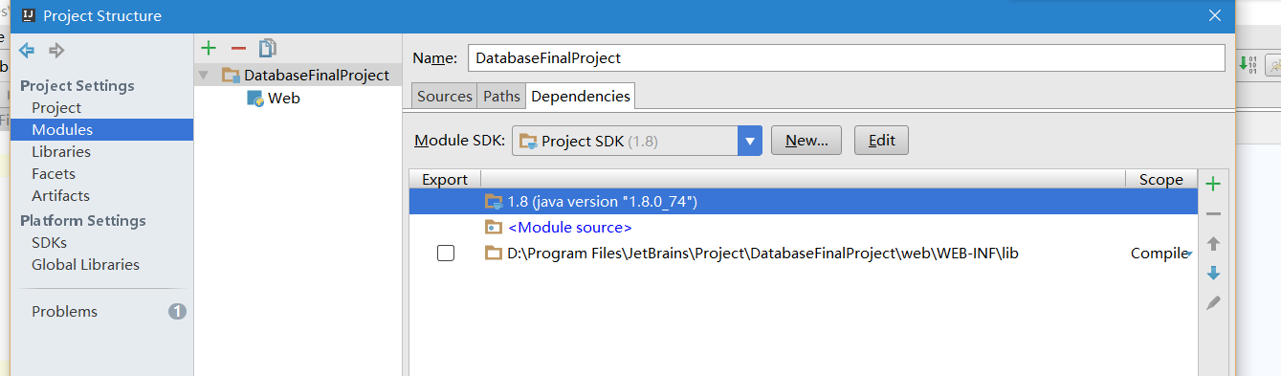
Create a web application and put .jar in.
And I modify other settings.
File->project structure

Slide 5
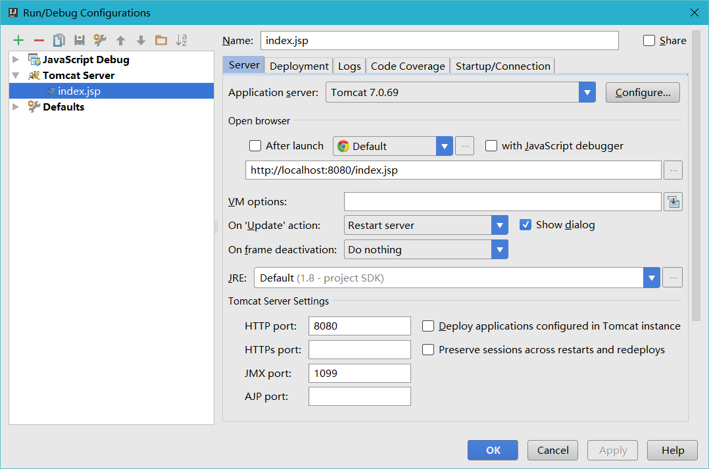
Set my server.

Slide 6
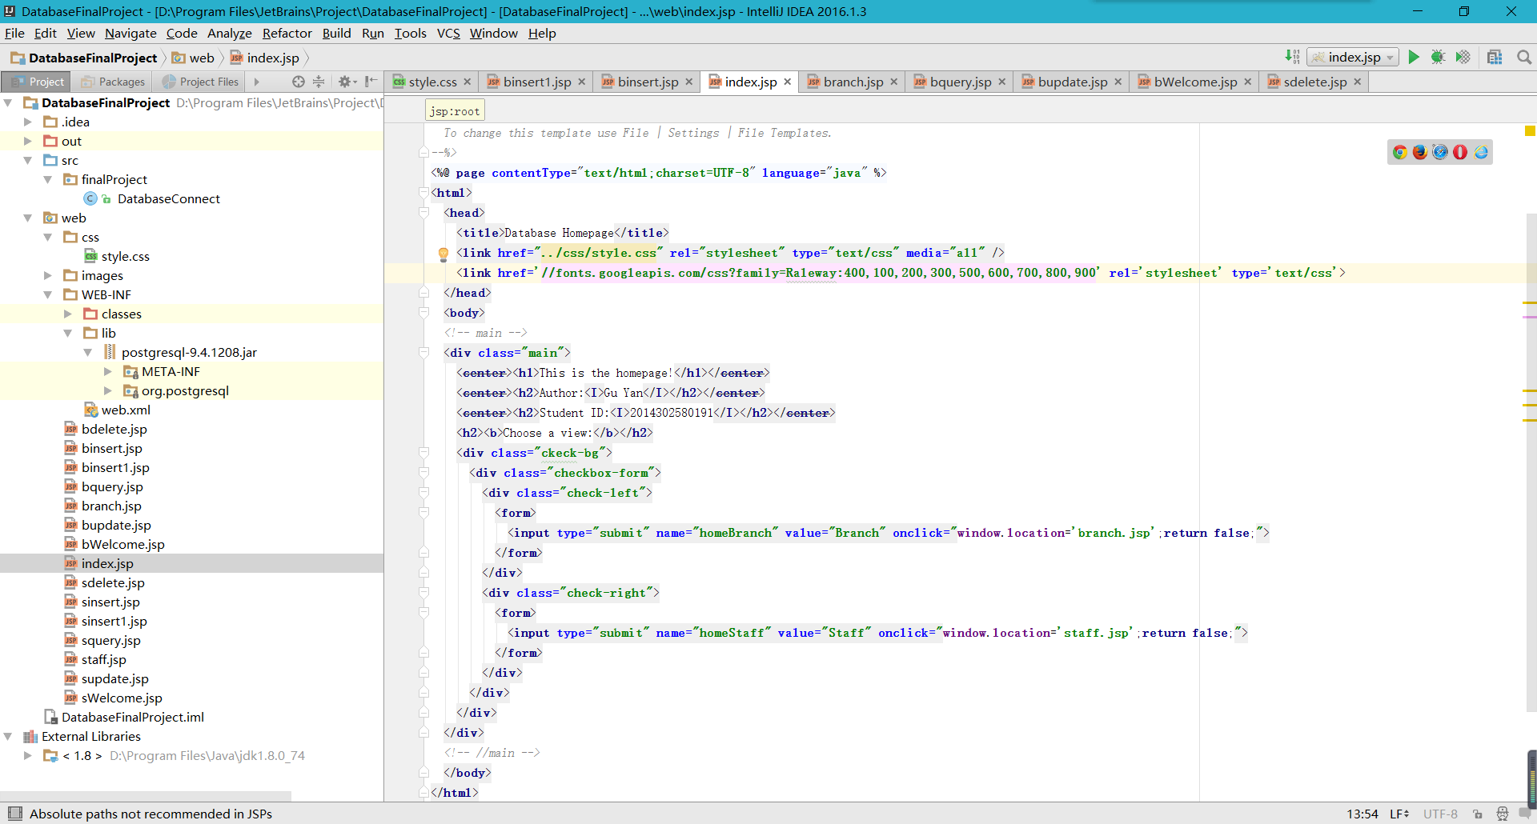
3、About jsp source code
See the project.

Slide 7
3.1、html5 and CSS to fix the UI
See the project.
Demonstration.

Slide 8
3.2、Java code
See the project.

Slide 9
4、About demonstration of the DBMA
(引号) Quotation marks is to prevent encoding problems so as other symbol.
And I found that all data tables have some fkey so that it cannot be used, and to do more high level delete is beyond my capability.
Notes:
引号quotation marks is to prevent encoding problems so as other symbol.

Slide 10
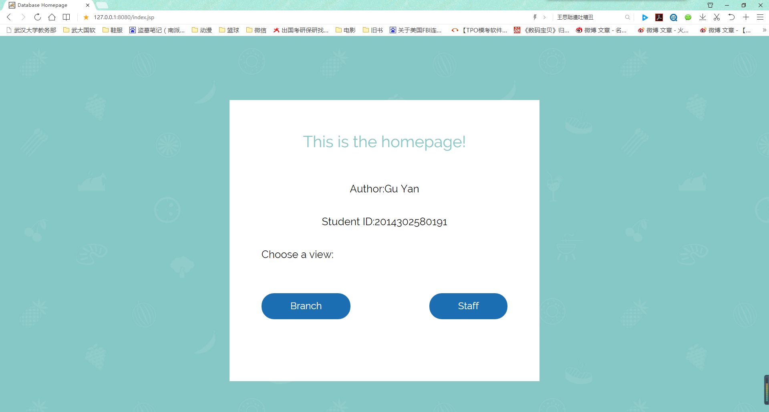
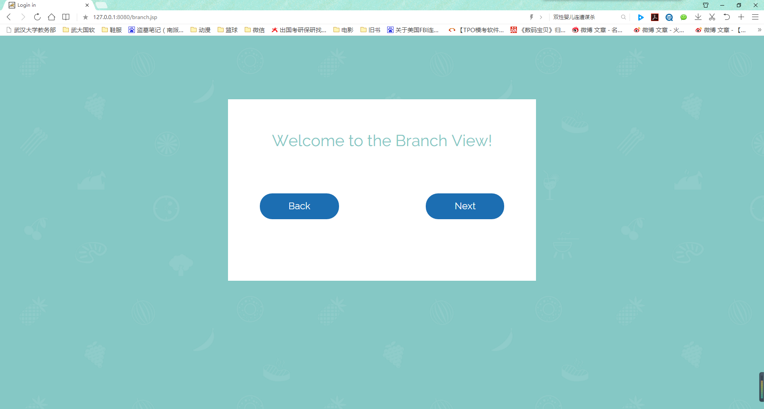
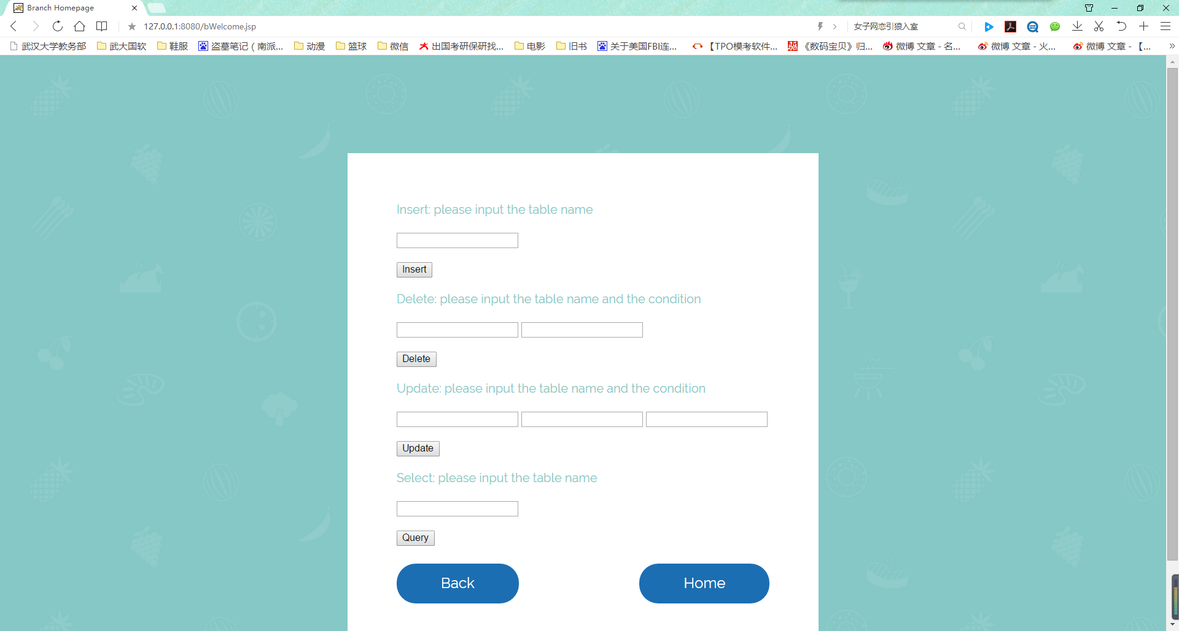

Slide 11
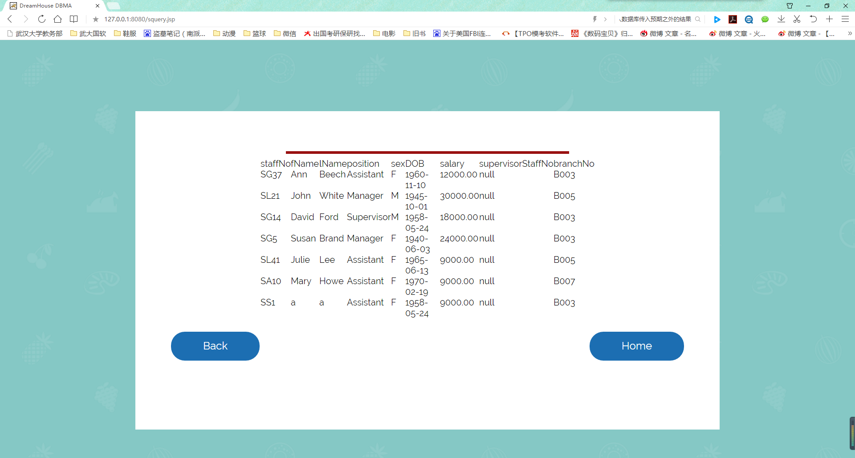
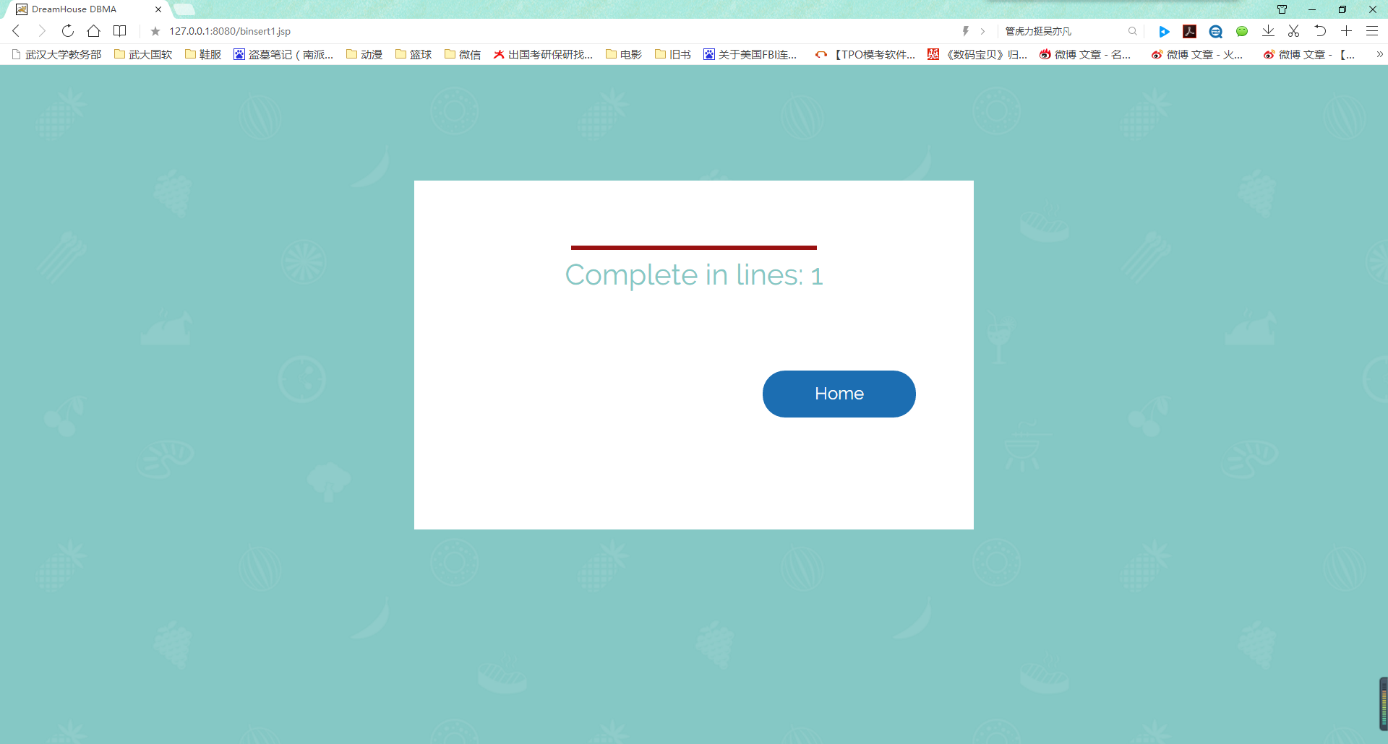
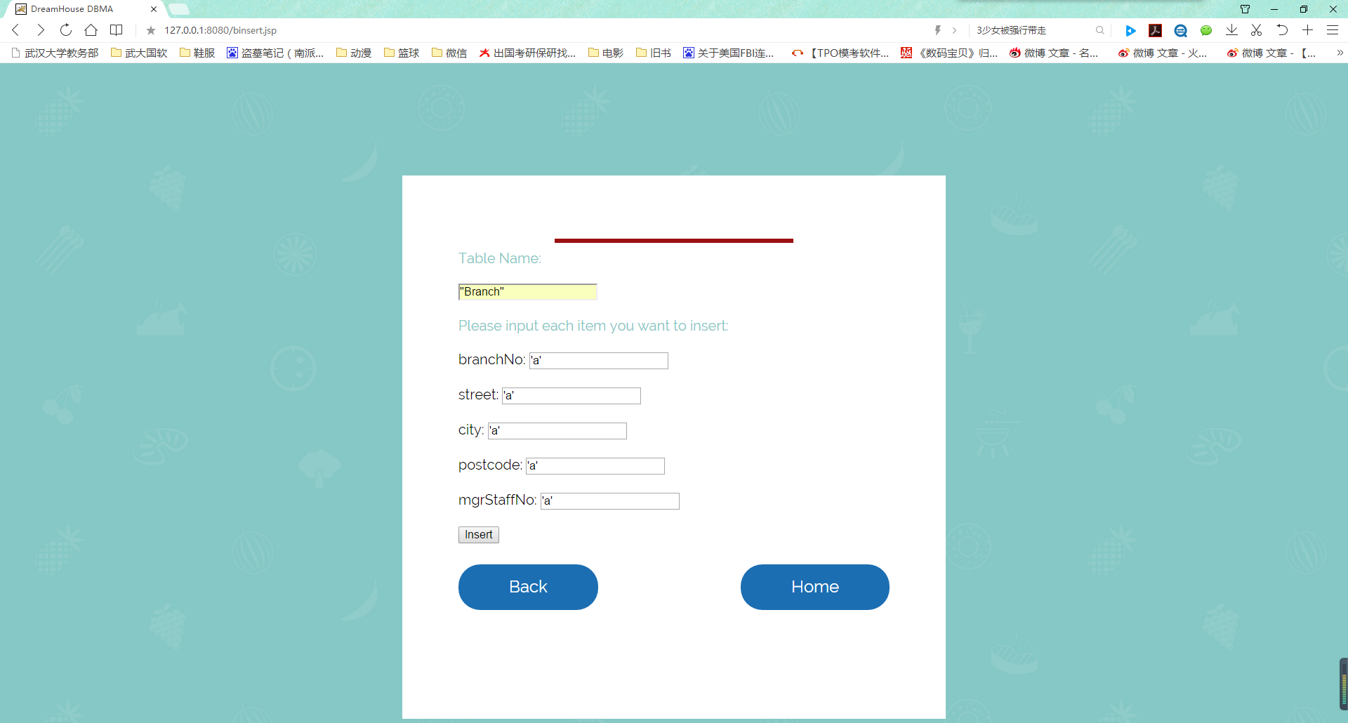

Slide 12
Thank you!

