Slide 1
Information Management

Slide 2
Doing it your way (while knowing other ways)
Public transportation
Cars
Bicycles
On foot
Electroscooters...

Slide 3
Version Control Software

Slide 4
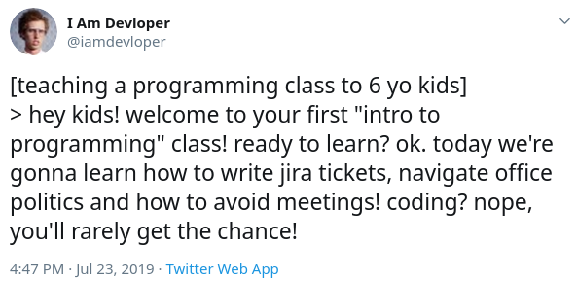
What are Jira tickets?
Jira,
Pivotal Tracker
Clubhouse
Asana
Aha!
Git
What is “Hands off”
https://en.wikipedia.org/wiki/Bug_tracking_system
https://en.wikipedia.org/wiki/Task_management

