Slide 1
Home Maintenance Service
Guided By :
Prepared By :
Ms. S.P.Parekh
Mr. M.B.Kalariya
Bhimani Vishva (146020307015)
Chavda Isha (146020307023)
Dhamecha Zankhna (146020307031)

Slide 2
ABSTRACT
In olden days there is no such resources for getting services for home. At that time we had to ask people to get contact number or their working place address then we had to either go to their working place or had to contact them. Then they will come to our home and provide services. This all things take a long time and also not easy.
But this time is for internet technology. Every people use very much technology. So we develop this portal to provide easily most of the home maintenance services.
So, using this home maintenance service website user can get reliable 24x7 services at their place. Services provided by our system like Pest-control, Appliance repairing, Home cleaning , Medical , Computer repairing , Painting , Carpentry, Plumbing , Mechanical , Electrical, Packers & Movers and also the person who will go to the home to provide service is trustworthy and expert in their particular field and also charges for the particular services are prescribed and reasonable.

Slide 3
In this, customer can register by their e-mail, contact number. They can requested for specific service by clicking on that service and fill necessary information like residential address, contact-number, area pin-code, e-mail id . Here when customer registered for service they will get a specific time. Service provided as per the schedule by expert person who will going to provide that service.
In Proposed System, as per the season discount voucher and cash back coupons. If the customer needs to use these coupons they have to provide particular promo code. Customer has to payment by credit card or debit card. Due to any reason if any user need to cancel the service then only 50% cash back is given to them from any type of service. In this, Particular person also join our website for work. They can also registered their name by providing digital copy of the following documents: Passport photo, police verification certificate, one residential proof.
Payment to the particular service provider is given as per their service and rules of company.
The project is developed in PHP (Hyper Text Preprocessor) language.

Slide 4
CHARACTERISTICS OF EXISTING SYSTEM
1. Manually :
In manual system Contact Number or Address taken from the peoples after that contact them either by calling them or meet personally.
2. Through Websites :
In website the service provider’s contact detail is given through which we can contact that person to get service.
3. Other Types of Websites Available that provide following Functionality:
Book Service by giving Contact Number and Address
Description of charges as per the service
Customer gives their Reviews
Payment online is available
Give time for the service that they provide.
Cancel services.

Slide 5
OVERVIEW
Provides Information of Service Provider (Experience, Background)
The person who wants to work with us they can also join us
Client can also book for AMC(Annual Maintenance Contract)
Provide Accessories for service
Client can also select emergency service on emergency time
Feedback
Provide expert solution for any Problem
Tips for Maintenance

Slide 6
SCOPE
In our proposed system the client can book services by viewing all the services and its sub services and also in this client can also choose particular service provider from whom they want to acquire the services.
In the system client can give AMC (Annual Maintenance Contract) for any services to service provider.
By this system client can give order for accessories related to the services.
In this service provider can also login to the system and can go to provide service to client in which they are experts.
Here Client should also get tips for the services.
Client can cancel service before the 2 hour of their service providing time.
Client can also give star rating and feedback.
Whenever client is going to book service they should see the feedback of service provider which were provided by other clients and also view their experience and other details.

Slide 7
PROCESS MODEL

Slide 8
USER CHARACTERISTICS
ADMIN
Admin work as an administrator in the website.
All types of authority having by admin.
He/She can manage the feedback or orders of accessories.
Admin having rights like
Add or Remove any service.
Delete id of any member.
Gives discounts and vouchers.
Decline the service provider.

Slide 9
2. CLIENT
Client will register then login and book a services.
Cancel services.
Client can also give time to the service provider person at which they wants emergency services.
They can give feedback.
Client can give star rating to Service Provider for particular Service.
User also buy accessories from website.
3. SERVICE PROVIDER
Service provider person can also register to the website for doing work.
They give time

Slide 10
FUNCTIONAL REQUIREMENT
REGISTER FOR ACCOUNT
INPUT: Enter all the required detail for registration
PROCESS: System checks that particular Email-Id exist or not if not exist then
Store into database
OUTPUT: “Registered successfully” message display and open Home page
2. LOGIN
INPUT: Enter username or password
PROCESS: Check from database username exists or not
OUTPUT: “Login successfully” message display and open Home page
3. BOOK SERVICES
INPUT: Select services, related sub service and service provider
PROCESS: Service details is stored in database and inform the service provider
OUTPUT: “Your service is Booked” and client get time for service

Slide 11
4. CANCEL SERVICES
INPUT: Select Service, Sub Service, Service Provider Name and date
PROCESS: Go to Database and cancel the Entry for that Service
OUTPUT: “Cancel Service” Message on Screen
5. ORDER ACCESSORIES FOR SERVICE
INPUT: Select accessory name
PROCESS: It will check from database that the accessory is available or not if
available than client can book
OUTPUT: “Your accessory is booked” message display on screen
6. BOOK EMERGENCY SERVICE
INPUT: Select Service name and service provider
PROCESS: Service details is stored in database and inform the service provider
OUTPUT: “Your service is Booked” and client get time for service

Slide 12
7. GET COUPONS & USE COUPONS
INPUT: Get coupons code and enter during payment
PROCESS: Check coupon code is exists and validity not expired
OUTPUT: Successfully used coupons
8. BOOK AMC(ANNUAL MAINTENANCE CONTRACT)
INPUT: select Service, Sub Service, Service Provider Name and Type of AMC
PROCESS: It will enter this details in database
OUTPUT: “Your AMC Booked” message display on screen
9. GIVE STAR RATING TO SERVICE PROVIDER PERSON
INPUT: Enter Email-Id and Select Service Provider name and give star rating to
particular provider
PROCESS: This star rating store in database
OUTPUT: “Thanks for giving Star rating” message on Screen

Slide 13
10. GIVE FEEDBACK ABOUT SERVICES
INPUT: Enter User Email-Id, Service Provider name and Feedback
PROCESS: This Feedback store in database with date
OUTPUT: “Thanks for giving Feedback” message on the screen
11. PROVIDE TIPS FOR MAINTENANCE
INPUT: Select Object or machine
PROCESS: Fetch tips
OUTPUT: Display solutions
12. PROVIDE EXPERT SOLUTION FOR ANY PROBLEM
INPUT: Select problem
PROCESS: Fetch solutions
OUTPUT: Display solutions

Slide 14
NON-FUNCTIONAL REQUIREMENT
Nonfunctional requirements are those that must be provided by any system for User convenience.
RELIABILITY
In case the user forgets or loses Password, then user can get helps by choosing “forgot password” option in the main login window.
While typing the password, if the caps lock is on it must be notified.
If the system is kept idle for 10 min the session will expire.
Proper validations of user.
SECURITY
This system is provides authentication without this no user can pass.
So only the registered users are allowed to use the application.
If user is not registered then they can only view this sites but can’t utilize any functionality.
Security of the system is maintained by giving access to only authenticated user id and password.

Slide 15
MAINTAINABILITY
During the maintenance stage, SRS document can be referred for any validations.
PORTABILITY
This system can be accessed from any personal computers supporting windows operating system platform or in android phones.
FLEXIBILITY
The system keeps on updating the data according to the transactions that takes place.
The user also gets message at which time they get service by service provider according to the schedule of service provider.
TIMELESS
The system carries out all the operations with consumption of very less time.
REUSABILITY
Reusability indicates the extent to which software components should be designed in such a way that they can be used in applications other than the ones for which they were initially developed.

Slide 16
FEASIBILITY STUDY
It is the main part of the process model.
In this whole requirements and all problems are analyzed and find out best solution for the problem.
Here solution examined in terms of Resource, Cost & Time.
After examining each solution they pick out best solution for the problem.
In this time required for creation of each module is also defined.
If all this task are not completed as per the schedule then the project may lead to the failure.
TECHNICAL FEASIBILITY
Technical Feasibility means to determine whether the software is technically feasible or not.
It means that in which platform it can run & how much time
This is concerned with specifying equipment and software that will successfully satisfy the user requirement. The technical needs of the system may vary considerably, but might include:
The facility to produce outputs in a given time.
Response time under certain conditions.
Ability to process a certain volume of transaction at a particular speed.
Facility to communicate data to distant locations.

Slide 17
In examining the technical feasibility the system configuration and types of hardware requirements are given.
All the functional and non-functional requirements of Home Maintenance Services can be implemented in front end PHP, and back end as MySQL.
As the PHP and MySQL are open source so, it’s Technically Feasible
ECONOMIC FEASIBILITY
Economic feasibility can be done by examining estimated cost of examining system from that we can estimate proposed system cost.
In this it can be identified that weather it will be affordable or not.
This is an outgoing effort that improves in accuracy at each phase of the system life cycle.
Development cost charged for the project.
The system is undertaken for the development as a part of the Diploma Computer Engineering course curriculum.
As the front-end and back-end is Open Source so it can be developed at free of cost.
So, it’s Economically Feasible.

Slide 18
OPERATIONAL FEASIBILITY
This is mainly related to human organizational and political aspects.
In operational feasibility it will be determined that in which condition it will work.
The user interface and time required to learn that software.
If anybody having little knowledge of computer and online booking services can easily use this system.
So, it’s Operationally Feasible.

Slide 19
USECASE DIAGRAM
ADMIN

Slide 20
CLIENT

Slide 21
SERVICE PROVIDER

Slide 22
E-R DIAGRAM

Slide 23
DATA FLOW DIAGRAM
Context Level

Slide 24
Level 0
Book Service
Obtain Service
Provide Service
Provide Schedule
Order Accessory
Receive Accessory
Provide AMC
Give/Renew AMC
Take Payment
Use Coupons

Slide 25
Level 1 Admin

Slide 26
Level 1 Client

Slide 27
Level 1 Service Provider

Slide 28
ACTIVITY DIAGRAM
Admin

Slide 29
Client

Slide 30
Service Provider

Slide 31
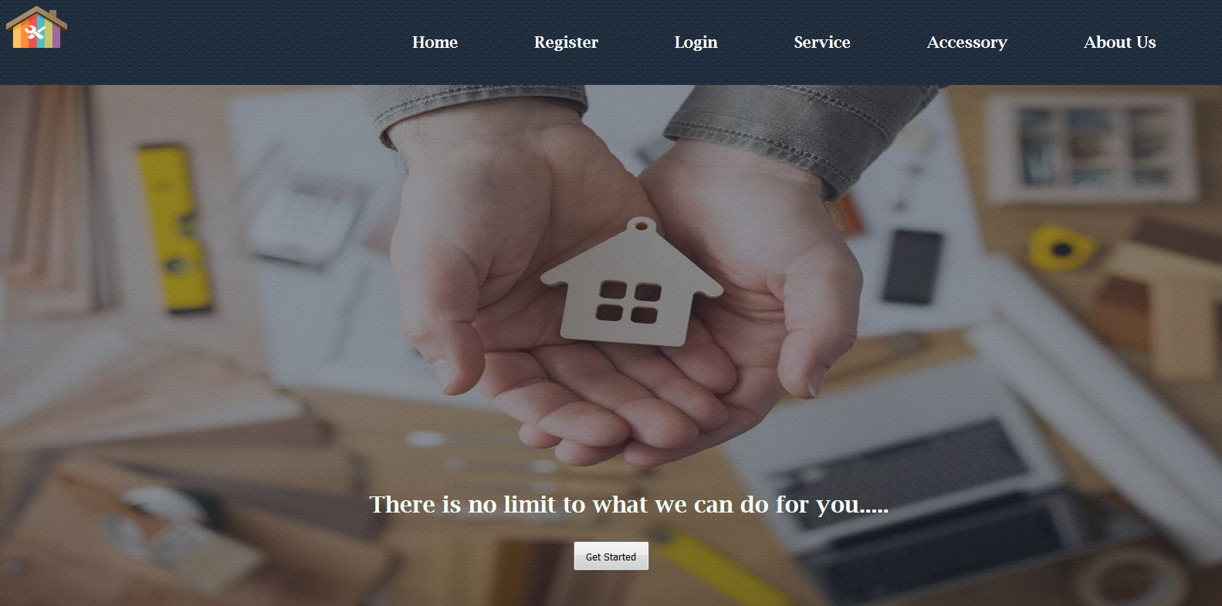
GRAPHICAL USER INTERFACE
Home Page

Slide 32
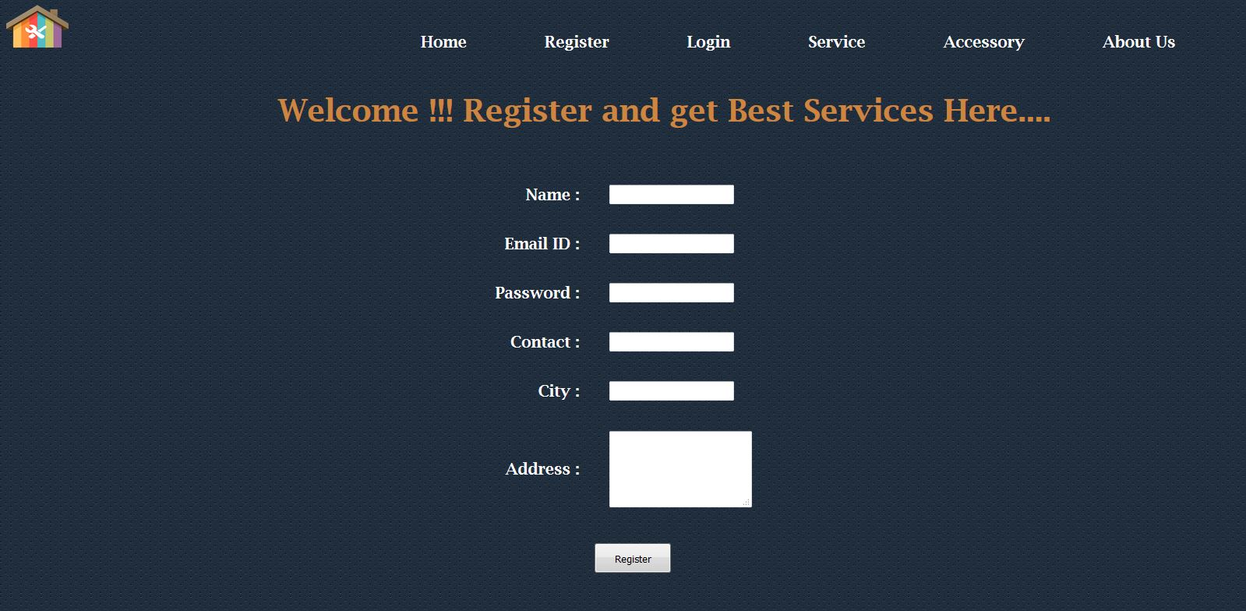
Register

Slide 33
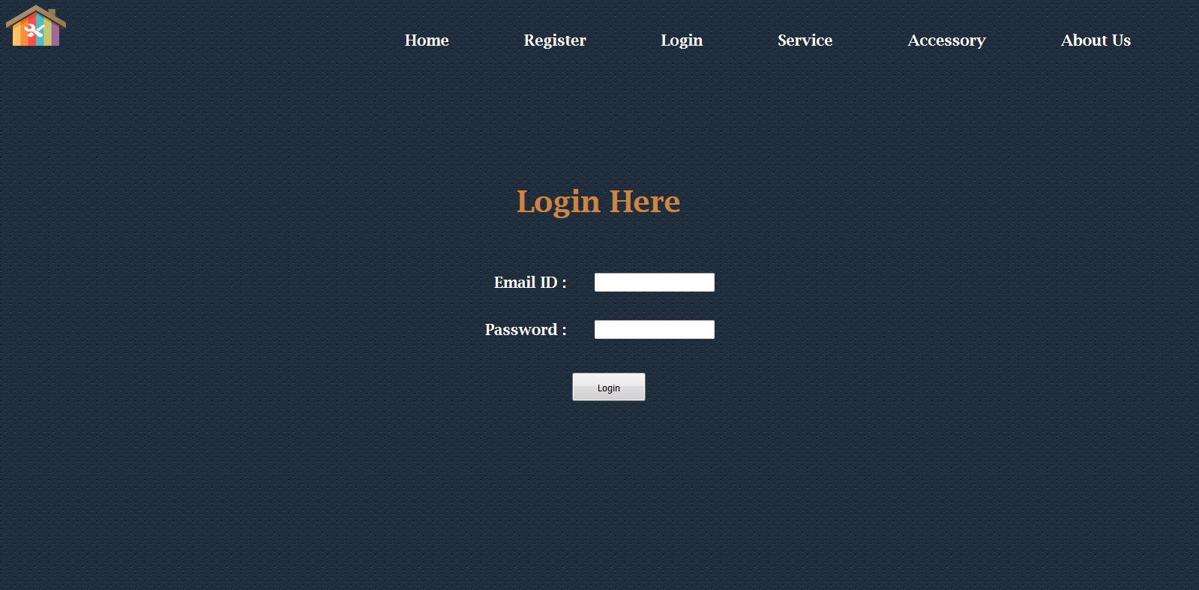
Login

Slide 34
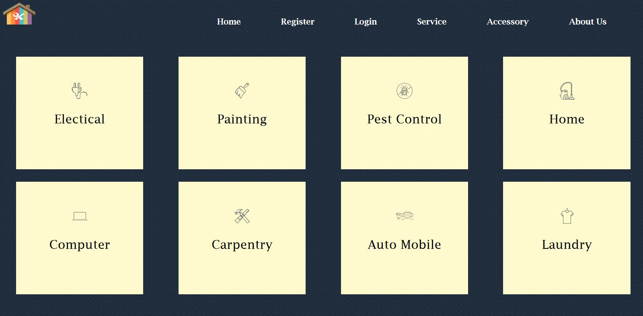
Services

Slide 35
REFRENCES
Fundamental of Software Engineering by Rajib Mall
www.Brighthubpm.com
www.reqtest.com
www.Calpoly.edu
www.Care4Home.in
www.Housejoy.in
www.Zimmber.com

