Slide 1
Welcome !

Slide 2


Slide 3
Table of contents :
01 >
The Problem
02>
Our IDEA
03 >
What is ?
04 >
OUR Goals
05 >
OUR Vision

Slide 4
The Problem

Slide 5
The Problem

Slide 6


The Problem
Weakened People

Slide 7


The Problem
Weakened People

Slide 8

The Problem
Feel
Weakened People

Slide 9
The Problem
Feel
Weakened People

Slide 10

The Problem
Feel
Weakened People

Slide 11

The Problem
Feel
Weakened People

Slide 12

The Problem
Feel
Weakened People

Slide 13

The Problem
Feel
Weakened People

Slide 14
The Problem
Feel
Weakened People

Slide 15
The Problem
Feel
Weakened People
Feel
Aware

Slide 16
OUR IDEA

Slide 17
OUR IDEA

Slide 18


OUR IDEA

Slide 19

OUR IDEA

Slide 20

OUR IDEA

Slide 21

OUR IDEA

Slide 22
OUR IDEA

Slide 23
What is
?

Slide 25
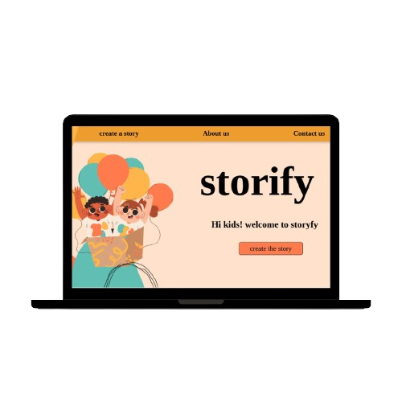
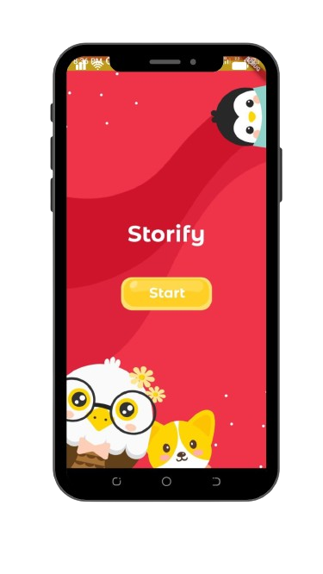
Mobile Version
Web Version

Slide 26

Mobile Version
Web Version

Slide 27


Slide 28


Slide 29


Slide 31


Slide 32




Slide 33


Slide 34


Slide 35


Slide 36


Slide 37
OVERVIEW

Slide 38
MOBILE VERSION

Slide 39
Landing Page

Slide 40
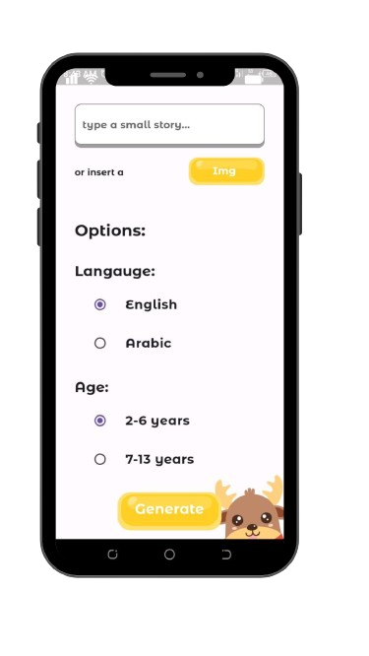
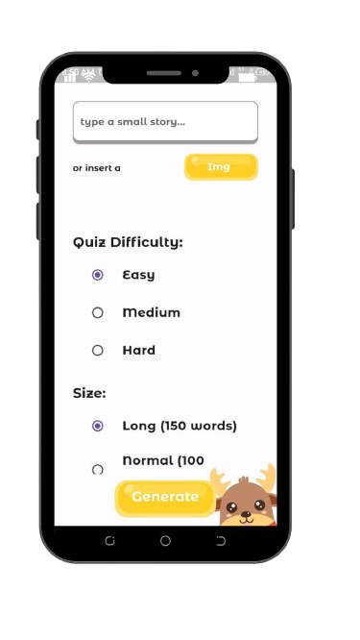
Prompt Page
1
2
(Top of the page)
(Scroll down)

Slide 41
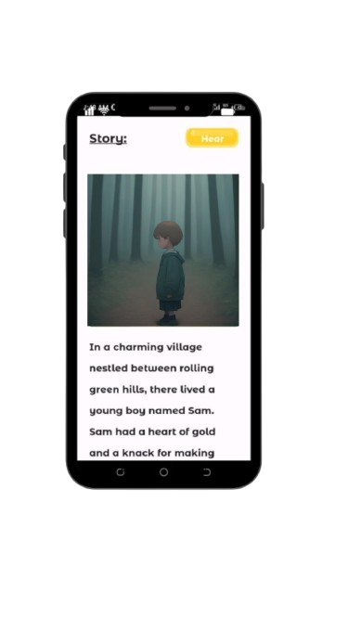
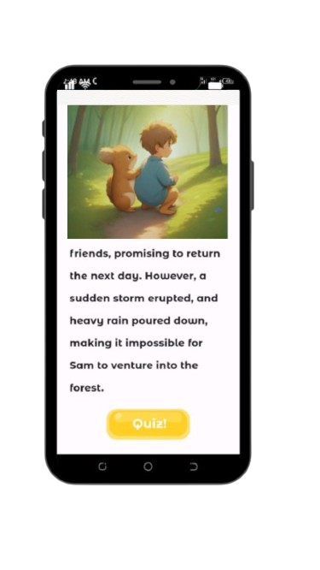
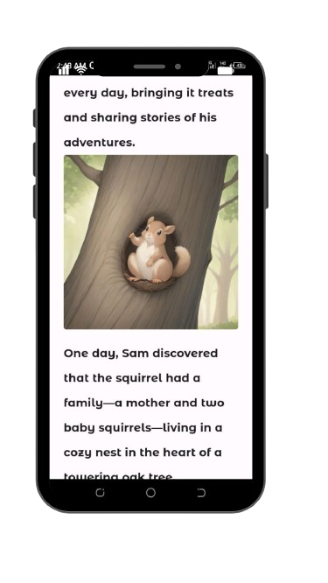
Story Page
2
3
1

Slide 42
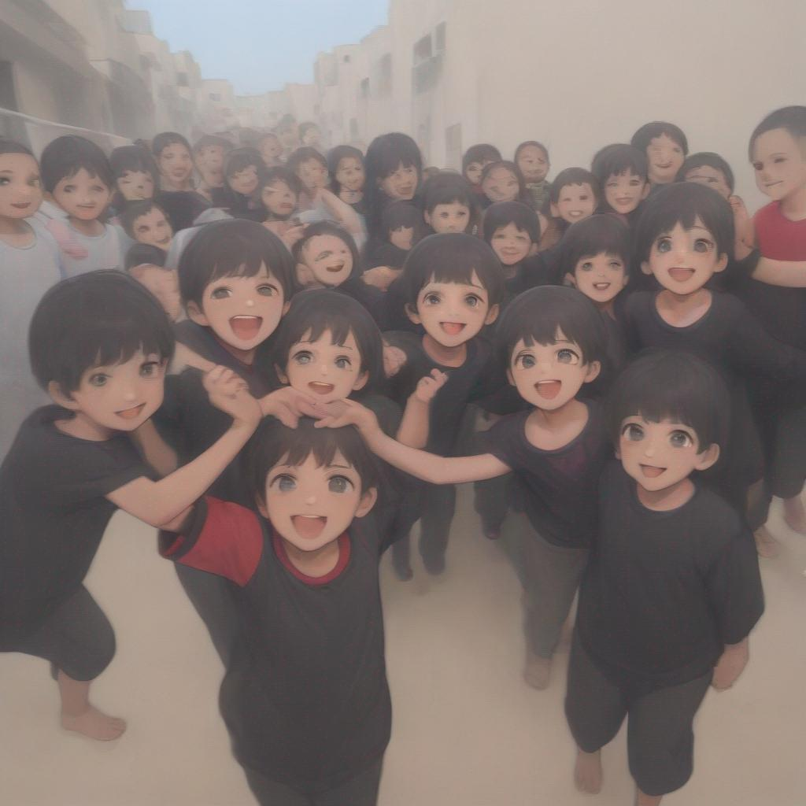
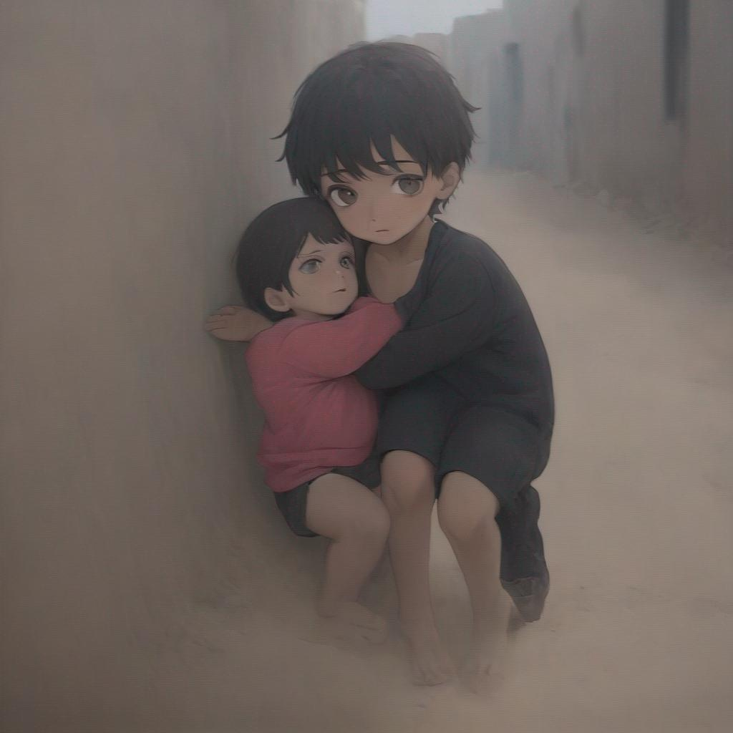

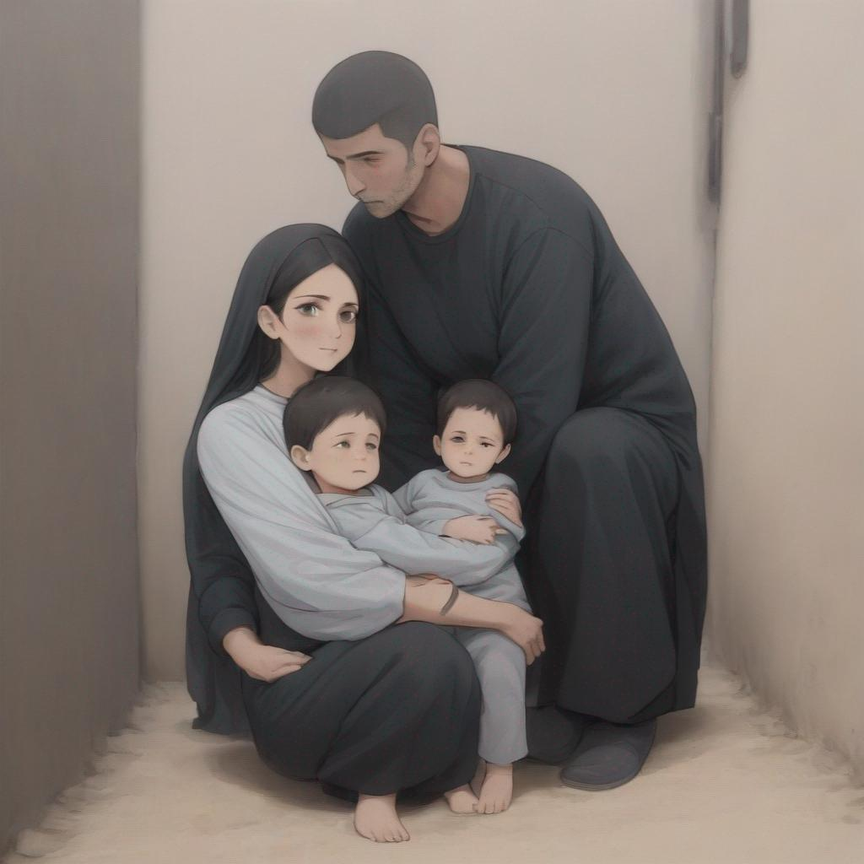
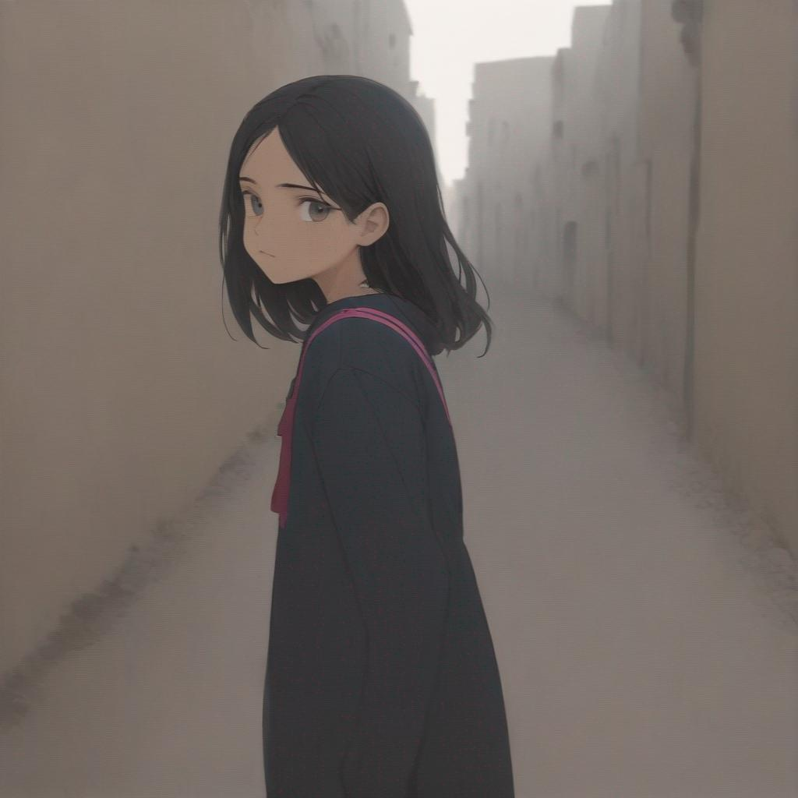
Story Page

Slide 43
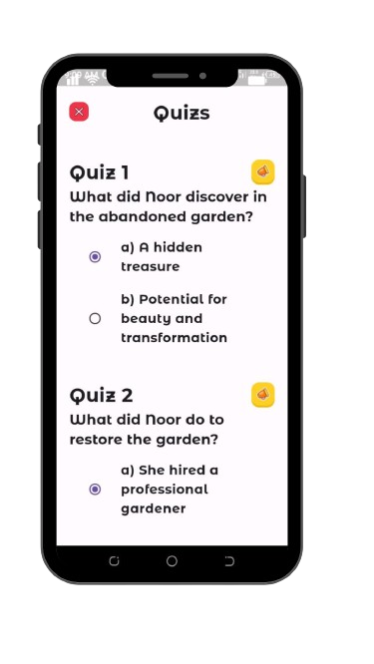
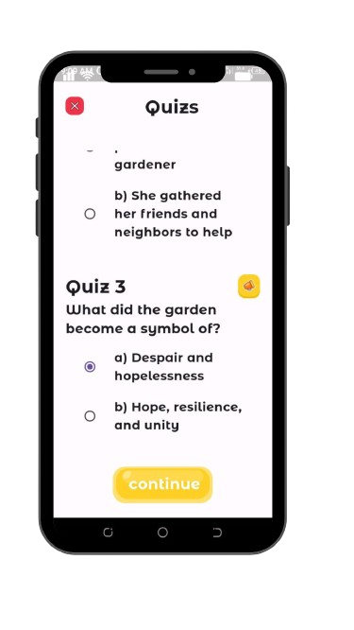
Quizes Page
1
2

Slide 44
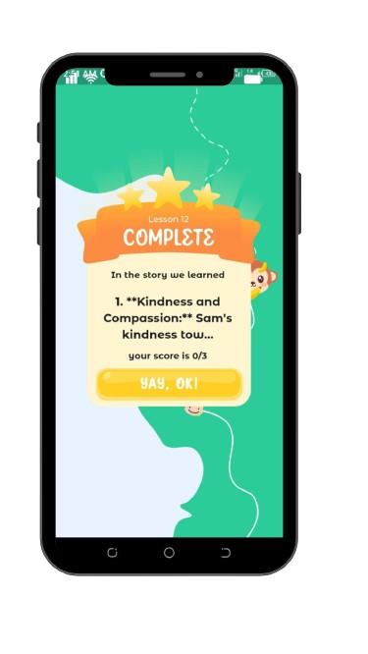
Value Page

Slide 45
WEB VERSION

Slide 46
Landing Page

Slide 47
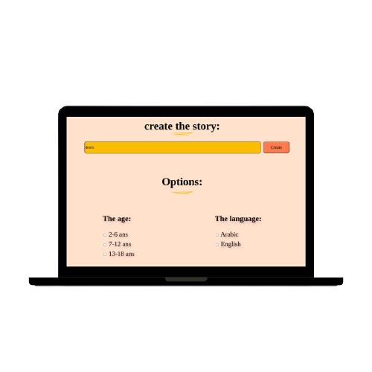
Prompt Page

Slide 48
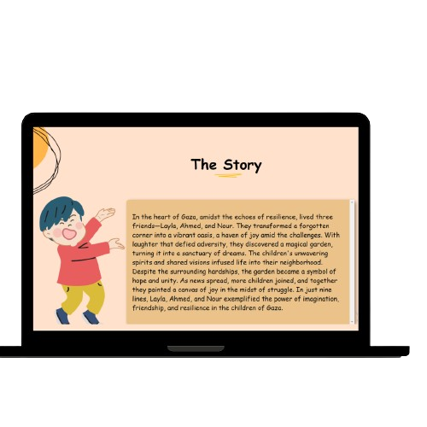
Story Page

Slide 49
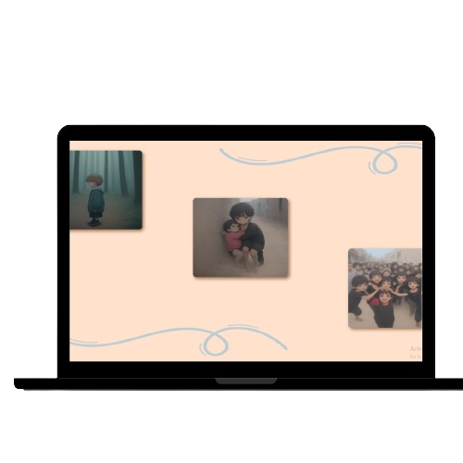
Story Page

Slide 50
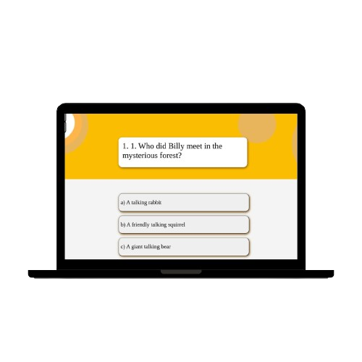
Quizes Page

Slide 51
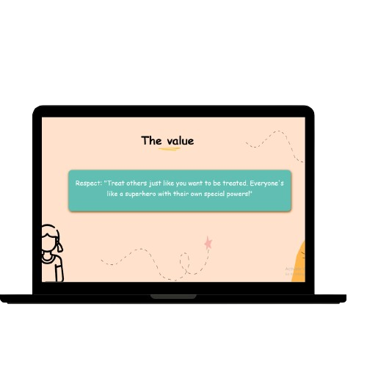
Value Page

Slide 52
OUR GOALS

Slide 53
OUR GOALS !

Slide 54

OUR GOALS !
Stand by our brothers and sisters facing wars and traumas.

Slide 55

OUR GOALS !
Stand by our brothers and sisters facing wars and traumas.
Build future generations rooted in awareness and knowledge.

Slide 56

OUR GOALS !
Stand by our brothers and sisters facing wars and traumas.
Build future generations rooted in awareness and knowledge.
Educate our children about the struggles of those who are weakened.

Slide 57
OUR VISION

Slide 58
OUR VISION !

Slide 59

OUR VISION !
Continue enhancing the app, of course!

Slide 60

OUR VISION !
Continue enhancing the app, of course!
Integrate additional languages (arabic)

Slide 61

OUR VISION !
Continue enhancing the app, of course!
Integrate additional languages (arabic)
Introduce more educational content, including historical information.

Slide 62

OUR VISION !
Continue enhancing the app, of course!
Integrate additional languages (arabic)
Introduce more educational content, including historical information.
Develop an adult version to cater to a wider audience (not only for kids)

Slide 63

OUR VISION !
Continue enhancing the app, of course!
Integrate additional languages (arabic)
Introduce more educational content, including historical information.
Develop an adult version to cater to a wider audience (not only for kids)
Add a Community platform where people share their Stories with others

Slide 64
Thank You From

