Slide 1
COMM 644 Web Programming Intermediate
Zak Ruvalcaba
Lecture 1
zruvalca@sdccd.edu Twitter: @zakruvalcaba LinkedIn: linkedin.com/in/zakruvalcaba

Slide 2
This week at a glance…
This week at a glance…
Introduction to the Course
Classic Web Architecture
The Core 3: HTML, CSS, and JavaScript
Modern Web Architecture
Future Web Architecture
ECMAScript and Current JavaScript Support
The W3C and Mozilla Foundation
Basic Structure of a Web Page
The Document Object Model (DOM)
Including JavaScript in a Web Page
Using Brackets / Common Brackets Extensions
Using a Browser for Testing Code
Working with Git and GitHub
Lab: Creating your First JavaScript Application

Slide 3
Classic Web Architecture

Slide 4
Classic Web Architecture
What is web architecture?
Webster’s has many definitions for architecture, the most generic being “Orderly arrangement of parts”. The most complex being “The overall design or structure of a computer system, including the hardware and the software required to run it”.
The Web is similar in concept to a computer system. In years past we’d have a mainframe as the foundation for company data. Terminals were used to retrieve and modify information within the mainframe computer. The mainframe was the supplier of data and the terminal was just a "dumb" access point.
Fortunately, the Web changed the way many of us interact with computers. Application service providers (ASP’s) are now common.
Since this is the case, the architecture of computing had to change. We now work in a tiered architecture model.

Slide 5

Classic Web Architecture
The Application Service Provider (ASP)
An Application Service Provider or ASP, is a third-party entity that manages and distributes software-based services and solutions to customers across a network from a central data center.
Let’s use eBay as an example.

Slide 6



Classic Web Architecture
The Tiered Architecture Model
Tiered architecture provides a model for developers to create applications regardless of technology or platform.
1st Tier - The application is located somewhere. That application, regardless of technologies used, is a tier of the architecture.
2nd Tier - eBay auction information is stored in some sort of data source.
3rd Tier – The millions of buyers and sellers that use eBay daily make up the 3rd tier.

Slide 7

Classic Web Architecture
The Tiered Architecture Model
Visitor (Client)

Slide 8
Classic Web Architecture
The Tiered Architecture Model
Visitor (Client) HTML, CSS, JavaScript

Slide 9


Classic Web Architecture
The Tiered Architecture Model
Visitor (Client) HTML, CSS, JavaScript
Web Server

Slide 10

Classic Web Architecture
The Tiered Architecture Model
Visitor (Client) HTML, CSS, JavaScript
Web Server
3. Server responds by sending back the page requested
Internet
1. Visitor types the URL into their browser in hopes of seeing a page
2. Request is sent to
server for processing

Slide 11
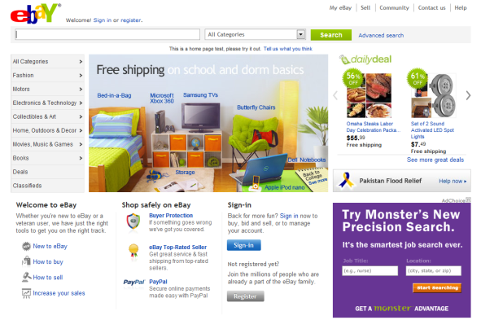
Classic Web Architecture
The Tiered Architecture Model
Visitor (Client) HTML, CSS, JavaScript
Web Server
3. Server responds by sending back the page requested
Internet
1. Visitor types the URL into their browser in hopes of seeing a page
2. Request is sent to
server for processing
4. Browser parses HTML, CSS, and JavaScript
and visitor sees the page.

Slide 12
Classic Web Architecture
The Tiered Architecture Model
Visitor (Client) HTML, CSS, JavaScript
Web Server PHP, ASP.NET, JSP, Ruby
3. Server responds by sending back the page requested
Internet
1. Visitor types the URL into their browser in hopes of seeing a page
2. Request is sent to
server for processing

Slide 13

Classic Web Architecture
The Tiered Architecture Model
Visitor (Client) HTML, CSS, JavaScript
Web Server PHP, ASP.NET, JSP, Ruby
3. Server responds by sending back the page requested
Internet
1. Visitor types the URL into their browser in hopes of seeing a page
2. Request is sent to
server for processing
Database SQL Server, Oracle, MySQL, DB2

Slide 14
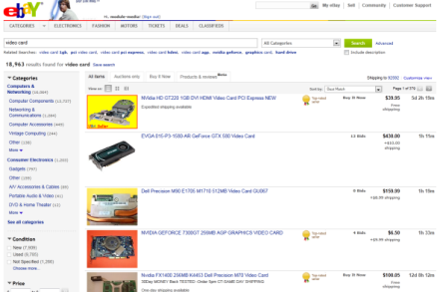
Classic Web Architecture
The Tiered Architecture Model
Visitor (Client) HTML, CSS, JavaScript
Web Server PHP, ASP.NET, JSP, Ruby
5. Server-side application processes data returned in a format the browser can understand. Typically HTML.
Internet
1. Visitor types the URL into their browser in hopes of seeing a page
2. Request is sent to
server for processing
3. Server-side application accesses information contained within data store. Also known as a query.
4. Data is returned in the form of a recordset.
6. Browser parses HTML, CSS, and JavaScript
and visitor sees the page.
Database SQL Server, Oracle, MySQL, DB2

Slide 15
HTML, CSS, and JavaScript

Slide 16


HTML, CSS, and JavaScript
HTML
Stands for HyperText Markup Language
Began as a subset of SGML
Proposed and prototyped by Tim Berners-Lee in 1989
Formally adopted and began to see use in 1993
Provides a way for developers to semantically "markup" web pages
Written using a series of tags
Tags are parsed by web browsers and the result is displayed visually to the user
HTML can include other technologies like JavaScript for scripting, CSS for format and structure, and more
HTML5.1 is the newest specification
All modern browsers support most features of HTML5
Hi, I’m Tim.

Slide 17

HTML, CSS, and JavaScript
CSS
Stands for Cascading Style Sheets
Used to describe the structure and presentation of a web page
Originally created primarily to allow developers to separate HTML from the presentational aspects of the page
Contains many properties that up until its inception weren’t available by HTML
Properties include the ability to format type, backgrounds, lists, paragraphs, borders, the layout of a page, and a lot more
CSS can also allow the same markup to be presented in different styles for different rendering methods. This is known as Responsive Web Design (RWD)
CSS3 is the newest specification
All modern browsers support most features of CSS3

Slide 18

HTML, CSS, and JavaScript
JavaScript
JavaScript is an implementation of ECMAScript which is closely related to C. More on this later…
Don’t confuse JavaScript with Java. The two languages are unrelated and have very different semantics
Netscape wanted to appeal to nonprofessional programmers like Microsoft did with Visual Basic
Netscape developed JavaScript under the name Mocha. Renamed to LiveScript for the release of Netscape 2.0 and 4 months later was released under the name JavaScript to coincide with Netscape’s support for Java in Netscape’s browser release of 2.0B3
Implemented as part of a web page to provide enhanced user interfaces, interactions, conditional logic, calculations, validation, and more
Use of JavaScript diminished for almost a decade during the “Flash” era
The advent of jQuery, asynchronous coding in the form of Ajax, and numerous other JavaScript-related libraries have helped return JavaScript to the spotlight
Today, JavaScript is arguably more important than HTML and CSS. It powers the Modern Web Architecture Model and ties in closely with the current/future NoSQL Architecture Model.

Slide 19
HTML, CSS, and JavaScript
JavaScript Versions
Version | Release Date | Notes
1.0 | March 1996 | Netscape 2 and IE 3
1.1 | August 1996 | Netscape 3
1.2 | June 1997 | Netscape 4 and Opera 3
1.3 | October 1998 | Netscape 4.06, IE 4, and Opera 5
1.4 |  | Developed for Netscape Server and Opera 6
1.5 | November 2000 | Netscape 6, Firefox 1, IE 5.5/6/7/8, Opera 7, Safari 3, Chrome 1-10
1.6 | November 2005 | Firefox 1.5
1.7 | October 2006 | Firefox 2, Chrome 28
1.8 | June 2008 | Firefox 3 and Opera 11.5
1.8.1 |  | Firefox 3.5
1.8.2 | June 2009 | Firefox 3.6+

Slide 20
Modern Web Architecture

Slide 21
Modern Web Architecture
The problem with the Classic Web Architecture model
The classic web architecture model works by triggering an HTTP request from the interface back to a web server. The server does some processing; retrieving data, crunching numbers, talking to various legacy systems, etc. and then returns an HTML page to the client. It’s a model adapted from the Web’s original use as a hypertext (linking from one page to the next) medium and has served its purpose for many years.
This approach doesn’t make for a great user experience. While the server is doing its thing, what’s the user doing? Waiting! And at every step in a task, the user waits some more.
If we were designing the Web from scratch for applications, we wouldn’t make users wait around. Once an interface is loaded, why should the user interaction come to a halt every time the application needs something from the server? In fact, why should the user see the application go to the server at all?

Slide 22
Modern Web Architecture
Introducing Ajax
Ajax stands for Asynchronous JavaScript and XML. More on this in a bit…
An Ajax application eliminates the start-stop-start-stop nature of interaction on the Web by introducing an intermediary (an Ajax engine) between the user and the server.
Instead of loading a webpage at the start of the session, the browser loads an Ajax engine which is responsible for both rendering the interface the user sees and communicating with the server. The engine allows the interaction with the application to happen asynchronously (independent of communication with the server). So the user is never staring at a blank browser window and an hourglass icon.
User actions that normally generate HTTP requests take the form of JavaScript calls to the Ajax engine.
Any response to a user action that doesn’t require a trip back to the server such as simple data validation, editing data in memory, and even navigation, the engine handles on its own. If the engine needs something from the server in order to respond, the engine makes those requests asynchronously, without stalling a user’s interaction with the application.

Slide 23
Modern Web Architecture
Defining Ajax
Ajax isn’t a technology. It’s really several technologies, each flourishing in its own right, coming together in powerful new ways. Ajax incorporates:
Standards-based presentation using HTML and CSS
Dynamic display and interaction using the Document Object Model
Data interchange and manipulation using XML
Asynchronous data retrieval using the browsers XMLHttpRequest object
JavaScript binding everything together

Slide 24
Modern Web Architecture
The Modern Architecture Model
Visitor (Client) HTML, CSS, JavaScript
Web Server PHP, ASP, JSP, Ruby
HTML + CSS
Ajax Engine
XML Data
JavaScript Call
HTTP Request
Data Request (Query)
Dataset
Database SQL Server, Oracle, MySQL, DB2

Slide 25
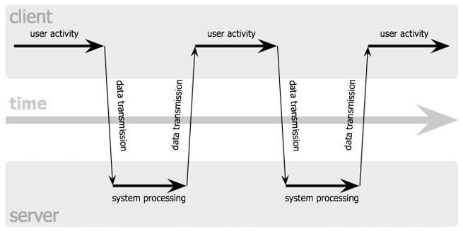
Modern Web Architecture
The Modern Architecture Model (Synchronous vs Asynchronous)
The Synchronous Model

Slide 26
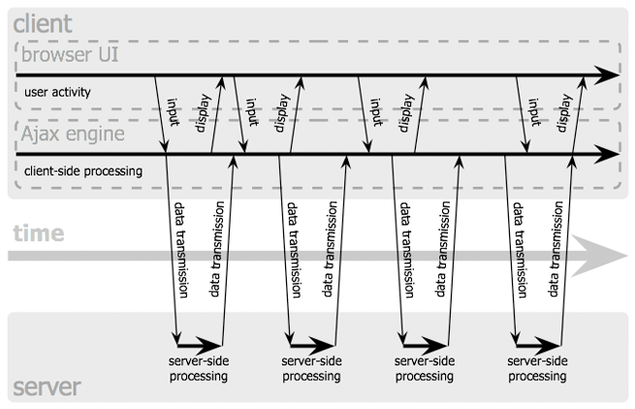
Modern Web Architecture
The Modern Architecture Model (Synchronous vs Asynchronous)
The Asynchronous Model

Slide 27
Future Web Architecture

Slide 28
Future Web Architecture
The "problem" with the Modern Web Architecture model
Although the current web architecture model solves many of the UX problems that have faced developers for years, it still has several technical drawbacks:
For years, XML was at the heart of the data-transport layer. XML, while being ubiquitous, is:
written in a different language
carries a heavy footprint
usually requires extra JavaScript code to iterate through and render nodes of data
The Ajax model still relies on a classic web server to handle HTTP Request processing. Drawbacks here include:
server-side architecture which includes server-side technology and dedicated language
additional servers, additional memory, more resources, etc.
adds one more "failure point" to the overall model
The Ajax model still relies on a relational database as a data store, drawbacks here include:
model is ancient, slow, process intensive, and can't handle volume of modern web applications
additional servers, additional memory, more resources, etc.
adds one more "failure point" to the overall model

Slide 29
Future Web Architecture
How the future Web will eliminate "classic resources"
The future (and to some extent current) web architecture model eliminates many "classic resources" that have acted as failure points to many Web developers starting with JSON replacing XML.
While the web application server remains, the server-side technology is gone! The web application server now hosts other resources and its role has shifted to handle other tasks.
The relational database model is eliminated! The model that E.F. Codd invented way back in 1970 while working for IBM and that has been used exclusively for almost 50 years is completely eliminated!
Changes are made to various components of the architecture model including how data is stored, how interfaces (views) are presented to the user, how JavaScript makes calls for data on the client, how data is queried, and more.
Most importantly, JavaScript plays a much more critical role in Web development that it ever did before. This is why it's critical that you learn it now!

Slide 30

Future Web Architecture
The Future Architecture Model: The NoSQL Model
Visitor (Client) HTML, CSS, JavaScript
Application Server Node.js
View HTML + CSS
Angular React.js Vue.js
JSON Data
Interaction
HTTP Verbs GET, POST, PUT, DELETE
Data Request (Query)
Express.js
JSON
NoSQL Database MongoDB, CouchDB, Couchbase, Oracle NoSQL, Cassandra, HBase, Firebase, IBM Domino, FoundationDB, etc.

Slide 31
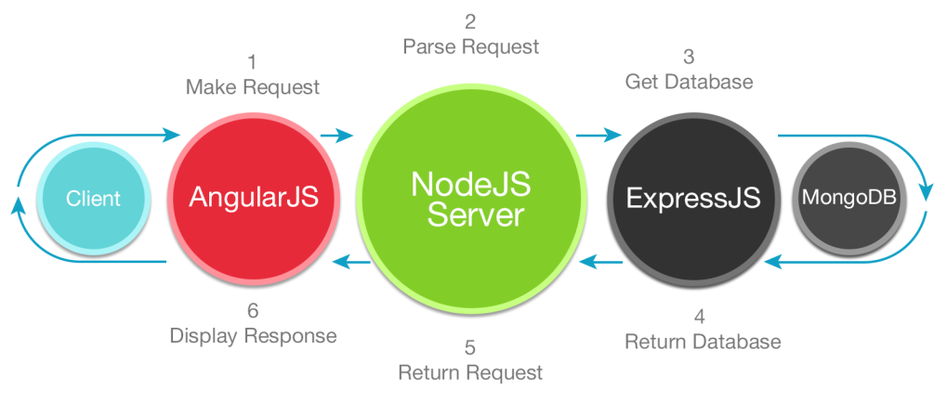
Future Web Architecture
The Future Architecture Model: The NoSQL Model

Slide 32
ECMAScript and Current JavaScript Support

Slide 33
ECMAScript
Introducing Ecma International
Ecma International is an international, private (membership-based like W3C), non-profit, standards organization for information and communication systems
Originally founded in 1961 to standardize computer systems in Europe
Membership is open to large and small companies worldwide that produce, market or develop computer or communication systems, and have interest and experience in the areas addressed by the group's technical bodies
Located in Geneva, Switzerland

Slide 34
ECMAScript
Introducing ECMAScript
The ECMAScript specification is a standardized specification of a scripting language developed by Brendan Eich of Netscape; initially it was named Mocha, later LiveScript, and finally JavaScript. In December 1995, Sun Microsystems and Netscape announced JavaScript in a press release. In March 1996, Netscape Navigator 2.0 was released, featuring support for JavaScript
Based on the widespread success of JavaScript, Microsoft developed a compatible dialect of the language, naming it JScript to avoid trademark issues. JScript was included in Internet Explorer 3.0, released in August 1996
Netscape delivered JavaScript to Ecma International for standardization and the work on the specification, ECMA-262, began in November 1996. The first edition of ECMA-262 was adopted in June 1997. The name "ECMAScript" was a compromise between Netscape and Microsoft
While both JavaScript and JScript aim to be compatible with ECMAScript, they also provide additional features not described in the ECMA specifications

Slide 35
ECMAScript
ECMAScript Versions
ES1 (June 1997): First edition
ES2 (June 1998): Editorial changes
ES3 (December 1999): Added regular expressions, better string handling, new control statements, try/catch exception handling, tighter definition of errors, formatting for numeric output and other enhancements
ES4 (Abandoned): Abandoned due to political differences concerning language complexity
ES5 (December 2009): Adds "strict mode". Clarifies many ambiguities in the 3rd edition specification. Adds some new features, such as getters and setters in functions, support for JSON, and more
ES5.1 (June 2011): Minor updates
ES6 (June 2015): Adds significant new syntax for writing complex applications including classes and modules, iterators and for/of loops, Python-style expressions, arrow functions, and more
ES7 (Work in progress)

Slide 36
ECMAScript
ECMAScript to JavaScript Versions
JavaScript Version | ECMAScript Edition
1.0 – 1.3 | 1
1.4 | 2
1.5 | 3
1.6 | 3 + enhancements
1.7 | 3 + 1.6 enhancements + more enhancements
1.8 | 3 + 1.7 enhancements + more enhancements
2.0 (work in progress) | 6
 | 7

Slide 37
The W3C and Mozilla Foundation

Slide 38

The W3C
Introducing the W3C
Stands for the World Wide Web Consortium
It’s the main international standards organization for the web
Founded by Tim Berners-Lee in 1994
Headquartered at MIT but has numerous offices worldwide
Comprised of hundreds of member organizations from various businesses, nonprofit organizations, universities, and government entities who dedicate full-time staff positions to the W3C
Also engages in education, outreach, software development, and serves as an open forum for discussion about the web

Slide 39
The W3C
Introducing the W3C
Hosts and currently manages the newest specifications for HTML including HTML5 and more recently, HTML5.1: http://www.w3.org/TR/html51/
Hosts and currently manages the newest specifications for CSS including CSS3: http://www.w3.org/TR/#tr_CSS

Slide 40
The Mozilla Foundation
Introducing the Mozilla Foundation
Mozilla is a free software community best known for the Firefox web browser
Started as a side project of Netscape to coordinate the development of the Mozilla Application Suite, the open source version of Netscape’s internet software
The name stems from a combination of Mosaic and Godzilla, Mosaic being the original implementation of the Netscape browser and Godzilla being the Netscape mascot of the time
Licenses the name “JavaScript” from Oracle Corporation for the development of current open source projects, APIs, Firefox add-ins, and more
Provides the official documentation for JavaScript here: https://developer.mozilla.org/en-US/docs/Web/JavaScript

Slide 41
Basic Structure of a Web Page

Slide 42
Basic Structure of a Page
The basic structure of a web page
A typical web page will contain two major areas:
The Doctype Declaration
The Document Tree

Slide 43
Basic Structure of a Page
The Doctype Declaration
The first item to appear in the source code of a web page is the doctype declaration. It will look like this:
<!DOCTYPE html>

Slide 44
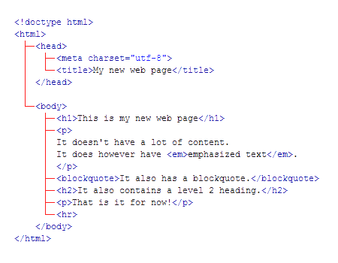
Basic Structure of a Page
The Document Tree
A web page is typically considered a document tree because it will contain a combination of HTML markup organized like the branches of a tree.
Pay close attention to the symmetry of the way that tags are opened and closed.

Slide 45
Basic Structure of a Page
The <html> Tag
Immediately after the doctype comes the html tag - this is the root tag of the document tree and everything that follows is a descendant of that tag.
The html tag breaks the document into two main sections: the head and the body.

Slide 46
Basic Structure of a Page
The <head> Tag
The head tag contains meta data - information that describes the document itself, or associates it with related resources, such as scripts and style sheets. The example below contains the title element, which represents the document’s title or name and a simple JavaScript code block that displays a popup message. <!doctype html> <html> <head> <title>Welcome to Vecta Corporation</title> <script> alert('Hello World'); </script> </head> <body> <h1>This is a simple example</h1> </body> </html>

Slide 47
Basic Structure of a Page
JavaScript Related Tags for the <head>
Tag | Description
<script> | Used either to embed or refer to an external script
<noscript> | Used to present alternate content when scripting is disabled

Slide 48
Basic Structure of a Page
The <body> Tag
This is where the bulk of the page is contained. Everything that you can see in the browser window is contained inside this element, including paragraphs, lists, links, images, tables, and more. How the page looks will depend entirely upon the content that you decide to fill it with.

Slide 49
The Document Object Model (DOM)

Slide 50
The DOM
Exploring the Document Object Model (DOM)
The Document Object Model (DOM) is a collection of nodes in the web browser’s memory that represent the current web page. These nodes are organized as a hierarchy.
The DOM for a web page is built as the page is loaded by the browser.
JavaScript can modify the web page in the browser by modifying the DOM. This is known as DOM scripting or DOM manipulation.
When the DOM is changed, the web browser immediately displays the results of the change.
Many JavaScript applications manipulate the DOM based on user actions.

Slide 51
The DOM
Exploring the Document Object Model (DOM)
As an example of how the DOM works, consider this block of code…
<!doctype html> <html> <head><title>Welcome to Vecta Corp.</title></head> <body> <h1>Welcome</h1> <p>With innovative approaches and advanced methodologies, Vecta Corp. provides scalable business solutions to help companies achieve success.</p> <h2>Our Solutions</h2> <ul> <li>vProspect 2.0</li> <li>vConvert 2.0</li> <li>vRetain 1.0</li> </ul> <p>Contact us now at 559-555-5555 to speak to a sales rep.</p> </body> </html>

Slide 52
The DOM
Exploring the Document Object Model (DOM)
...and how it would be rendered visually in the browser’s memory…

Slide 53
Including JavaScript in a Web Page

Slide 54
Including JS in a Web Page
Methods for including JavaScript in a web page
There are several methods that you can use to work with JavaScript including:
Creating a web page and writing embedded JavaScript code
Creating a web page and writing JavaScript within an external JavaScript .js file
Creating a web page and writing your JavaScript code inline

Slide 55
Including JS in a Web Page
Creating a web page and writing embedded JavaScript code
<!doctype html> <html> <head> <title>Welcome to Vecta Corp.</title> </head> <body> <h1>Welcome</h1> <p>With innovative approaches and advanced methodologies, Vecta Corp. provides scalable business solutions to help companies achieve success.</p> <p>Copyright &copy; <script> var today = new Date(); document.writeln( today.getFullYear() ); </script> </p> </body> </html>

Slide 56
Including JS in a Web Page
Creating a web page and writing JavaScript within an external file
index.html <!doctype html> <html> <head> <title>Welcome to Vecta Corp.</title> </head> <body> <h1>Welcome</h1> <p>With innovative approaches and advanced methodologies, Vecta Corp. provides scalable business solutions to help companies achieve success.</p> <p>Copyright &copy; <script src="script.js"></script></p> </body> </html>
script.js
var today = new Date(); document.writeln( today.getFullYear() );

Slide 57
Including JS in a Web Page
Creating a web page and writing your JavaScript code inline
<!doctype html> <html> <head> <title>Welcome to Vecta Corp.</title> </head> <body onload="javascript:alert('Thank you for visiting our web page');"> <h1>Welcome</h1> <p>With innovative approaches and advanced methodologies, Vecta Corp. provides scalable business solutions to help companies achieve success.</p> <p>Copyright &copy; 2014</p> </body> </html>

Slide 58
Using Brackets

Slide 59
Using a Browser for Testing Code

Slide 60
Working with Git and Github

Slide 61
Working with Git and GitHub
What's a Version Control System?
A Version Control System is an application that allows you to record changes to a codebase in a structured and controlled fashion.
Makes it way easier to undo errors or roll back to earlier versions of code
Makes it way easier to share a codebase between developers without creating conflicts
Makes it way easier to deploy changes from development to staging or production environments
As a Front-End Web Developer, you will be required to know Git (at least some of the more popular commands), be familiar with GitHub, and in some cases, have your own GitHub repository that other developers or potential employers can fork.

Slide 62
Working with Git and GitHub
Popular Version Control Systems
CVS - Concurrent Version System
SVN – SubVersioN or Subversion
Git
Mercurial
Bazaar
LibreSource
Perforce

Slide 63
Working with Git and GitHub
Centralized vs. Distributed Development
Centralized Development
Central Server
Damon
Agnes
Wally
Ferris

Slide 64
Working with Git and GitHub
Centralized vs. Distributed Development
Distributed Development
Central Server
Damon
Agnes
Wally
Ferris

Slide 65
Working with Git and GitHub
What is Git?
Open source, free, Distributed Source Control system which focuses on speed and efficiency
Originally developed by Linus Torvalds for the development of Linux in 2005
You’re not dependent on a central server and you don’t have to be online
It’s extremely fast - much faster than other popular systems
Projects are stored as repositories (repos) which can contain branches (states of the project over time)
Every Git project contains the repository, version history, and full revision tracking for the project
You can always save snapshots of the current state of development
Used on personal or very large projects and for all sizes of team

Slide 66
Working with Git and GitHub
What is GitHub?
It’s a Git repository hosting service but it adds many of its own features
While Git is a command line tool, GitHub also provides a web-based graphical interface
Provides access control and collaboration features such as wikis and basic task management tools
By default, all projects are public and free. In you want a private project, then you'll have to pay
You can clone any public repository, follow projects and developers, post comments, etc.
It’s the "Facebook" for developers
Using GitHub
Using GitHub is easy. Browse to the site at github.com and create a free account
Download the GitHub desktop app: https://desktop.github.com and install it

Slide 67
Using the GitHub Desktop App

