Slide 1
HTML Hyper Text Markup Language

Slide 2
What is HTML?
HTML is a language for describing web pages.
It is a set of markup tags.

Slide 3
HTML Tags
HTML tags are used in the following format:
→ HTML Element
When you open a tag make sure it is closed; except tag that has no content, will not be closed.
Tag opened FIRST is closed LAST.
HTML tags are not case sensitive.
<tagname> content </tagname>

Slide 4
HTML Page Structure
<!DOCTYPE>
<html>
<head>
</head>
<body>
</body>
</html>

Slide 5
HTML Page Structure (Cont.)
<!DOCTYPE>
The <!DOCTYPE> declaration helps the browser to display a web page correctly.
There are many different documents on the web, and a browser can only display an HTML page 100% correctly if it knows the HTML type and version used.
The Version we will use is XHTML 1.0; it will be declared as the following:
<!DOCTYPE html PUBLIC "-//W3C//DTD XHTML 1.0 Strict//EN" "http://www.w3.org/TR/xhtml1/DTD/xhtml1-strict.dtd">
The case must be upper case 'DOCTYPE‘ and It does not close like other tags.

Slide 6
HTML Page Structure (Cont.)
<html></html>
The root element that specifies that the content of the document is HTML.
The opening tag immediately follows the DOCTYPE declaration and the closing tag is the last thing in the document.
The html element must contain the head and the body elements.

Slide 7
HTML Page Structure (Cont.)
<head></head>
The header of an HTML document where information about the document is placed.
You must use this element and it should be used just once.
It must start immediately after the opening html tag and end directly before the opening body tag.

Slide 8
HTML Page Structure (Cont.)
<body></body>
The main body of an HTML document where all of the content is placed.
You must use this element and it should be used just once.
It must start immediately after the closing head tag and end directly before the closing html tag.

Slide 9
HTML Attributes
HTML elements can have attributes
Attributes provide additional information about an element
Attributes are always specified in the start tag
Attributes come in name/value pairs like: name="value"
Attribute values should always be enclosed in quotes. Double style quotes are the most common, but single style quotes are also allowed.

Slide 10
HTML Attributes (Cont.)
Example using id attribute for specifying a unique id for an element:
<body id=“bodyId”> content </body>
<tagname attributename =“value”> content </tagname>

Slide 11
HTML Headings
Headings are defined with the <h1> to <h6> tags.
<h1> defines the most important heading. <h6> defines the least important heading.
Use HTML headings for headings only. Don't use headings to make text BIG or bold.
Search engines use your headings to index the structure and content of your web pages.

Slide 12
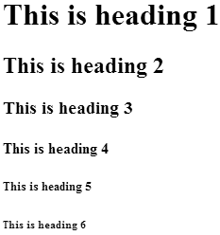
HTML Headings (Cont.)
Source Code:
<html>
<body>
<h1>This is heading 1</h1>
<h2>This is heading 2</h2>
<h3>This is heading 3</h3>
<h4>This is heading 4</h4>
<h5>This is heading 5</h5>
<h6>This is heading 6</h6>
</body>
</html>
Result:

Slide 13
HTML Paragraphs
Paragraphs are defined with the <p> tag.
Example:
<html>
<body>
<p>This is a paragraph.</p>
</body>
</html>
Result:

Slide 14
HTML Lines
The <hr>tag creates a horizontal line in an HTML page.
It can be used to separate content.
Has no content so, has no closed tag.
Example:
<html>
<body>
<p>This is a paragraph.</p>
<hr>
</body>
</html>
Result:

Slide 15

HTML Line Breaks
New Line is defined with the <br> tag.
Has no content so, has no closed tag.
Example:
<html>
<body>
<p>This is one paragraph <br> but, we want to write it in two lines.</p>
</body>
</html>
Result:

Slide 16
HTML Comments
Comments are ignored by the browser and are not displayed.
Comments are written like this:
<!-- This is a comment -->

Slide 17
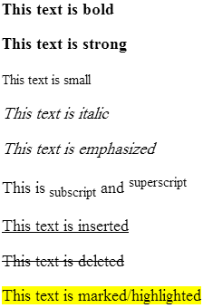
HTML Text Formatting Tags
Source Code:
<html>
<body>
<p><b>This text is bold</b></p>
<p><strong>This text is strong</strong></p>
<p><small>This text is small</small></p>
<p><i>This text is italic</i></p>
<p><em>This text is emphasized</em></p>
<p>This is<sub> subscript</sub> and <sup>superscript</sup></p>
<p><ins>This text is inserted</ins></p>
<p><del>This text is deleted</del></p>
<p><mark>This text is marked/highlighted</mark></p>
</body>
</html>
Result:

Slide 18
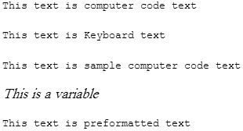
HTML "Computer Output" Tags
Source Code:
<html>
<body>
<p><code>This text is computer code text</code></p>
<p><kbd>This text is Keyboard text</kbd></p>
<p><samp>This text is sample computer code text</samp></p>
<p><var>This is a variable</var></p>
<p><pre>This text is preformatted text</pre></p>
</body>
</html>
Result:

Slide 19
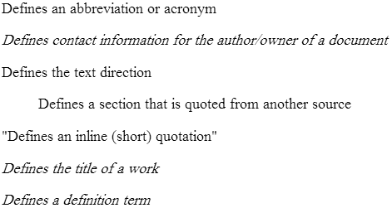
HTML Citations, Quotations, and Definition Tags
Source Code:
<html>
<body>
<p><abbr>Defines an abbreviation or acronym</abbr></p>
<p><address>Defines contact information for the author/owner of a document</address></p>
<p><bdo>Defines the text direction</bdo></p>
<p><blockquote>Defines a section that is quoted from another source</blockquote></p>
<p><q>Defines an inline (short) quotation</q></p>
<p><cite>Defines the title of a work</cite></p>
<p><dfn>Defines a definition term</dfn></p>
</body>
</html>
Result:

Slide 20
HTML Hyperlinks (Links)
The link is defined by <a> tag.
A hyperlink (or link) is a word, group of words, or image that you can click on to jump to another document.
By default, links will appear as follows in all browsers:
An unvisited link is underlined and blue
A visited link is underlined and purple
An active link is underlined and red

Slide 21
HTML Hyperlinks (Links) (Cont.)
Href Attribute:
The most important attribute for <a> tag which indicates the link’s destination.
Syntax: <a href="url">Link text</a>
Example: <a href="http://www.facebook.com/">Visit Facebook</a>
Target Attribute:
Specifies where to open the linked document.
It can takes any of the following values:
"_blank“ loads content in a completely new window.
"frame name“ loads content in a frame with a custom name.
"_parent“ loads content in the parent frameset for the current frame.
"_self“ loads content in the same frame (The default behaviour).

Slide 22
HTML Hyperlinks (Links) (Cont.)
Anchor: a point in a page where a link can jump to.
Id Attribute:
The id attribute can be used to create a bookmark inside an HTML document.
Example:
An anchor with an id inside an HTML document:
<p id="tips">Useful Tips Section</p>
Create a link to the "Useful Tips Section" inside the same document:
<a href="#tips">Visit the Useful Tips Section</a>

Slide 23
HTML Images
HTML Image is defined by <img> tag.
The <img> tag is empty, which means that it contains attributes only, and has no closing tag.
Src Attribute:
The value of the src attribute is the URL of the image you want to display.
Alt Attribute:
The alt attribute provides alternative information for an image if a user for some reason cannot view it (because of slow connection, an error in the src attribute, or if the user uses a screen reader).
Syntax:
<img src="url" alt="sometext">

Slide 24
HTML Images (Cont.)
You can set the height and width for an image using width and height attributes (their values are specified in pixels by default).
<map> tag:
Defines a client-side image-map.
<area> tag:
Defines a clickable area inside a client-side image-map.
Example:
<map id ="atlas">
<area shape ="rect" coords ="0,0,115,90" href ="northamerica.html" alt="North America" />
<area shape ="poly" coords ="113,39,187,21,180,72,141,77,117,86" href ="europe.html" alt="Europe" />
<area shape ="poly" coords ="119,80,162,82,175,102,183,102,175,148,122,146" href ="africa.html" alt="Africa" />
</map>

Slide 25
HTML Tables
Tables are defined with the <table> tag.
<tr>: Defines a row in a table.
<th>: Defines a header cell in a table.
<td>: Defines a cell in a table. It can contain text, links, images, lists, forms, other tables, etc.
<caption>: Defines a table caption.
<thead>: Groups the header content in a table.
<tbody>: Groups the body content in a table.
Border Attribute:
If you do not specify a border attribute, the table will be displayed without borders.

Slide 26
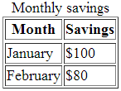
HTML Tables (Cont.)
Source Code:
<html>
<body>
<table border="1">
<caption>Monthly savings</caption>
<thead>
<tr>
<th>Month</th>
<th>Savings</th>
</tr>
</thead>
Result:
<tbody>
<tr>
<td>January</td>
<td>$100</td>
</tr>
<tr>
<td>February</td>
<td>$80</td>
</tr>
</tbody>
</table>
</body>
</html>

Slide 27

HTML Lists
HTML Unordered Lists:
<ul>: Defines an unordered list
<li>: Defines list item.
The list items are marked with bullets.
Example:
<ul> <li>Coffee</li> <li>Milk</li> </ul>
Result:

Slide 28

HTML Lists (Cont.)
HTML Ordered Lists:
<ol>: Defines an ordered list
<li>: Defines list item.
The list items are marked with numbers.
Example:
<ol> <li>Coffee</li> <li>Milk</li> </ol>
Result:

Slide 29

HTML Lists (Cont.)
HTML Description Lists:
A description list is a list of terms/names, with a description of each term/name.
<dl>: Defines an description list
<dt>: Defines terms/names.
<dd>: Describes each term/name.
Example:
<dl> <dt>Coffee</dt> <dd>- black hot drink</dd> <dt>Milk</dt> <dd>- white cold drink</dd> </dl>
Result:

Slide 30
HTML Blocks
HTML Block Elements:
Block level elements normally start (and end) with a new line when displayed in a browser.
Examples: <h1>, <p>, <ul>, <table>
HTML Inline Elements:
Inline elements are normally displayed without starting a new line.
Examples: <a>, <img>
HTML <div> Element:
The HTML <div> element is a block level element that can be used as a container for grouping other HTML elements.
The browser will display a line break before and after it.
It replaces the "old way" of defining layout using tables.

Slide 31
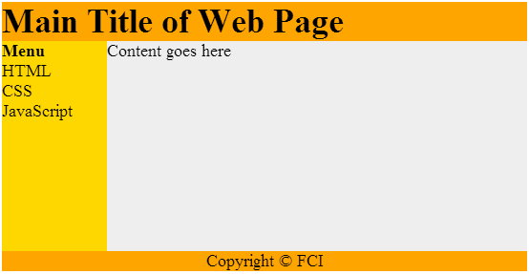
HTML Layouts - Using <div> Elements

Slide 32
HTML Layouts - Using <div> Elements (Cont.)
Example:
<html>
<body> <div id="container" style="width:500px"> <div id="header" style="background-color:#FFA500;"> <h1 style="margin-bottom:0;">Main Title of Web Page</h1></div> <div id="menu" style="background-color:#FFD700;height:200px;width:100px;float:left;"> <b>Menu</b><br>HTML<br>CSS<br>JavaScript</div>
<div id="content" style="background-color:#EEEEEE;height:200px;width:400px;float:left;"> Content goes here</div> <div id="footer" style="background-color:#FFA500;clear:both;text-align:center;"> Copyright © FCI</div> </div>
</body>
</html>

Slide 33
HTML Forms
HTML forms are used to pass data to a server.
<form>: Defines HTML form for user input.
Action Attribute:
It is a mandatory attribute.
It is used to specify where the form is sent to.
It must take the form of a URL.
Method Attribute:
It is an optional attribute.
It can be used to specify how the form is sent.
The value must be “get” (default), or “post”; where “get” visibly sends the form data in the body of the HTTP request (URL), while “post” invisibly sends the form data in the body of the HTTP request.

Slide 34

HTML Forms – Input Element
The most important form element.
<input>: Defines an input control.
It can vary in many ways, depending on the type attribute.
Text Fields:
<input type="text"> defines a one-line input field that a user can enter text into.
Example:
<form> First name: <input type="text" name="firstname"><br> Last name: <input type="text" name="lastname"> </form>
Result:

Slide 35

HTML Forms – Input Element (Cont.)
Password Field:
<input type="password"> defines a password field.
Example:
<form> Password: <input type="password" name="pwd"> </form>
Result:

Slide 36

HTML Forms – Input Element (Cont.)
Radio Buttons:
<input type="radio"> defines a radio button.
Radio buttons let a user select ONLY ONE of the available choices.
Example:
<form> <input type="radio" name=“gender" value="male">Male<br> <input type="radio" name=" gender " value="female">Female </form>
Result:

Slide 37

HTML Forms – Input Element (Cont.)
Checkboxes:
<input type="checkbox"> defines a checkbox.
Checkboxes let a user select ZERO or MORE options from the available choices.
Example:
<form> <input type="checkbox" name="vehicle" value="Bike">I have a bike<br> <input type="checkbox" name="vehicle" value="Car">I have a car </form>
Result:

Slide 38
HTML Forms – Input Element (Cont.)
Submit Button:
<input type="submit"> defines a submit button.
A submit button is used to send form data to a server. The data is sent to the page specified in the form's action attribute.
Example:
<form name="input" action="html_form_action.asp" method="get"> Username: <input type="text" name="user"> <input type="submit" value="Submit"> </form>
Result:

Slide 39
HTML Forms – Input Element (Cont.)
Reset Button:
<input type=“reset"> defines a reset button.
A Reset button is used to clear all form data.
Example:
<form>
Username: <input type="text" name="user">
<input type="reset" value="reset">
</form>
Result:

Slide 40
HTML Forms – Input Element (Cont.)
General Button:
<input type=“button"> defines a general button.
It does nothing so you need to write the onClick attribute.
Example:
<form>
<input type="button" value=“alert" onclick="alert('Hello world!')" >
</form>
Result:

Slide 41
HTML Forms – Input Element (Cont.)
Attributes:
Name: can be used so that the value of the element can be processed.
Id: can be used to identify an element
Type: can be used to specify the type of input.
Value: can be used to specify the initial value.
Checked can be used when type is set to checkbox or radio to set the initial state of a check box or radio button to be selected. It must be used in the format checked="checked".
Maxlength: can be used to specify the maximum number of characters allowed in a text box.
Accept: can be used when type is set to file to specify which file-types should be accepted.
Disabled: can be used to disable an element. It must be used in the format disabled="disabled".
Readonly: can be used to specify that the value of the element can not be changed. It must be used in the format readonly="readonly“.

Slide 42
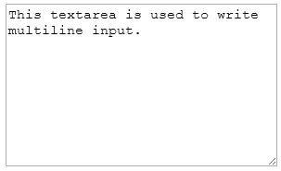
HTML Forms - TextArea
Defines a multiline input control.
Use rows and cols attributes to define the number of viewable rows and columns.
Example:
<textarea rows="10" cols="30">
This textarea is used to write multiline input.
</textarea>
Result:

Slide 43
HTML Forms - Button
Define a general clickable button.
It does nothing so you need to write the onClick attribute.
Example:
<button onclick="alert('Hello world!')"> alert</button>
Result:

Slide 44

HTML Forms - Select
<select>: Defines a drop-down list.
<option>: Defines an option in a drop-down list.
Example:
<select name="cartype">
<option value="volvo">Volvo</option>
<option value="saab">Saab</option>
<option value="opel">Opel</option>
<option value="audi">Audi</option>
</select>
Result:

Slide 45
HTML Forms – Select (Cont.)
<select> Important Attributes:
size can be used to specify how many items of the list are displayed at any time. The default is 1.
multiple can be used to specify that more than one item from the list can be selected. This must be used in the format multiple="multiple".
<option> Important Attributes:
selected can be used to specify that the option is initially selected. It must be used in the format selected="selected".
value can be used to specify a value for the option. If value is not used, the value of the option element is set to its contents (Label) by default.

Slide 46
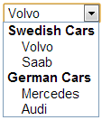
HTML Forms - Optgroup
<optgroup>: Defines a group of related options in a drop-down list.
label is a required attribute used to assign a label to the option group.
Example:
<select>
<optgroup label="Swedish Cars">
<option value="volvo">Volvo</option>
<option value="saab">Saab</option>
</optgroup>
<optgroup label="German Cars">
<option value="mercedes">Mercedes</option>
<option value="audi">Audi</option>
</optgroup>
</select>
Result:

Slide 47
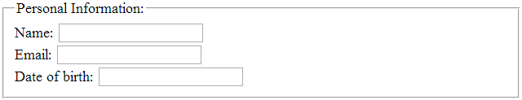
HTML Forms - Fieldset
<fieldset>: Groups related elements in a form.
<legend>: Defines a caption for a <fieldset> element.
Example:
<form>
<fieldset>
<legend>Personal Information:</legend>
Name: <input type="text"><br>
Email: <input type="text"><br>
Date of birth: <input type="text">
</fieldset>
</form>
Result:

Slide 48

HTML Objects
<object>: define an embedded multimedia object.
<param>: define an object parameter.
<embed>: used to embed the multimedia object.
Example:
<object >
<param name="SRC" value="bookmark.swf">
<embed src="bookmark.swf" width="400" height="40"></embed>
</object>
Result:

Slide 49
HTML Head - Title
<title>: defines the title of the document.
Example:
<head> <title>Page title</title> </head>

Slide 50
HTML Head - Link
<link>: defines the relationship between a document and an external resource.
It is most commonly used to link a CSS file to an HTML document.
Example:
<head> <link rel="stylesheet" type="text/css“ href="mystyle.css"> </head>

Slide 51
HTML Head - Style
<style>: defines style information for an HTML document.
Example:
<head> <style type="text/css"> body {background-color:yellow;} p {color:blue;} </style> </head>

Slide 52
HTML Head - Meta
<meta>: used to provide information about the HTML page.
Example:
<head>
<meta http-equiv="Content-Type" content="text/html; charset=UTF-8" />
</head>
This example sets the character set to Unicode which is very important if your page contains Arabic characters.
Example:
<head>
<meta name="description" content=“This page is for showing the activities of your friends.">
</head>
This example define a description for the web page.

Slide 53
HTML Head - Script
<script>: defines a client-side script, such as a JavaScript.
Example:
<head>
<script type="text/javascript" src="somescript.js">
</head>
Example:
<head>
<script type="text/javascript" >
Alert(“Hello World”);
</script>
</head>

Slide 54
Absolute Path VS Relative Path
Absolute path : uses the full URL of an object or page. For instance, http://www.facebook.com is an absolute path to a specific web site.
This method is the best choice whenever you need to send a visitor to another site or need to get content from another site.
DO NOT use absolute path to go to pages or images within your web site.
Relative path : defines where to go from the current page location on the server.
Any time you need to send a visitor to another page within your site or include an object from your site (like an image) on one of your pages a relative link will work just fine.

Slide 55
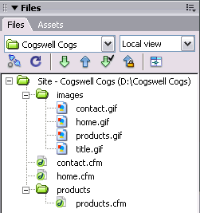
Relative Path
I’m now viewing home.cfm
To insert title.gif
<img src="images/title.gif">
If I go to products.cfm
To insert title.gif
<img src="../images/title.gif">

Slide 56
Root Relative Path
It is an absolute path that starts from the website root/main directory.

