Slide 1
URL/HTTP
How to connect your application to the web
By: Gary king

Slide 2
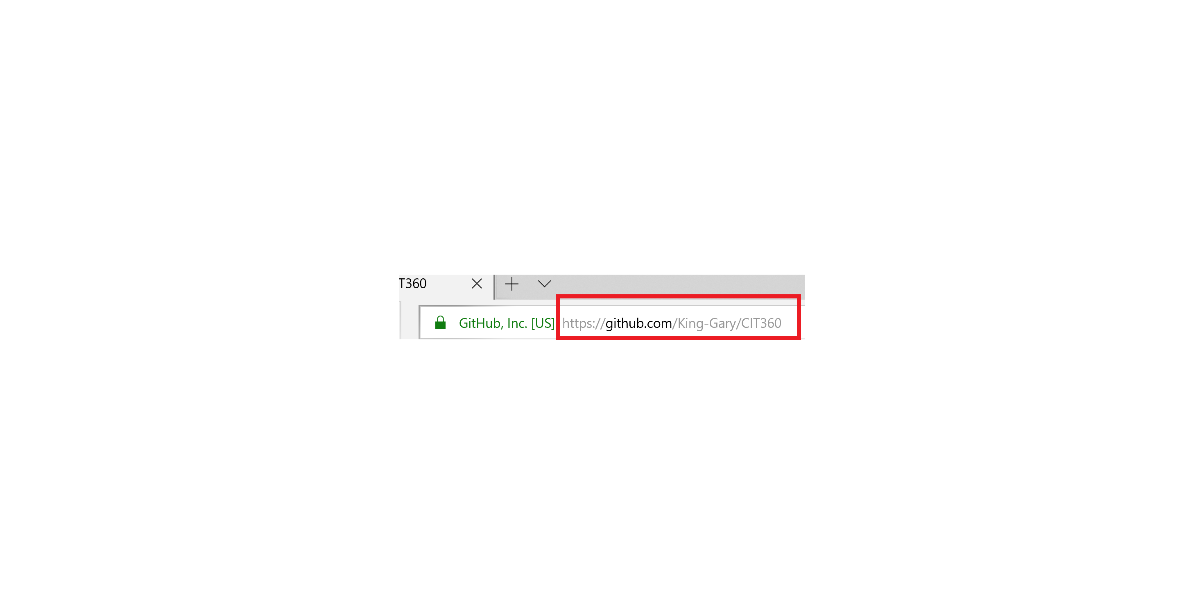
URL
URL stands for Universal Resource Locator: A Protocol for specifying addresses on the internet.
https://www.dictionary.com/browse/url
It is essentially the address for any website we want to visit, or any webserver we want to retrieve information from.
Example

Slide 3
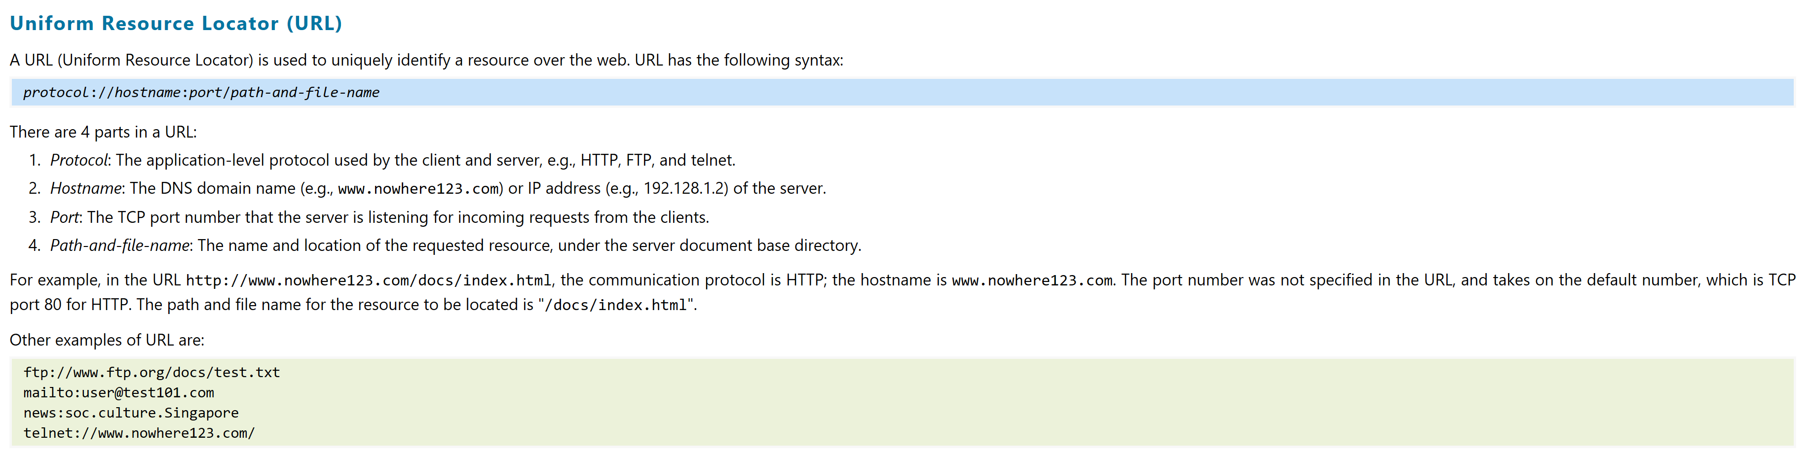
Example

Slide 4
HTTP
Stands for Hyper Text Transfer Protocol: the standard protocol for transferring hypertext documents on the World Wide Web.
https://www.dictionary.com/browse/http?s=t
HTTP is not as visible, it is not the address of the site.
HTTP is not a coding language that we use to write websites
HTTP is the protocol or set of rules that tells computers, webservers, etc. how to send, receive, and process code

Slide 5
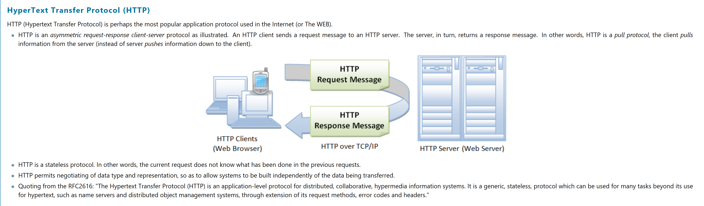
Overview of HTTP

Slide 6
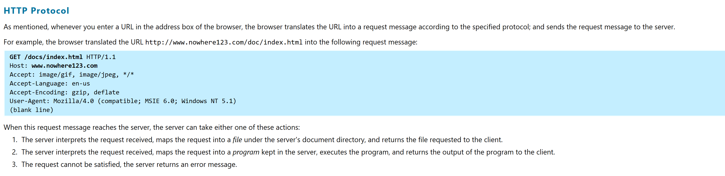
HTTP Request

Slide 7
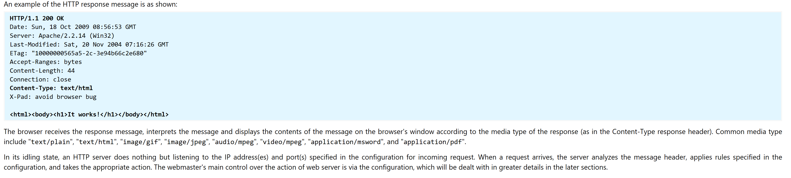
HTTP Response

Slide 8
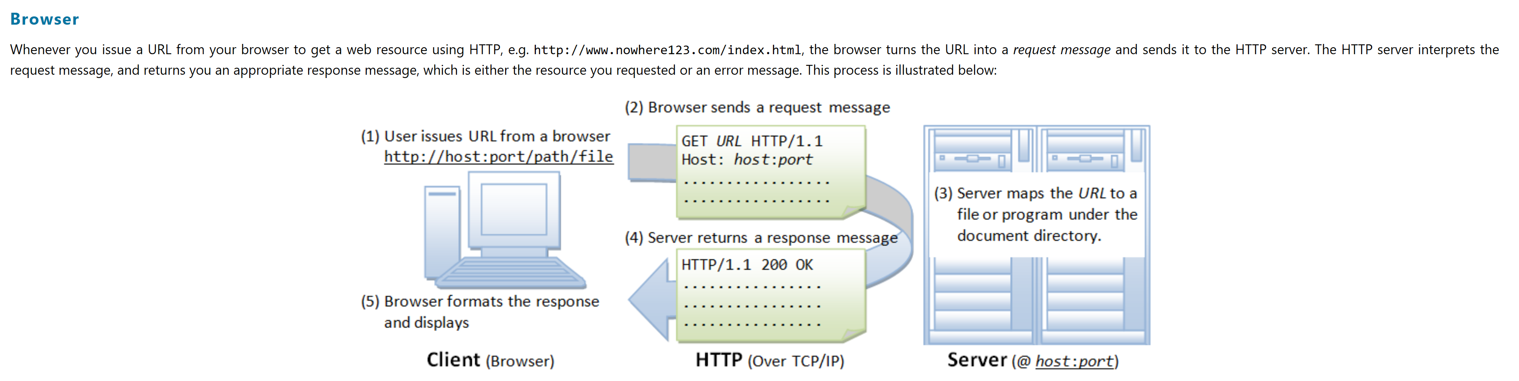
Browser

Slide 9
How it Works with Java
You will need to import the java.net library
You will also need to import the java.io import if you want to retrieve any info from the site
It allows you to open a connection to a site, or database
If you would like to connect to a sql db then you will need to import java.sql library

Slide 10
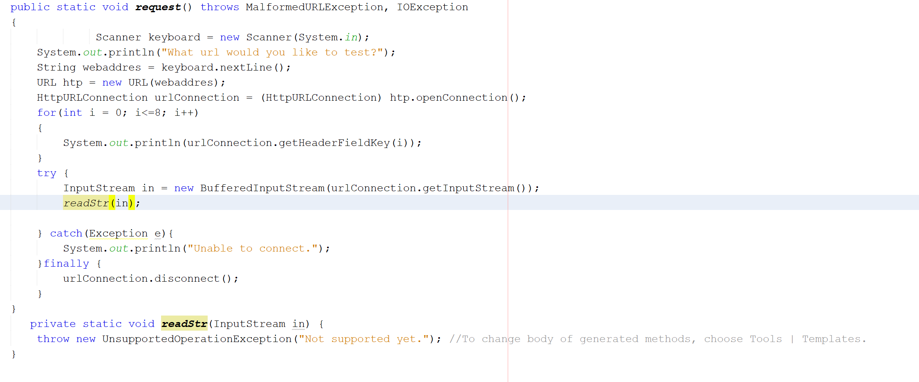
Example of Code

Slide 11
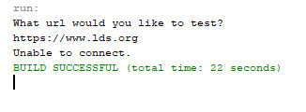
Output with no connection

Slide 12
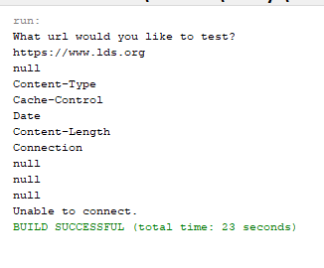
Output with connection

Slide 13
Works Cited
Websites
http://www.ntu.edu.sg/home/ehchua/programming/webprogramming/HTTP_Basics.html
https://docs.oracle.com/javase/tutorial/networking/urls/readingWriting.html
Videos
https://www.youtube.com/watch?v=vaXJFXp2TqQ
https://www.youtube.com/watch?v=XXc0kbt208w
https://www.youtube.com/watch?v=LjHQ44vBG0g

