Slide 1
Analysis of Commodity X Consumption
Author: George Opondi

Slide 2
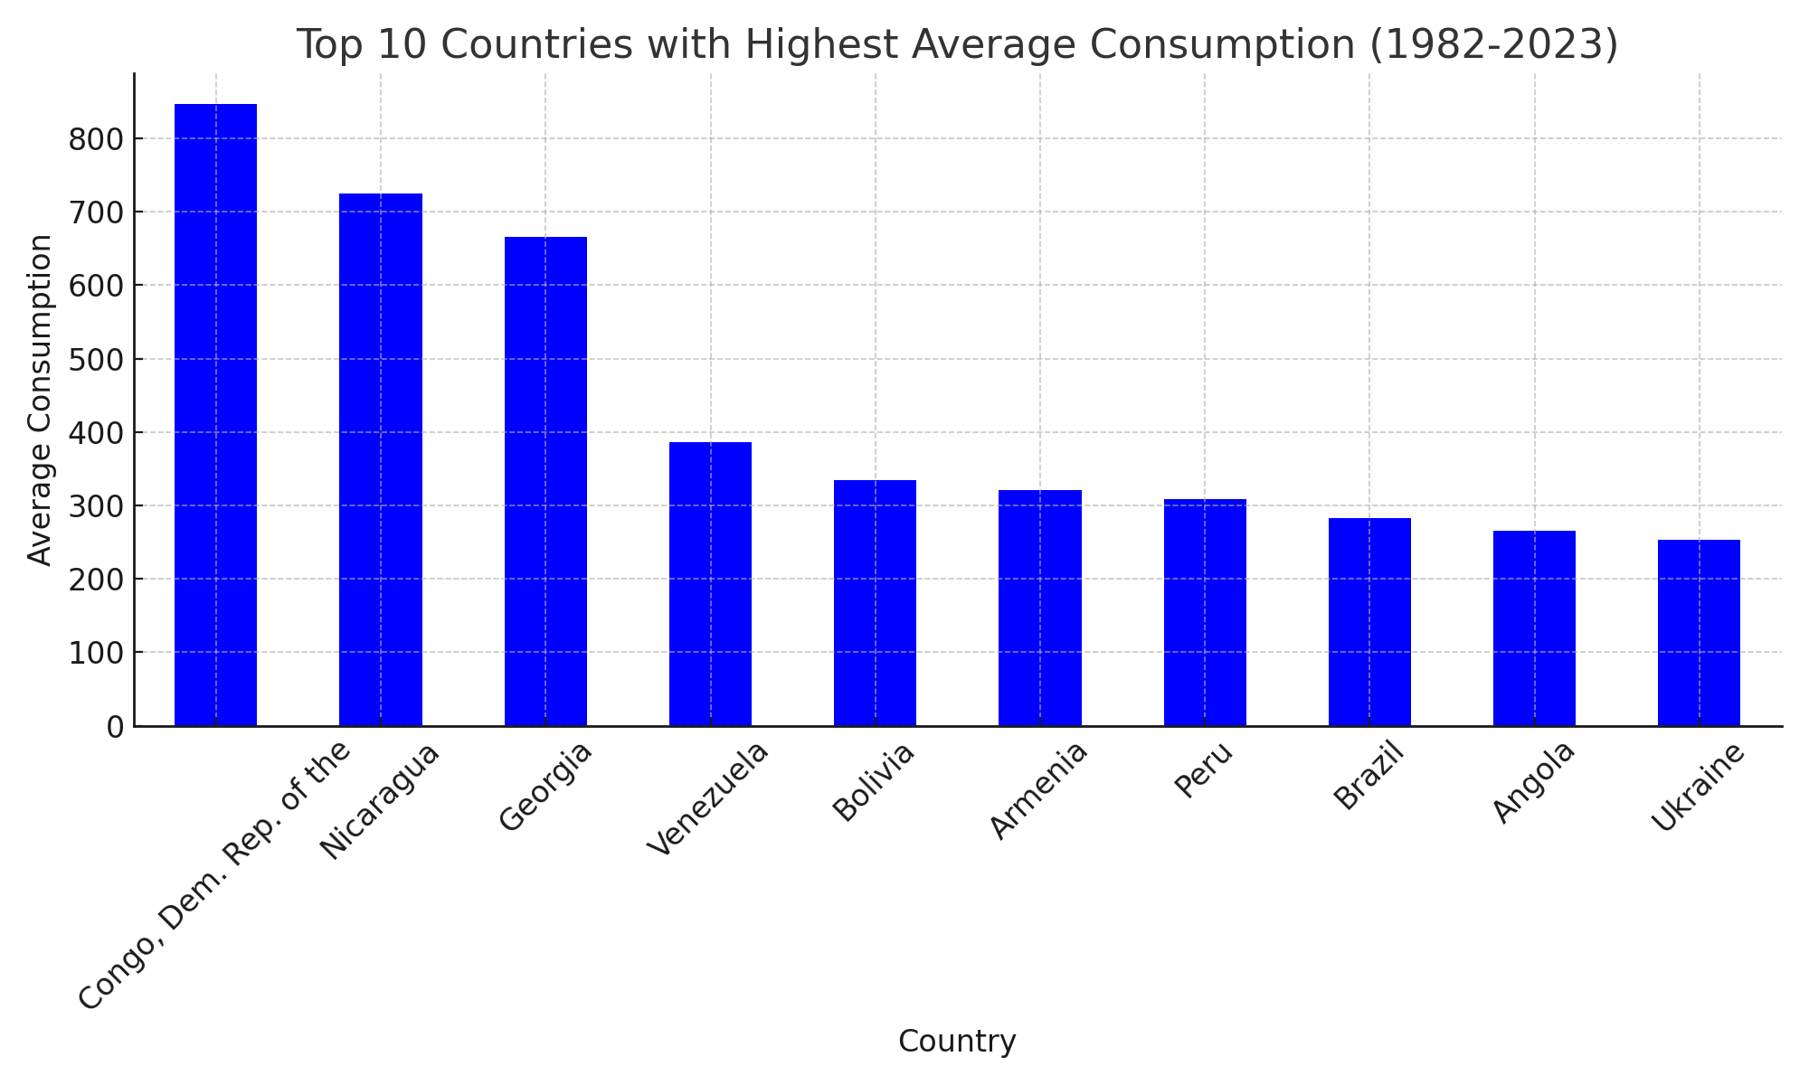
Average Consumption by Country

Slide 3
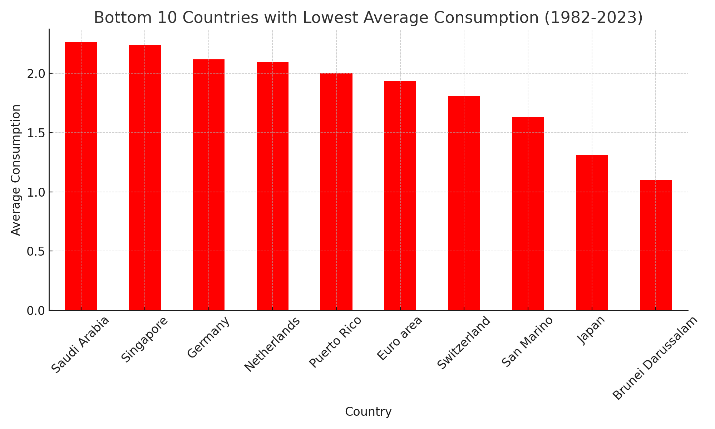
Average Consumption by Country

Slide 4
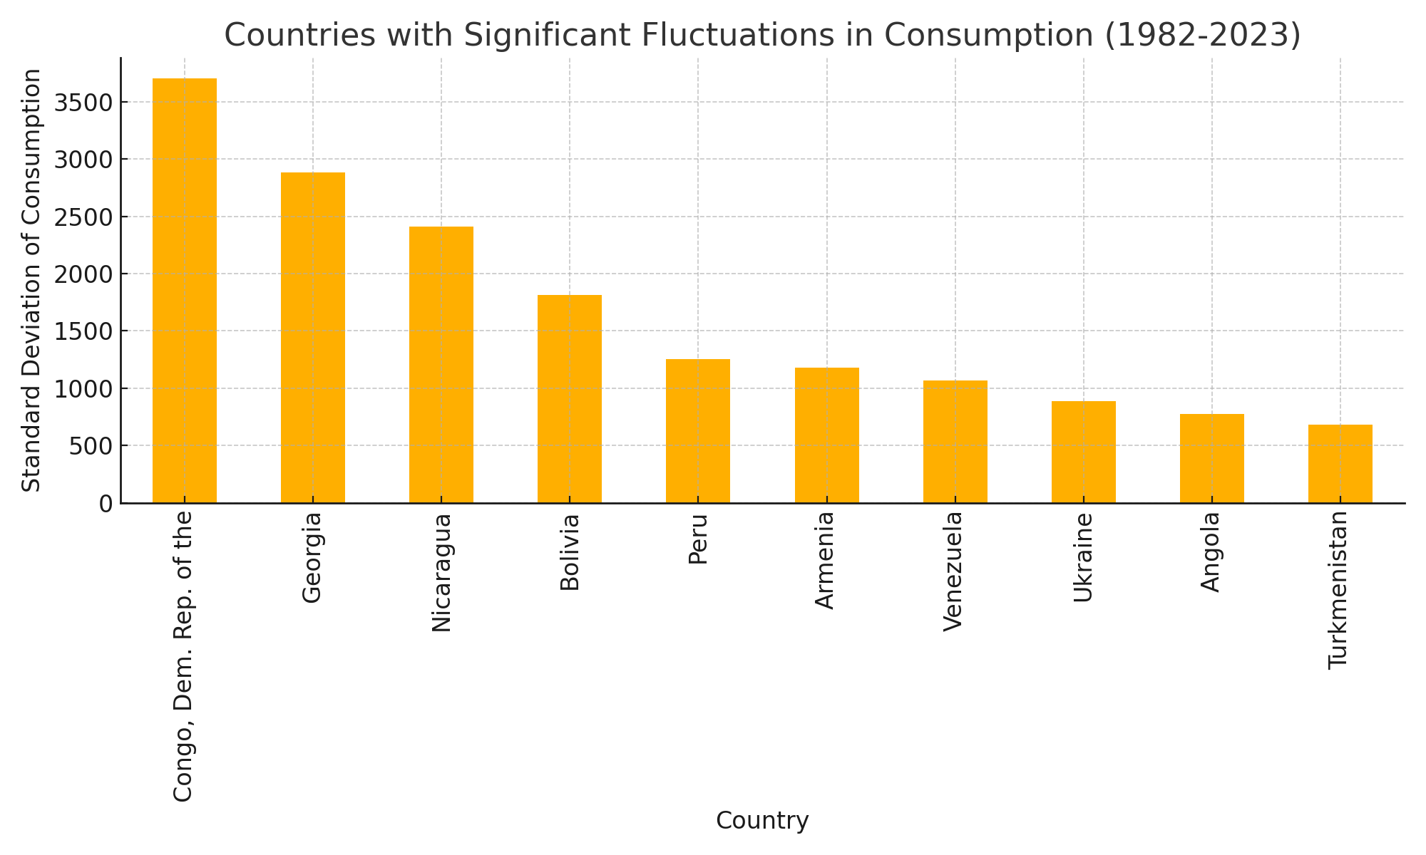
Countries with Significant Fluctuations in Consumption

Slide 5
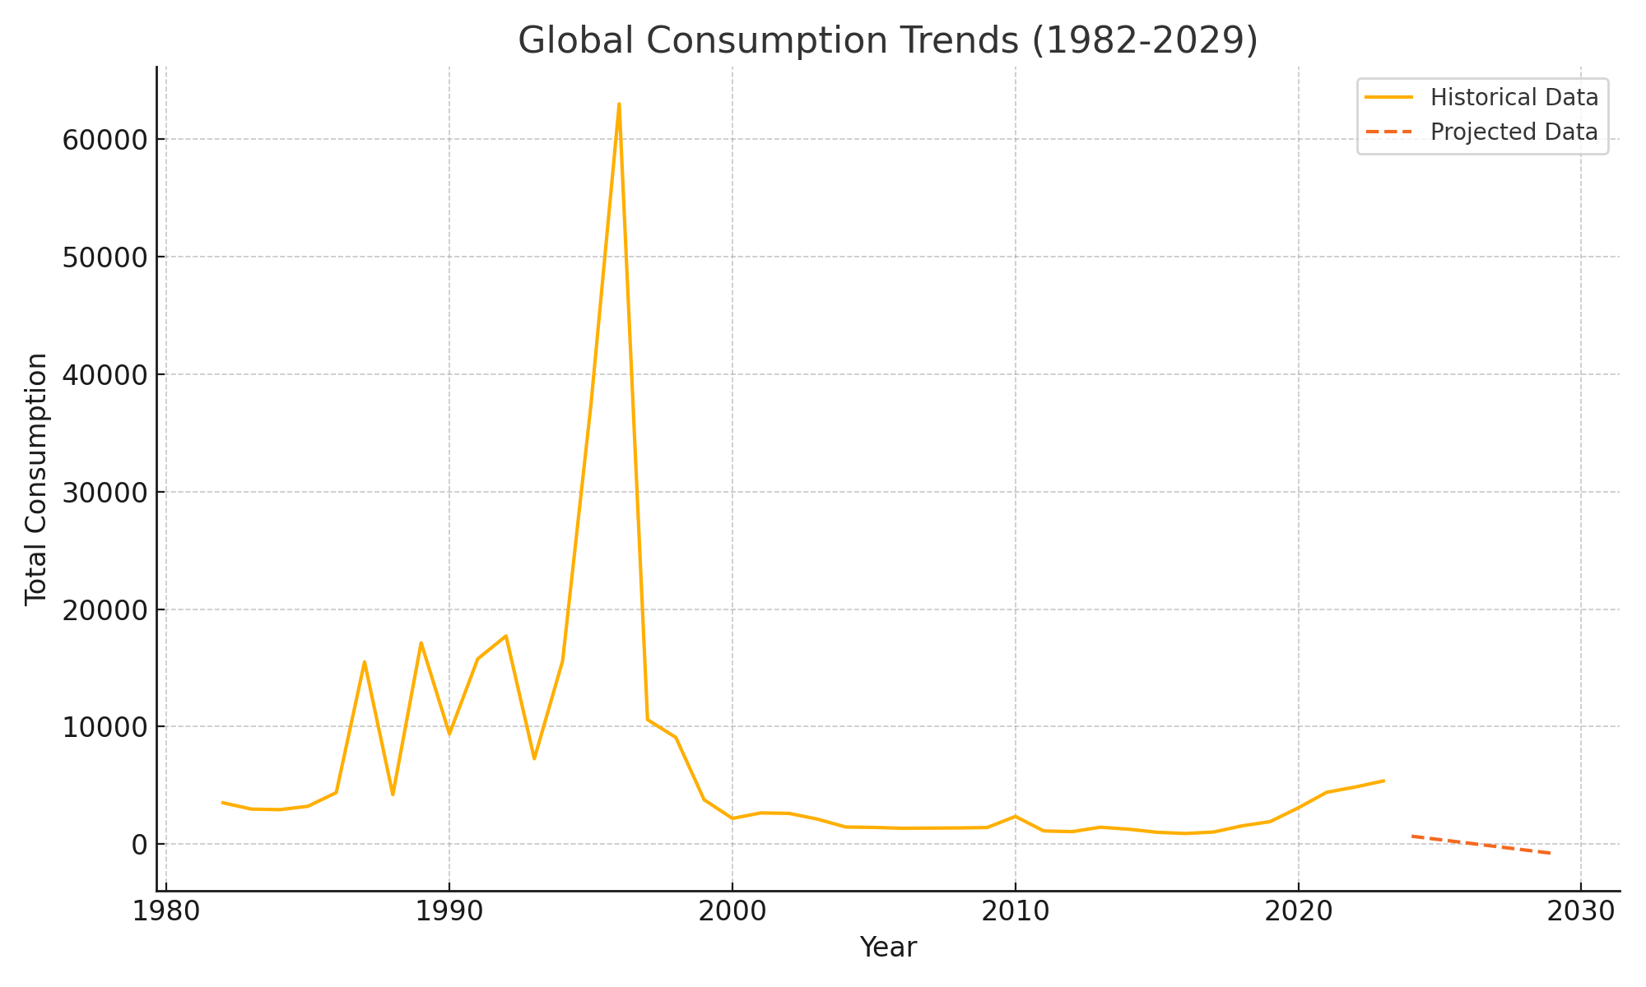
Global Consumption Trends (1982-2029)

