Slide 1
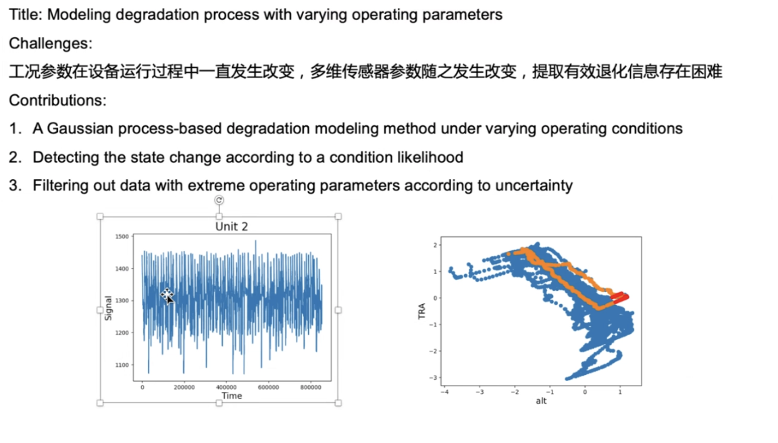
DS026 数据，3.6

Slide 2
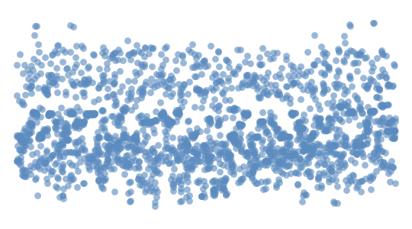
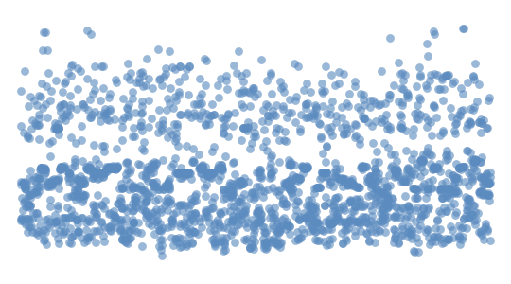
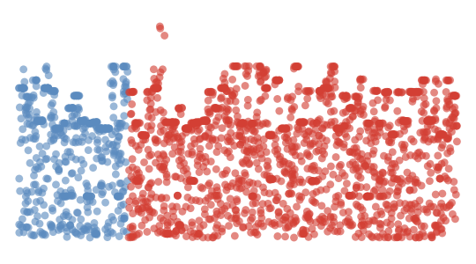
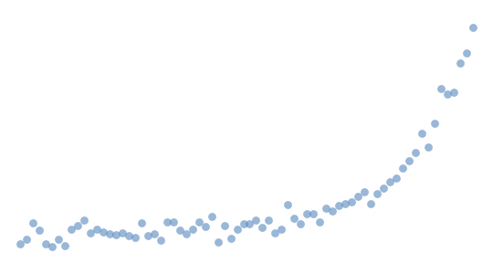
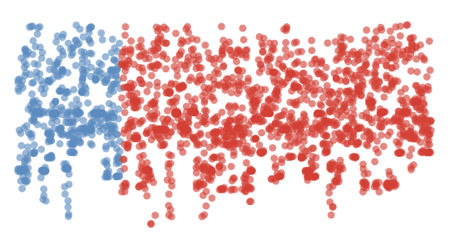
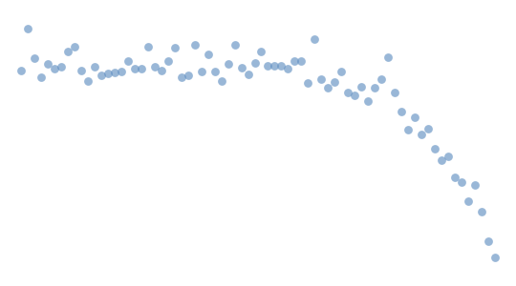
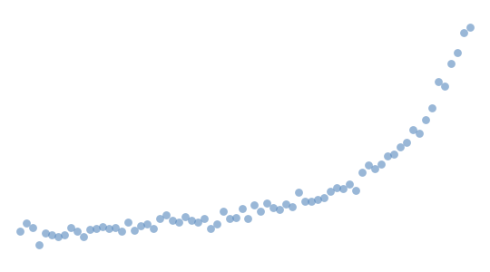
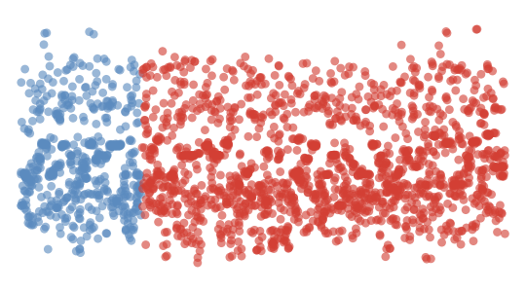
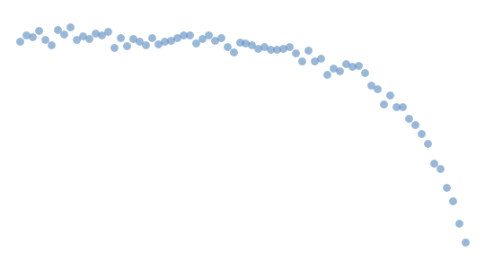
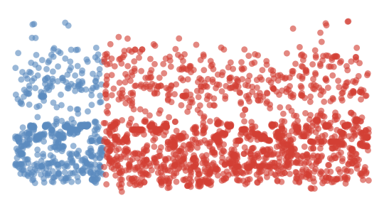
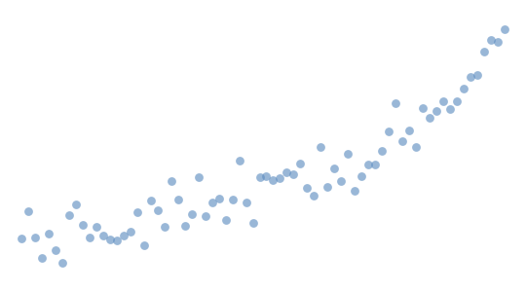
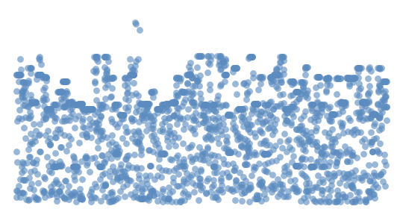
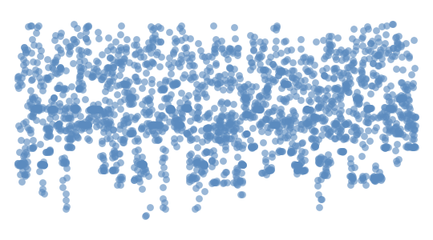






Raw historical data
Residuals of $X$
$$X_{1}^{∗∗}$$
$$X_{1}$$
Gaussian Process
(trained on normal)
Health Index
hₙ(c) ∈ [0,1]
…
Input data
$$X_{2}^{∗∗}$$
$$X_{14}$$
$$X_{13}^{∗∗}$$
Residuals =
True – Predicted
(on all ranges)
$$ω_{1}$$
…
$$X_{14}^{∗∗}$$
Output data
$$ω_{4}$$
$$X_{k}^{∗∗}=\frac{r_{k}}{n}$$

Slide 3
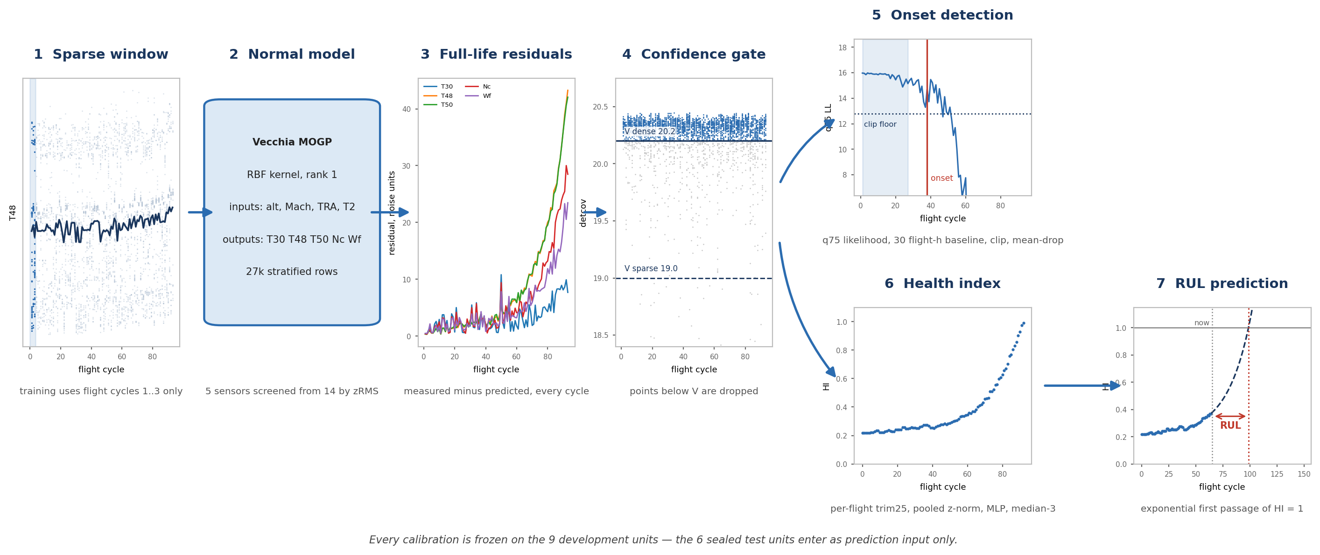

Slide 4
Failure moment predict score
acc = (TP + TN) / (TP + FP + FN + TN)
 | New one | Previous one
acc | 82.1% | 81.9%
Overall RUL | 8.76 | 9.48
20% | 10.19 | 12.01
40% | 6.79 | 6.90
60% | 9.63 | 9.96
80% | 8.01 | 8.30
要用 RMSE 10左右，score指标，case study

