Slide 1
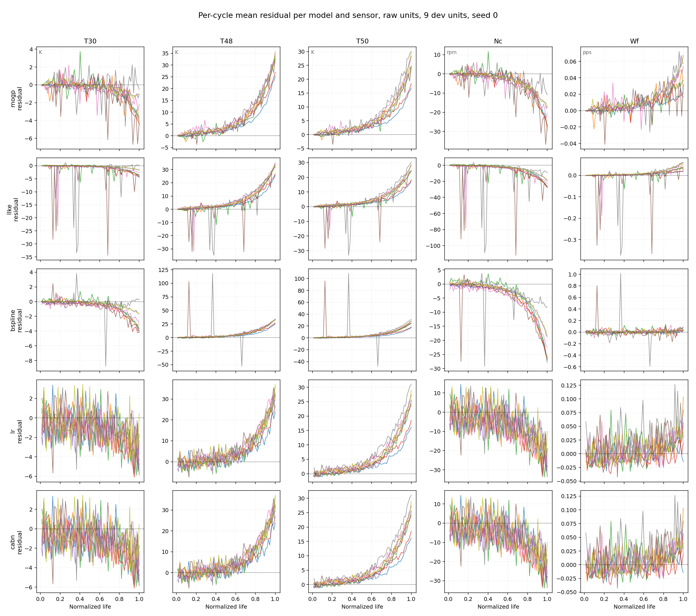

Slide 2
model |  |  |  |  |  | Train(s) | Inference(s)
mogp |  |  |  |  |  | 921.3 | 9.1
llke |  |  |  |  |  | 74.6 | 15.3
bspline |  |  |  |  |  | 0.5 | 0.2
lr |  |  |  |  |  | 0.006 | 0.004
cabn |  |  |  |  |  | 0.1 | 0.004

