Slide 1
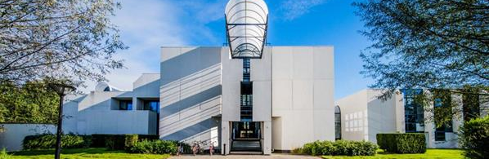

Droplet size and concentration measurement of an ultrasonic generated spray (using laser diffraction)
Student: Abad Sethi
Stagebegeleider IMO-IMOMEC: ing. Pieter Verding & prof. dr. ing. Wim Deferme
Stagebegeleider PXL: dr. ing;. Frederik Vreys

Slide 2

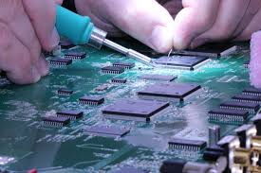
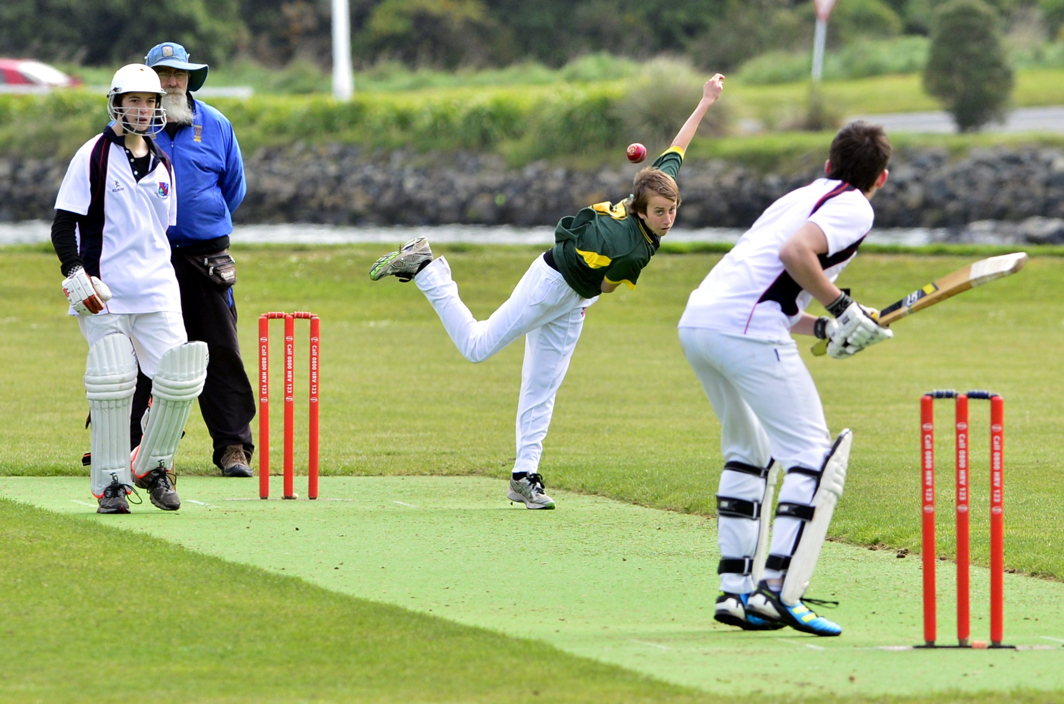

Who am I?
Abad Ur-Rehman Sethi
Last year student at PXL
Professional bachelor in the electronics and ICT

Slide 3
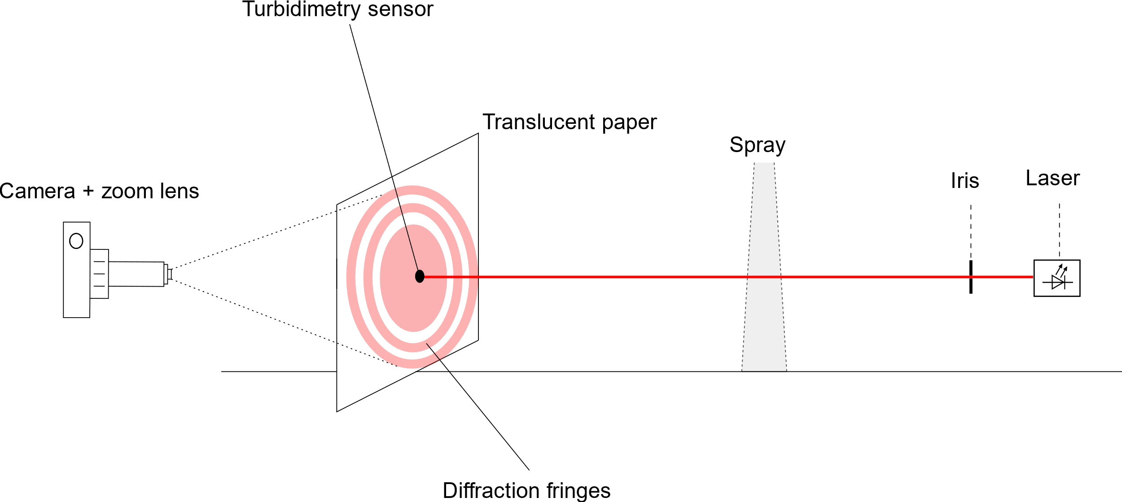
Method

Slide 4
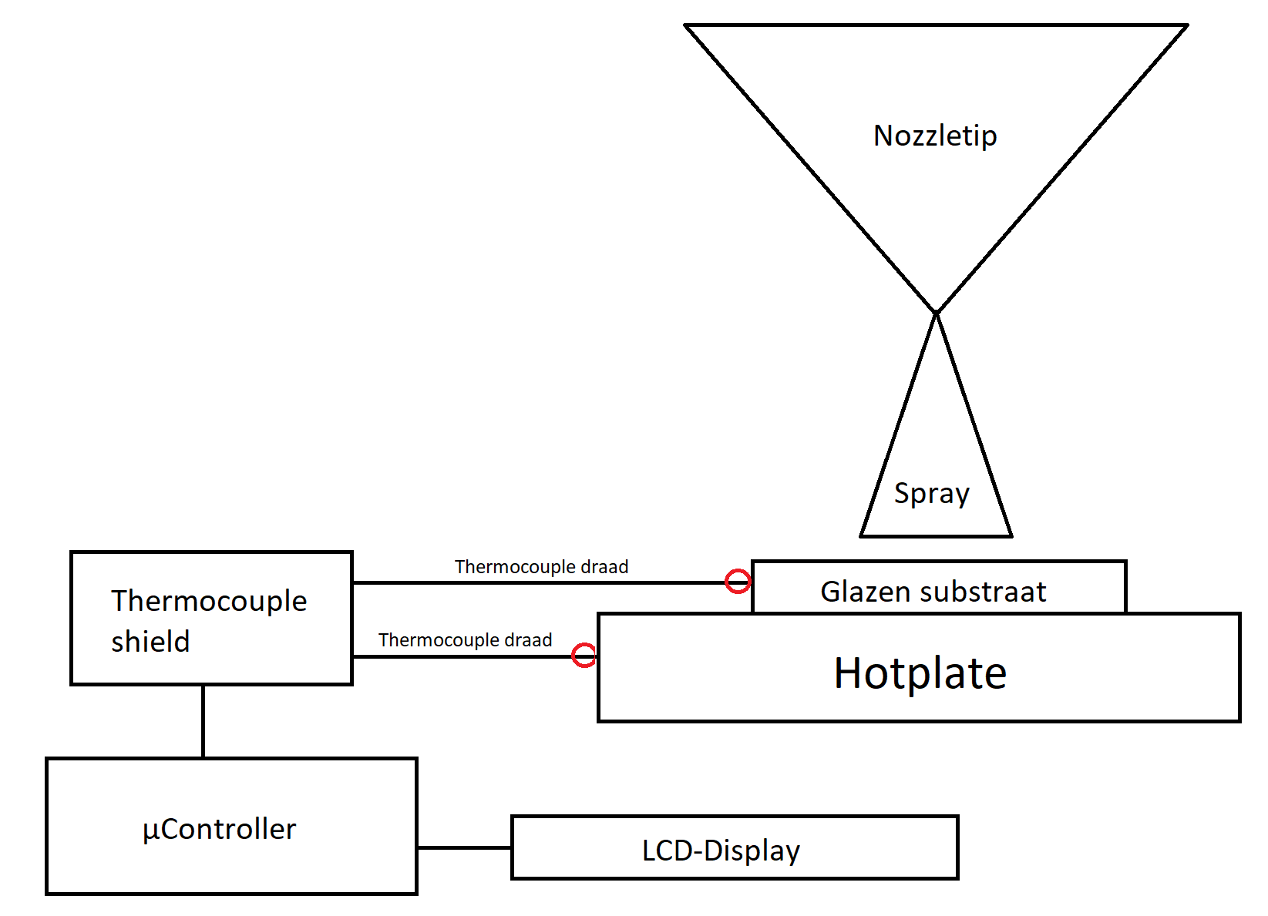
Method

Slide 5
Research question
Can the droplet size and concentration in the ultrasonic generated spray be determined with limited resources?

