Slide 1
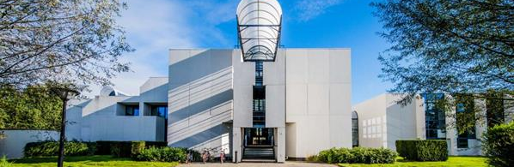

Droplet size and concentration measurement of an ultrasonic generated spray (using laser diffraction)
Student: Abad Sethi
Stagebegeleider IMO-IMOMEC: ing. Pieter Verding & prof. dr. ing. Wim Deferme
Stagebegeleider PXL: dr. ing;. Frederik Vreys

Slide 2

Intro
Issue
Introduction
Research question
My thesis projects
Materials and methods
Progress

Slide 3
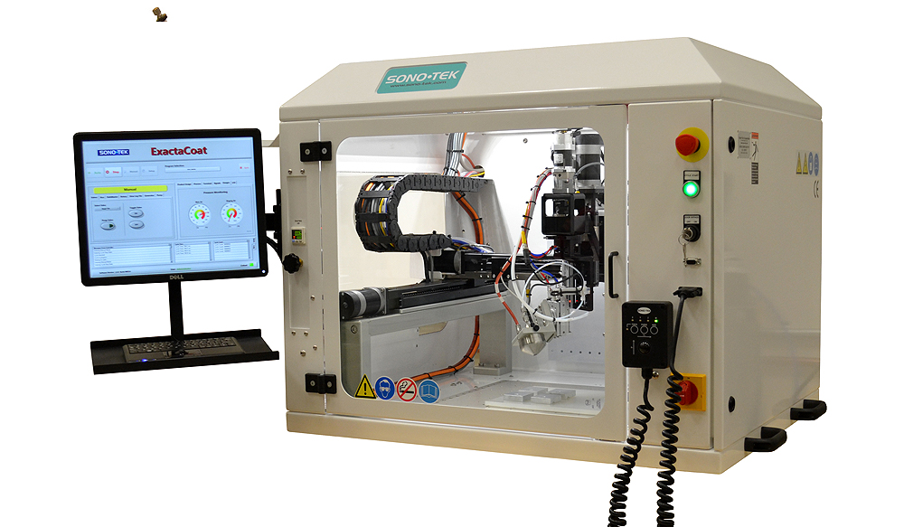
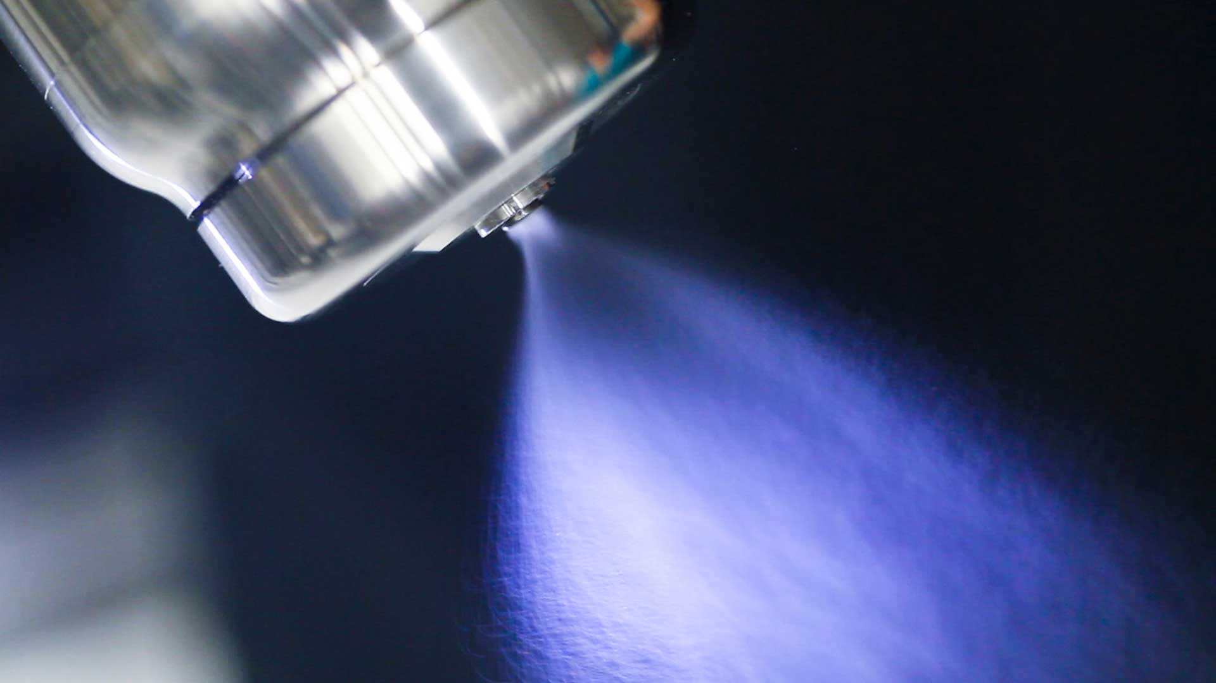
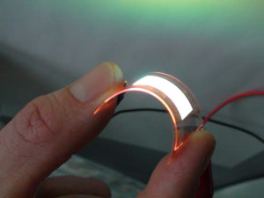
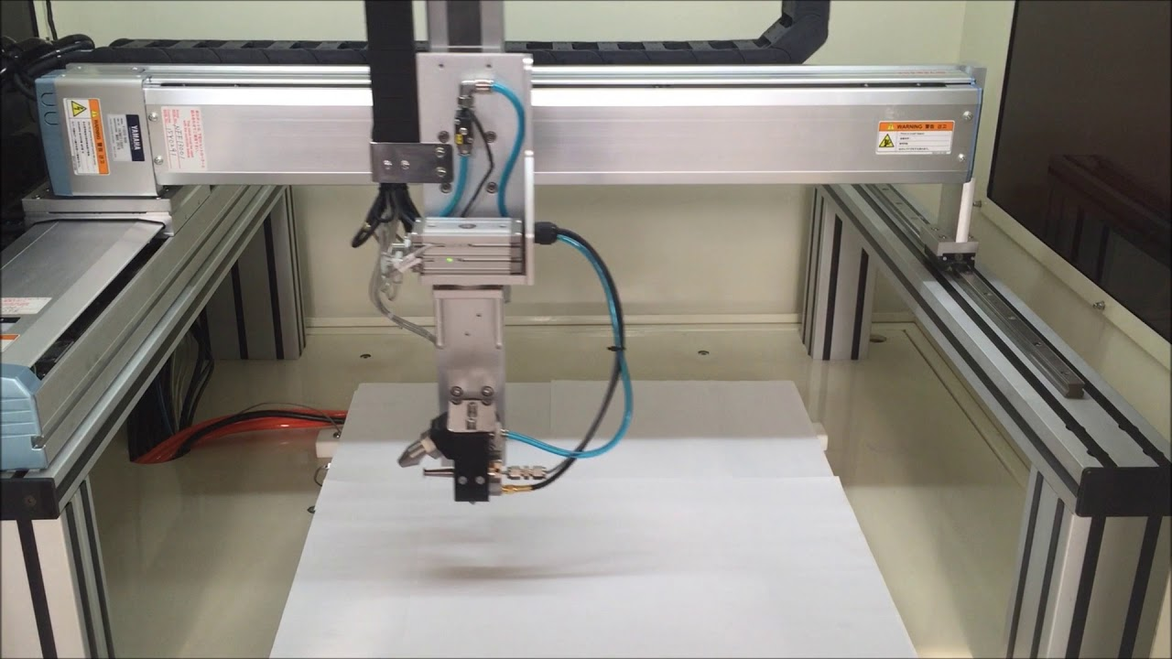
Introduction

Slide 4
Research question
Can the droplet size and concentration in the ultrasonic generated spray be determined with limited resources with laser diffraction?

Slide 5
My thesis projects
Laser diffraction for droplet size and concentration
Hotplate and substrate temperature measurement

Slide 6
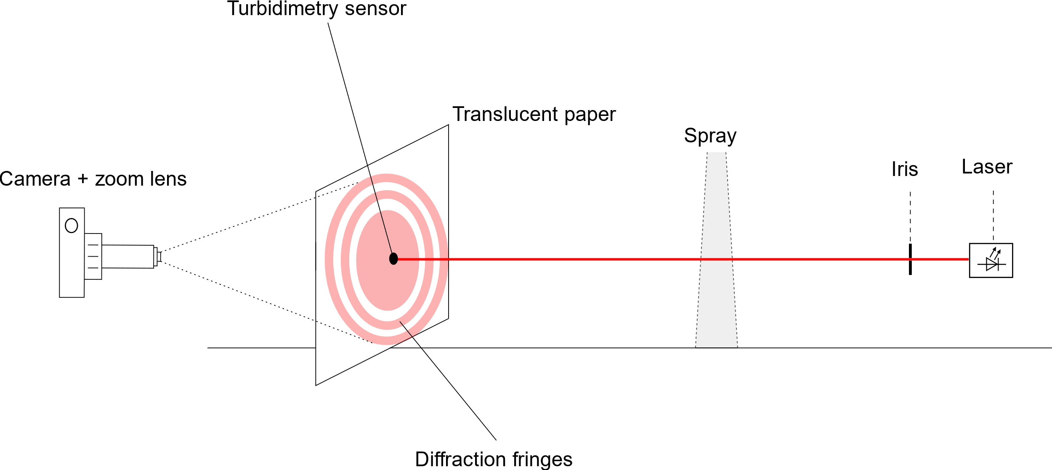
Materials and methods
Laser diffraction for droplet size and concentration
Ultrasonic spray coater
Laser
Camera
Transculent paper
Lens
Iris

Slide 7
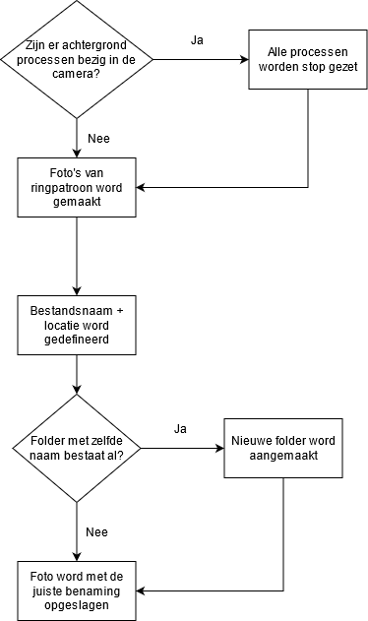
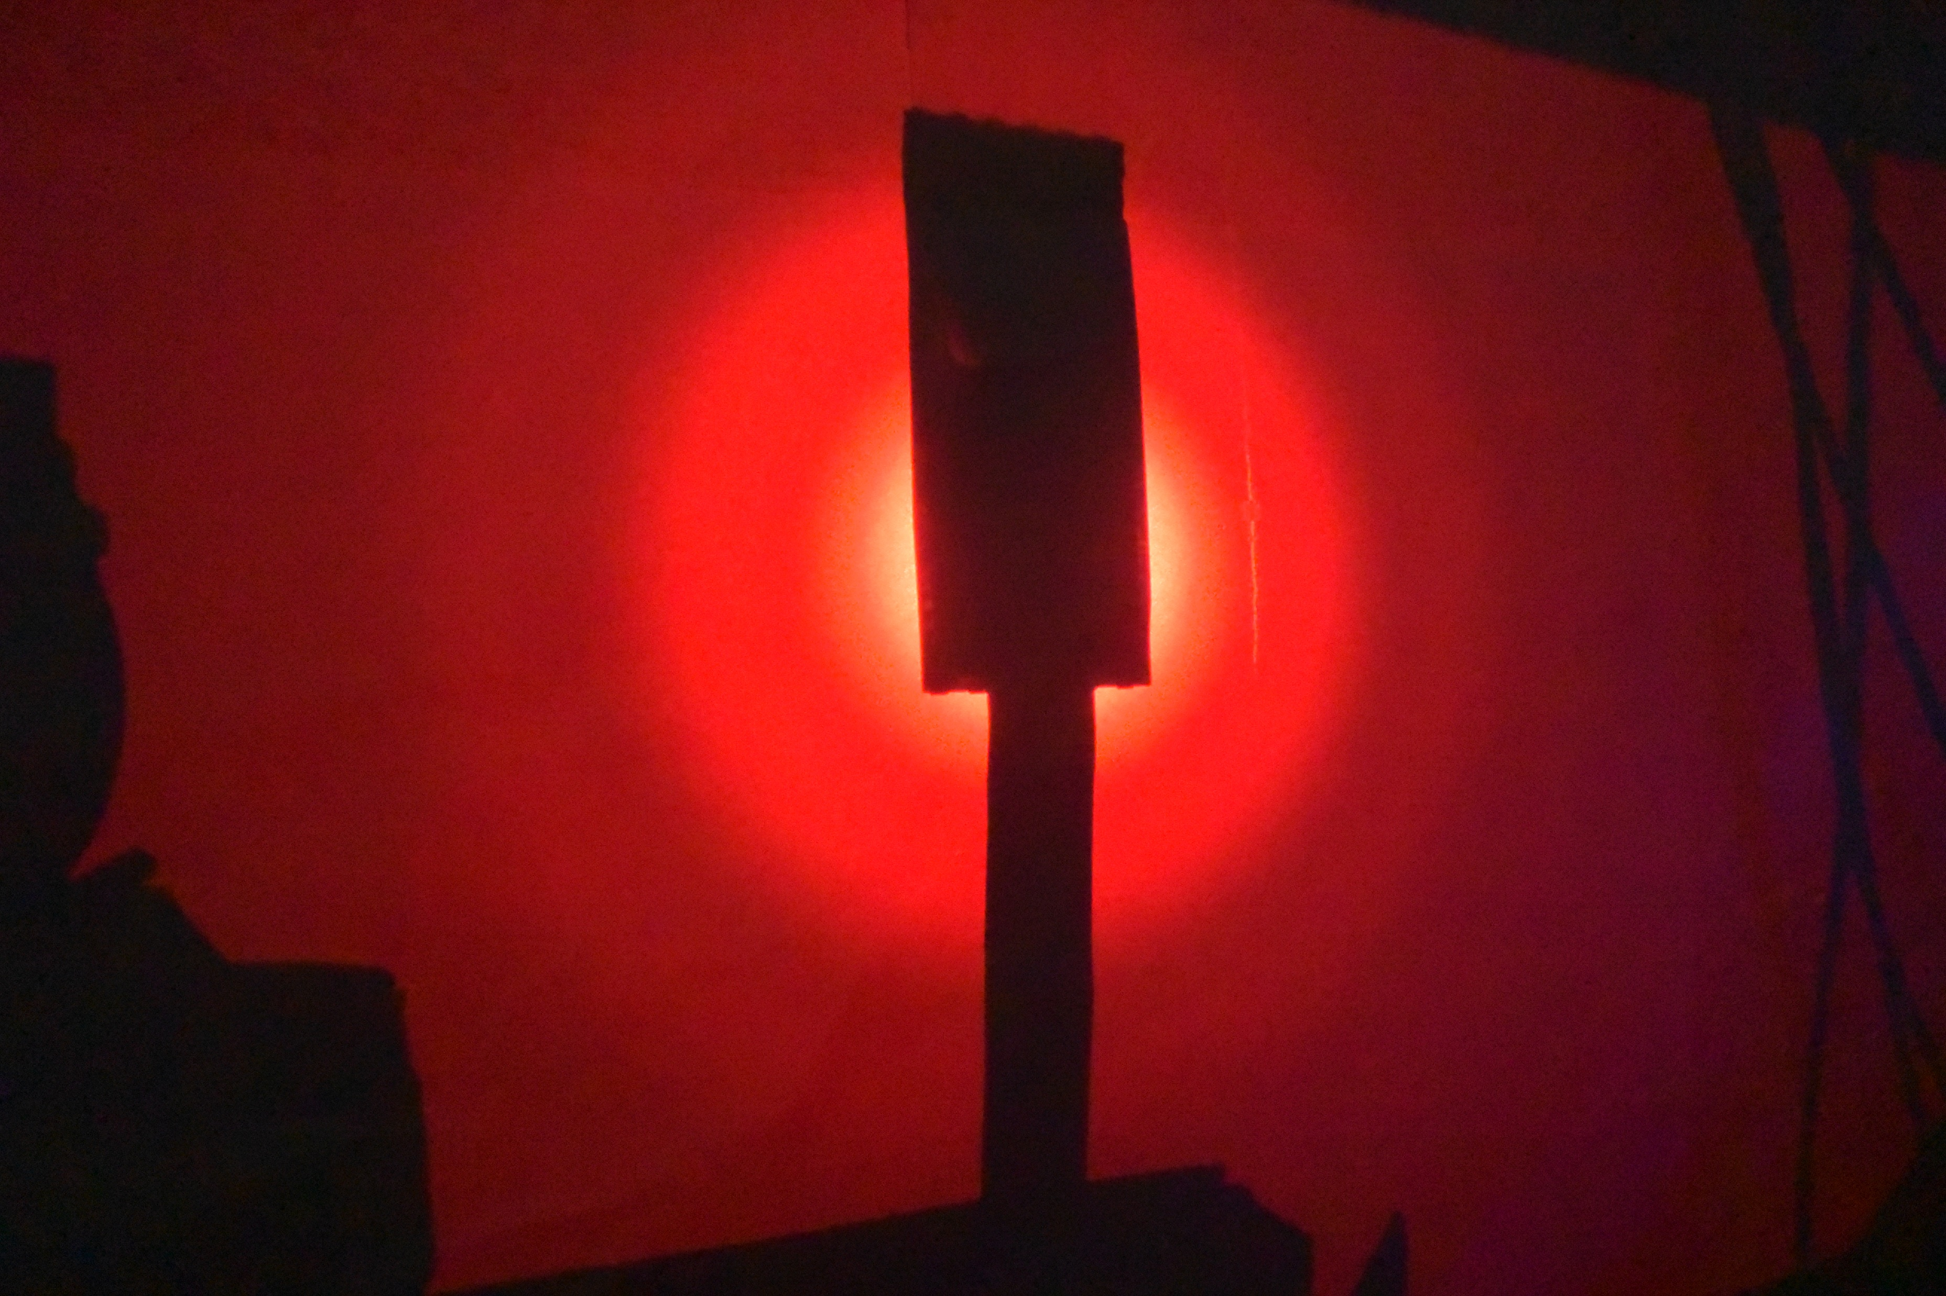
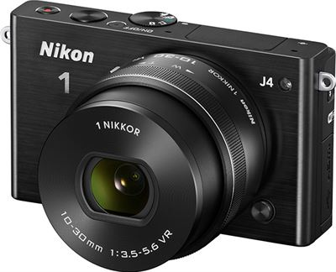
Progress: Automating the Nikon camera

Slide 8
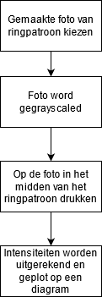
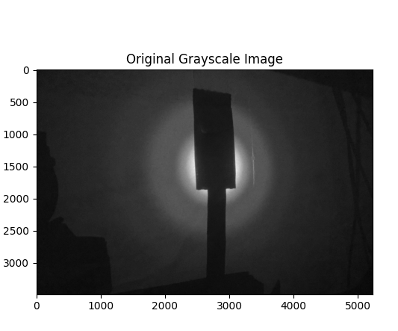
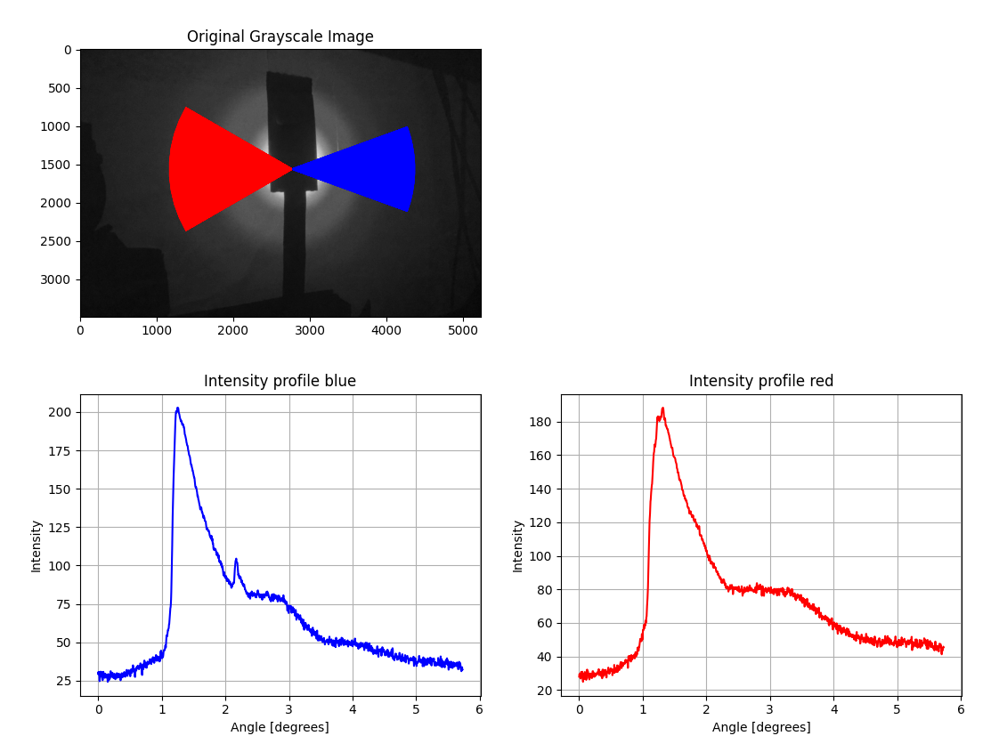
Progress: Plotting the intensity diagram

Slide 9
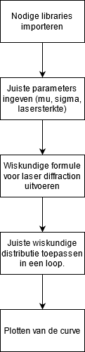
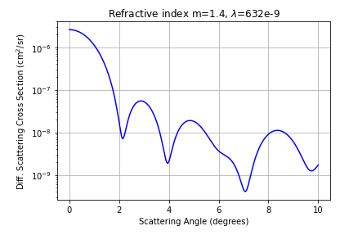
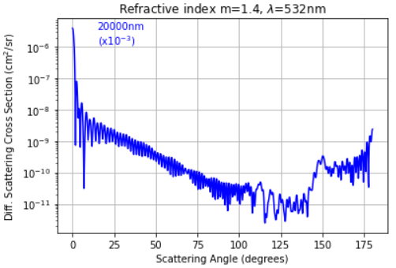
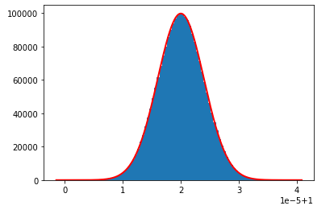
Progress: Theoretical way of plotting intensity diagram

Slide 10
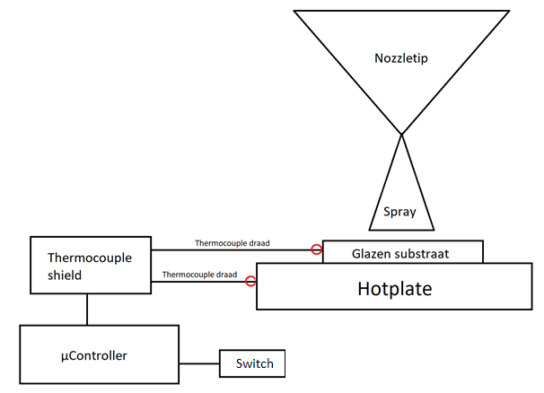
Materials and methods
Hotplate and substrate temperature measurement
µController
Thermocouple shield (KTA-259v4)
2x Thermocouple
Switch

Slide 11
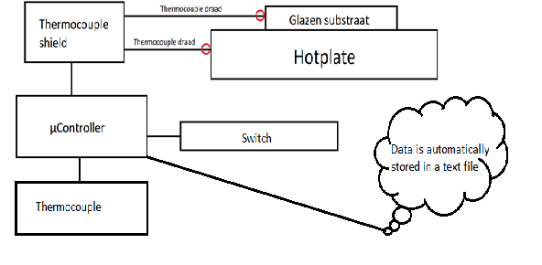
Progress: Thermocouple temp measurement

Slide 12
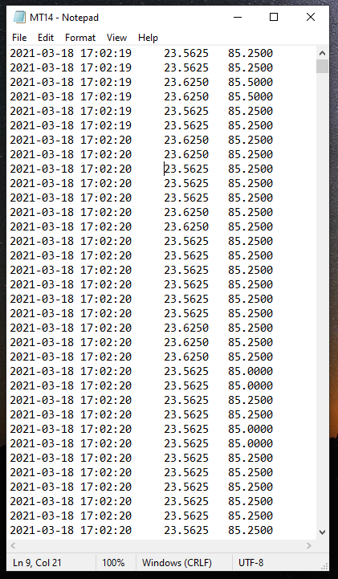
progress: Thermocouple temp measurement

Slide 13
Left to do
Finalise my scripts
Put the setup together
Finish my application note

Slide 14
Any questions?

