Slide 1
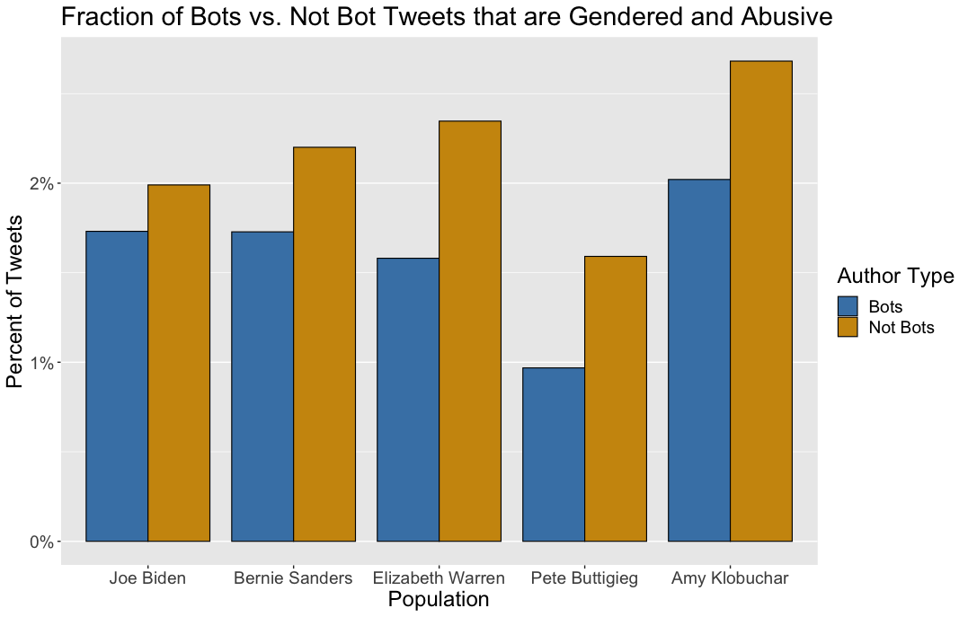
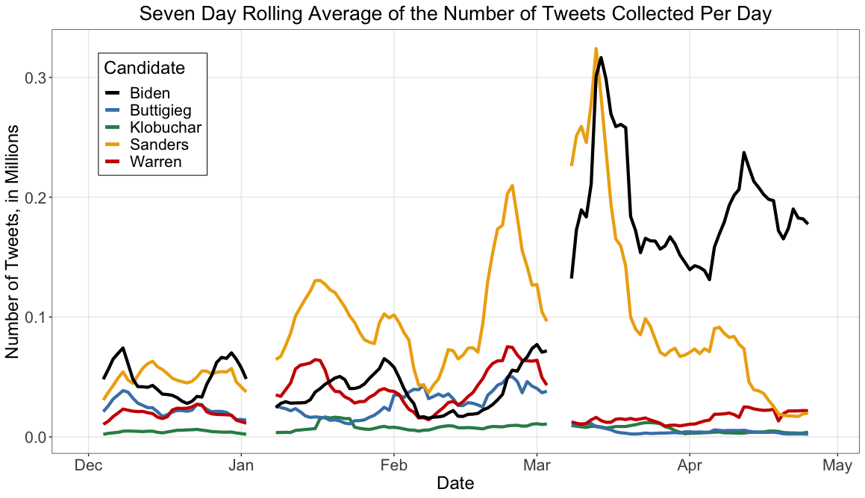
Catherine King
cking2@.cmu.edu
Dr. Kathleen M. Carley
kathleen.carley@cs.cmu.edu
Gender dynamics on Twitter during the 2020
U.S. Democratic Presidential Primary
More women ran for U.S. President in 2020 than ever before
2019 was the first year more than one woman candidate was on the presidential debate stage [1]
Senators Warren, Klobuchar, Harris, and Gillibrand, Representative Gabbard, and author Marianne Williamson
Also, first openly gay major party presidential candidate, Mayor Buttigieg
Representation is improving
Roughly 25% of Congress is made up of women [2]
Abusive language analysis
Abusive language metrics were extracted from each dataset using NetMapper [6]
Popular candidates (especially Biden) had the highest fraction of abuse
Next, tweets were searched for female gendered-based slurs: “b*tch, c*nt, s*ut, wh*re, sk*nk, cow” (selected based on literature)
The women had a higher fraction of their abusive tweets as gendered
Candidate | Total # tweets that are abusive and gendered | % of abusive tweets that are abusive and gendered
Joe Biden | 11,094 | 1.92%
Bernie Sanders | 8,804 | 2.09%
Elizabeth Warren | 3,198 | 2.15%
Pete Buttigieg | 1,414 | 1.44%
Amy Klobuchar | 488 | 2.44%
Gender penalty when women run for office
When candidates are of equal qualifications, there is an observed gender penalty of 3% at the ballot box [3]
Possible reasons include:
Gender roles and implicit bias [4]
Receiving less mainstream news coverage [5]
On Twitter, women presidential candidates were more likely to be attached by far-right users and fake accounts on Twitter [5]
Also, in every candidate’s data set, the frequency of the top female slur (“b*tch”) was always more than the top two male slurs combined (“d*ck”, “b*stard”)
Bot analysis
For each dataset, we ran Tier-1 Bothunter algorithm to see if bots were the driver in these differences [7]
A higher fraction of regular users were behind abusive/gendered tweets than bots
Research Questions
How did the volume of the Twitter conversations surrounding the major candidates change over time?
Was there differential treatment of the Democratic primary candidates in terms of abusive and gendered abusive language?
If there are differences observed, are they due to bots or regular users?
Data
Twitter data collected on election related hashtags and all official candidate accounts between Dec 1st, 2019 – April 28th, 2020
Split into 5 data sets, one for each of: Joe Biden, Bernie Sanders, Elizabeth Warren, Pete Buttigieg, Amy Klobuchar
Elections began on Feb 3rd , remained competitive until March 3rd when Biden became presumptive nominee, then all competitors dropped out by April 15th
Main findings
Popular candidates were targeted the most
Women were targeted with gender slurs, and slurs that typically describe women were used much more frequently than male slurs in general
Normal accounts were more likely to use abusive words or gender slurs than bot accounts
NOTE: This paper is published in Social Network Analysis and Mining
References
[1]Zhou, “It’s the first time more than one woman will be on the presidential debate stage,” Vox, Jun. 2019.
[2] Women in the U.S. Congress. Center for American Women and Politics. Rutgers. 2020
[3] Fulton, “When Gender Matters: Macro-dynamics and Micro-Mechanisms.” Political Behavior, July 2013
[4] Conroy et al., “Gender, Sex, and the Role of Stereotypes in Evaluations of Hillary Clinton and the 2016 Presidential Candidates” Journal of Women, Politics, and Policy. Mar 2020
[5] Oates et al., “Running while Female,” SSRN. Sept 2019.
[6] https://netanomics.com/netmapper/
[7] Beskow and Carleyt. “BotHunter: A Tiered Approach,” SBP-BRiMS. July 2018
Note: Data gaps are due to stream going down on certain days
This work was supported in part by the Office of Naval Research (ONR) Award N00014182106, the Knight Foundation, the Center for Informed Democracy and Social-cybersecurity, and the Center for Computational Analysis of Social and Organization Systems (CASOS). The views and conclusions contained in this document are those of the authors and should not be interpreted as representing official policies, either expressed or implied, of ONR or the U.S. government.
Notes:
The more popular candidates had more
abusive tweets and a higher percentage of the tweets classified as abusive
Biden: 4.11% of tweets about him were abusive, Warren 3.72%, Buttigieg 3.62%, Sanders 3.32%, then Klobuchar at 1.98%%

