Slide 1
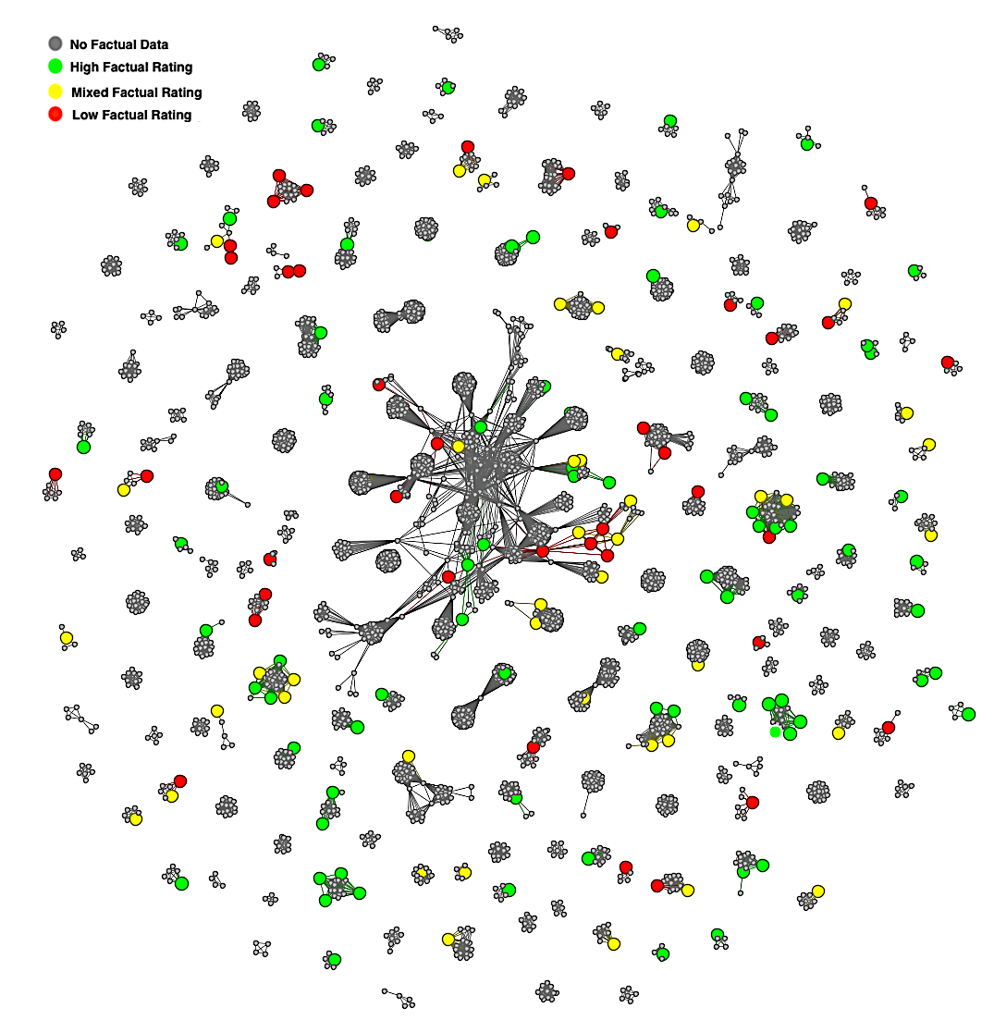
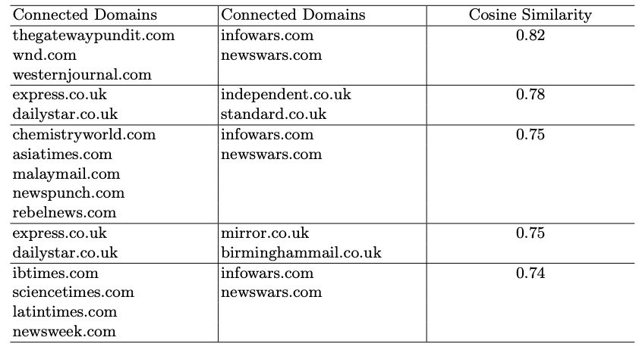
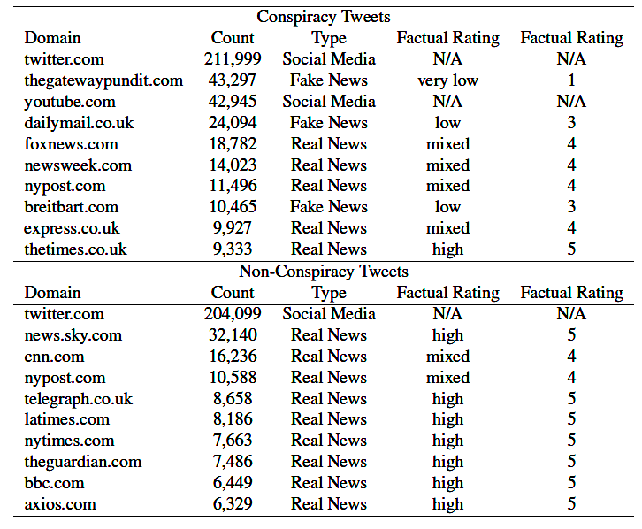
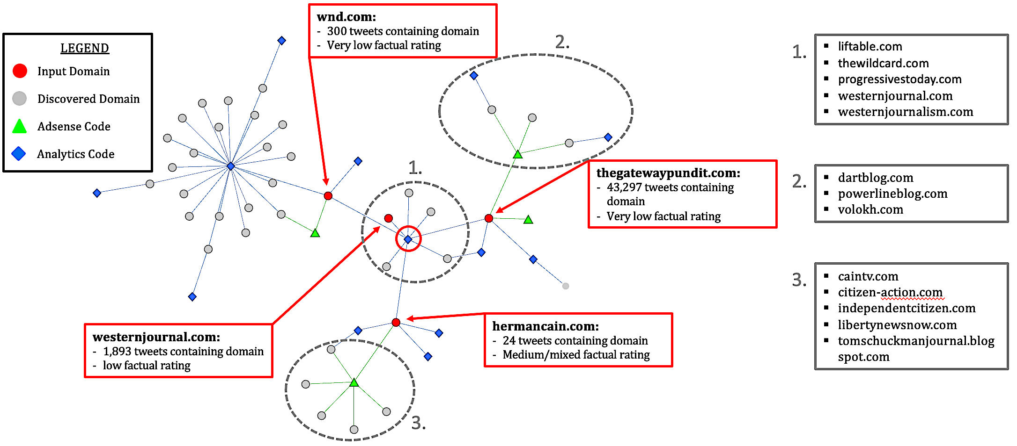
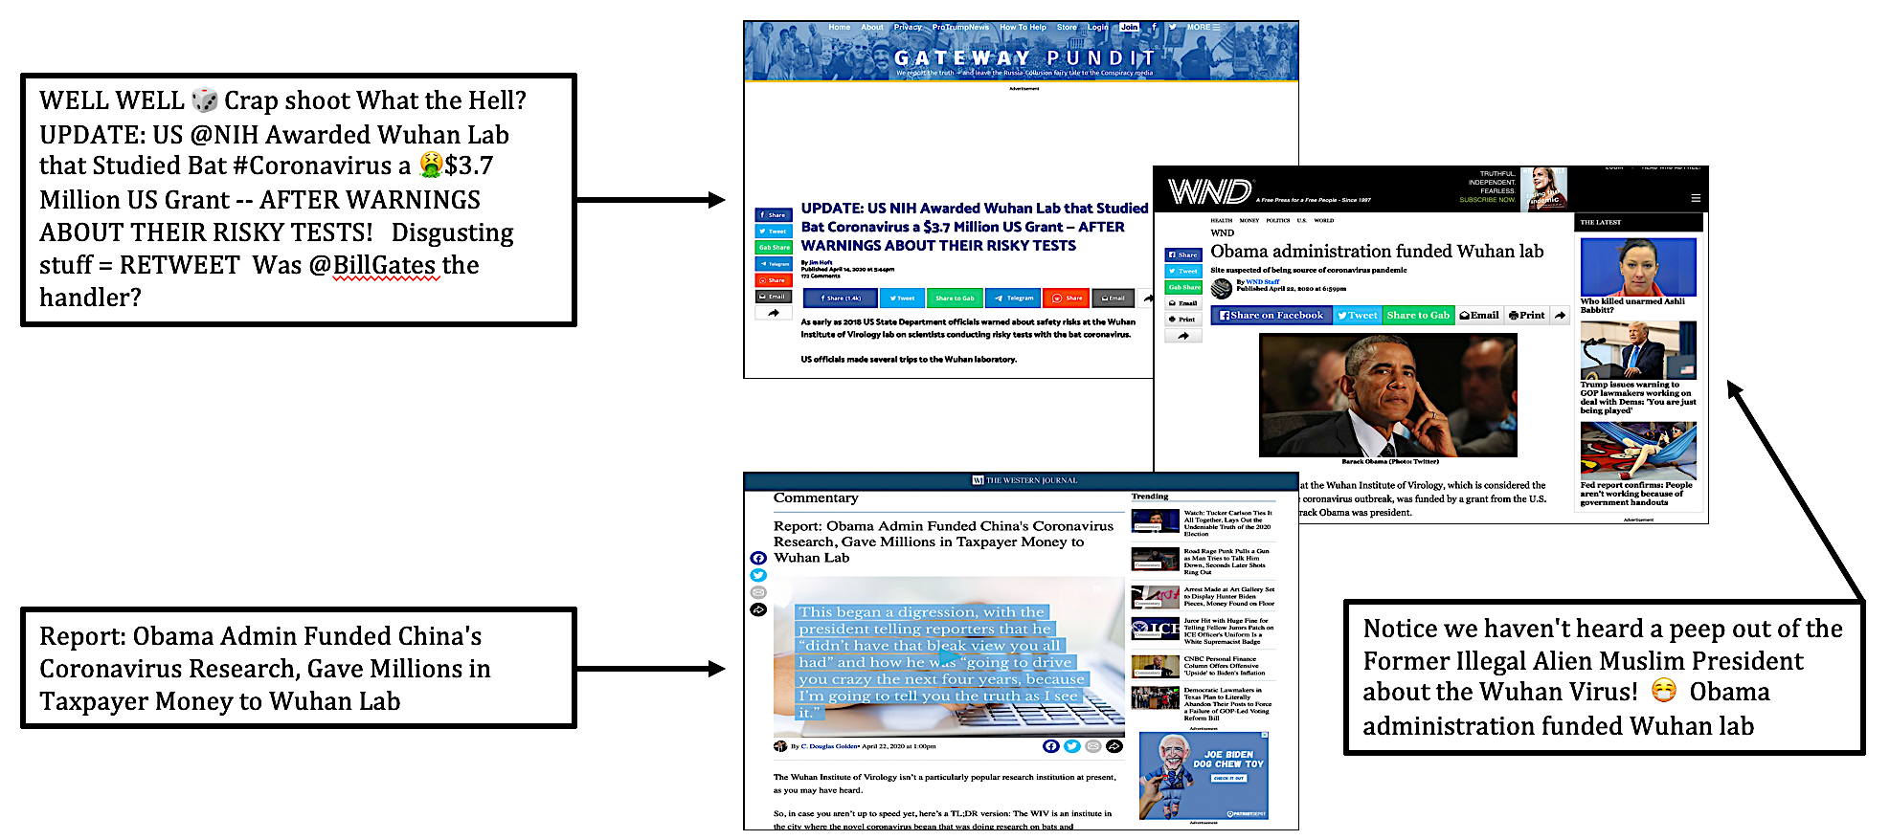
J.D. Moffitt
jdmoffit@cs.cmu.edu
Catherine King
cking2@cs.cmu.edu
Kathleen M. Carley
kathleen.carley@cs.cmu.edu
Connecting the Domains: An Investigation of Internet Domains found in COVID-19 Conspiracy Tweets
Introduction
Results
The Internet and social media platforms help facilitate the spread of conspiracy theories faster than ever before; As strong disinformation, effective tool for influence operations [1]
Conspiracy Tweets leveraged outside evidence (URL links) to support conspiracy views on Twitter, and are more likely to link to media sites with low fact-checking and editorial review processes [1]
This table provides the top cosine similarity scores comparing clusters of connected domains
Domain by Domain shared tracking code network formed from the snowball sample of domains discovered in tweets labeled as conspiracy. Nodes are colored by factual rating
Discussion
We found levels of coordination between web domains found in conspiracy related tweets connected via Google Analytics and AdSense code
Domains of similar factual rating tend to cluster together
Connected domains linked to conspiracy theories have high, direct user engagement
Methods
We use a conspiracy classifier with an F1 score of 0.948 to label Twitter datasets (~1.5million)
We extract URLs from tweets, then leverage the URLs to extract Google Analytics and AdSense codes, and finally use web crawling services to find sites that share tracking codes
Network science and machine learning lead to novel insights on the network dynamics of conspiracy
ORA is used to quantify network properties and identify communities
Thegatewaypundit.com was one of the top domains found in conspiracy tweets and is connected to other domains low in editorial oversight.
References
[1] Moffitt, J. D., King, C & Carley, K. M. (2021). Hunting Conspiracy Theories During the COVID-19 Pandemic. Social Media+ Society, under review.
[2] Carley, K. M. (2020). Social cybersecurity: an emerging science. Computational and Mathematical Organization Theory, 26(4), 365–381.
[3] Carley, K. M. “Key Entities and Basic Measures for Social Network Analysis.” Dynamic Network Analysis Course. Carnegie Mellon University, 13 Jan. 2020, Pittsburgh, PA. Lecture.
[4] Software: ORA, NetMapper: Carley, L.R., Reminga, J., Carley, K.M.: Ora & NetMapper. In: International Conference on Social Computing, Behavioral-Cultural Modeling and Prediction and Behavior Representation in Modeling and Simulation. Springer (2018)
[5] Google AdSense: https://support.google.com/adsense/answer/6242051?hl=en
[6] Google Analytics: https://developers.google.com/analytics/resources/concepts/gaConceptsTrackingOverview
An example of tweets from 24 April 2020 containing URLs to three connected domains pushing a common narrative
This work was supported in part by Office of Naval Research (ONR) under grants N00014182106 and N000141812108, the Knight Foundation, the United States Army, and the Center for Computational Analysis of Social and Organization Systems (CASOS). The views and conclusions contained in this document are those of the authors and should not be interpreted as representing official policies, either expressed or implied, of ONR, the Knight Foundation, the United States Army or the U.S. government.

