Slide 1
Lying about Lying on Social Media: A Case Study of the 2019 Canadian Elections
Catherine King, Daniele Bellutta, and
Kathleen M. Carley
cking2@cs.cmu.edu, dbellutt@cs.cmu.edu
October 19^{th,} 2020

Slide 2
A new social media phenomenon is emerging on lying about lying
Users are lying about not being “bots” on Twitter
A higher proportion of those users are bots than the general population
These users amplify misinformation campaigns
Users are saying certain mainstream news sources, reporters, or individuals are #FakeNews more often than on actual fake news
This new defensive strategy shows how campaigns continue to evolve
Notes:
This slide is analogous to the abstract to outline the findings

Slide 3
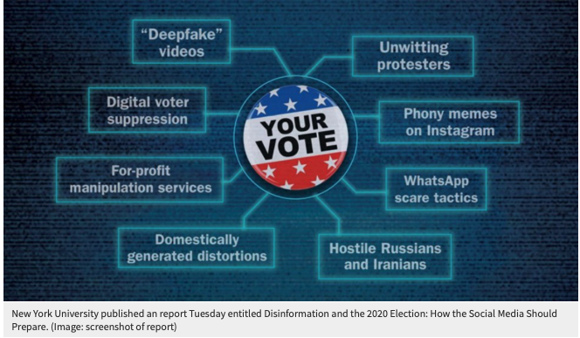
Why should we care?
There’s widespread concern since 2016 that foreign actors are trying to increase division and spread misinformation in democratic nations

Slide 4
2019 Canadian Federal Election
The election was held in October 2019 to elect members of Parliament
This was a referendum on Prime Minister Trudeau and his Liberal Party
The #TrudeauMustGo twitter movement was amplified by bots and often paired with #NotABot
Journalists suspected that #NotABot was used disingenuously¹
The “fake news” phrase has been used to discredit true news stories and political opponents
This term is used by both malicious actors and regular people

Slide 5
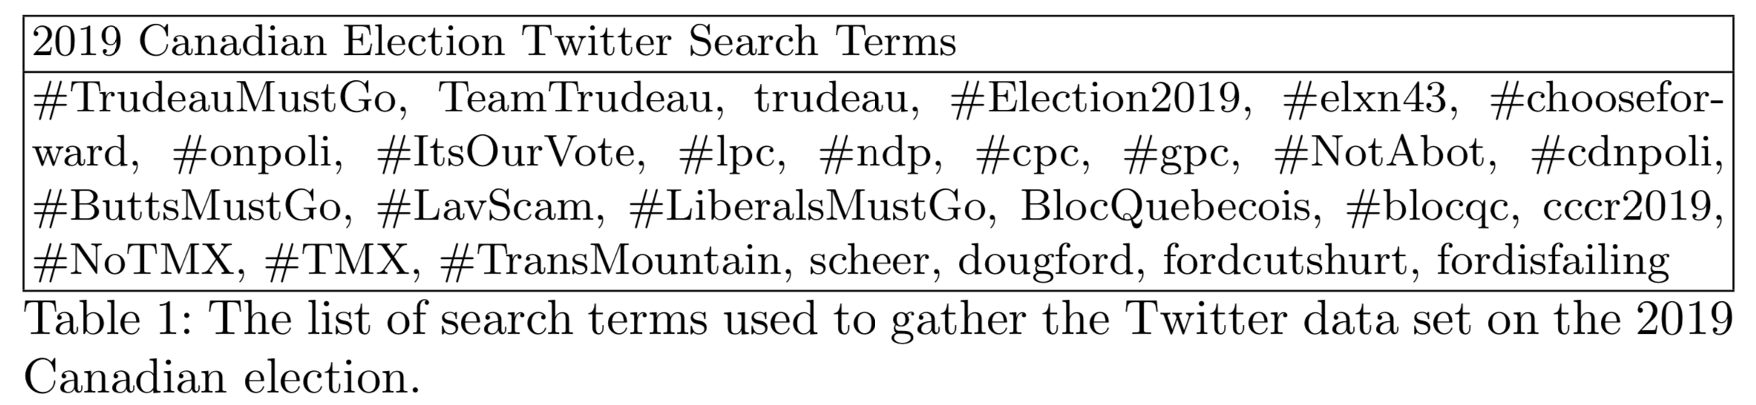
Twitter data related to the election was collected
Collected streaming tweets matching a set of search terms
July 2019 through November 2019
Yielded 16+ million tweets written by 1.3+ million users using over 137,000 hashtags
Notes:
16,784,400 tweets written by 1,303,761 accounts using 137,419 hashtags.

Slide 6
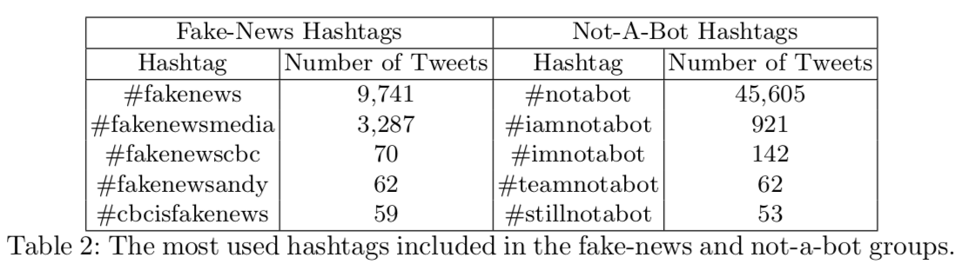
Two groups of hashtags were identified for further study
Notes:
16,784,400 tweets written by 1,303,761 accounts using 137,419 hashtags.

Slide 7
The data was augmented with bot identification
Tier 1 BotHunter algorithm developed by Beskow and Carley² determines the probability that an account was run by a bot
The algorithm considers:
Screen name length
Number of tweets
Number of friends and followers
Content of a tweet
General timing of tweets
Organizational accounts were removed using a neural network classifier created by Huang and Carley³
We use a probability threshold ranging from 0.6 to 0.8 throughout

Slide 8
The likely targets of the #FakeNews were determined
For each tweet, the set of targets was the union of:
The users mentioned in the tweet
The author of the original tweet if the tweet is a reply
The websites linked to in the tweet (if they belong to a potential target)
The specific targets of fake-news hashtags (ex: #fakenewscbc is likely targeting the Canadian Broadcasting Corporation)
Potential targets included political organizations, news, politicians, and reporters
Notes:
I think it might be nice to show an example tweet here

Slide 9
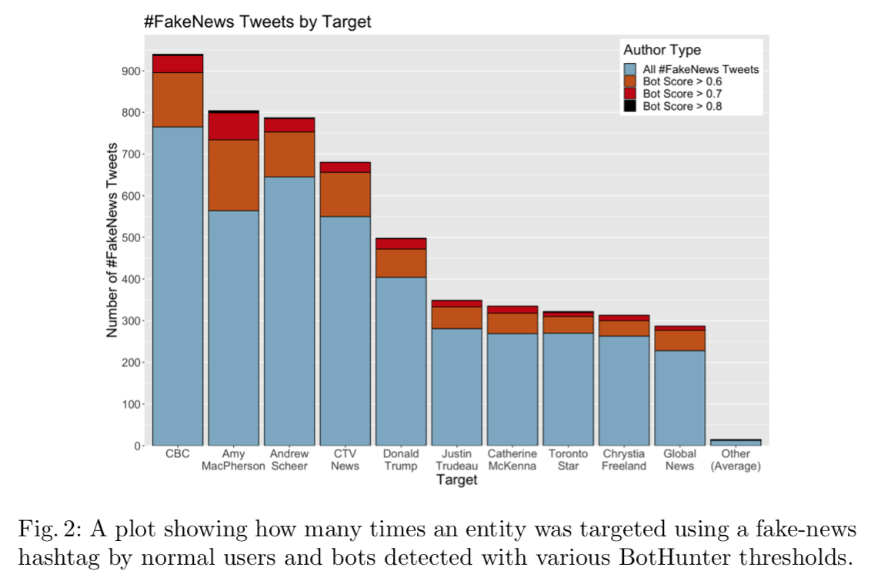
The most targeted are mainstream news agencies and politicians

Slide 10
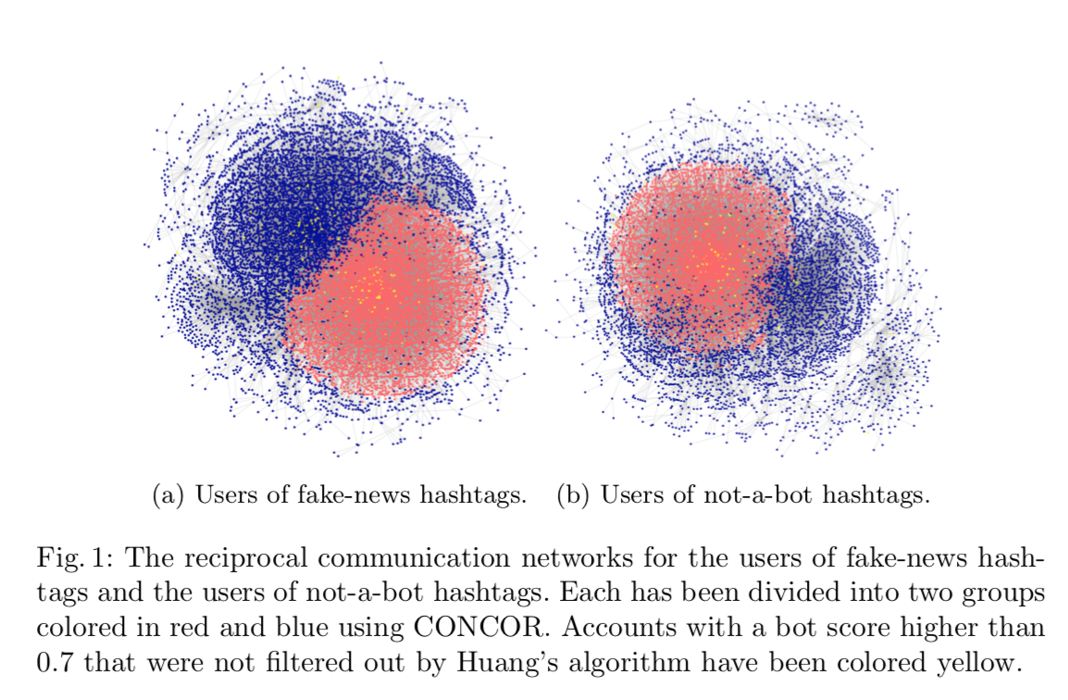
Users of both hashtags separate into two partisan groups
Notes:
Should the caption be included?

Slide 11
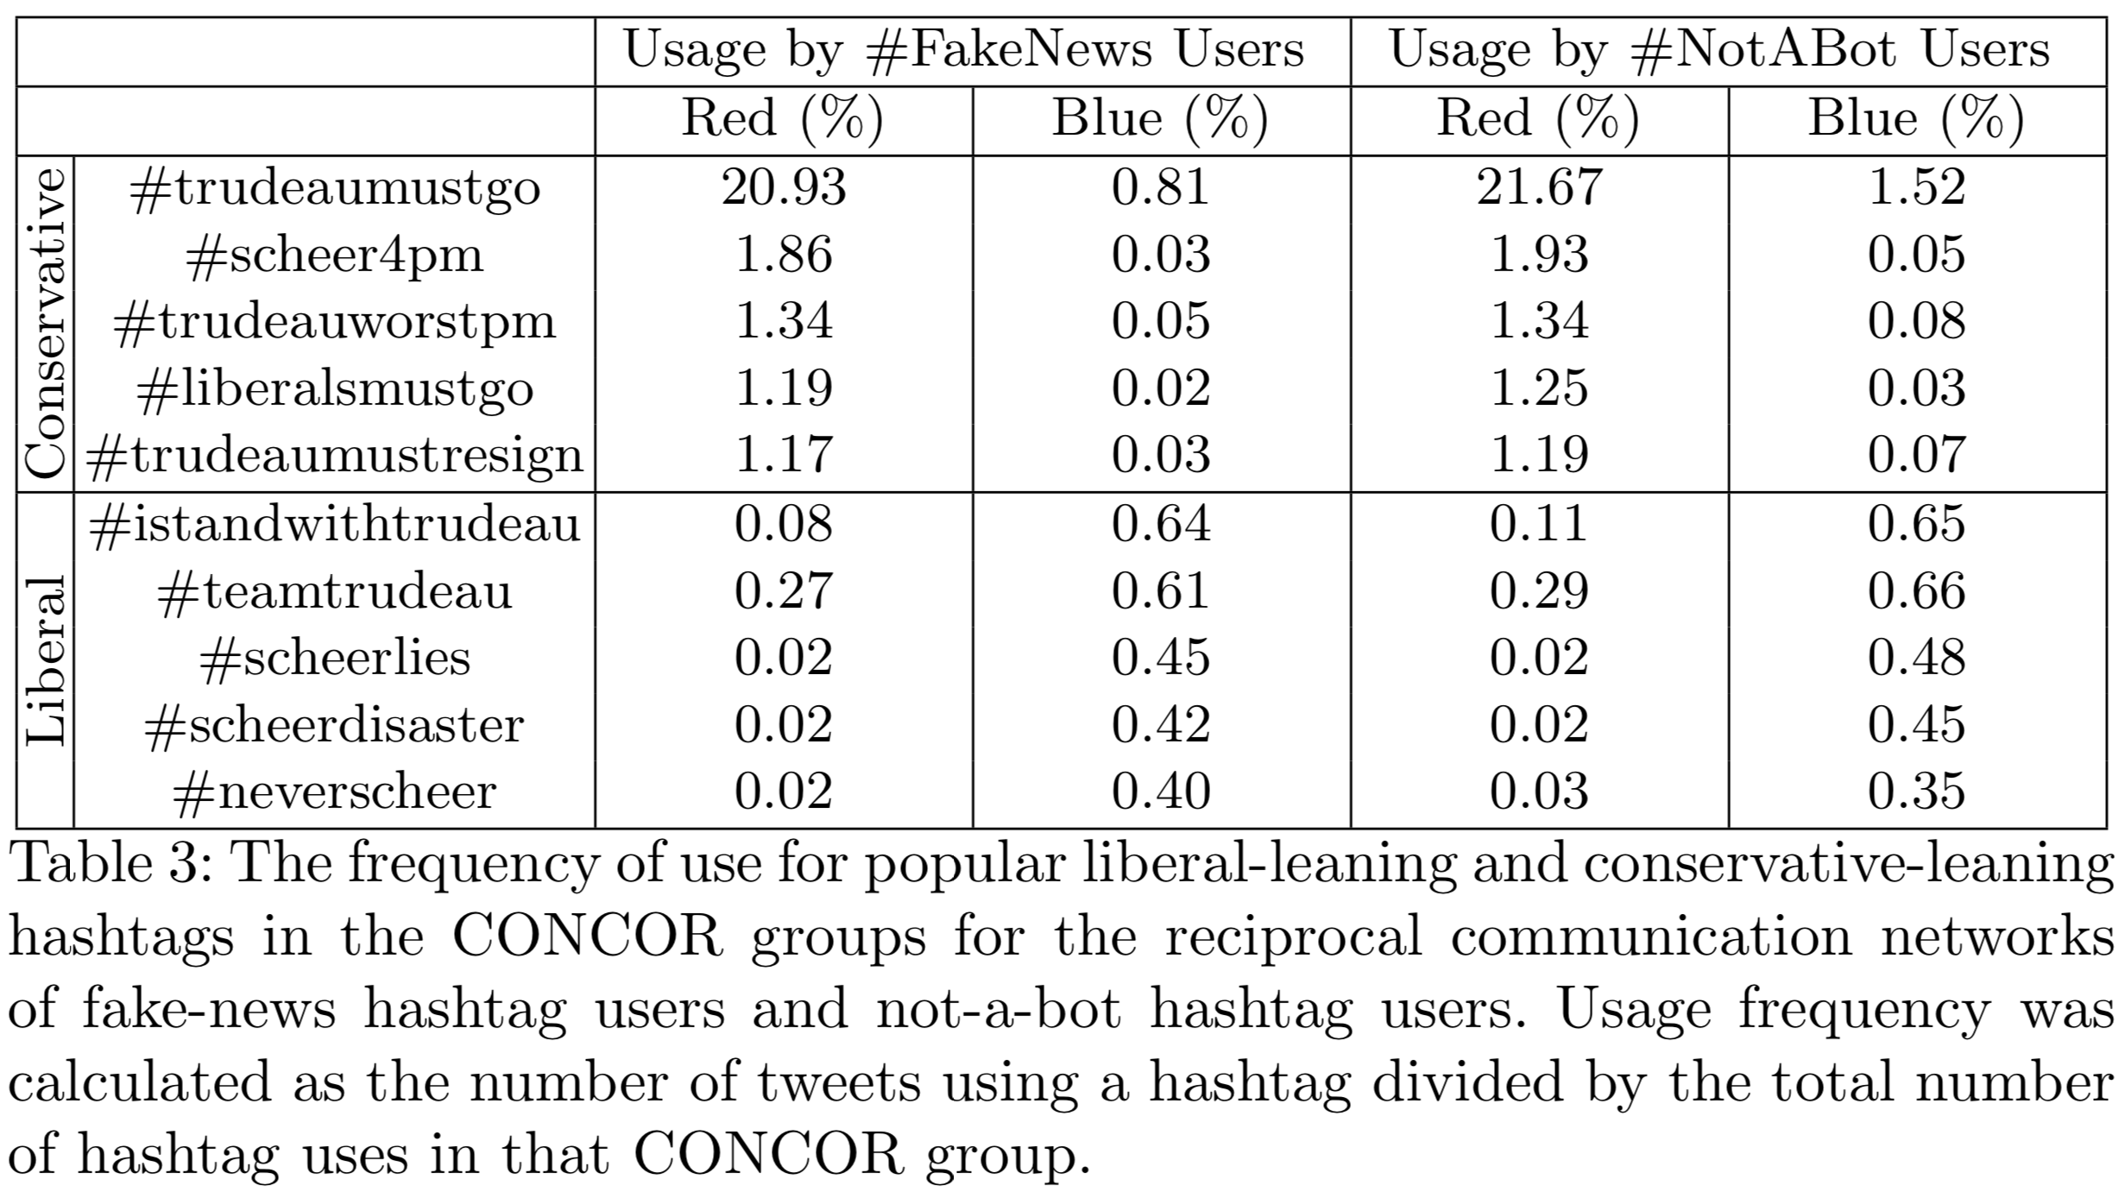
Users of both hashtags separate into two partisan groups
Notes:
Should the caption be included?

Slide 12
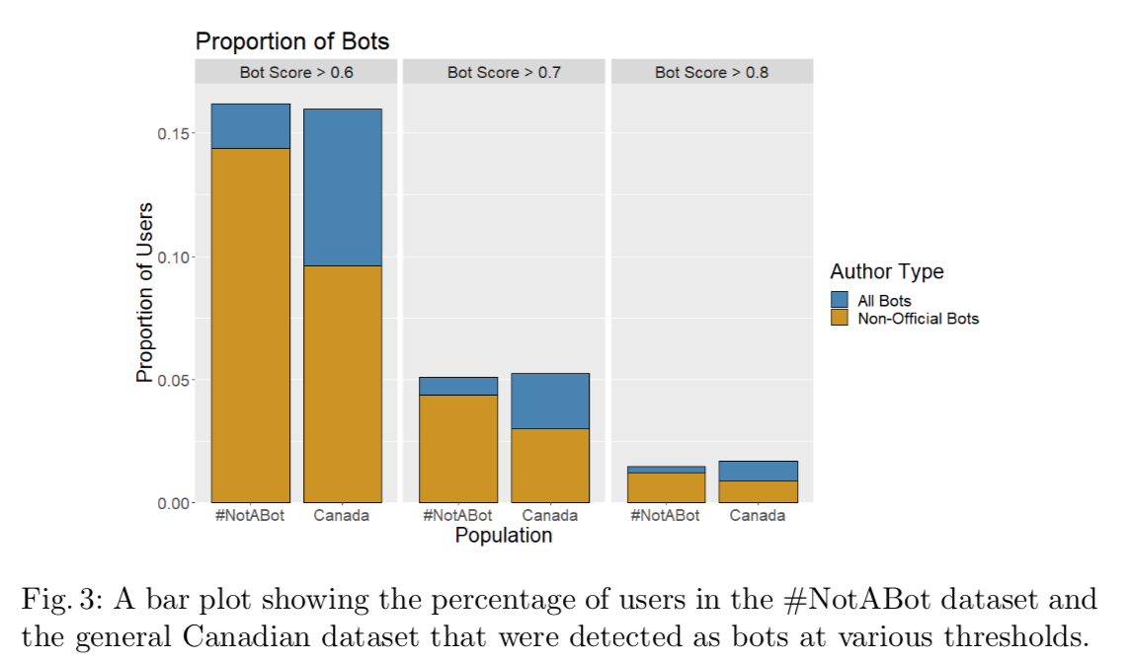
Users of #NotABot are more likely to be bots than non-users
Notes:
I thought the graph might be easier to understand than the statistics, but what is the best way to show or talk about the t-tests?

Slide 13
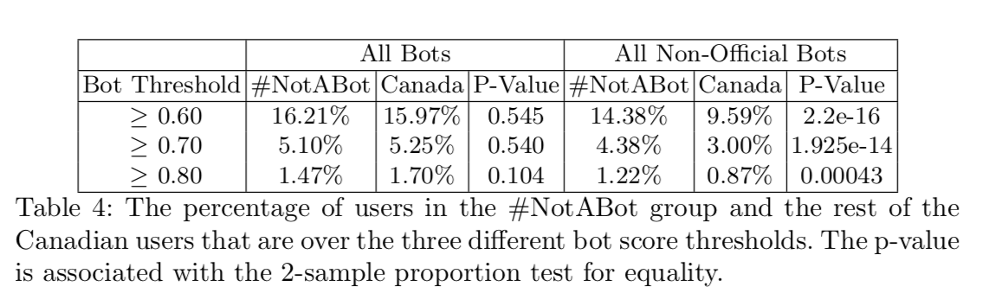
Users of #NotABot are more likely to be bots than non-users
We ran a Mann-Whitney U Test to test if the distribution of two populations is the same, which was also highly significant
Notes:
I thought the graph might be easier to understand than the statistics, but what is the best way to show or talk about the t-tests?

Slide 14
Discussion
Large and established news agencies are the most targeted with accusations of spreading #FakeNews
Accusations calling something “fake” are coming from both liberal and conservative leaning users
Using not-a-bot hashtag is not a reliable signal for indicating that one is not a bot
Both networks of hashtag users show a strong partisan divide

Slide 15
Limitations
The Twitter sample may not be representative of the entire Twitter conversation surrounding the election
The method for determining fake news targets is a reasonable heuristic but may not catch all targets
The Not-A-Bot analysis is based on probabilities rather than certainties that an account is a bot
These results may hold for other elections in similar countries, but circumstances or misinformation strategies may quickly evolve

Slide 16
Future Work
Build on this set of hashtags to investigate how lying about lying continues to evolve over time or in different countries
Examine these hashtags in non-political contexts
Investigate how much of an impact these hashtags are having on human behavior → do other users believe them?

Slide 17
Questions?
Main Results:
Our work describes new tactics being used to influence elections
Mainstream news organizations are being labeled as “fake news” at higher rates than fake or satirical sites
A Twitter user claiming to not be a bot was more likely to actually be a bot
Catherine King, Daniele Bellutta, and
Kathleen M. Carley
cking2@cs.cmu.edu, dbellutt@cs.cmu.edu

Slide 18
References
Orr, C.: A new wave of disinformation emerges with anti-Trudeau hashtag, https://www.nationalobserver.com/2019/07/25/analysis/new-wave-disinformation-emerges-trudeaumustgo
Beskow, D., Carley, K.: Bot-hunter: A tiered approach to detecting characterizing automated activity on twitter. In: International Conference on Social Computing, Behavioral-Cultural Modeling and Prediction and Behavior Representation in Modeling and Simulation (July 2018)
Huang, B., Carley, K.M.: Discover your social identity from what you tweet: a content based approach. Disinformation, Misinformation, and Fake News in Social Media-Emerging Research Challenges and Opportunities (2020)

