Slide 1
Modeling Hail Risk
by Praneetha Parupudi, Alden Jettpace, and Bobbie Cavna

Slide 2
Goal
Demonstrate how deep learning models, trained on weather data, can be used to improve estimates of regional hail risk relativities.
Compare and contrast results of models to existing FEMA hail-risk maps.
Start analysis with Indiana data and expand to other states if time permits.
Significance
Risk Management for natural disasters based on calculated risk of event.
Modelling financial hail loss has lagged behind modelling for other catastrophic risk (ie. floods/tornadoes/hurricanes.)
Loss from a single hail storm can exceed $1-billion in damages.
Usual Risk Models are created based on historical reported frequency:
Problems with traditional models:
Hail is very in-frequenuent, potentially under-reported in rural areas.
Frequencies could change as a result of global warming, and urban growth.

Slide 3
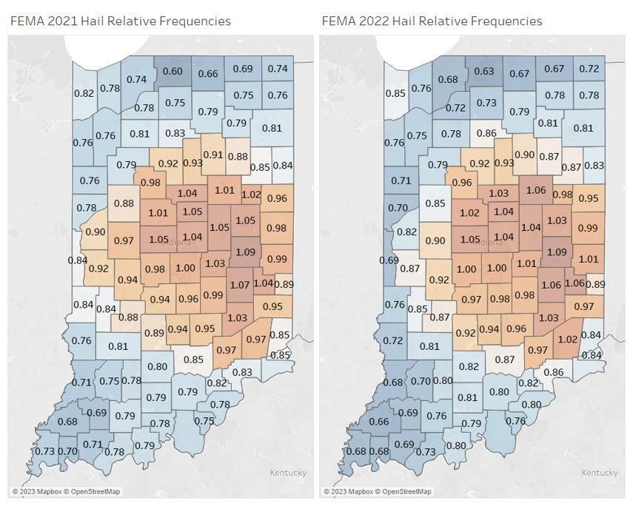

Slide 4
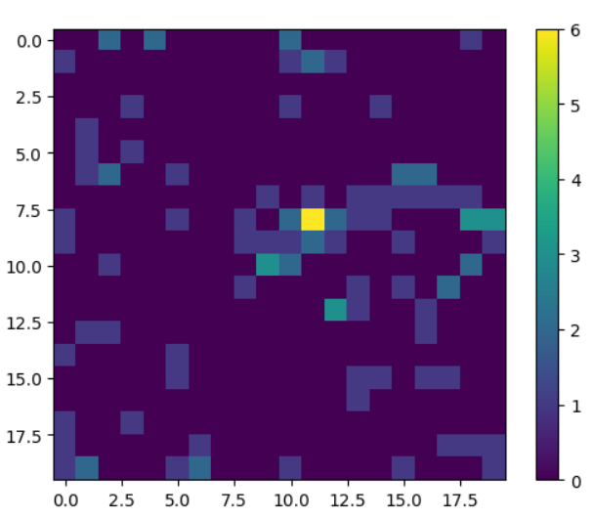
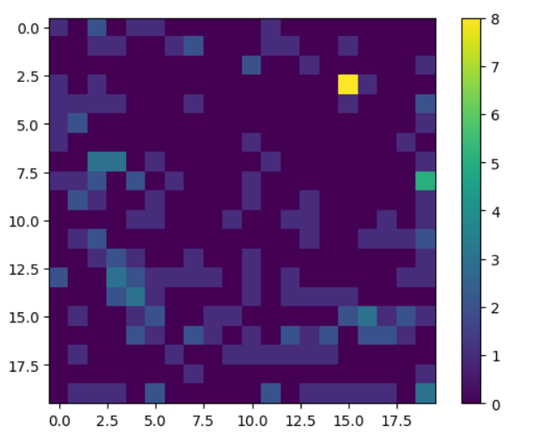
2021-2022 Test Data Risk Maps
Sum of events in cells

Slide 5
Data Sources:
ERA-5 Hourly Pressure Levels:
https://cds.climate.copernicus.eu/cdsapp#!/dataset/reanalysis-era5-single-levels?tab=overview
Atmospheric Features at several atmospheric levels, at different days and locations
Total of 37-atmospheric levels and 4-selected features each:
V-Component Wind, U-Component Wind, Temperature, Humidity
NOAA Storm Events Dataset (Hail):
https://www.ncdc.noaa.gov/stormevents/choosedates.jsp?statefips=18%2CINDIANA
National Oceanic and Atmospheric Administration
Records of Hail-Events at specific times and locations
Consisted of Latitude/Longitude of Indiana and little bit of surrounding countryside
Latitude-Range: 37N -> 42N
Longitude-Range: 85W -> 89W (or -85 -> -89)
Dates:
2011-2020: Training/Validation
2021-2022: Testing
Label Imbalance: Hail Events very rare, non-hail events outnumbered hail events in conventional data by factor of 10,000

Slide 6
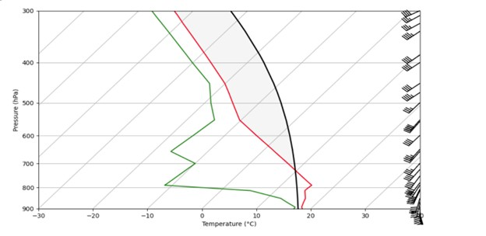
Method 1:
Based on “Skew T Log P” Meteorology Diagram
Focuses on assumed correlations between hail and 4 features at each of 23 altitudes:
Temperature, wind speed, vertical wind velocity, and dew point.

Slide 7
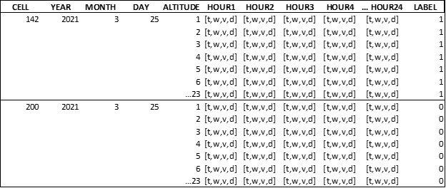
Method 1:
Features are evaluated independently for each location.
Assumes that features are localized within latitude/longitude cells.

Slide 8
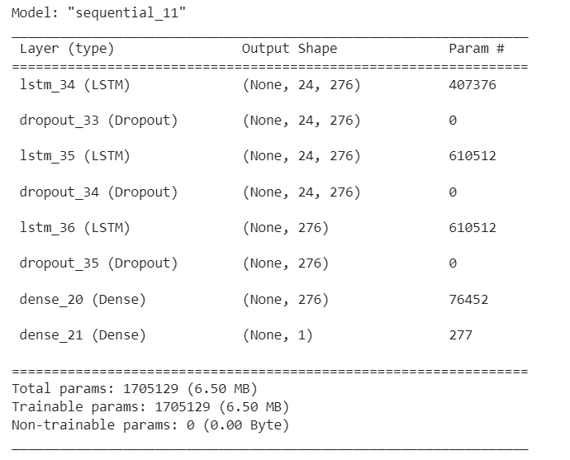
Method 1:
LSTM Model
Implemented similarly to a word embedding matrix within an LSTM model.
Input is reshaped to 24 hours x 23 altitudes x 4 features: (24, 94).
24 steps are used, so that hail conditions that occur any time within the day will be detected.
Hourly steps also helped with class imbalance, since labels are assigned to a single day rather than each hour.
Keras Balanced Batch Generator used to mitigate class imbalance.
Training data was also limited to days where hail occurred somewhere in the state, to further limit the imbalance.

Slide 9
Method 1 Results
Year: 2021 | Precision | Recall
Class-0 (No Hail) | 1.00 | 0.93
Class-1 (Hail) | 0.00 | 0.44
Accuracy |  |  | 0.93
Year: 2022 | Precision | Recall
Class-0 (No Hail) | 1.00 | 0.98
Class-1 (Hail) | 0.00 | 0.10
Accuracy |  |  | 0.98

Slide 10
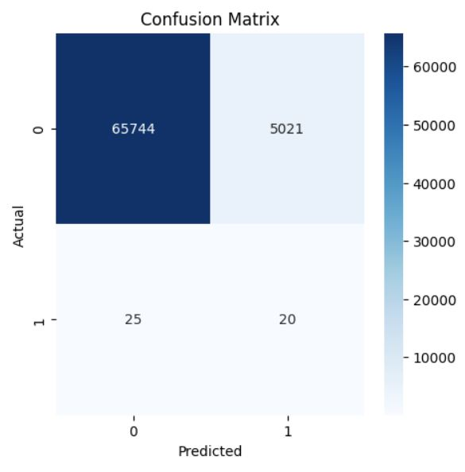
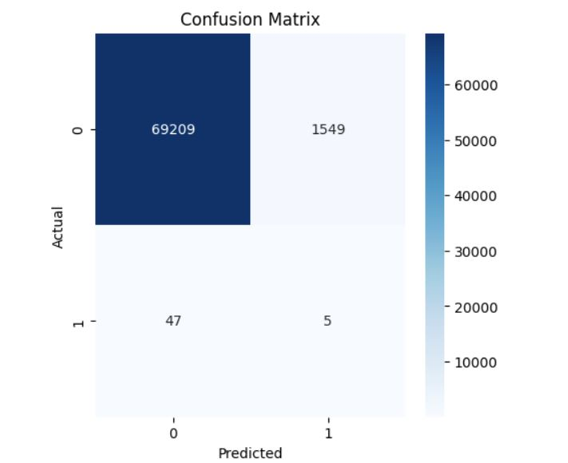
Year: 2021
Year: 2022

Slide 11
Method 2:
Data
A time-series convolution of 5-hours, with the different feature and atmospheric level combinations becoming 37*4 = 148-features for each cell in each time-period
Detects each hail event in each latitude-longitude range cell at a specific hour each day, 5-hour range of features from 2-hours previous to 2-hours after predicted time
Input=>Output:
Input: (t-2 [20*20*148], t-1 [20*20*148], t [20*20*148], t+1 [20*20*148], t+2 [20*20*148])
Output: (t [20*20*1])
Ie: (None, 5, 20, 20, 148) => (None, 20, 20, 1)
Total Instances: > 100,000

Slide 12
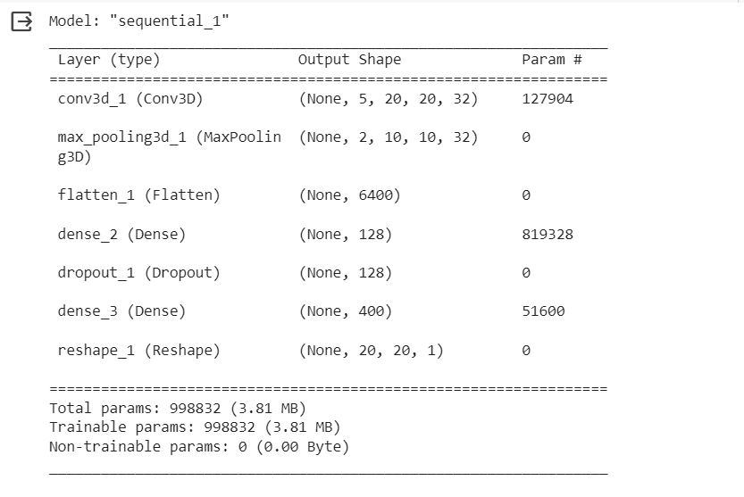
Method 2:
Model: Convolution and Dense Network:
Used max pooling 3D
Epochs of Training (by Validation Tuning): 6-epochs
Label-Balancer:
Label-Loss {0:1, 1:5000}

Slide 13
Method 2 Results:
Year: 2021 | Precision | Recall
Class-0 (No Hail) | ~ 1.00 | 0.83
Class-1 (Hail) | ~0.00 | 0.52
Accuracy |  |  | 0.83
Year: 2022 | Precision | Recall
Class-0 (No Hail) | ~ 1.00 | 0.84
Class-1 (Hail) | ~0.00 | 0.49
Accuracy |  |  | 0.84

Slide 14
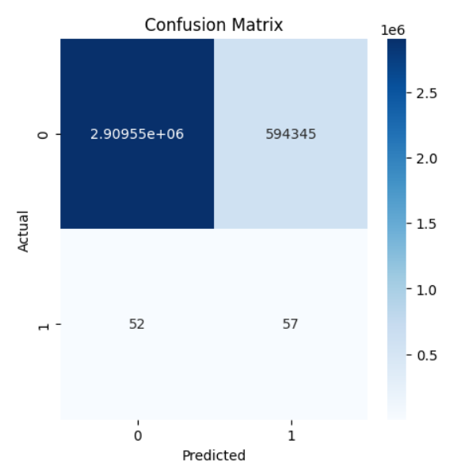
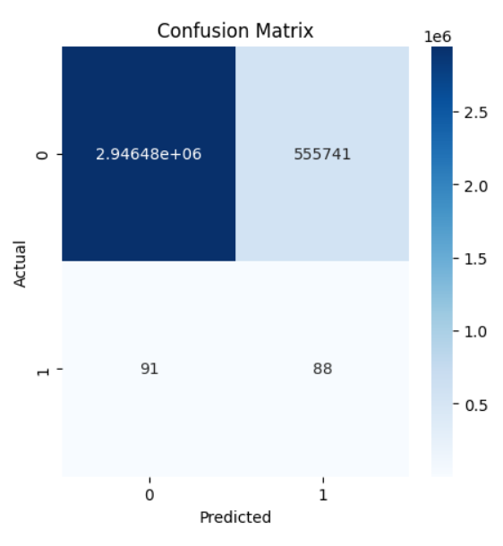
Year: 2021
Year: 2022

Slide 15
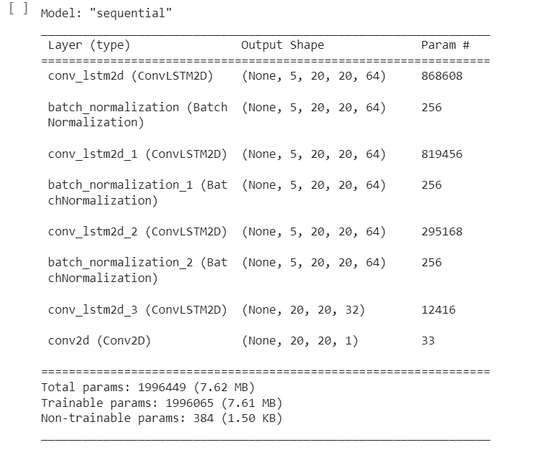
Method 3:
Data: Same as Method 1
Models architecture is on Convolutional 3d architecture, using time-series convolution similar to a next-frame prediction model (like film)
Weight-Correction: {0:1, 1:5000}

Slide 16
Method 3: Results:
Year: 2021 | Precision | Recall
Class-0 (No Hail) | ~1.00 | 0.90
Class-1 (Hail) | ~0.00 | 0.46
Accuracy |  |  | 0.90
Year: 2022 | Precision | Recall
Class-0 (No Hail) | ~1.00 | 0.87
Class-1 (Hail) | ~0.00 | 0.68
Accuracy |  |  | 0.87

Slide 17
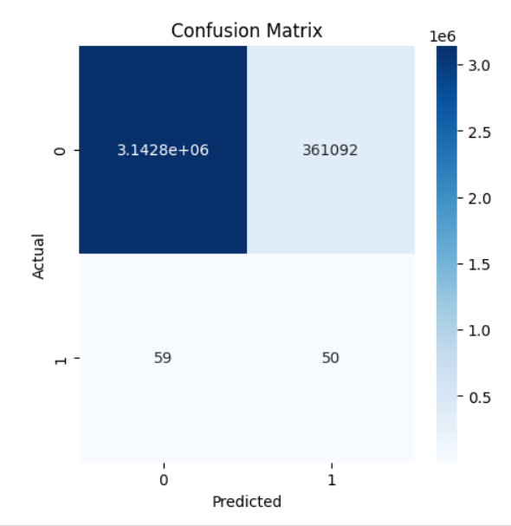
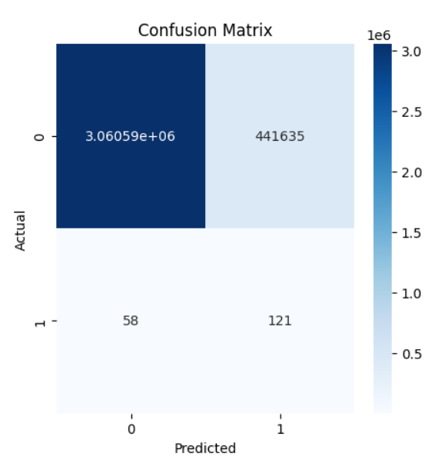
Year: 2021
Year: 2022

Slide 18
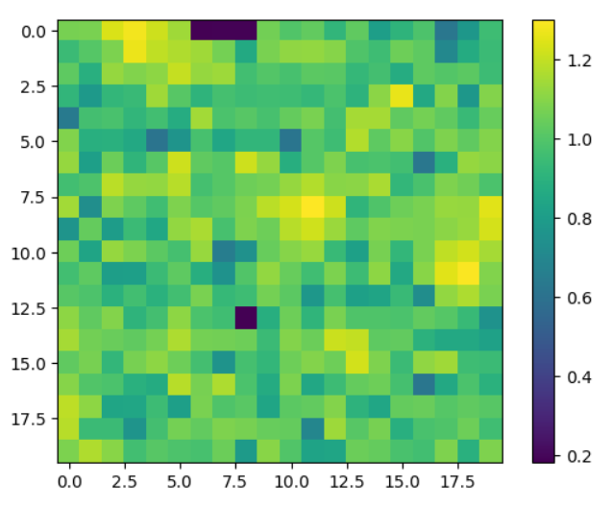
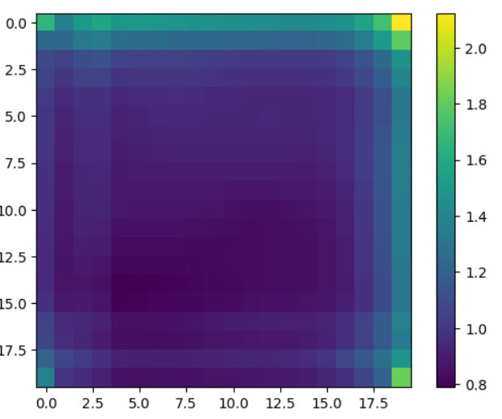
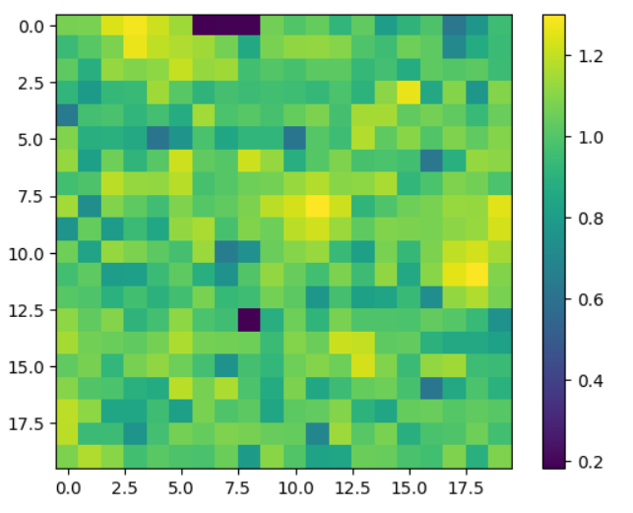
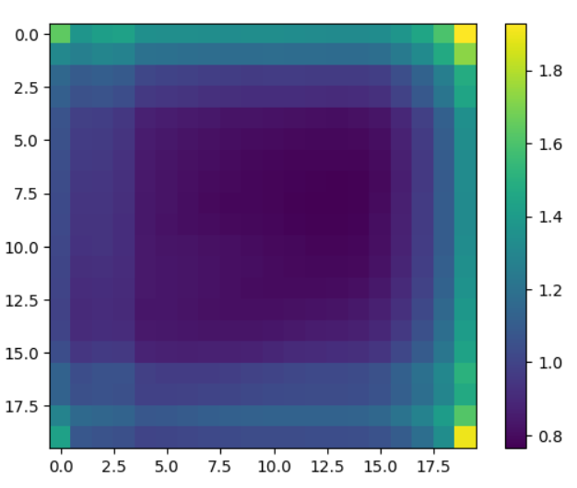
Method 2-3 2021-2022 Prediction Maps (percentage-normalized)

Slide 19
Overall Performance:
Neural Network Models developed purey on features and not modified for domain knowledge is imprecise, has tendencies towards false-positives
Convolution Models lack granularity in prediction
Time Series inclusion for convolution improved precision, but still very poor
Challenges:
Large Data Size
Improper Computing Resources
Areas for Improvement:
Greater Resources + Feature Availability
Expand Inputs to include entire country + longer time period

