Slide 1



Your gaming library, all in one place.
POOSD Capstone Project • github.com/Ayloonah/POOSD-Cartridge
Damien • Judhy • Jules • Angela • Ethan • Hailey • PH

Slide 2







Our Team
DA
JU
JU
AN
Damien
Judhy
Jules
Angela
Documentation & API
Project Mgmt & Mobile
Documentation & API
Prototyping & Web Frontend
ET
HA
PH
Ethan
Hailey
PH
Documentation & Prototyping
Mobile Frontend
Web Frontend
2

Slide 3
Problem Statement
Gamers don't have a single, dedicated space for their games.
There's no central place to track and sort every game someone owns or wants to play, and most tracking tools are locked to one platform or storefront.
How can we build something that isn't limited by the platform a gamer plays on?
3

Slide 4
Proposed Solution
Track your entire library, regardless of platform
1
Rate and review the games you've played
2
Cartridge
Discover new games
One platform for your whole game library
3
Accessible on the web and through a mobile app
4
4

Slide 5
Project Requirements
The app had to:
Our app lets a user:
Use a MERN stack
Ship a mobile app built with Flutter
Enforce password complexity rules
Verify accounts by email before login
Communicate between client and server using JSON
Register and log in, with email verification and password reset
Add and delete game entries
Rate and review their games
Create and delete personal lists
Add and remove games to/from a list
5

Slide 6







Technology Used
MERN Stack — Core framework (MongoDB, Express, React, Node.js)
Flutter / Dart — Mobile application
Figma — Prototyping
SwaggerHub — API documentation
GitHub — Version control
Draw.io & Sequencediagram.org — Diagrams
Jira — Project management & Gantt chart
Discord — Team communication
Figma
SwaggerHub
GitHub
Draw.io
SequenceDiagram
Jira
Discord
6

Slide 7
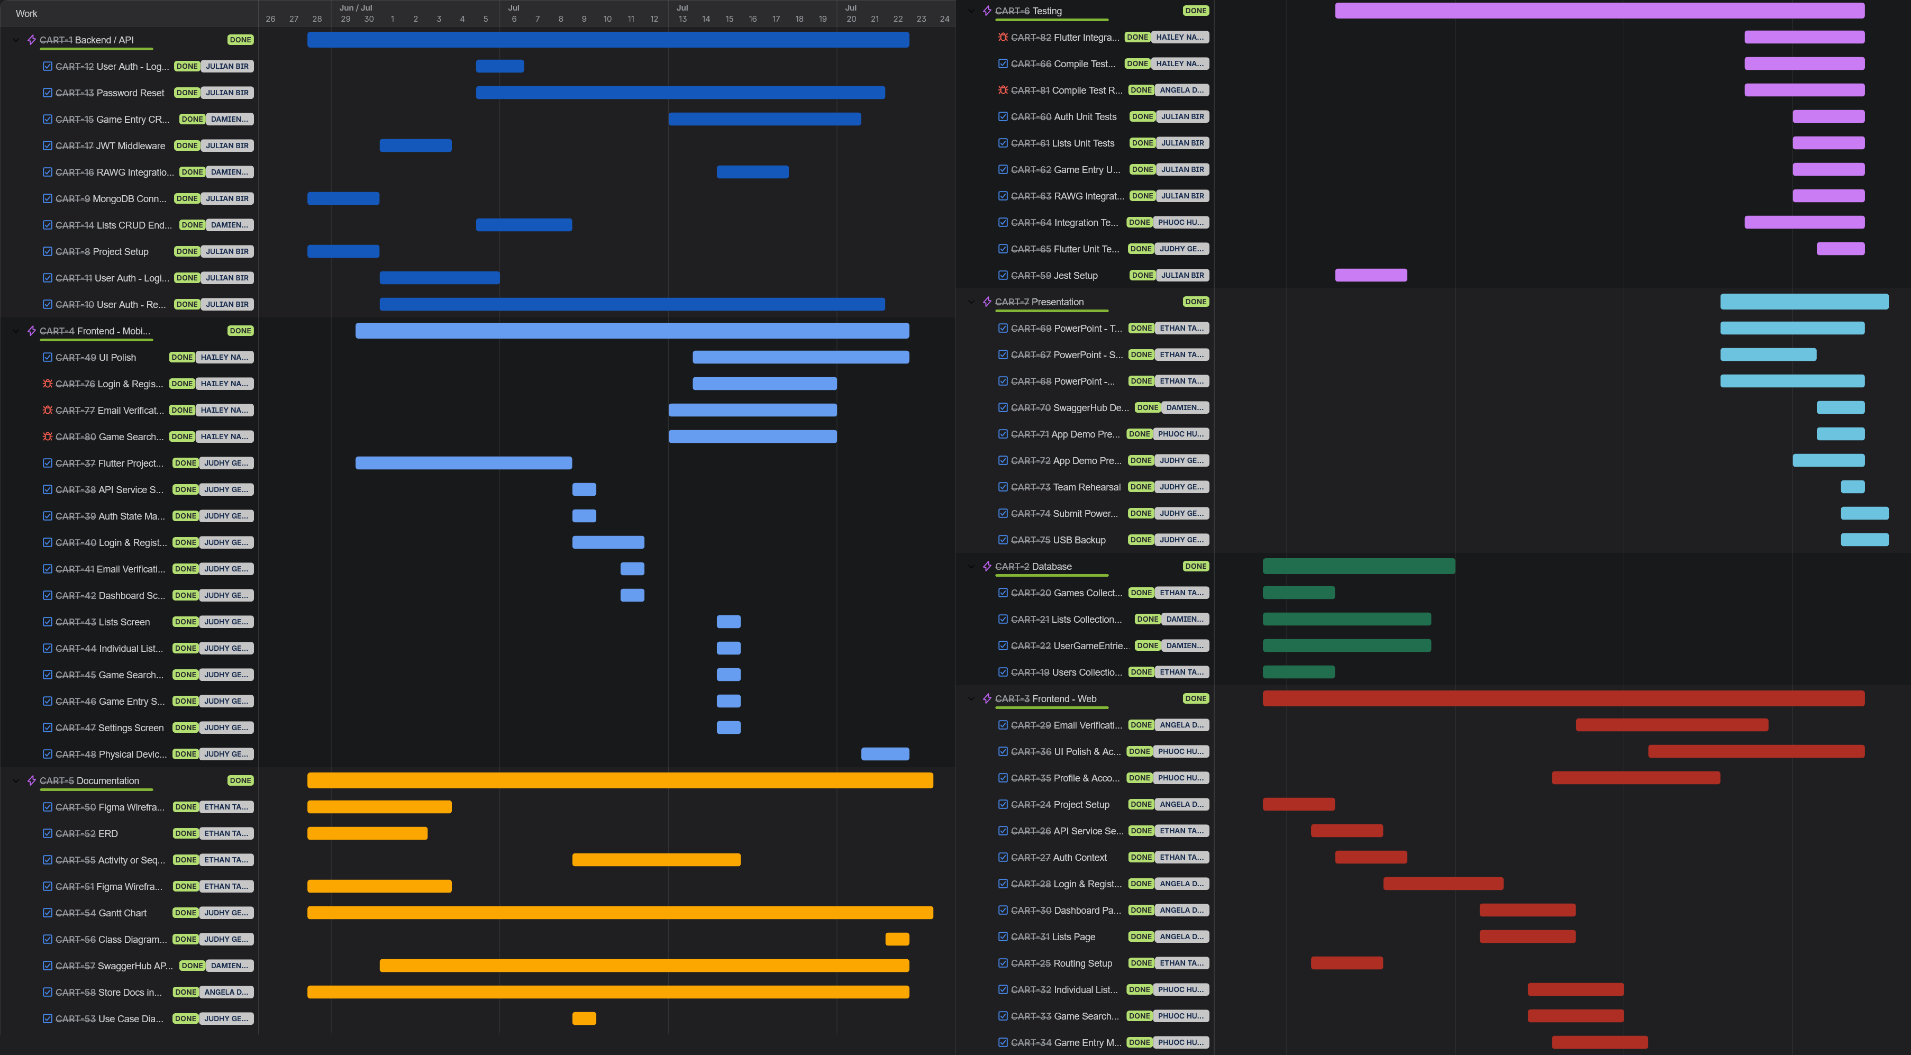
Gantt Chart
7

Slide 8
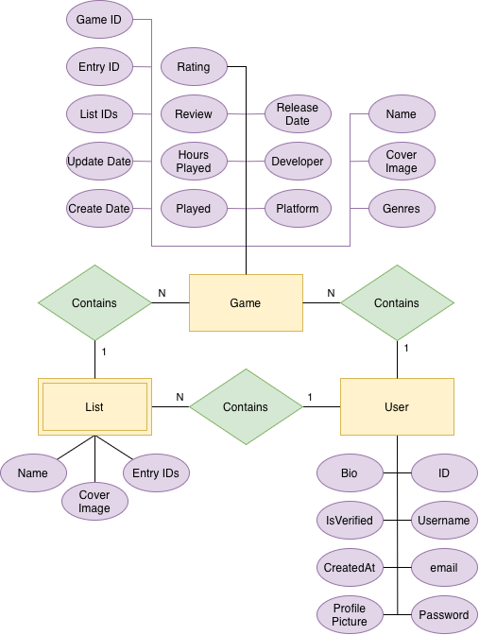
Entity Relationship Diagram
Core relationships
Users can create games
Users can create lists of games
Users can add any game to a list
8

Slide 9
Class Diagram
Class Key
States / Service
App Shell
Authentication Screens
Game/List Flow
Main Tabs
Models
Reusable Widgets
9

Slide 10
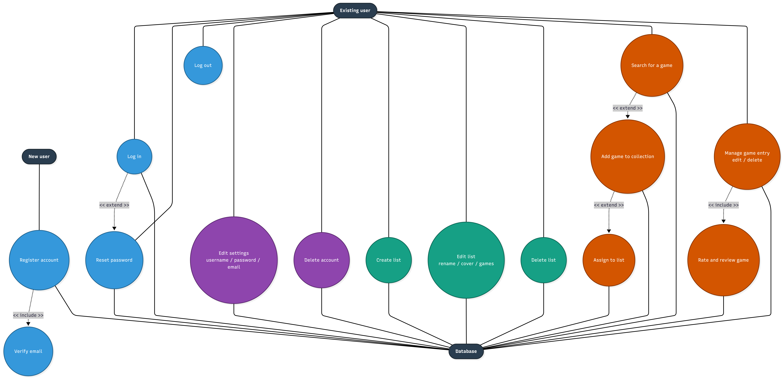
Use Case Diagram
10

Slide 11
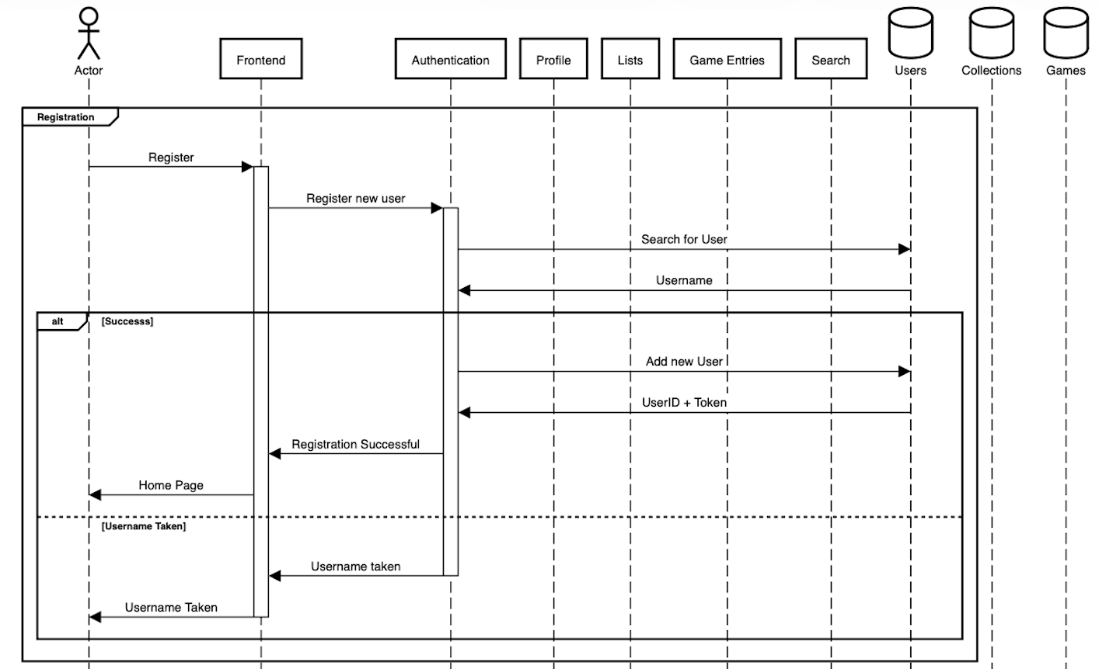
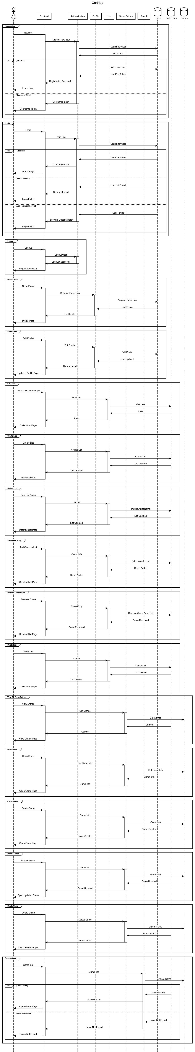
Sequence Diagram: Auth
11

Slide 12
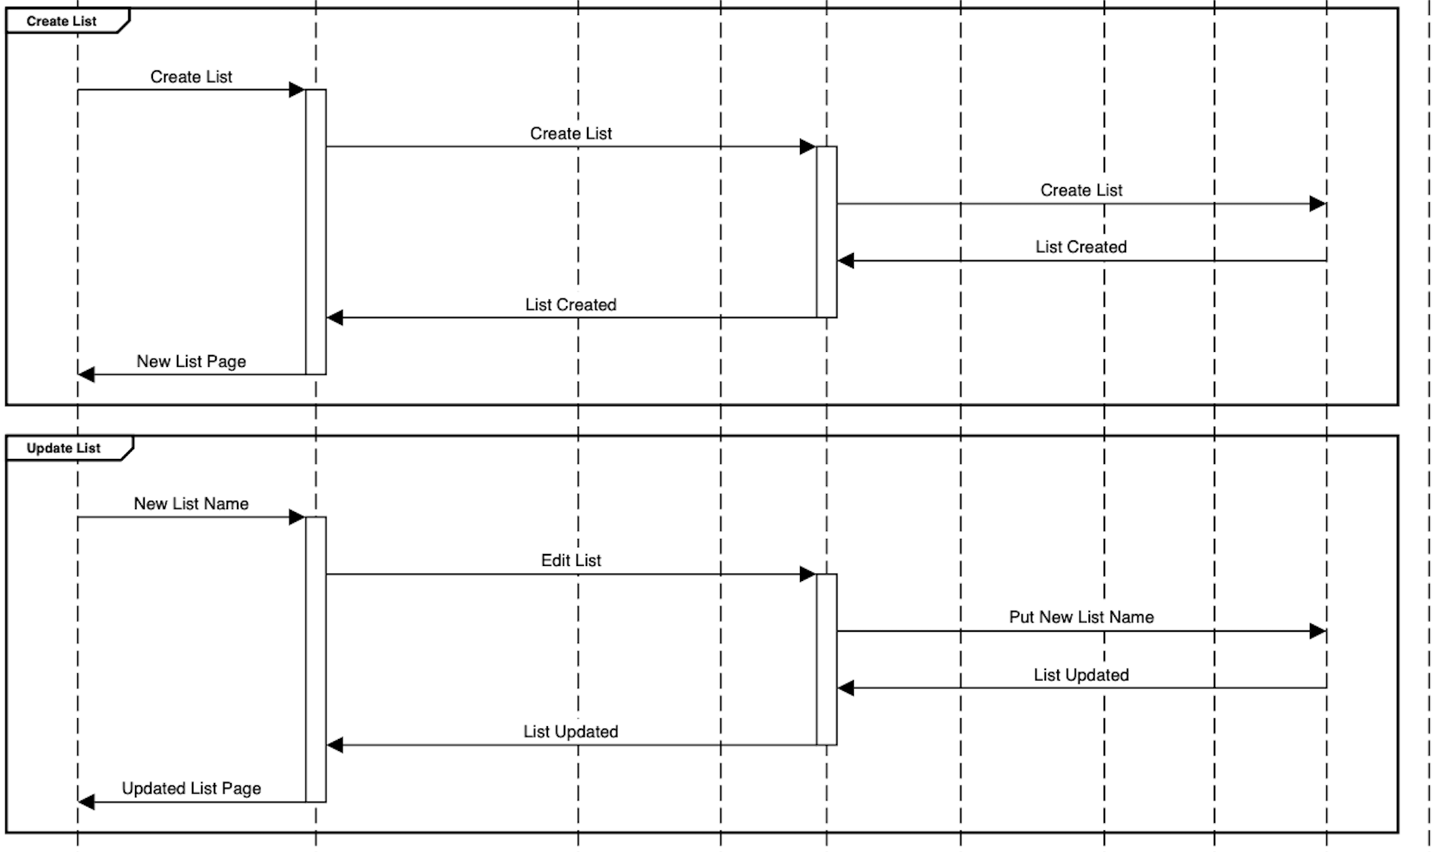
Sequence Diagram: Profile & Lists
12

Slide 13
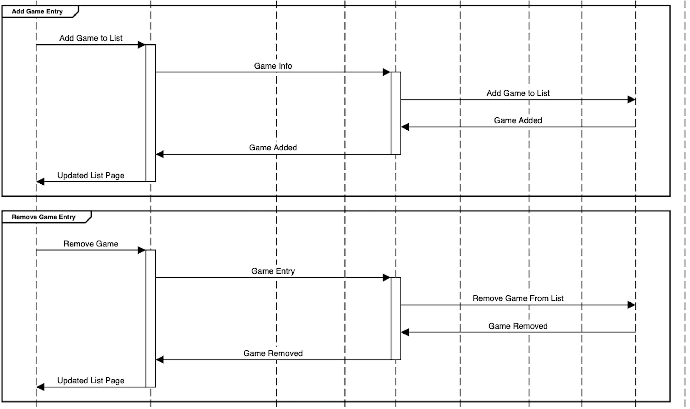
Sequence Diagram: Game Entries
13

Slide 14
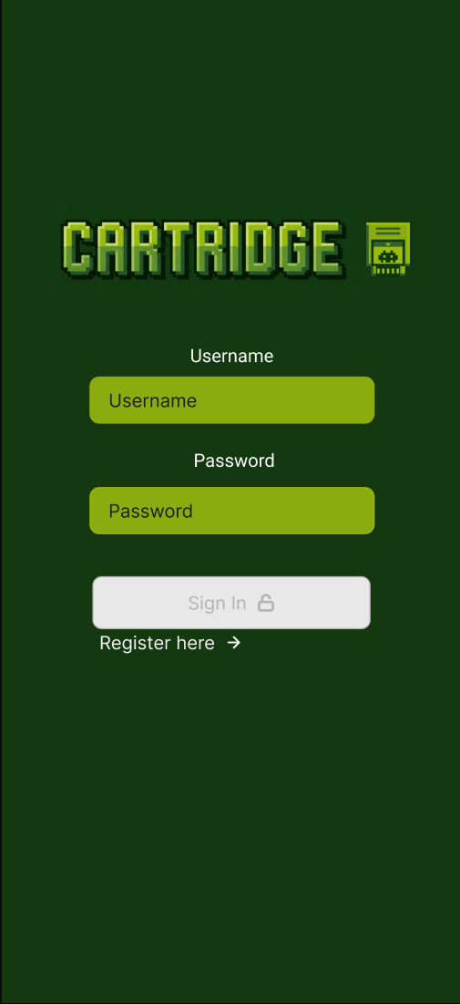
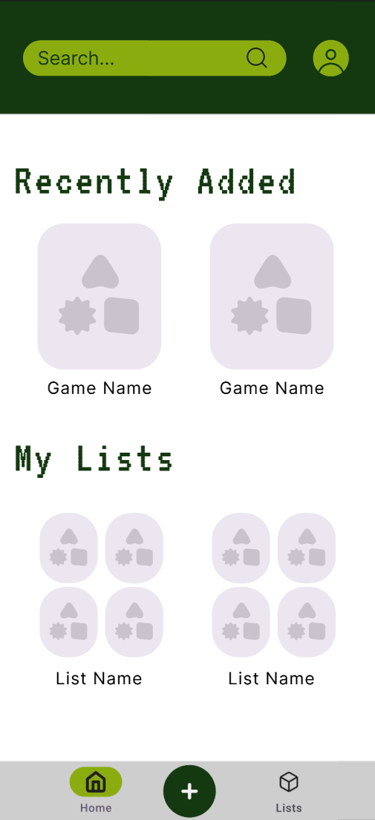
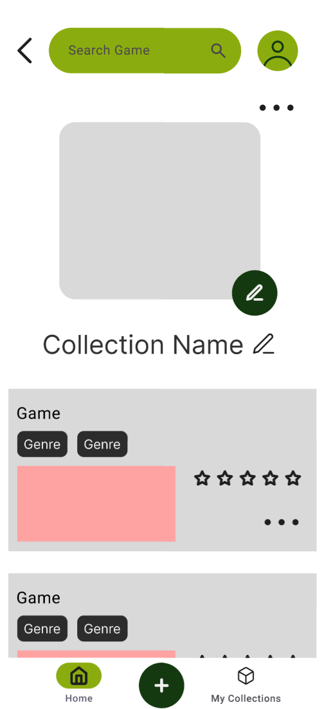
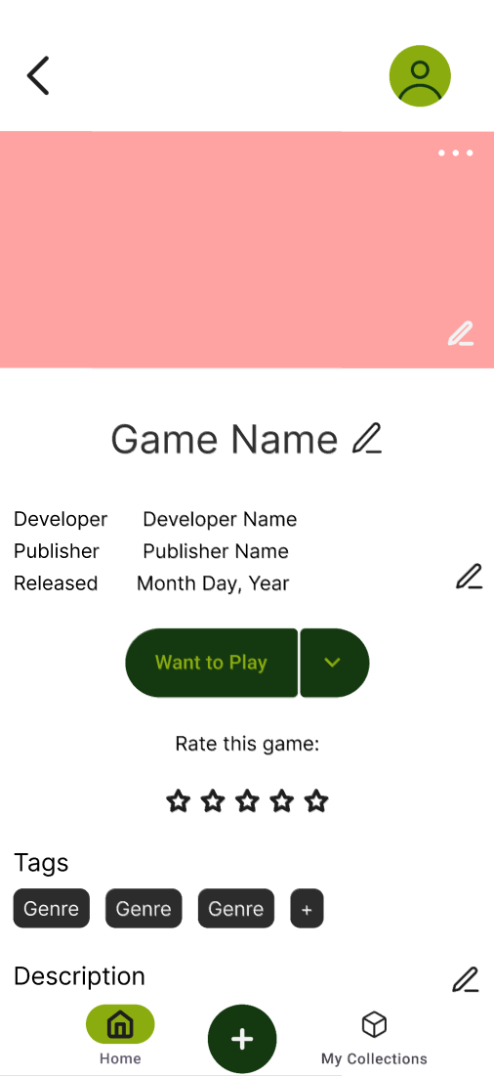
Prototypes: Mobile
Sign In
Home
Collection
Game Details
14

Slide 15
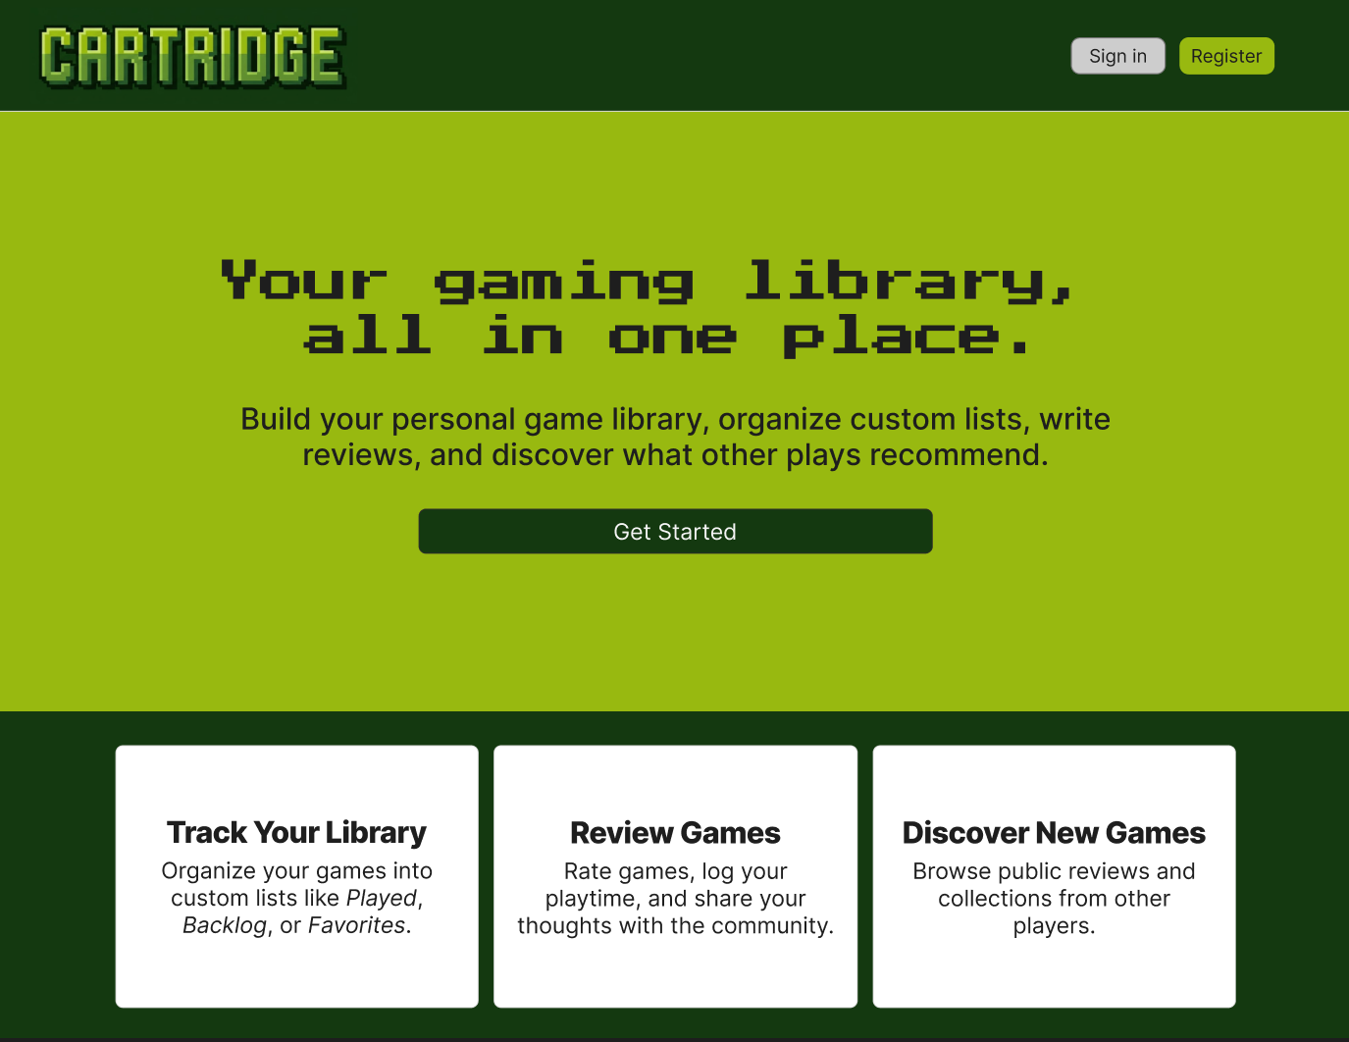
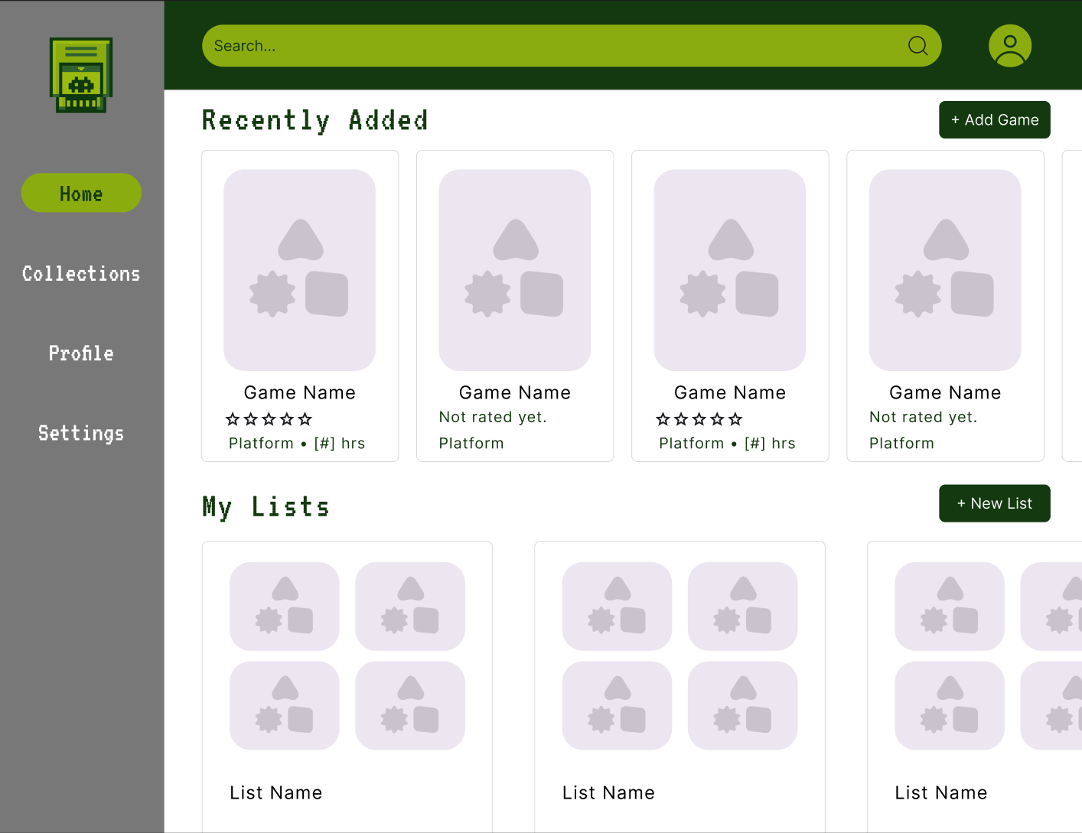
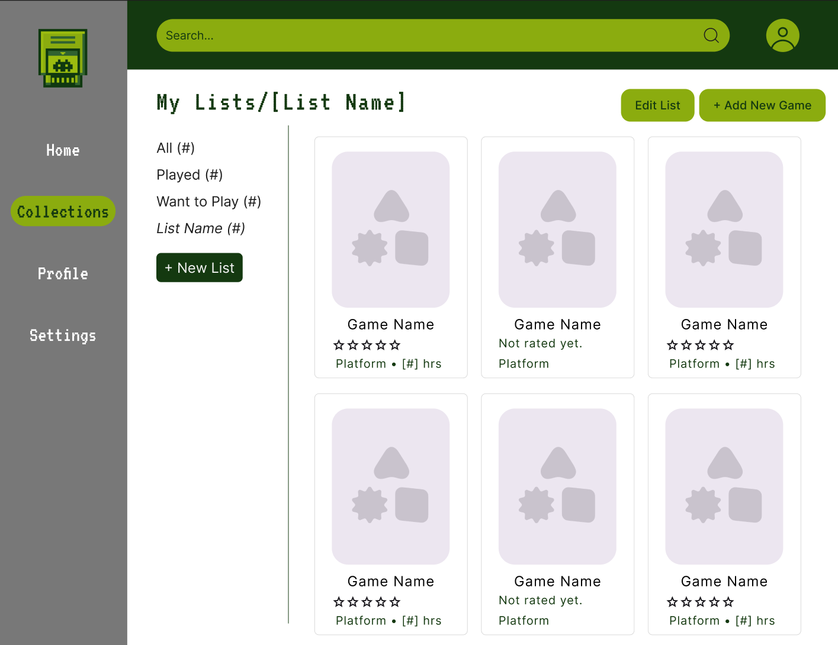
Prototypes: Web
Home
Collections
List View
Full-fidelity Figma prototypes for the responsive web client, used to align the team before frontend build-out.
15

Slide 16
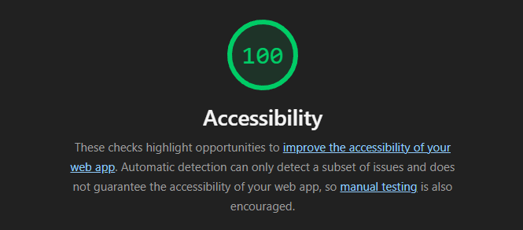
Accessibility
Lighthouse Score
The web client was audited with Chrome Lighthouse to check accessibility fundamentals — color contrast, semantic markup, and labeled inputs — alongside performance and best practices.
16

Slide 17
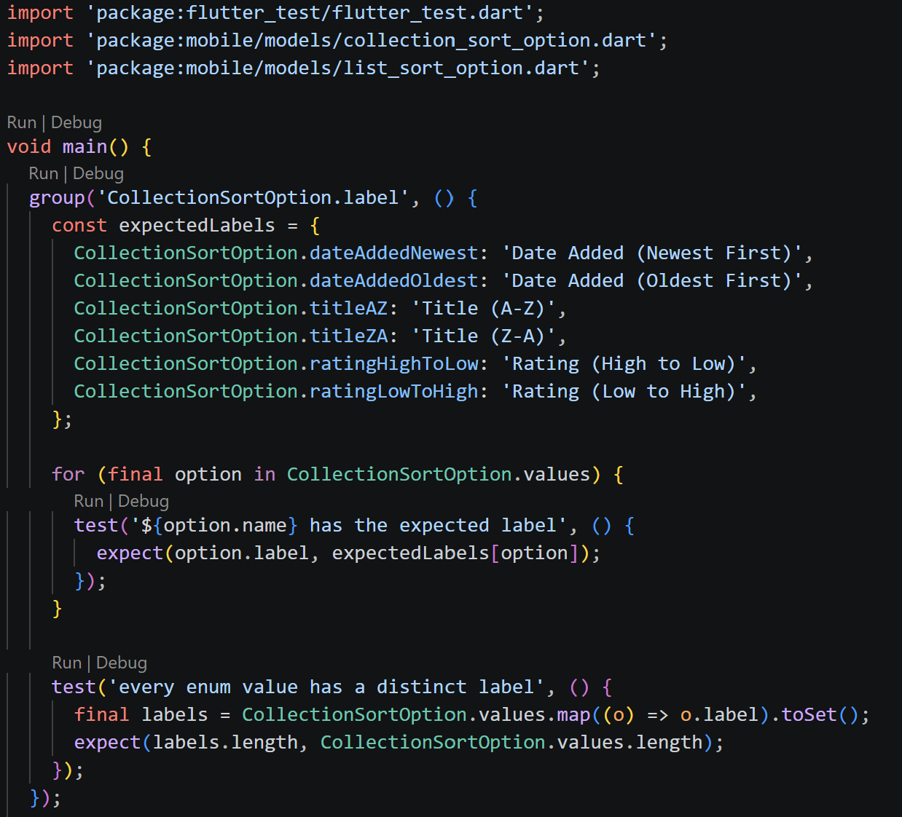
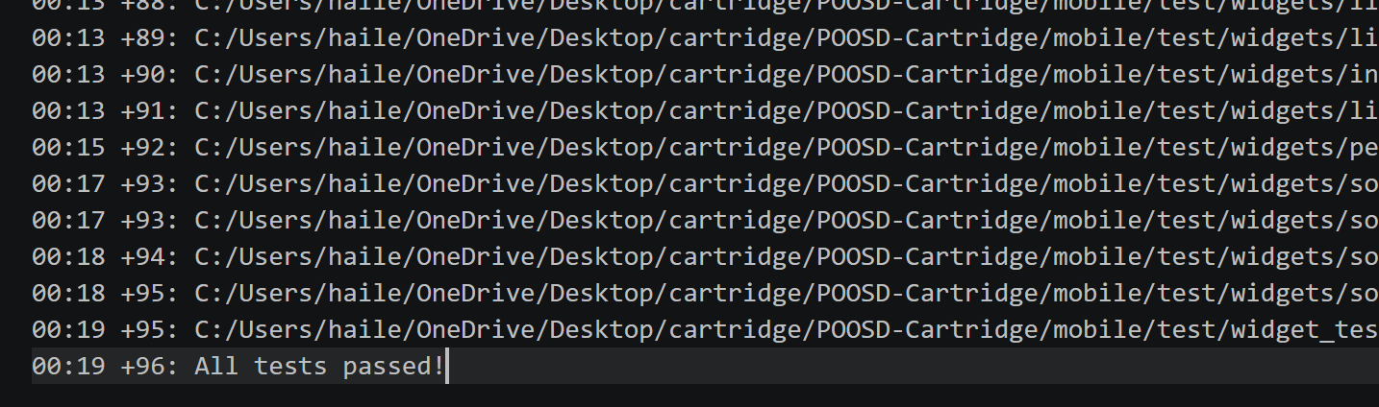
Unit Testing: Mobile
96 unit tests total, all passing
Covers models, services, and sort/filter logic
Panel at left previews collection-filter coverage
17

Slide 18
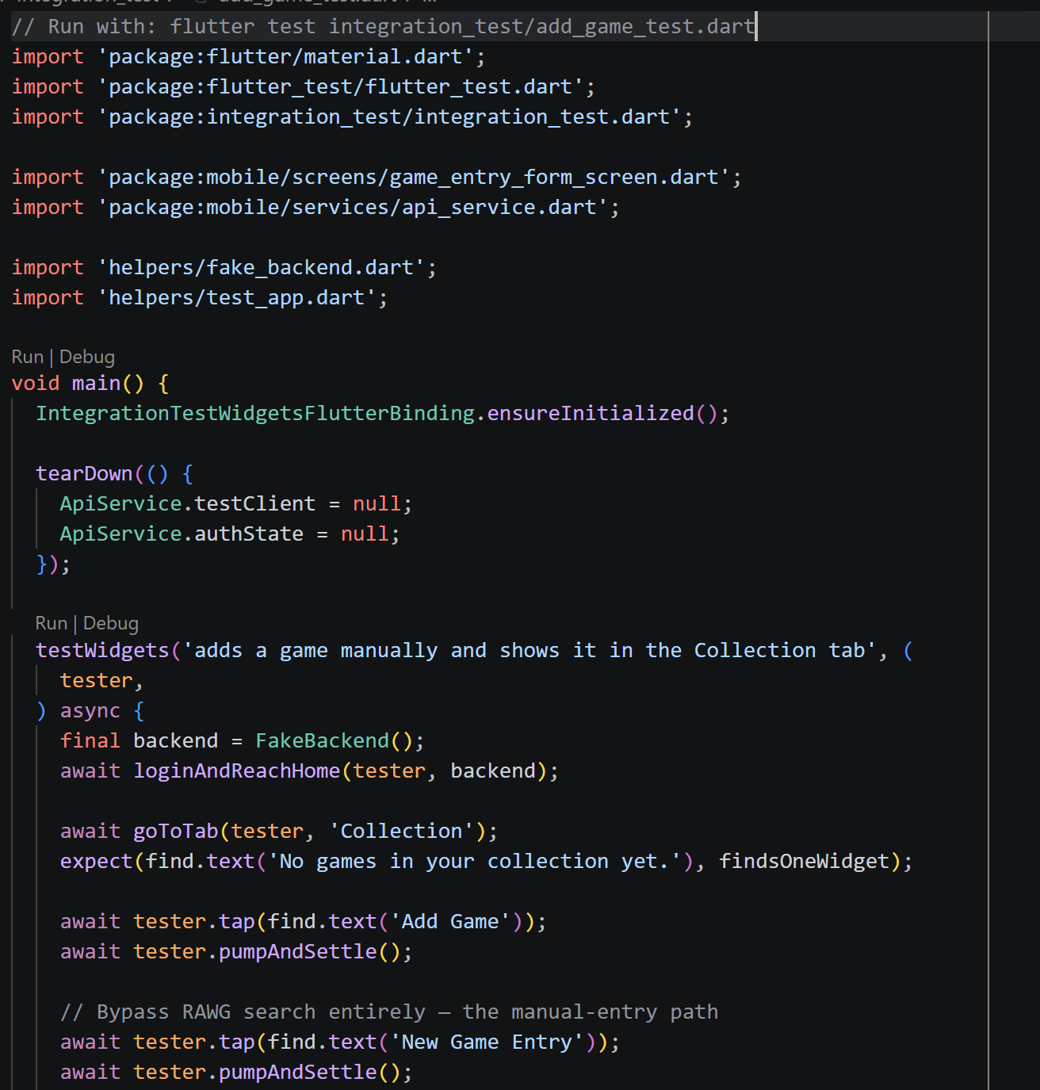
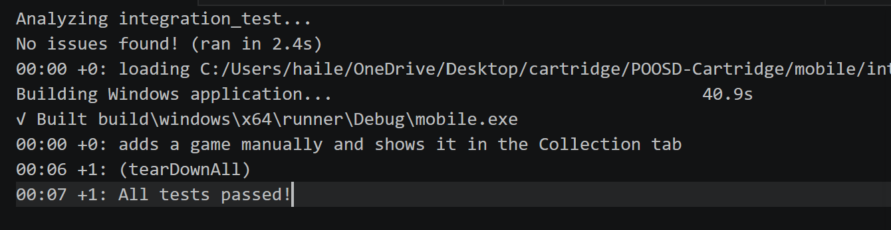
Integration Testing: Mobile
8 integration tests total
Example at left: adding a game end-to-end
Covers login, add/edit/delete game, add/edit/delete list, logout
18

Slide 19
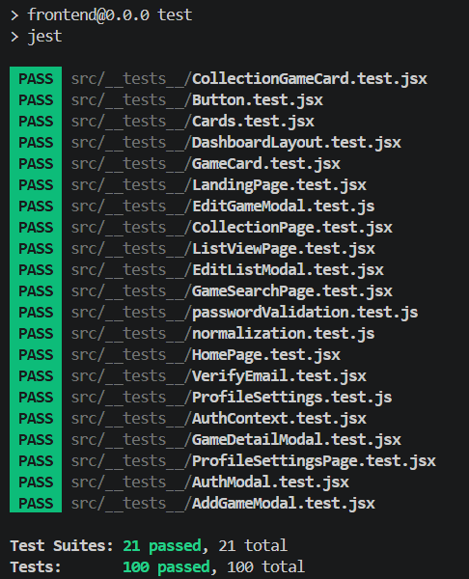
Unit Testing: Web
100 unit tests, using Jest & React Testing Library
Coverage:
Components: modals, cards, buttons, navigation, layouts
Pages
Context & core logic
19

Slide 20
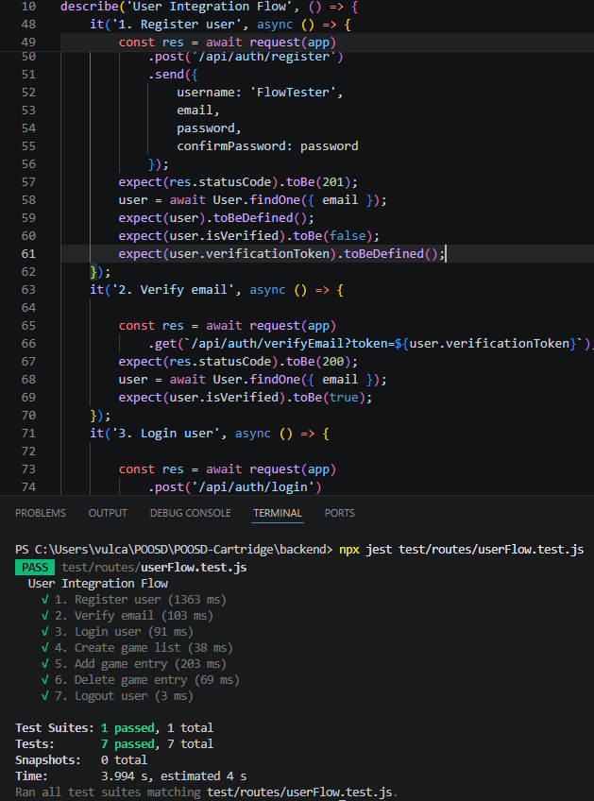
Integration Testing: Web
7 integration tests total
Registration
Email verification
Logging in
Create game list
Add and delete game entry
Logging out
20

Slide 21
Retrospective
Backend
Web Dev
Mobile Dev
Went Well
Progress was quick once we started
External APIs (SendGrid, RAWG) were very user friendly
Went Poorly
A lot of knowledge acquisition needed
Getting familiar with MongoDB, Express, Node.js
Went Well
Good communication and coordination between developers
Effective task division
Went Poorly
Initial difficulty understanding the existing project structure
Some features needed refactoring after backend integration
Went Well
Great communication between developers
Effectively worked together on the same tasks
Went Poorly
Had to learn Flutter from scratch
Slow to start because of this
21

Slide 22
API Demonstration
Live demo — SwaggerHub
Showing a live API endpoint via SwaggerHub
22

Slide 23
App Demonstration
Live demo — Web & Mobile
cartridgeapp.fun
23

Slide 24

Any Questions?

