Slide 1


Slide 2
#
#

Slide 3
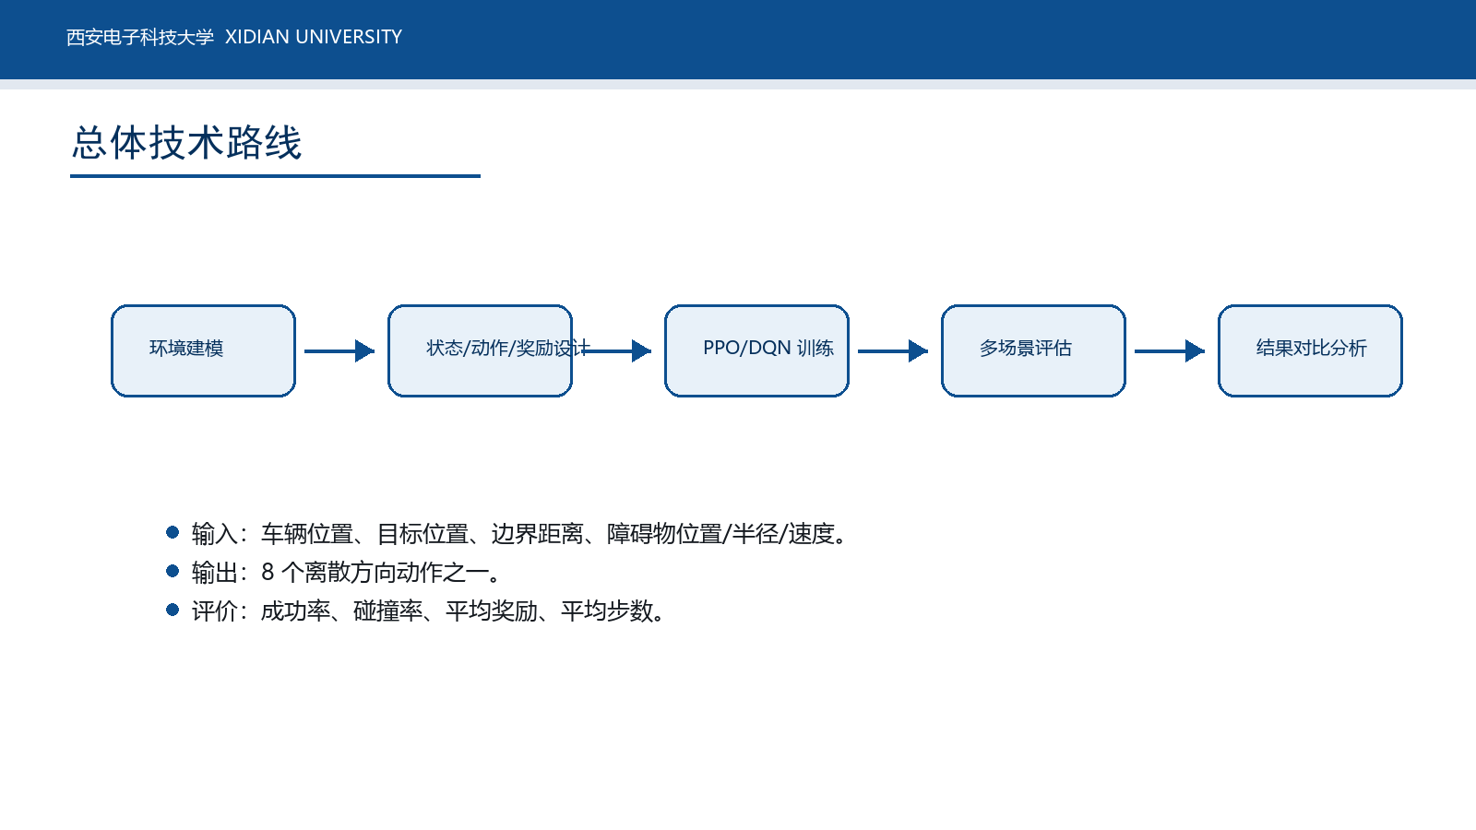

Slide 4
#
#

Slide 5
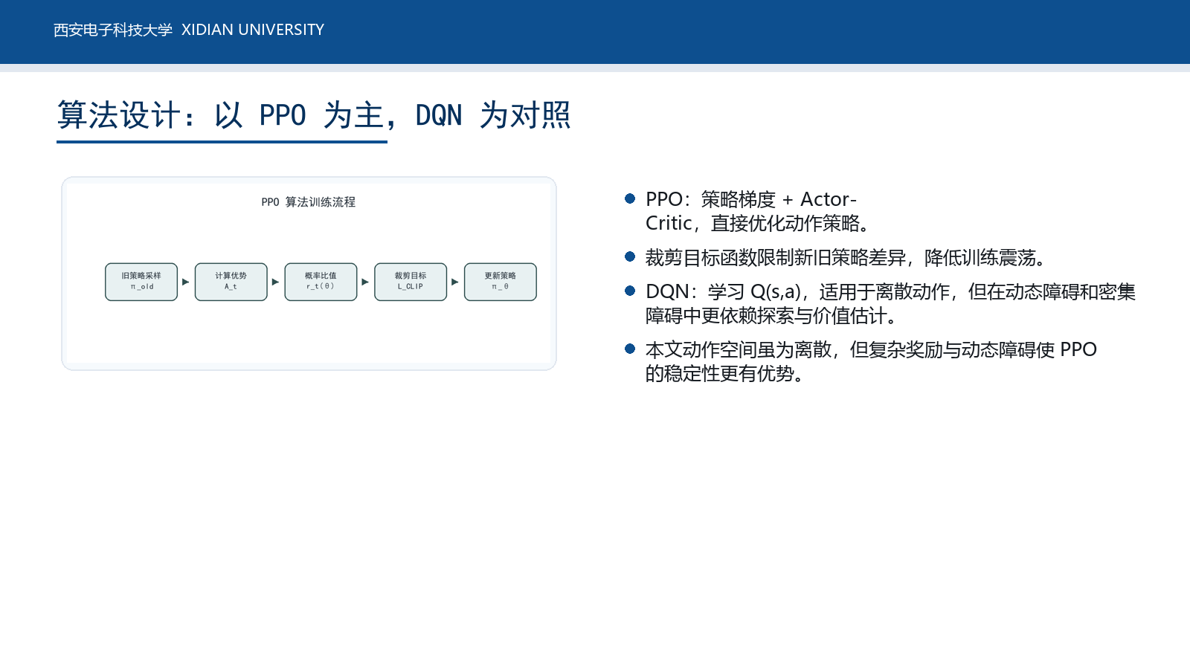

Slide 6
#
#

Slide 7
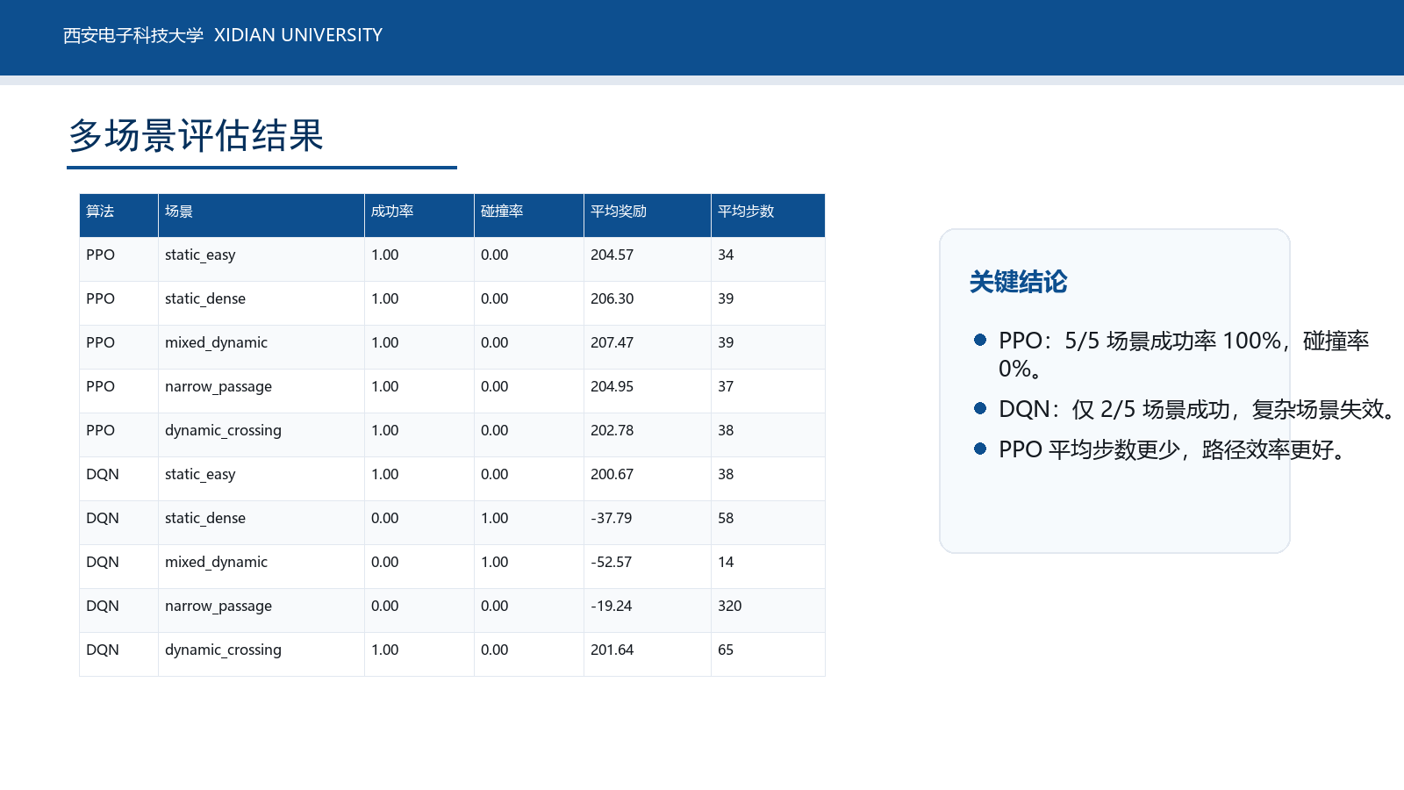

Slide 8
#
#

Slide 9
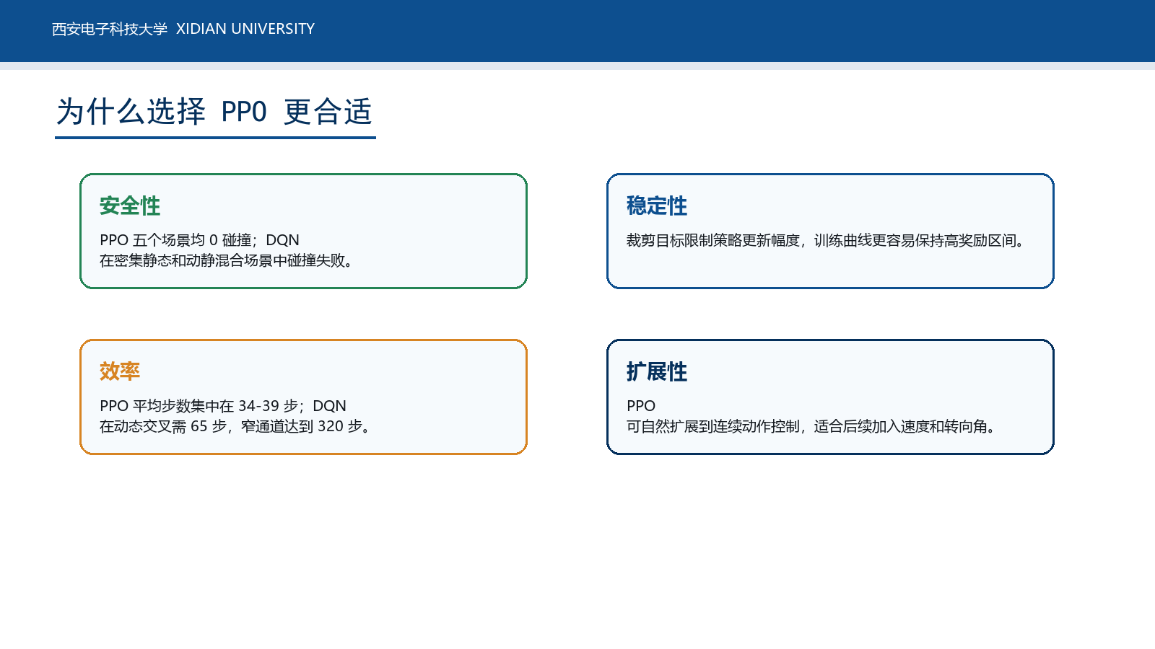

Slide 10
#

Slide 11
