Slide 1

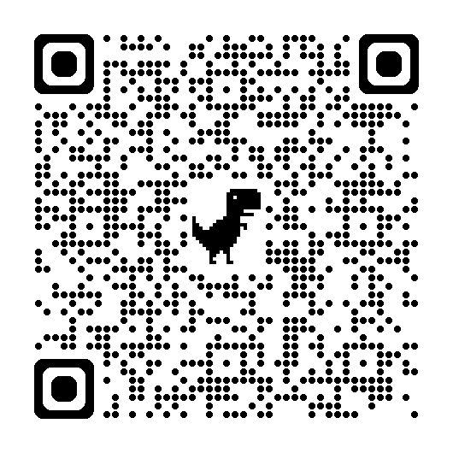
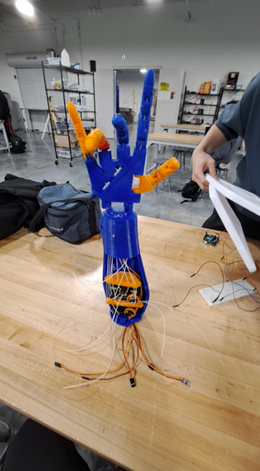
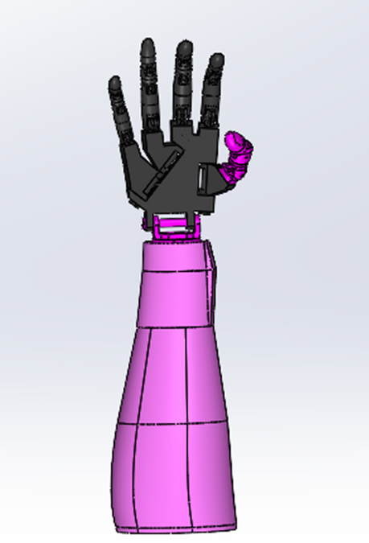
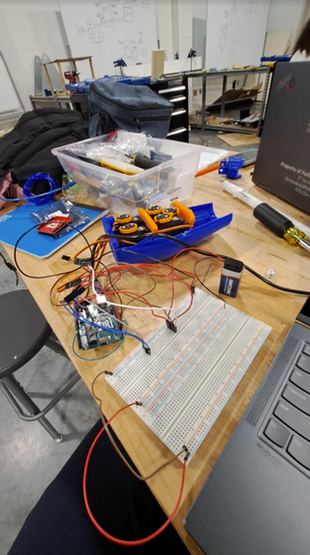
Mechanical Robotic Hand
Background
Farooq Anwar | Dylan Kong | Patrick Matyniak
Acknowledgements
This project was inspired by amputees. People should not be limited to the functionality of their limbs. As a result, we decided to make an EMG powered prosthetic hand. Utilizing a MyoWare sensor, we can use this to power the servos thus retracting or clenching the hand.
Special thanks to our wonderful engineering teacher Mr. Reid, who motivated us through our challenges.
How are we able to improve current systems of modern technology using engineering to facilitate a change in healthcare?
We can create a robotic arm that follows your dominant hand for handling dangerous substances in labs as well for amputees.
Methods / Materials
Conclusion
We started by 3d printing parts of the arm. We started from the fingertips to the forearm. After, assembled everything. We then installed the high-powered servos into the forearm. After this step, we then threaded badminton string from the finger, down the wrist, and ending at the forearm being tied up to the servo.
At the end of assembling our arm, we needed to wire everything up and code it. We used the MyoWare 2.0 Muscle sensor to move the robotic arm, but our Arduino shield used up all the pins and preventing us from attaching the servo. We tried many solutions, but none worked. With some miracle, on the last day of working, our idea came to life.
What is MyoWare?
“This muscle sensor from Advancer Technologies measures a muscle’s activity by monitoring the electric potential generated by muscle cells. This is referred to as electromyography (EMG). The sensor amplifies and processes the complex electrical activity of a muscle and converts it into a simple analog signal that can easily be read by any microcontroller with an analog-to-digital converter (ADC), such as an A-Star or Arduino – or even a Maestro servo controller. As the target muscle group flexes, the sensor’s output voltage increases. The exact relationship between the output voltage and the muscle activity can be fine-tuned using an on-board gain potentiometer. The MyoWare Muscle Sensor is an updated version of Advancer Technologies’ older Muscle Sensor v3 with several improvements, notably single-supply operation (no need for a negative voltage supply) and built-in snap connectors for electrodes. Other new features include a raw EMG output, reverse power protection, a power switch, and LED indicators.” - Pololu

