Slide 1
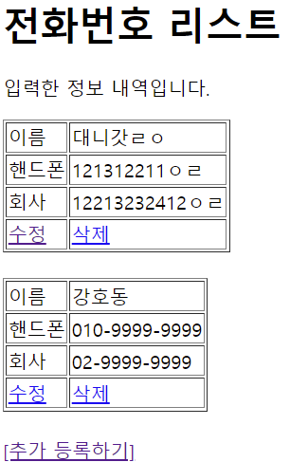
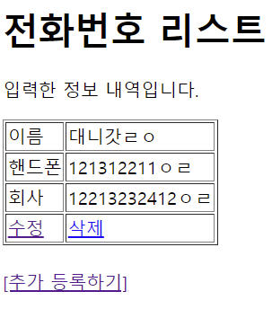
Handler Mapping
“/phonebook3/delete” get post-> PhoneController.delete()
*Delete
Tomcat
Phonebook3
http://localhost:8088/phonebook3/delete?
personId=?
web.xml
spring-servlet.xml
Handler Mapping
PhoneDao 객체
/delete
PhoneController
personDelete(personId)
Front Controller
DispatcherServlet
2
1
3
Controller
personId
리다이렉트
Request
*파라미터
personId=?
*어트리뷰트
4
ModelAndView
count
Jdbc -> pom.xml
6
5
View
View Resolver
Response
html <- jsp
7
view
Return “list.jsp”
DB

Slide 2
Handler Mapping
Tomcat
Phonebook3
PhoneDao 객체
web.xml
spring-servlet.xml
Handler Mapping
Front Controller
DispatcherServlet
2
1
3
Controller
Request
*파라미터
*어트리뷰트
4
ModelAndView
6
5
View
View Resolver
Response
7
DB

Slide 3
Handler Mapping
Tomcat
Phonebook3
PhoneDao 객체
web.xml
spring-servlet.xml
Handler Mapping
Front Controller
DispatcherServlet
2
1
3
Controller
Request
*파라미터
*어트리뷰트
4
ModelAndView
6
5
View
View Resolver
Response
7
DB

