Slide 1
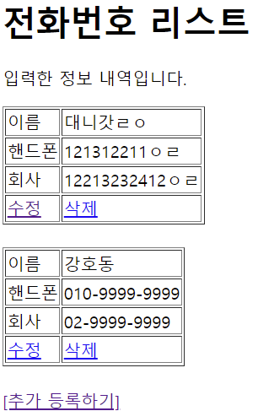
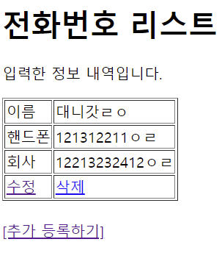
Handler Mapping
“/phonebook3/delete” get post-> PhoneController.delete()
*Delete
Tomcat
Phonebook3
http://localhost:8088/phonebook3/delete?
personId=?
web.xml
spring-servlet.xml
Handler Mapping
PhoneDao 객체
/delete
PhoneController
personDelete(personId)
Front Controller
DispatcherServlet
2
1
3
Controller
personId
빈화면
리다이렉트
Request
*파라미터
personId=?
*어트리뷰트
4
ModelAndView
count
Jdbc -> pom.xml
6
5
View
View Resolver
Response
리다이렉트
7
view
Return “redirect:/list”
DB

Slide 2
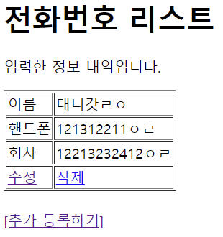
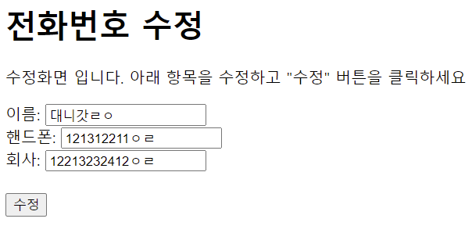
Handler Mapping
“/phonebook3/updateForm” get post-> PhoneController.updateForm()
*updateForm
Tomcat
Phonebook3
http://localhost:8088/phonebook3/
updateForm?
personId=?
web.xml
spring-servlet.xml
Handler Mapping
PhoneDao 객체
getPerson(personId)
Front Controller
DispatcherServlet
2
1
3
Controller
personId
Request
*파라미터
personId=?
*어트리뷰트
“personList” , personVo
4
ModelAndView
personVo
6
5
View
View Resolver
Response
Html <- jsp
7
Model
“personList”, personVo
view
Return “updateForm.jsp”
DB

Slide 3
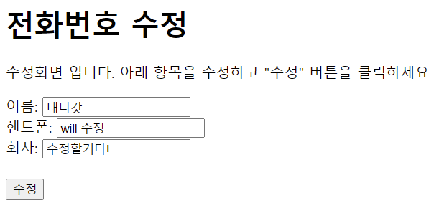
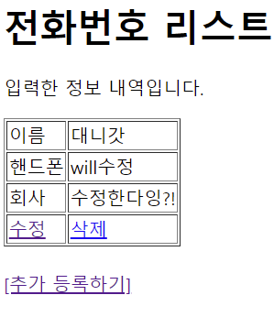
Handler Mapping
“/phonebook3/update” get post-> PhoneController.update()
*update
Tomcat
Phonebook3
http://localhost:8088/phonebook3/
update?
name=?
&hp=?
&company=?
&personId=?
web.xml
spring-servlet.xml
Handler Mapping
PhoneDao 객체
personUpdate(personVo)
Request
*파라미터
name=?
hp=?
company=?
personId=?
*어트리뷰트
Front Controller
DispatcherServlet
2
1
3
Controller
personVo
4
ModelAndView
count
빈화면
리다이렉트
6
5
View
View Resolver
Response
리다이렉트
7
view
Return “redirect:/list”
DB

