Slide 1
Phish Trawler
Email Phishing Identifier

Slide 2




WHY ?
Rise of Cyber Threats & AI
Convincing
Harder to Detect

Slide 3



PhishTrawler
Accurate
Email Phishing Identifier
Easy to Use

Slide 4




PhishTrawler – Core Features
Email Extraction
Email Verification
Language Analysis
URL Checking

Slide 5


PhishTrawler – Additional Features
Document Analysis
Graphical User Interface

Slide 6
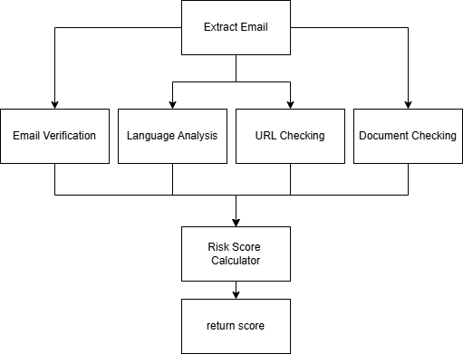
PhishTrawler – System Diagram

Slide 7
Functions

Slide 8


PhishTrawler – Email Verification
Domain Whitelist Check
Lookalike Domain Check

Slide 9


PhishTrawler – Language Analysis
Detect Probability
Email Language Risk

Slide 10


PhishTrawler – URL Checking
Offline Redirection Check
Domain Page Rank Check

Slide 11


PhishTrawler – Document Checking
High Risk Extension Check
Archive Check

Slide 12
PhishTrawler – Weightage
Scenario/Checks | Email Verification | Language Analysis | URL Checking | Document Checking
URL Not Present Document Not Present | 55% | 45% | None | None
Document Present | 40% | 35% | None | 25%
URL Present | 40% | 35% | 25% | None
URL Present Document Present | 35% | 15% | 25% | 25%

Slide 13
DEMO

