Slide 1





Slide 2

Skills Development program 2022/2023
Overview
ISPA, in partnership with WAPA and WASPA, launched phase 1 of the ICT Skills Registry, in September 2022, when registrations for candidates were opened. So far there have only been 75 candidate profiles submitted. 56 for internship/learnerships, and 23 seeking permanent employment.
The Skills Registry is a searchable database containing the profiles and skill sets of registered candidates pursuing a career path in the ICT industry. It is primarily designed to create an entry point for younger job seekers to obtain skills development through internship or learnership programs; or to gain workplace experience to complete their studies.
Phase 2 will be launched when sufficient candidates have registered, and the Skills Registry will then be open for qualifying ICT companies to easily search for candidates registered on the system to source and offer internship/learnerships, or full time employment to suitable individuals meeting their specific skills criteria.

Slide 3
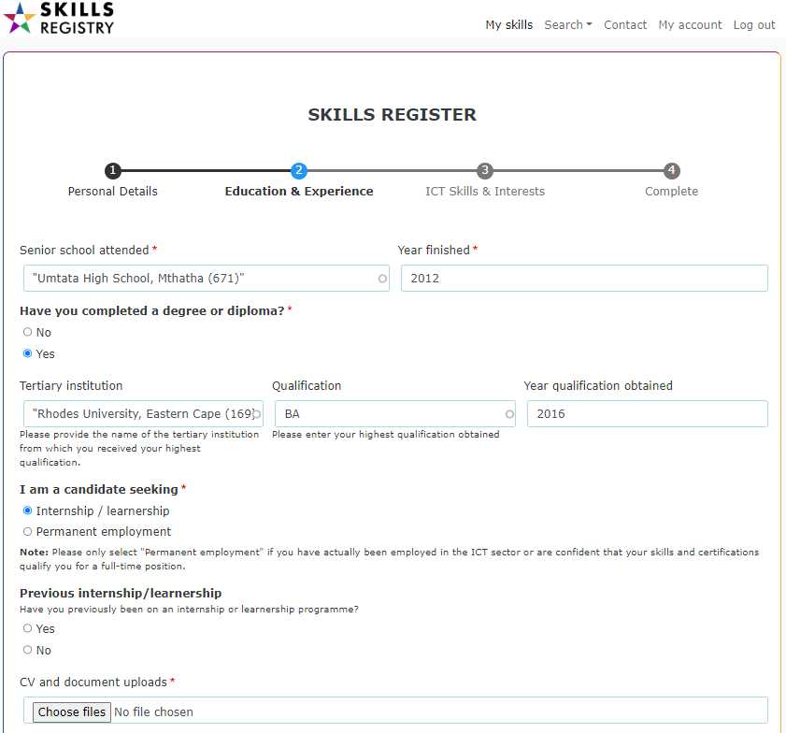
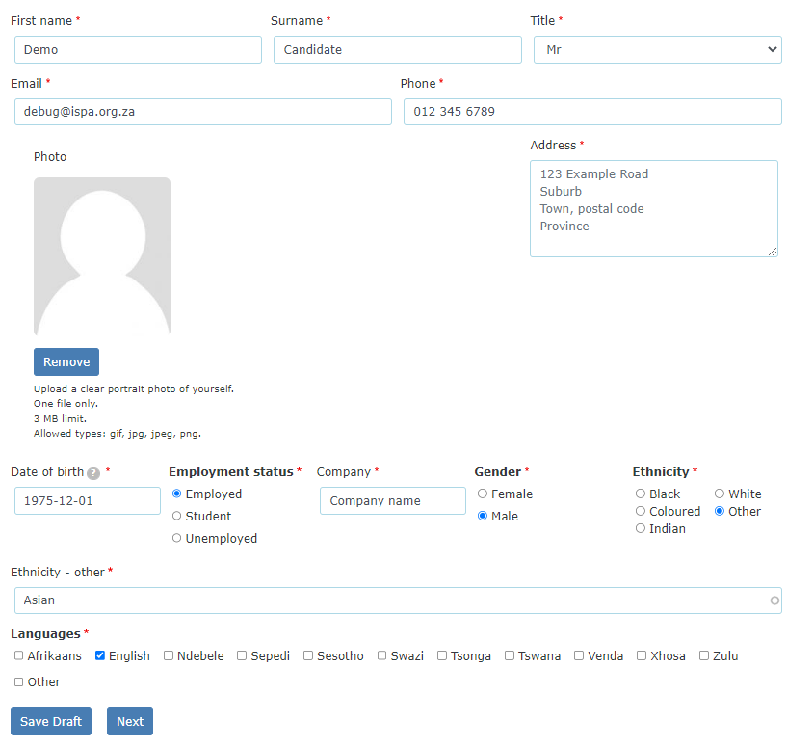
Phase 1, step 1: Candidate registration
NB

Slide 4
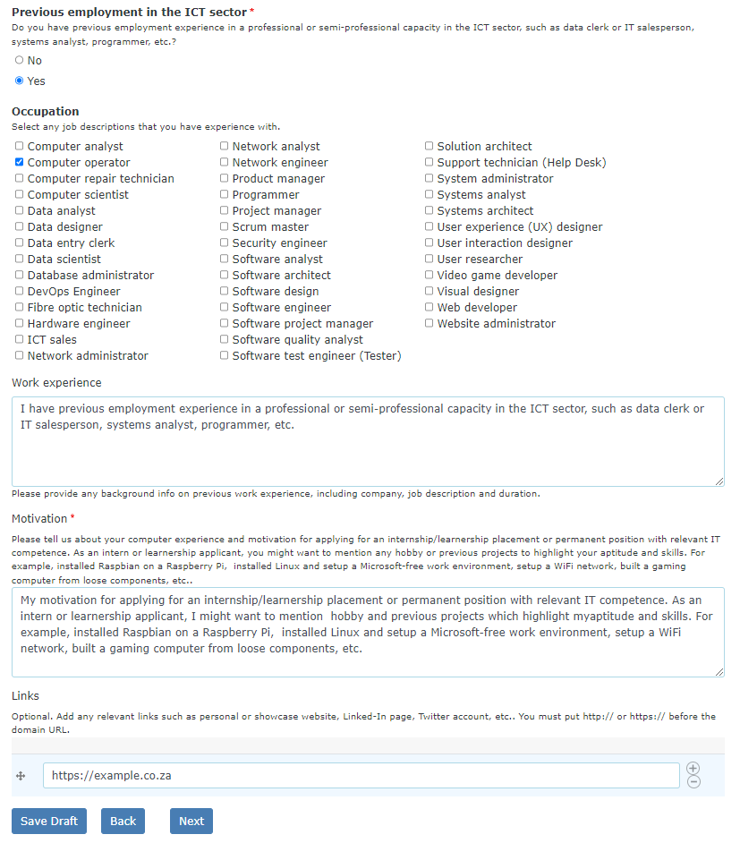
Data captured on candidate webform includes:
Demographics
Location using geolocation
Education
Qualifications
CV upload
Industry experience / occupations (if applicable)
Previous internship details if applicable
Work experience
… Motivation
Links to personal website/s. E.g. Linkedin, Instagram, etc., or personally designed showcase site.

Slide 5
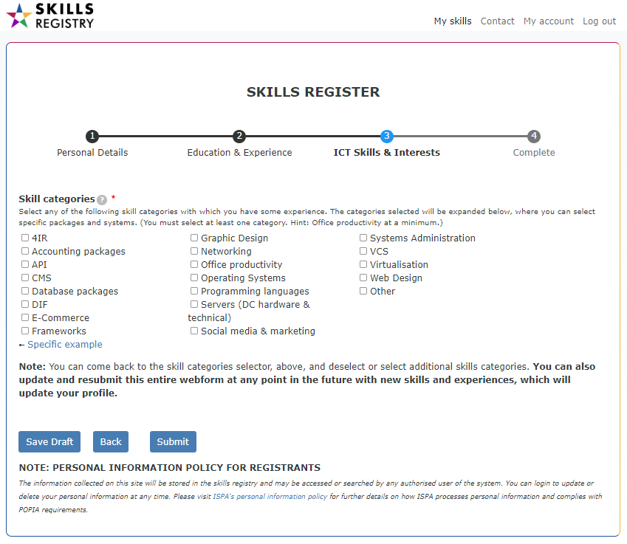

The core of the search engine is specific skills selected in section 3, ICT Skills & Interests
Candidate
Matrix

Slide 6
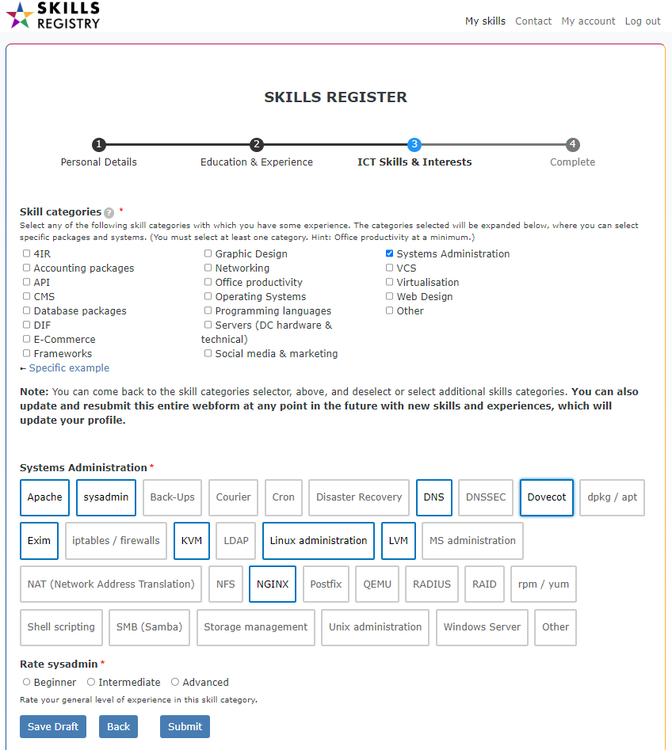
A few skill category examples:
Types of:
Accounting packages
Office productivity packages
Operating systems
Databases
Programming languages
Servers (Data Centre hardware)
Networking
Social Media and Marketing
Etc., etc..
(Certain specific applications or skillsets are duplicated in different categories. The more conscientious applicants will benefit by selecting, e.g., Bootstrap under both Frameworks and Web design; as the search engine ranks repeated keywords higher.)
The candidate rates their experience in each selected category…
And submits the application for moderation

Slide 7
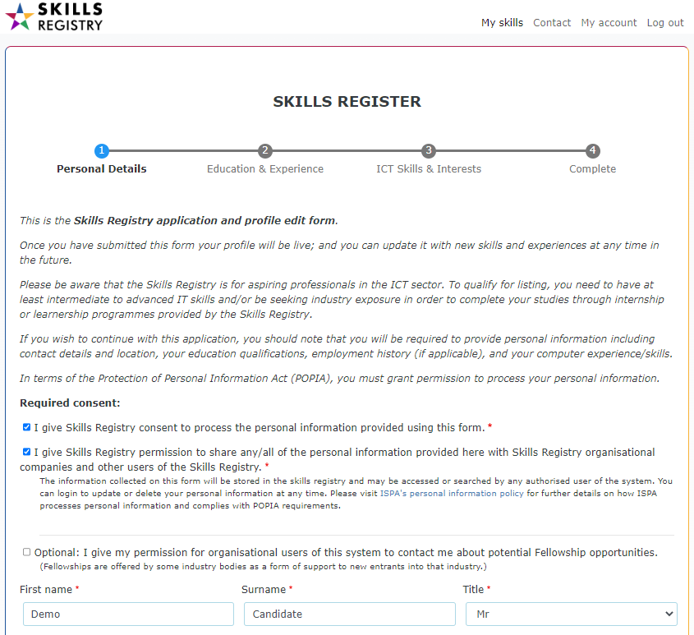
A KEY feature…
A candidate can login to the system at any time and update their profile by clicking on [My skills] and working through the same webform….

Slide 8

Phase 2
Company search engine for candidates

Slide 9
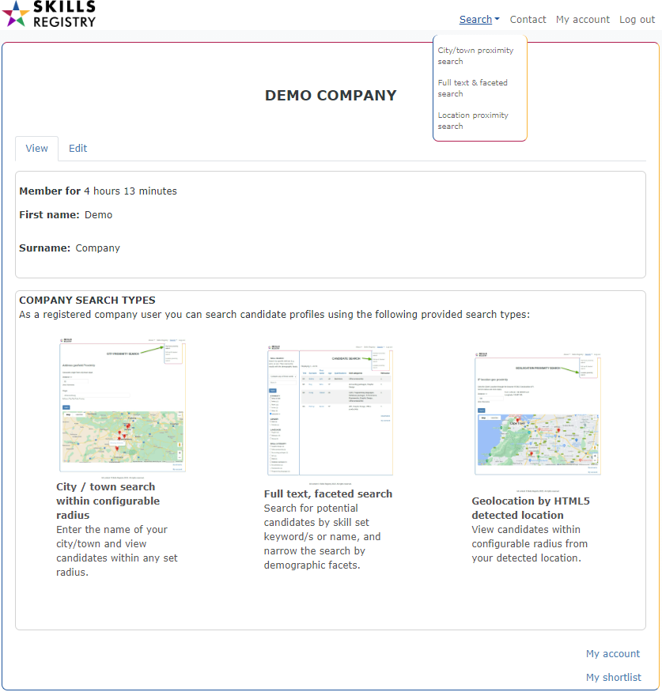
(Note: Company registrations are not yet open.)
After a company user has registered and been approved …
They will always land on their ‘home page’ after login, where they can access 3 different types of searches.
City / town search with configurable radius
Full text, faceted search
Radius selection from HTML5 Geolocation detected location

Slide 10
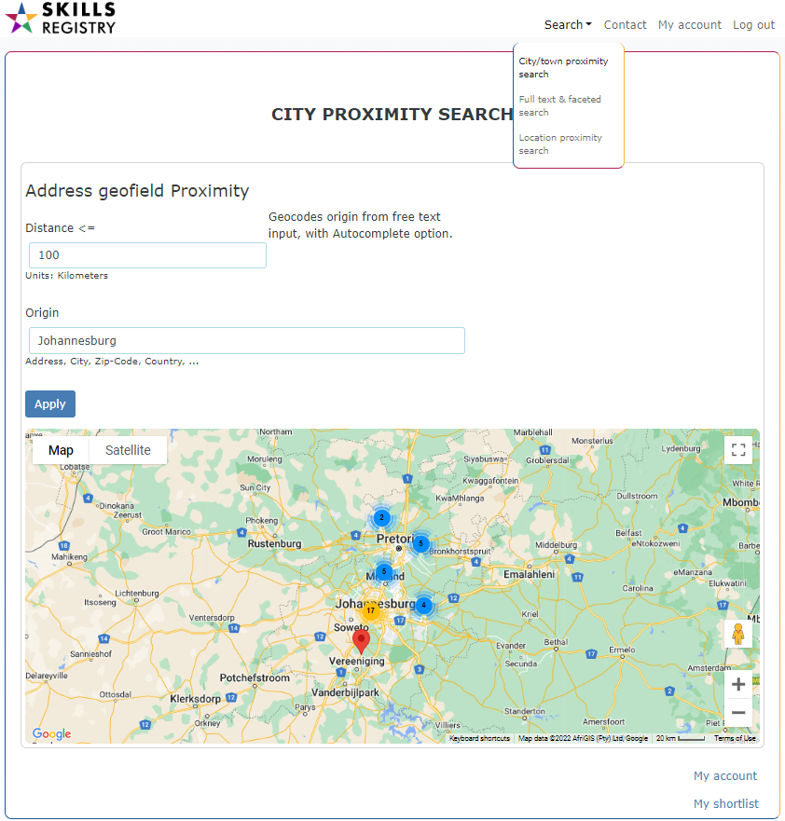
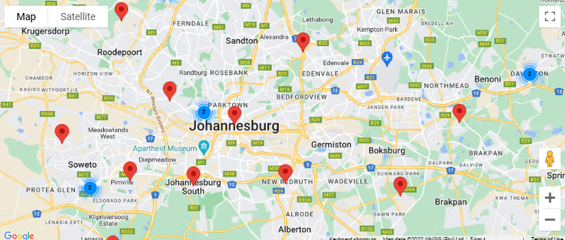
1. City / town proximity search
Allows the company user to set the radius distance from the centre of any recognised city or town.
“Cluster markers” are used to zoom into high density locations of potential candidates

Slide 11
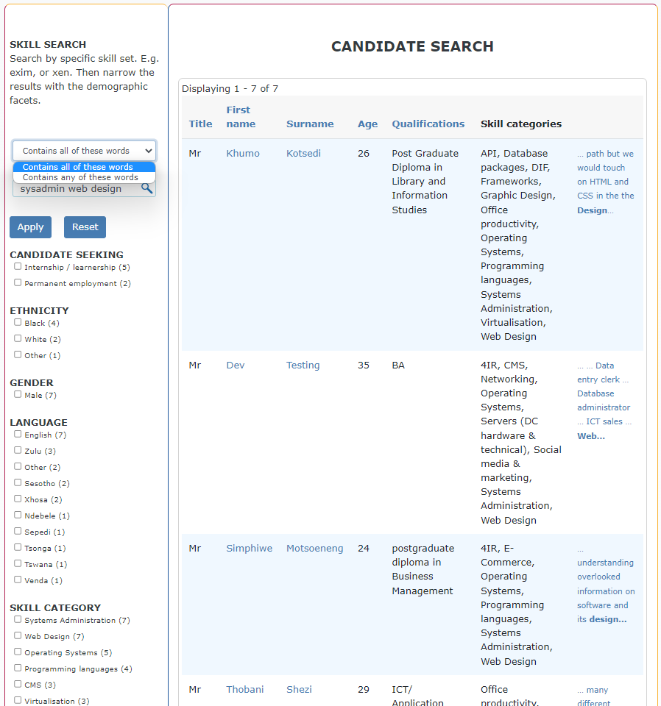
2. Full text & faceted search
AND / OR
AND searches are the default and must “Contain all of these words” in the search.
In this example, “sysadmin” AND “web design” returns 7 results.
OR searches can contain any of the search words, and would widen the result.
In this case, it would return 44 results of cadidates with EITHER or BOTH sysadmin and web design skills; which is distinctly less useful.

Slide 12
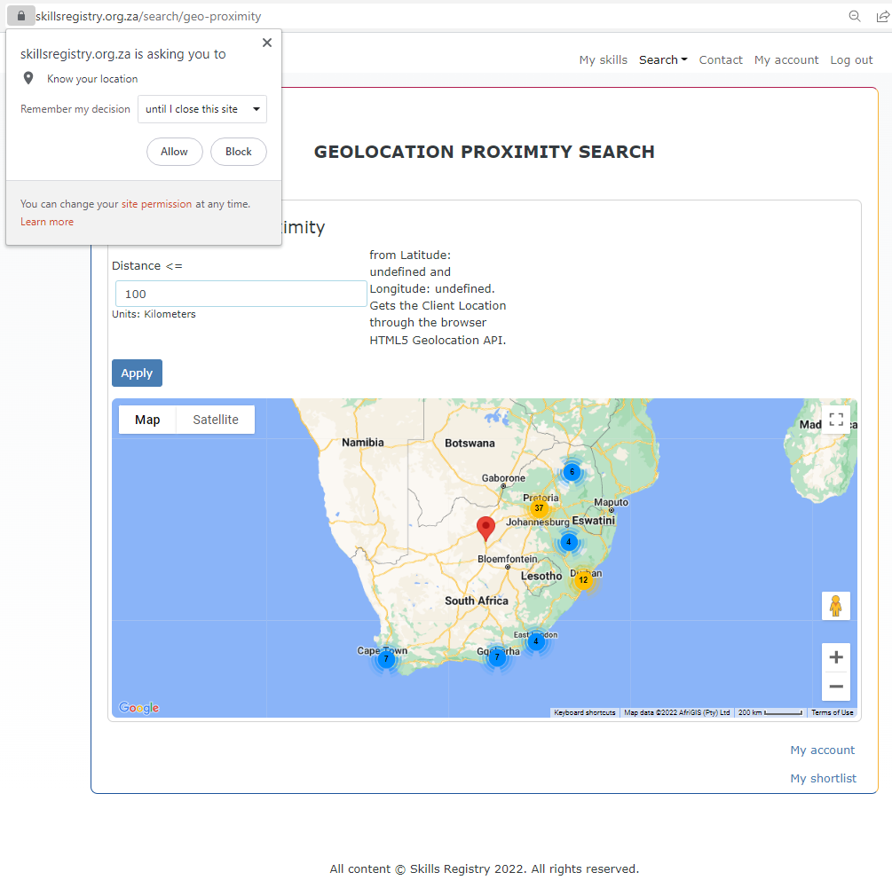
3.Search by a radius of x kilometers from detected HTML5 Geolocation
The company user’s location is automatically detected, provided the user allows the site to know their location.
Where this may be specifically useful is for locating potential candidates or employees in the nearby vicinity from your exact physical location.
But the precision depends on the paranoia level of the user to some extent, as they must be logged into a service such as Google or Microsoft on a device with GPS tracking enabled.
… Otherwise the location detected will be of the IP address of their provider’s gateway.

Slide 13
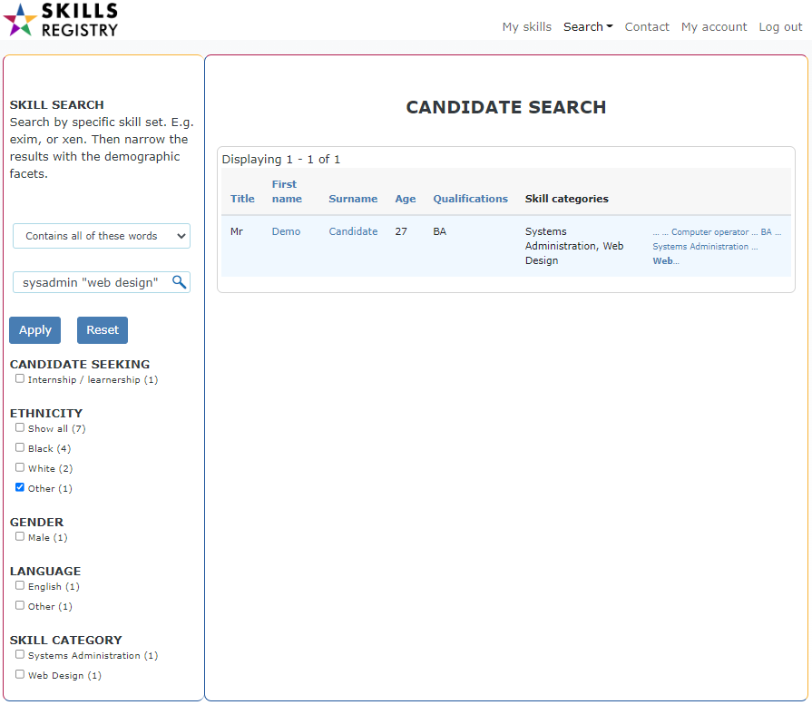
Candidate interaction
Full text & faceted search using
SKILL SEARCH by specific skill sets “sysadmin” AND “web design”... Then narrowing the results with the demographic facets. (Basic example for the sake of demonstration.)

Slide 14
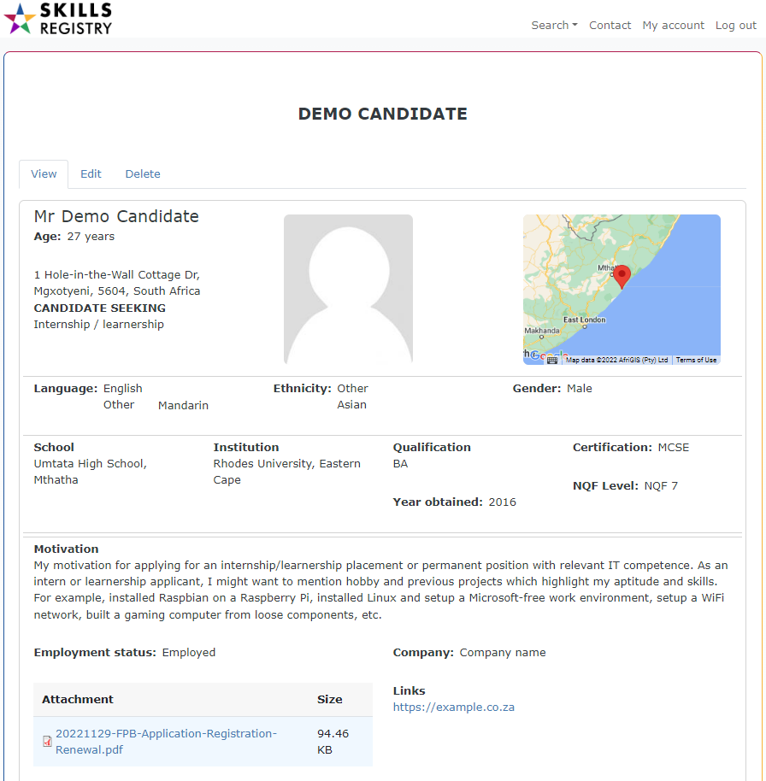
Candidate interaction
This candidate page is rendered for a company user, but also for a Skills Registry admin, which has the additional facility of a 10 star content rating widget – which orders the candidate positions in the search result.

Slide 15
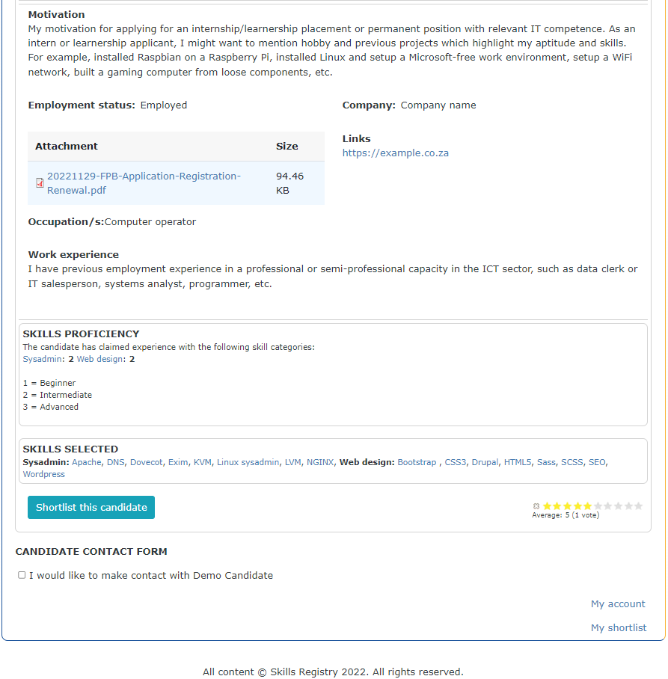
Candidate profile
… Continued from the previous page…
Motivation, CV and other attachments, industry occupation and work experience
Skill categories selected… and self-rated
Admin rating
Specific skills / experience…
Company user can add to shortlist
Company to candidate contact form

Slide 16
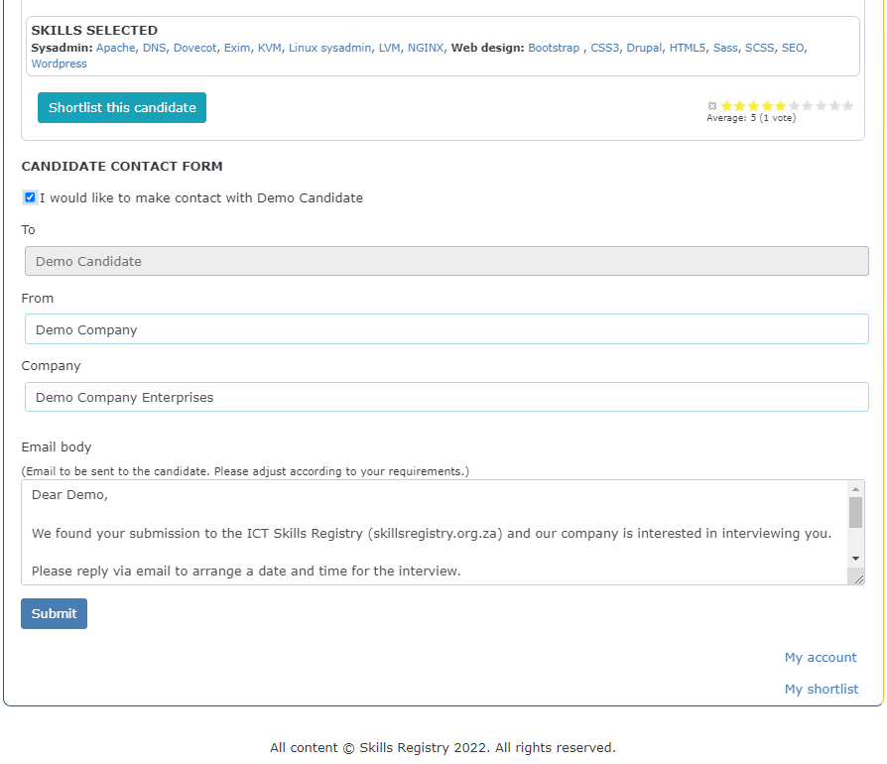
Candidate contact form
The company user sends an email to the candidate through a webform.
The interaction is recorded on both the company user’s and the candidates home pages… as seen on the following page.
… And a follow-up email is sent to both after 30 days to provide feedback on the interview.

Slide 17
