Slide 1
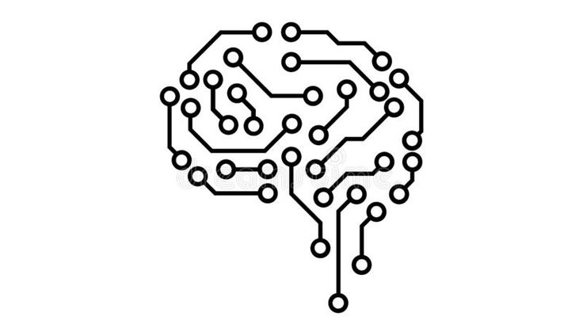
An Overview of Reinforcement Learning with Tic-Tac-Toe and Python

Slide 2
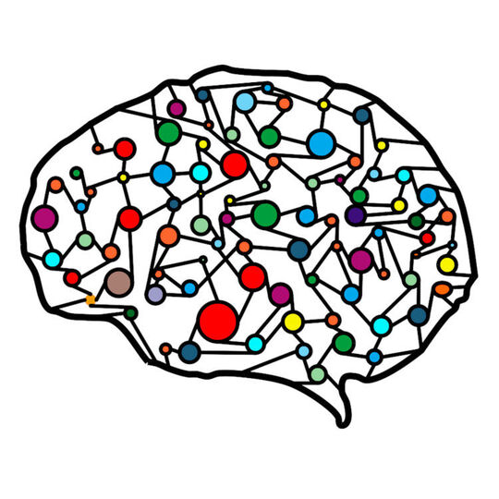
Contents
Introduction to Machine Learning
Software used in this Project
Algorithm used in this Project
Conclusion

Slide 3
Introduction to Machine Learning

Slide 4
Introduction
machine learning (ML) is a branch of artificial intelligence (AI) that allows software applications to become more accurate at predicting outcomes without being explicitly programmed to do so
Classical machine learning is often categorized by how an algorithm learns to become more accurate in its predictions

Slide 5
Types of Machine Learning
Supervised learning: In this type of machine learning, data scientists supply algorithms with labeled training data and define the variables they want the algorithm to assess for correlations. Both the input and the output of the algorithm is specified.
Unsupervised learning: This type of machine learning involves algorithms that train on unlabeled data. The algorithm scans through datasets looking for any meaningful connection. The data that algorithms train on as well as the predictions or recommendations they output are predetermined.
Reinforcement learning: works by programming an algorithm with a distinct goal and a prescribed set of rules for accomplishing that goal. Data scientists also program the algorithm to seek positive rewards -- which it receives when it performs an action that is beneficial toward the ultimate goal -- and avoid punishments -- which it receives when it performs an action that gets it farther away from its ultimate goal.

Slide 6
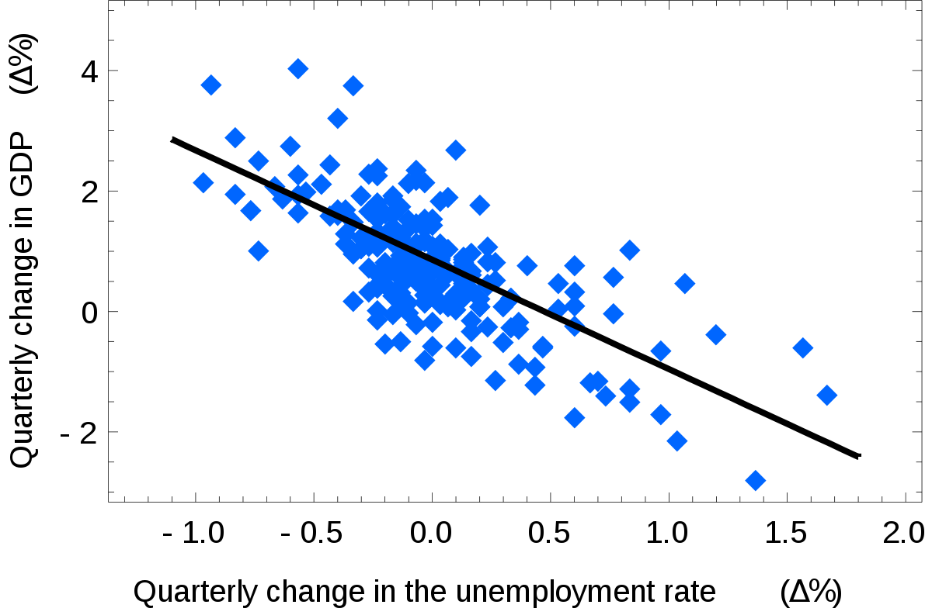
Supervised Learning

Slide 7
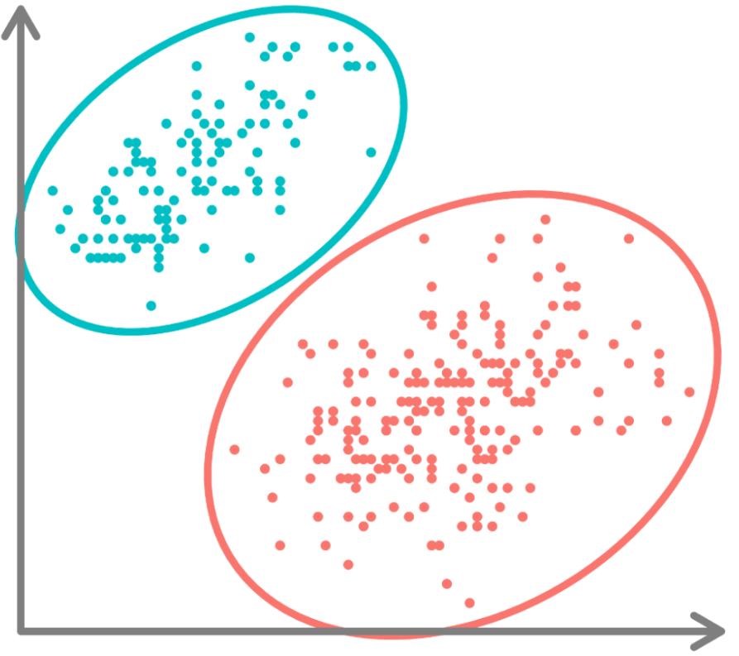
Unsupervised Learning

Slide 8

Reinforcement Learning

Slide 9
Software used in this Project

Slide 10

Python Programming Language
Python is a high-level, general-purpose, and very popular programming language. Python programming language (latest Python 3) is being used in web development, Machine Learning applications.
Python was used to code this project because of its simplicity and available modules that makes it very easy to develop this project
Numpy module is used for matrix transformations
Pygame module is used to make user interface

Slide 11
Algorithm used in this Project

Slide 12
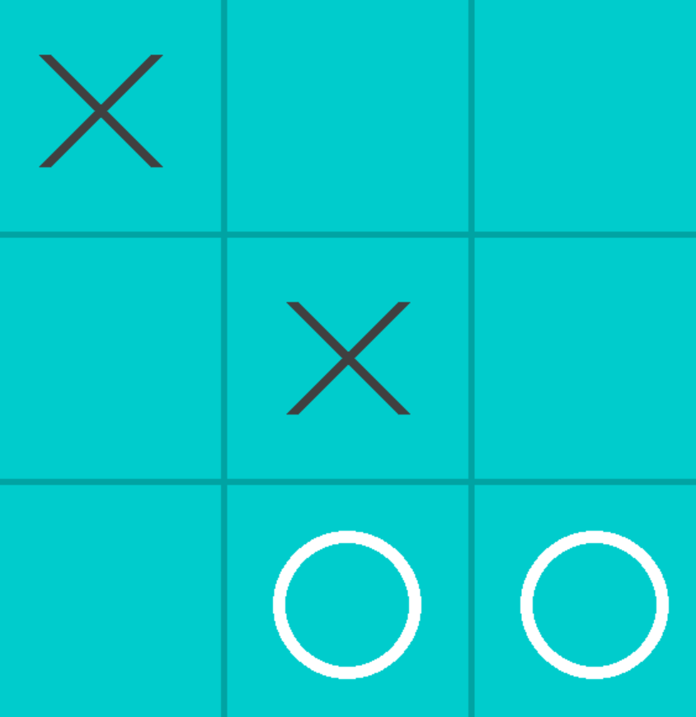
Representing The Game State Squares as a Matrix and a hash
A game state like shown in figure below is represented in the matrix as [[ 1,0,0 ], [ 0,1,0 ], [ 0,2,2 ] ]. So this 2d array is an instance of our game state.
Here X is presented by 1, O is presented by 2 and empty square is presented by 0 in our 2d array
Now state matrix is iterated and values are added to a python string is formed as hash for this current state, the hash for the shown image will be “100010022”

Slide 13
“100010022”
[[1,0,0],
[0,1,0],
[0,2,2]]
0
1
2
0
1
2

Slide 14
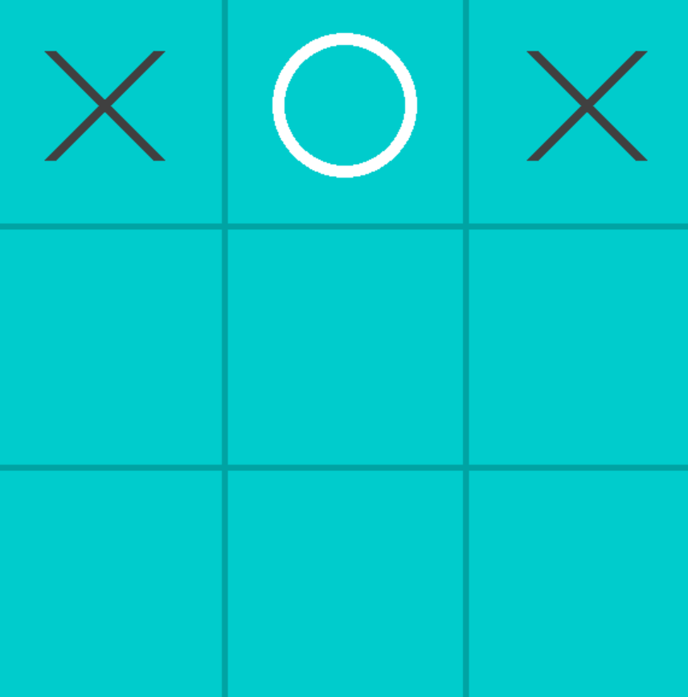
Symmetrical States
Generating Symmetrical States
s=0 s=1 s=2 s=3 s=4 s=5 s=6

Slide 15
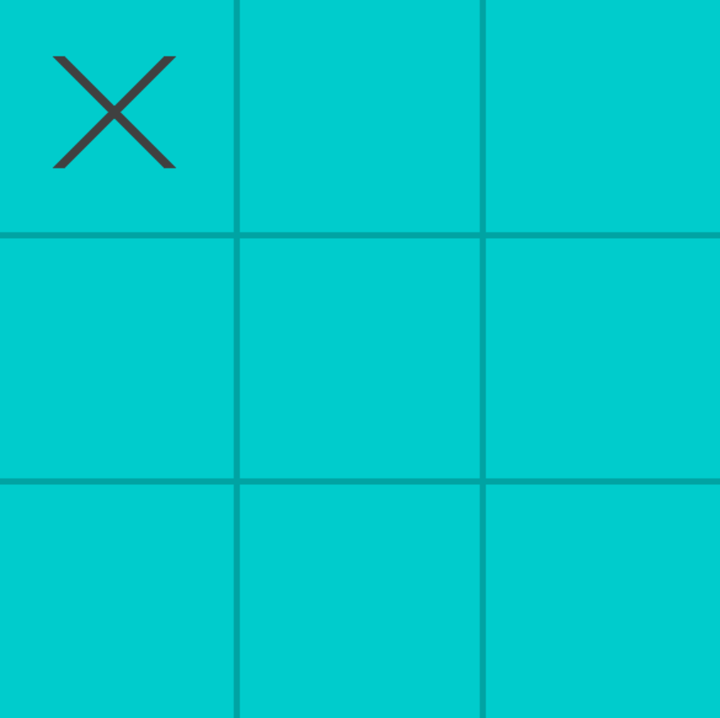
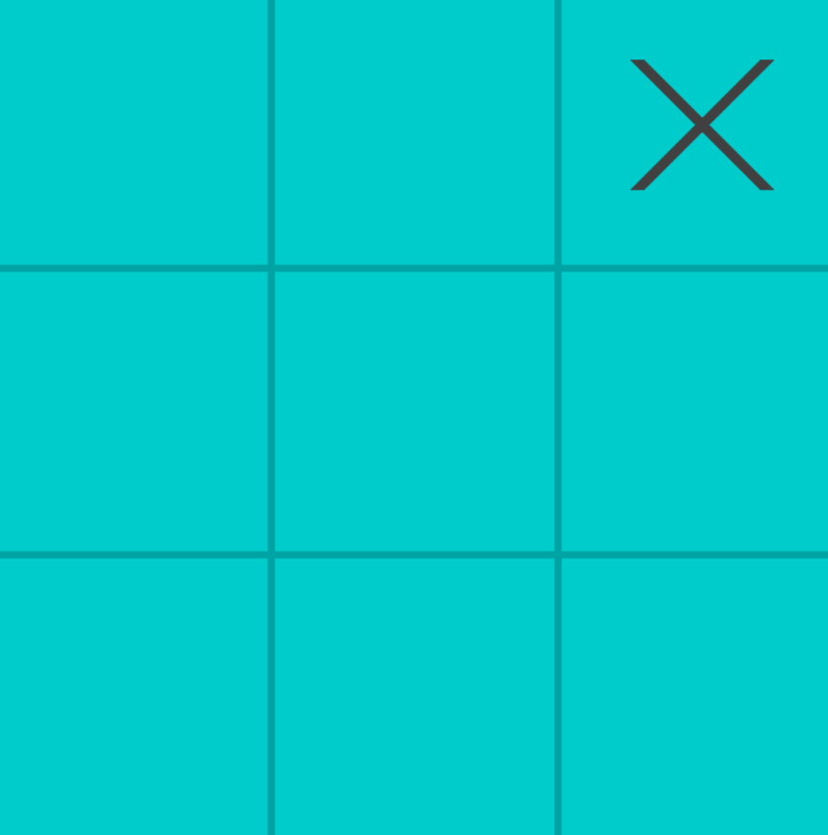
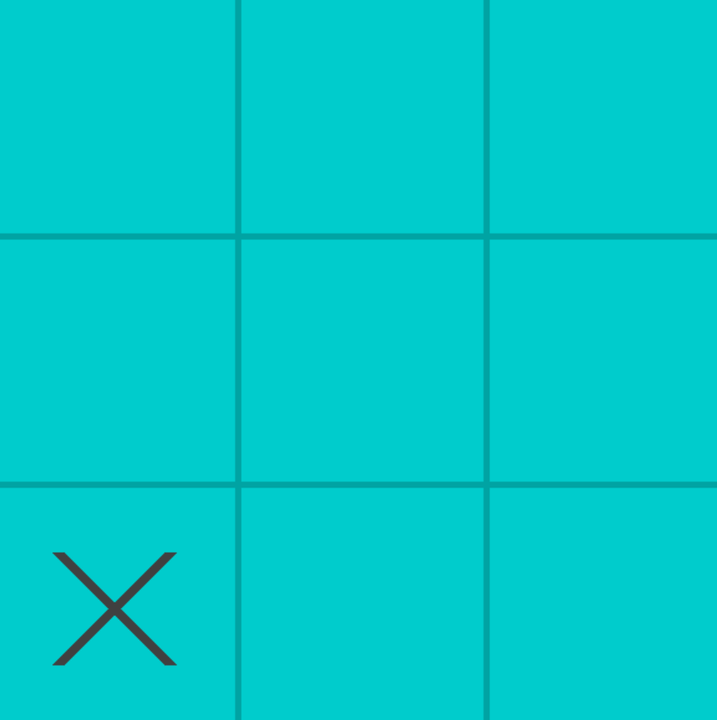

“001000000” “000000100” “000000001” “100000000”
s:0 s:2 s:1

Slide 16
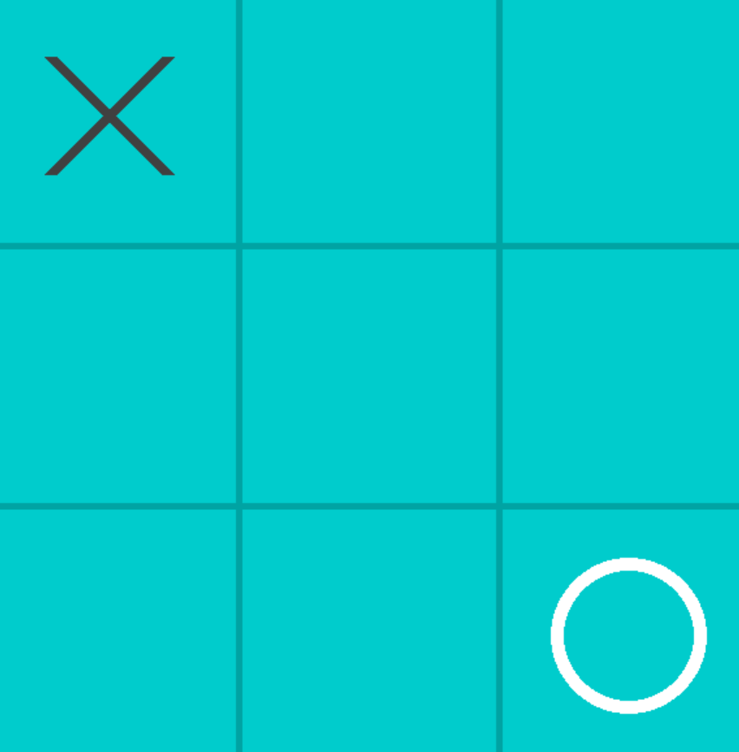
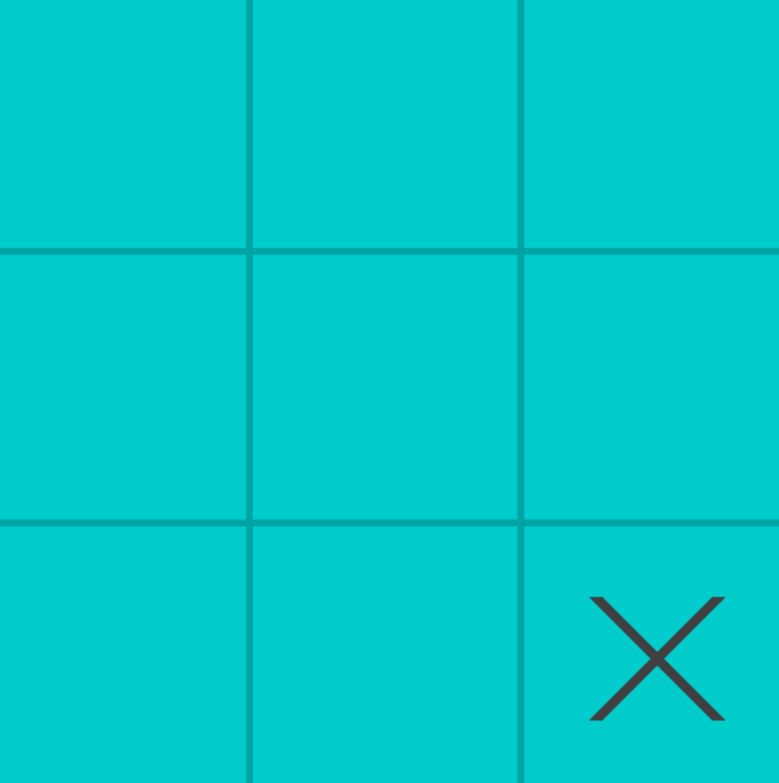
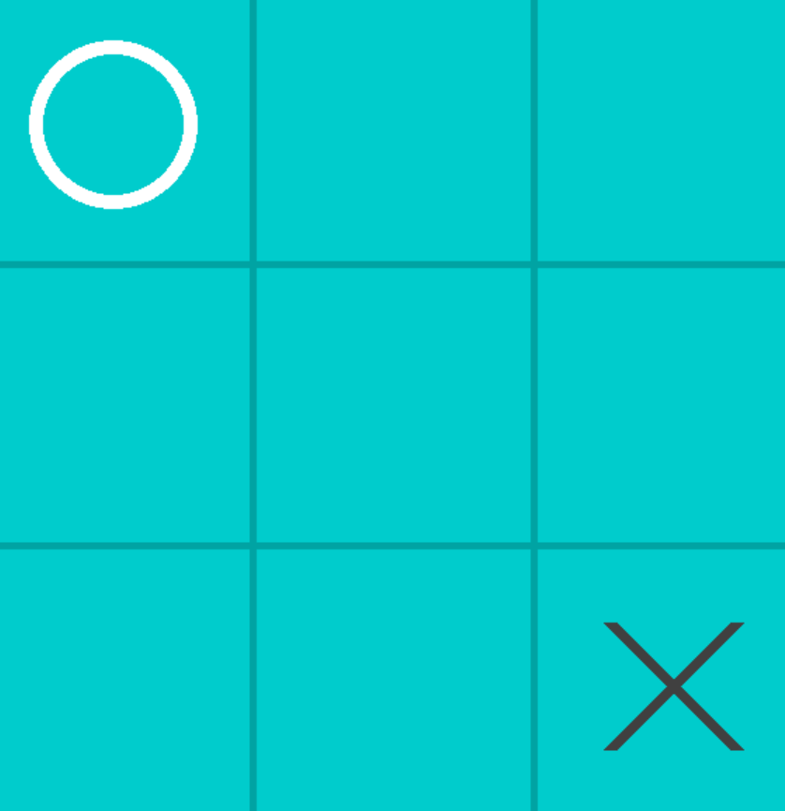
0
1
2
0
1
2
0
1
2
0
0
0
New Game
S:1 Rotation
1
1
1
2
2
2
Best Move: (2,2)
Best Move: (0,0)
{“000000001”: { “hash”:”100000000”, “s”:1}
s:1 (rotation)

Slide 17
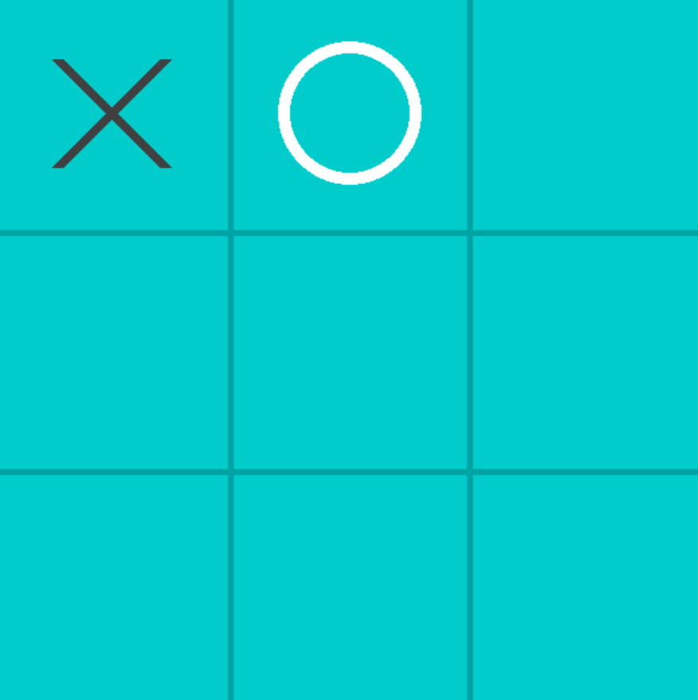
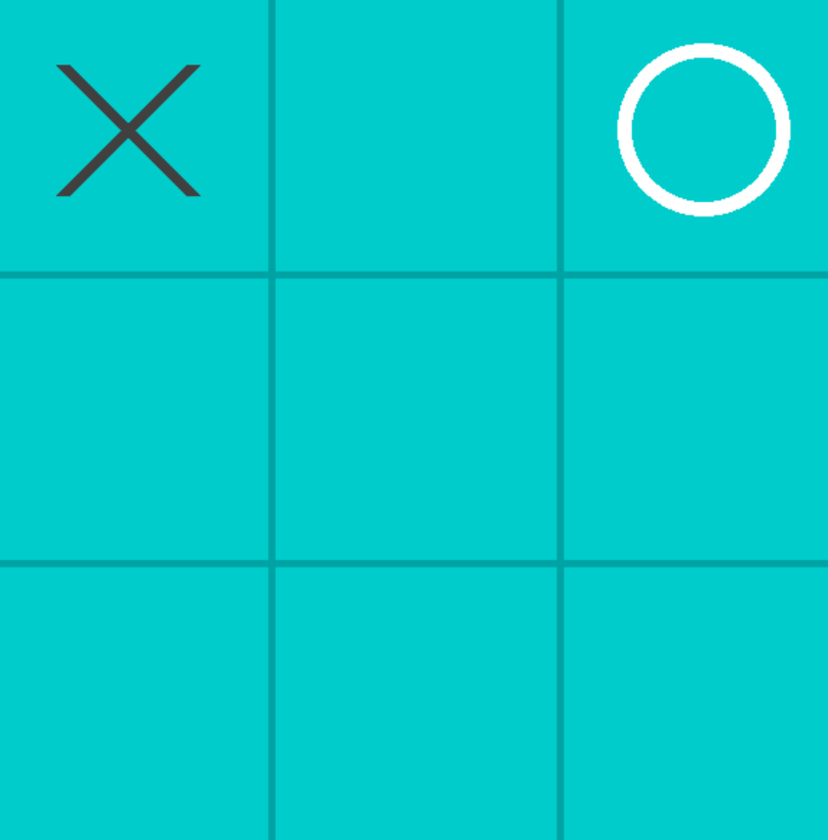
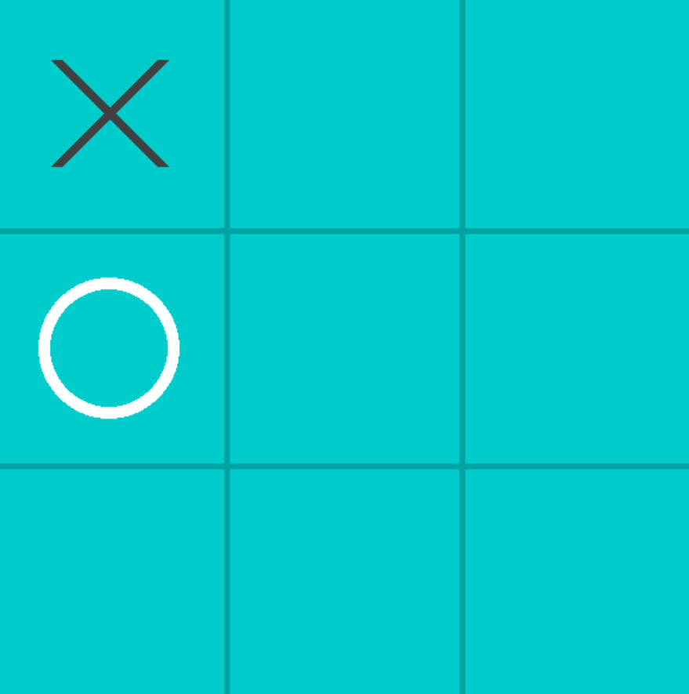
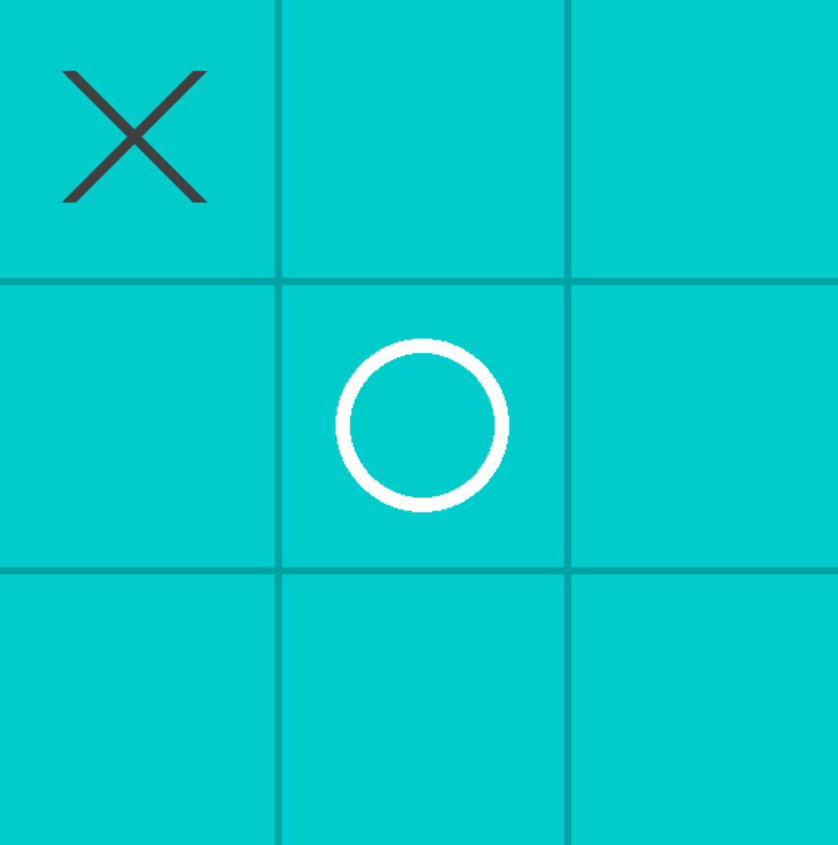
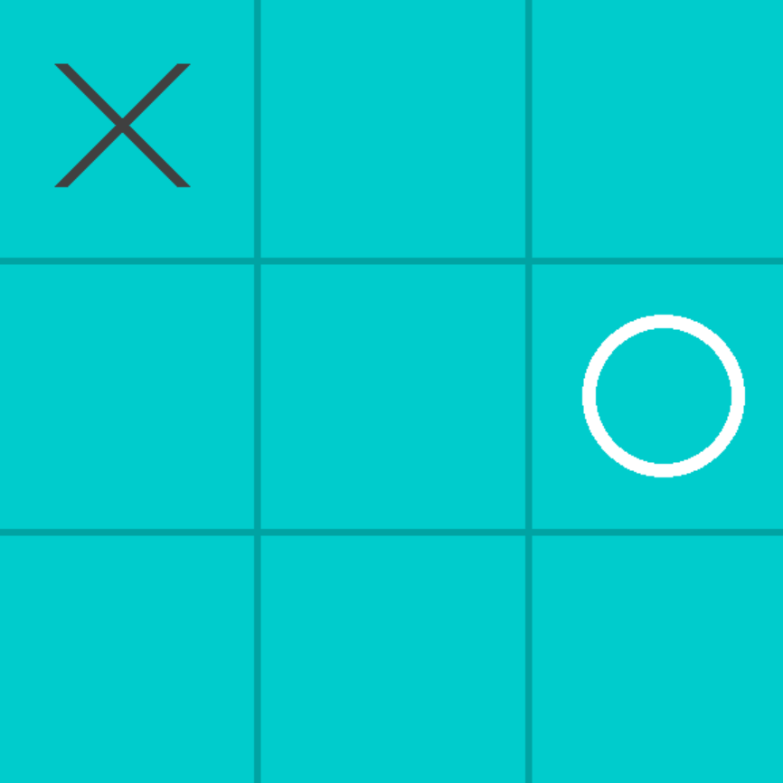
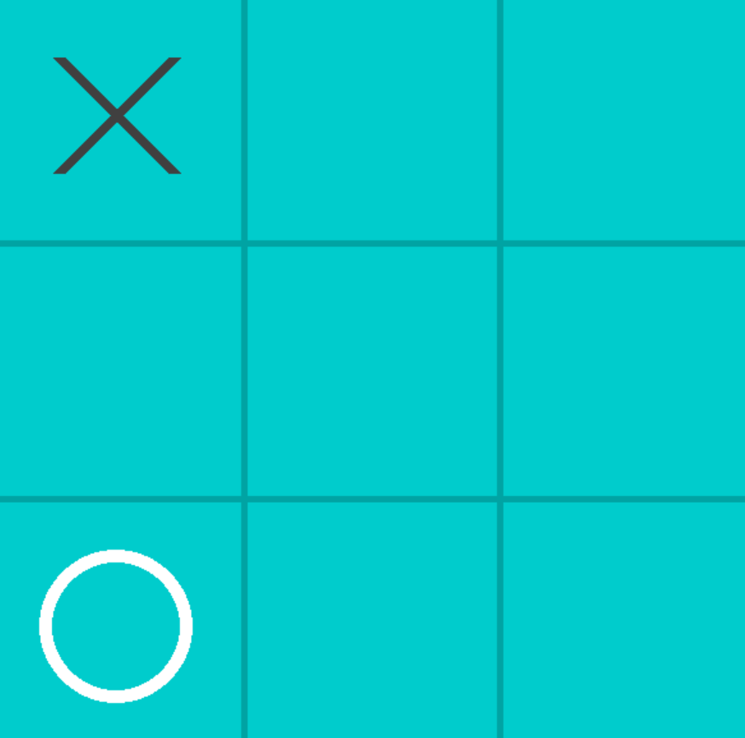
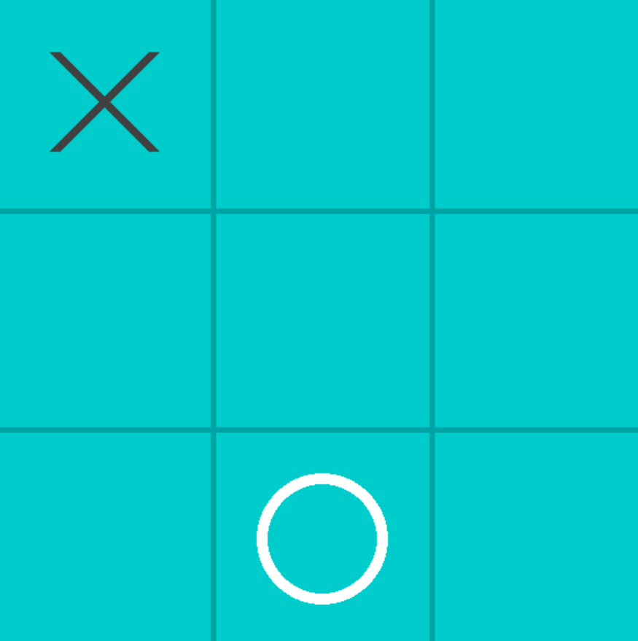
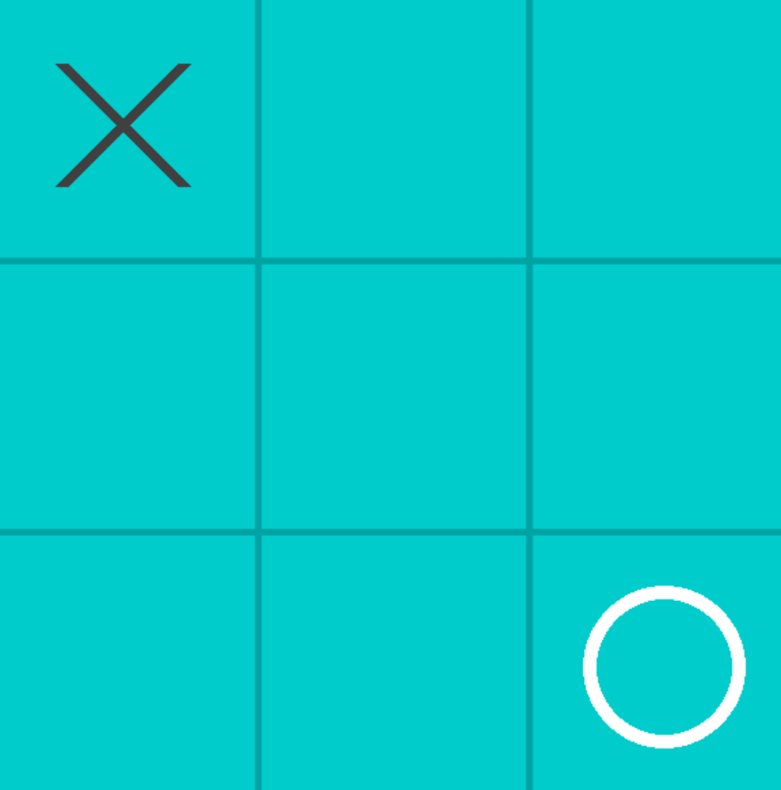
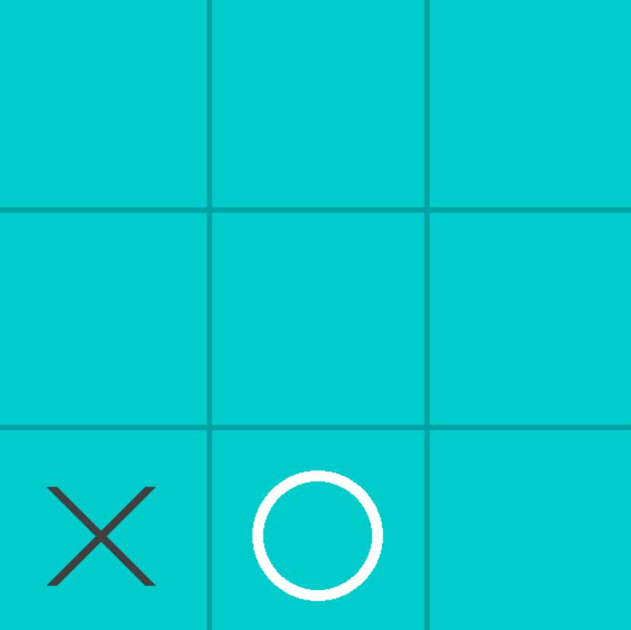
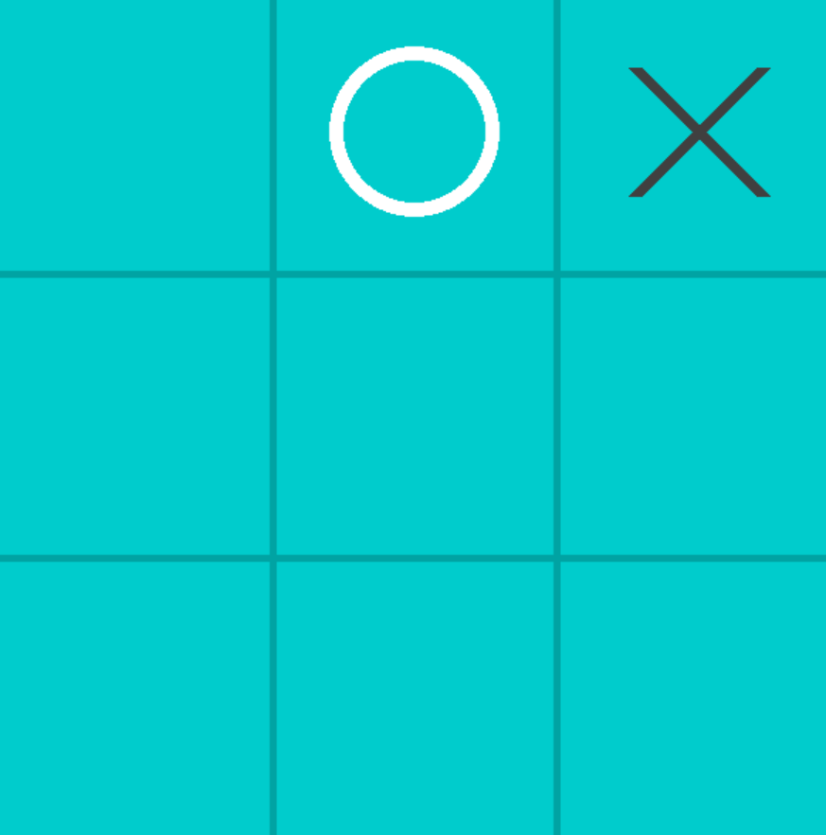
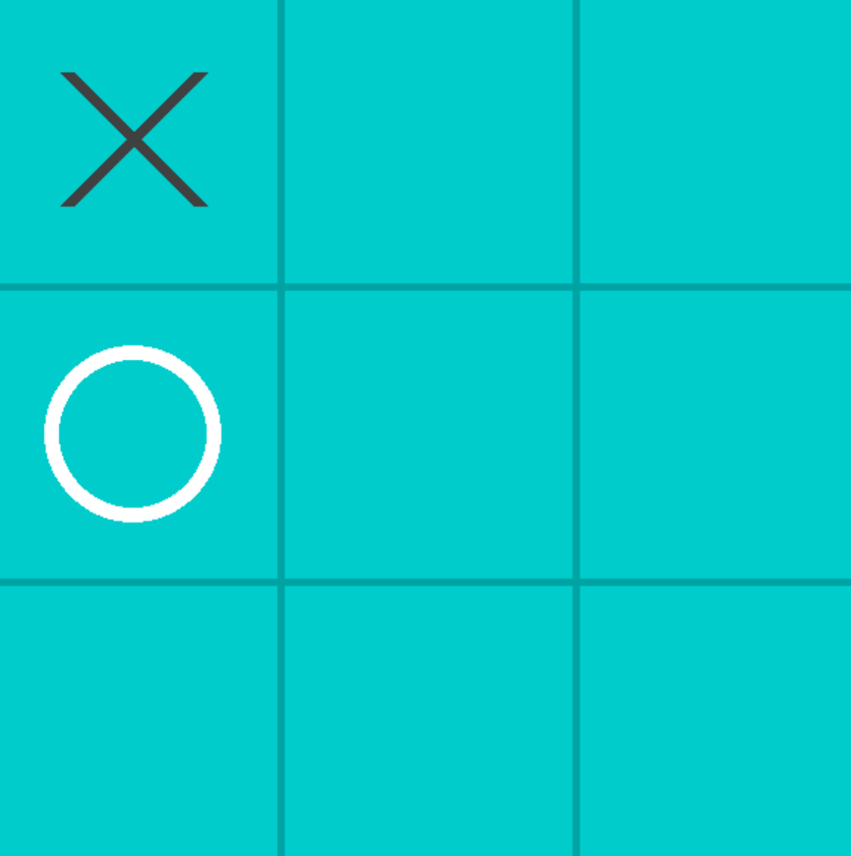
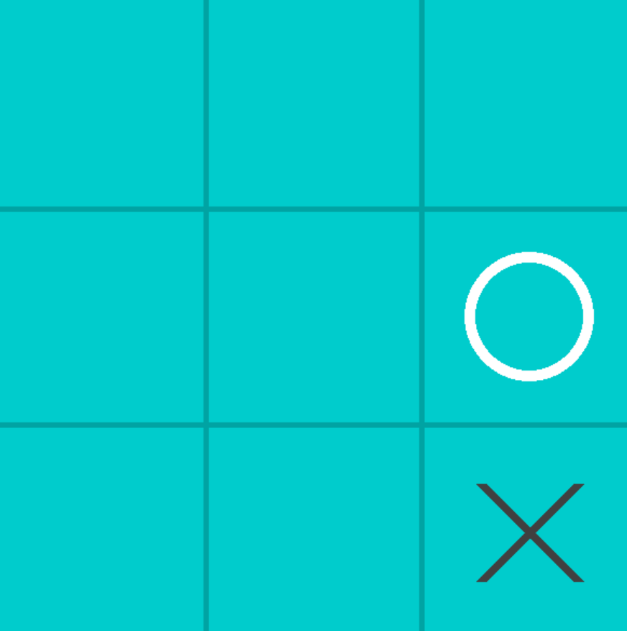
0
1
2
0
1
2
s=0 s=1 s=2 s=3 s=4 s=5 s=6
{ “100000000” : { (1,0):1, (1,1):1, (2,0):1, (2,1): 1, (2,2):1 } }

Slide 18
{ “100000000” : { (1,0):1, (1,1):1, (2,0):1, (2,1): 1, (2,2):1 } }

Slide 19
How is game data stored
8
“no_of_games” ( int )
“100000000”:{ (0,1):1, (1,1):1, (1,2):1, (2,1):1, (2,2):1 },
“100020001”:{(1,0):1, (2,0):1, (2,1):1 },
“120000100”:{…}
“game_space” ( dict )
“
“001000000”: { “hash”:”100000000” , ”s”:0 },
“000000001”: { “hash”:”100000000” , ”s”:1 },
“000000100”: { “hash”:”100000000” , ”s”:2 },
“game_space_link” ( dict )
game_data ( dict )
Empty
game_stack (list)

Slide 20
0
1
2
0
1
2
0
1
2
0
0
0
New Game
S:1 Rotation
1
1
1
2
2
2
Best Move: (2,2)
Best Move: (0,0)
{“000000001”: { “hash”:”100000000”, “s”:1}
s:1 (rotation)

Slide 21
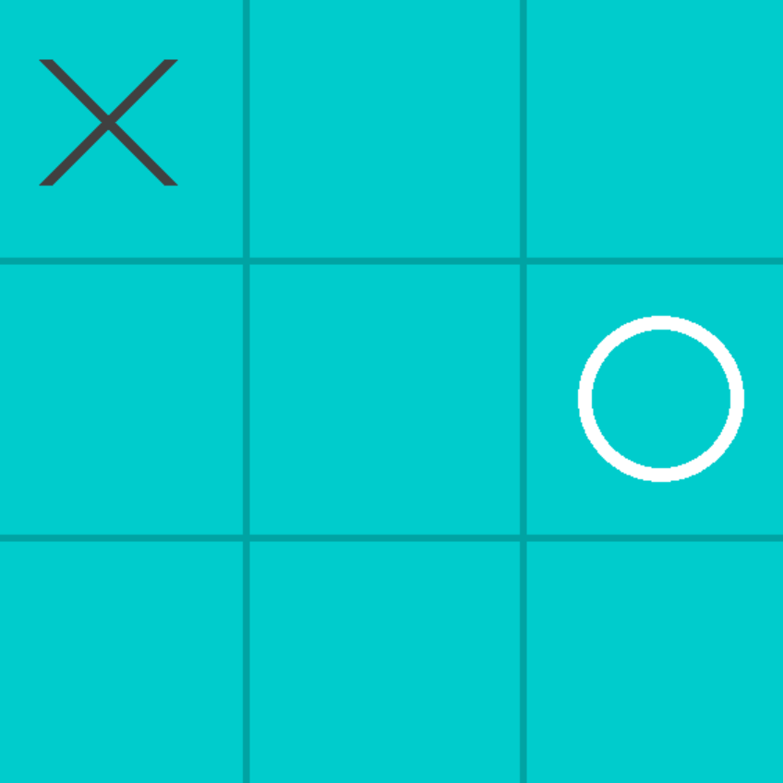
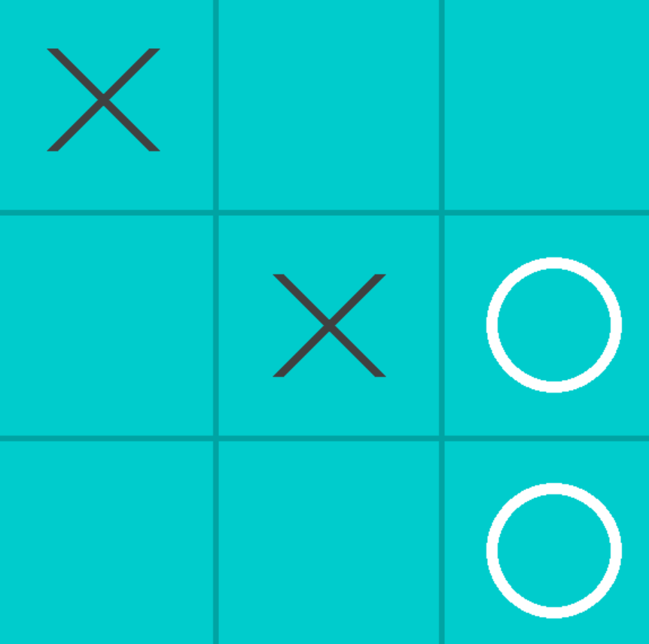
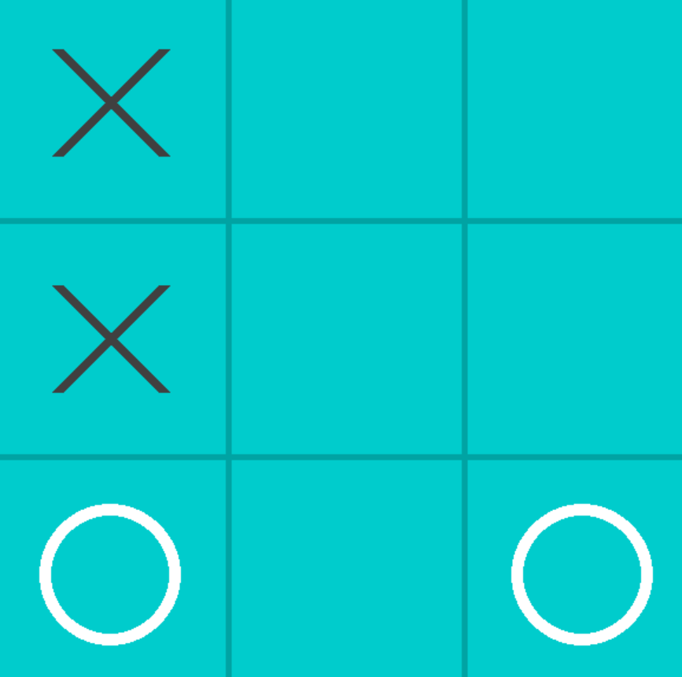
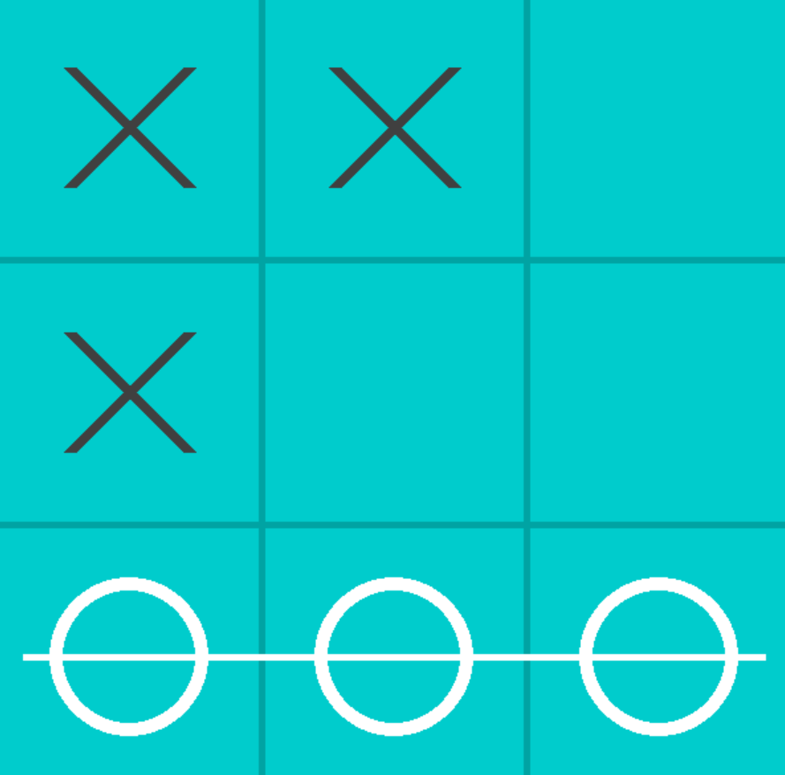
Now the bot checks if there is a winning move by traversing the current state matrix. If a winning move is found then it is played, then if a winning move is not available the bot checks if there is a next winning move for the player and by traversing the current state matrix and if a move is available then it is played so it is not available for the player anymore.

Slide 22
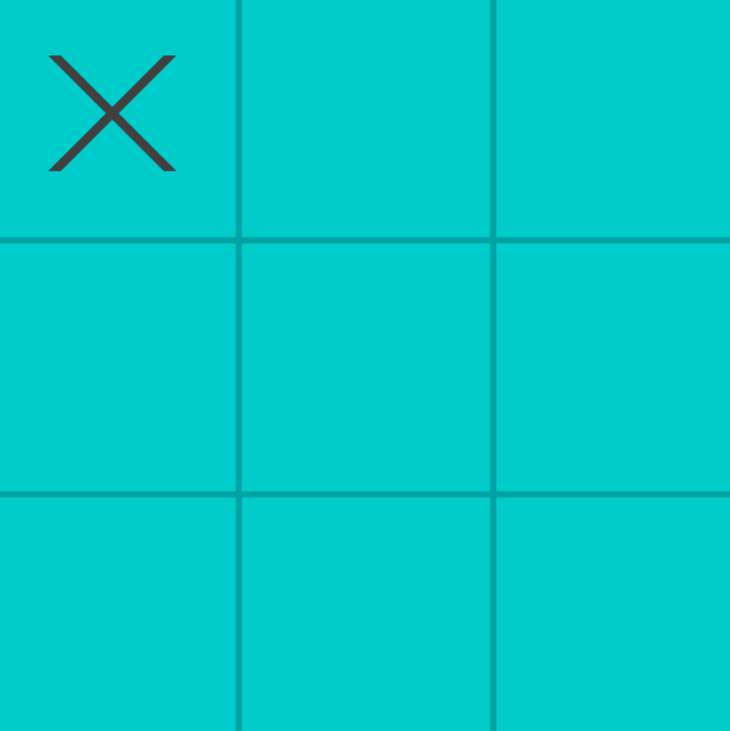
Example of a played game
First player makes the first move at (0,0) of the matrix, Now a matrix and a hash for this current state is generated
0
1
2
0
1
“100000000”
[[1,0,0],
[0,0,0],
[0,0,0]]
2

Slide 23
Check if current hash “100000000” present in game_space link,
if not.
Empty
game_space_link
Check if current state present in game_space
If not.
Check if any symmetrical state of current hash present in game_space.
If not then store current hash in game_space with its available moves as values
Empty
game_space
0
1
2
0
“100000000”:{ (0,1):1, (1,1):1, (1,2):1, (2,1):1, (2,2):1 }
game_space
1
Now using prababilty distribution on values for moves, we chose the best move.
2

Slide 24
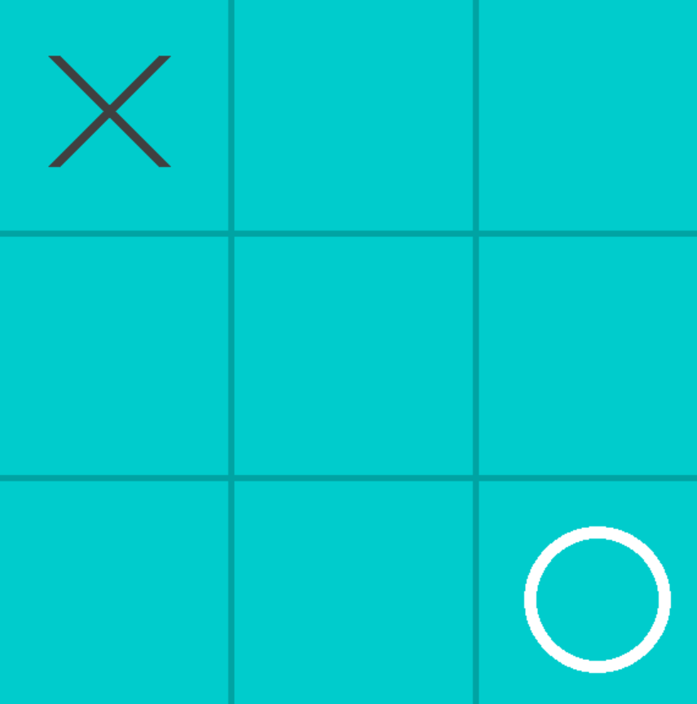
0
1
2
Computer choses move (2,2) with probability 1/5, Now this move and it’s previous state hash will be pushed in game stack
0
1
0
1
2
2
0
{“hash”:“100000000”, “move”: (2,2)}
1
(2,2)
game_stack (lst)
2

Slide 25
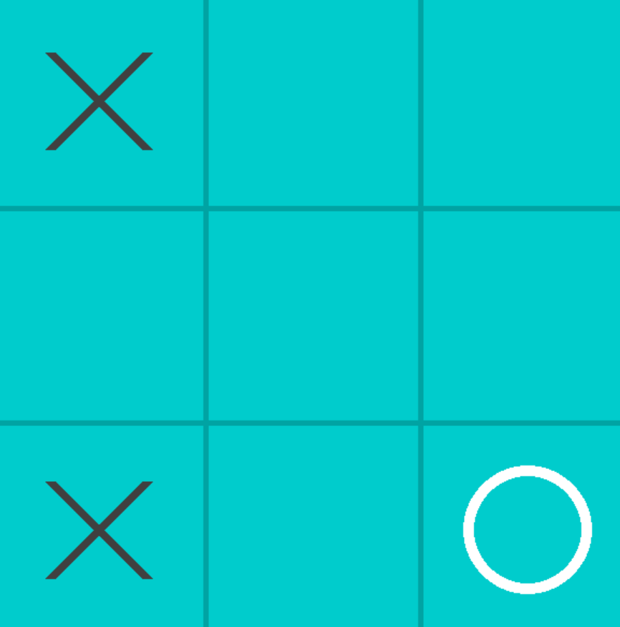
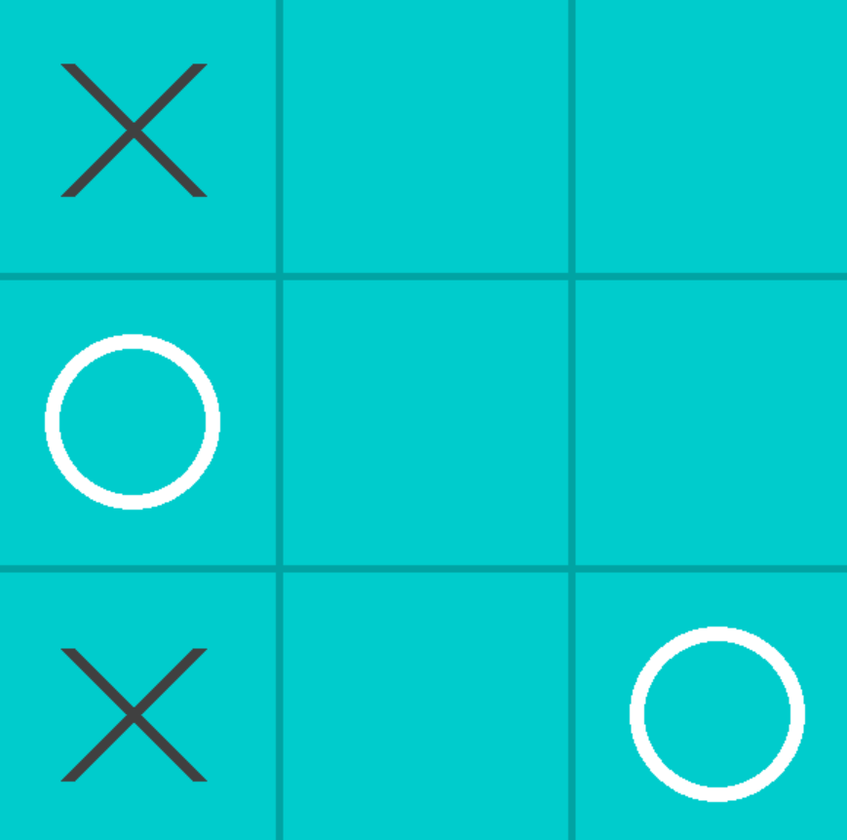
0
1
2
Now second move is played at 2,0 so now bot has no other choice than to chose the move 1,0 as per the rule
0
1
0
1
2
0
2
1
Move 1,0 is played by the bot as a response
2

Slide 26
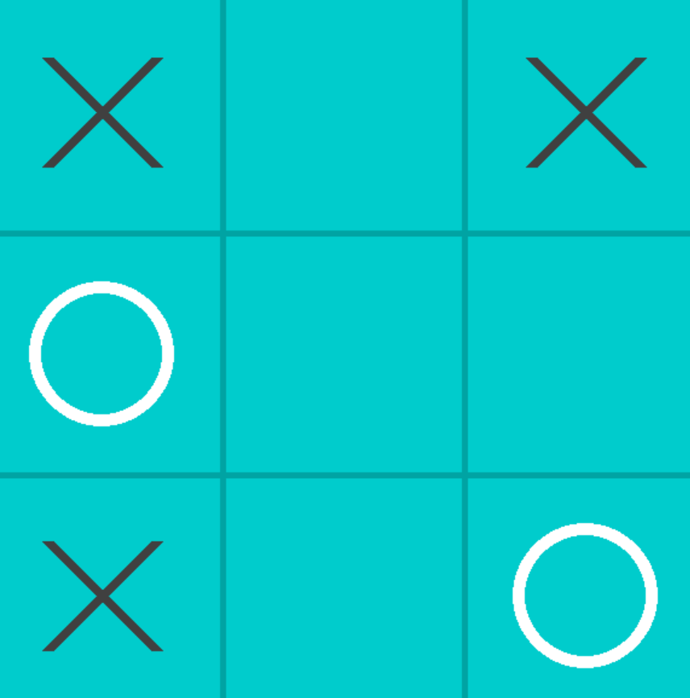
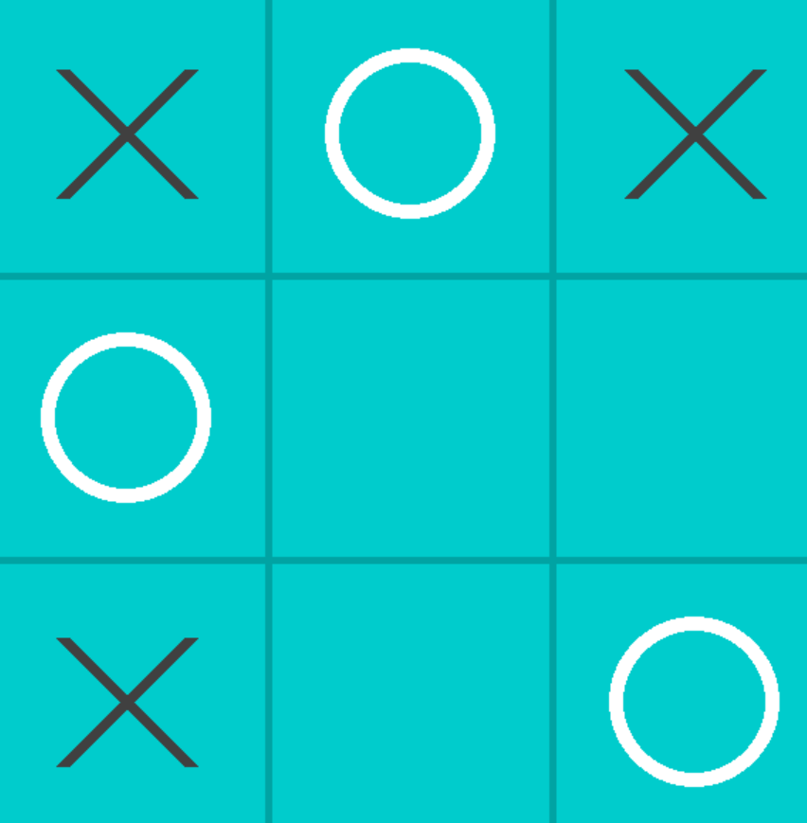
0
1
2
Now third move is played at 0,2 so now bot has no other choice than to chose the move 0,1 or 1,1 as per the rule
0
1
0
1
2
2
0
1
Move 0,1 is played by the bot as a response
2

Slide 27
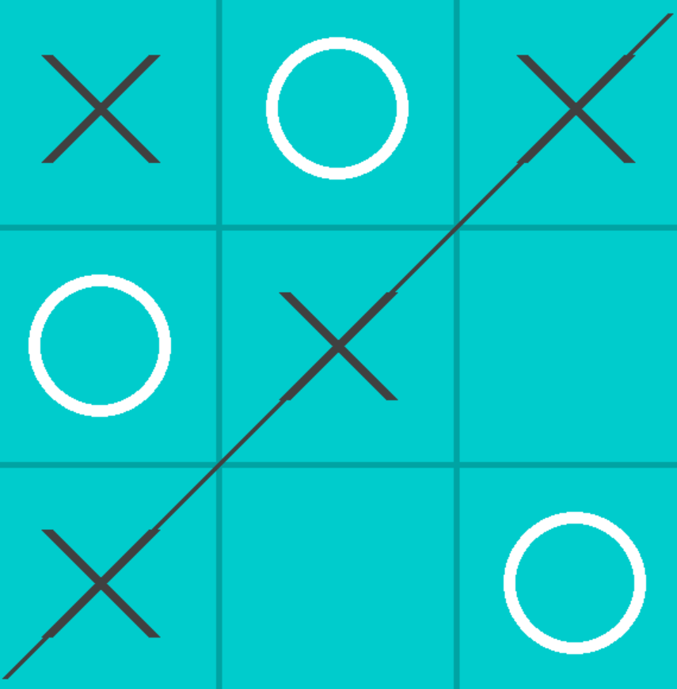
0
1
2
Now fourth move is played at 1,1 and the game is over, player one wins
0
1
“hash”:“100000000”, “move”: (2,2)
game_stack
Now values from game_stack will be poped and be used to update the values of moves in game_space
2
“100000000”:{ (0,1):1, (1,1):1, (1,2):1, (2,1):1, (2,2):1 }
game_space
First value poped from game_stack is “hash”:”100000000”, “move”(2,2), and as the game was lost by bot, the value
of move 2,2 from “100000000” in game_space will be subtracted by two

Slide 28
Empty
0
1
2
game_space_link
0
Empty
game_stack
1
Stack is empty , so updating values in done
“100000000”:{ (0,1):1, (1,1):1, (1,2):1, (2,1):1, (2,2):-1}
2
game_space
Now value at (2,2) has changed from 1 to -1.

Slide 29
After some games has been played
“
“001000000”: { “hash”:”100000000” , ”s”:0 },
“000000001”: { “hash”:”100000000” , ”s”:1 },
“000000100”: { “hash”:”100000000” , ”s”:2 },
“game_space_link” ( dict )
“100000000”:{ (0,1):-1, (1,1):5, (1,2):-1, (2,1):-1, (2,2):-1 },
“100020001”:{(1,0):3, (2,0):-1, (2,1):3 },
“120000100”:{…}
“game_space” ( dict )
8
“no_of_games” ( int )
This data is saved as a pickle file and used when ever a new game is played
game_data ( dict )

Slide 30
{ “100000000” : { (1,0):-1, (1,1):3, (2,0):-1, (2,1):- 1, (2,2):-1 } }

Slide 31
{ “100000000” : { (1,0):-1, (1,1):3, (2,0):3, (2,1):- 1, (2,2):-1 } }

Slide 32
{ “100000000” : { (1,0):-1, (1,1):-1, (2,0):-1, (2,1):-1, (2,2):-1 } }

Slide 33
Conclusion
This whole project mainly focuses on developing a Bot that learns how to play tic tac toe better by gaining experience of playing just like a human would do. This bot can learn how to not lose any game after getting minimum training as a second player when the first person to play a move is a human. This bot can identify the losing pattern by losing just once and thereafter tries to avoid that particular move.

Slide 34

Thank You

