Slide 1

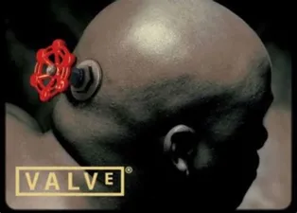
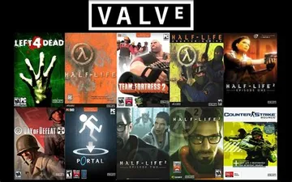
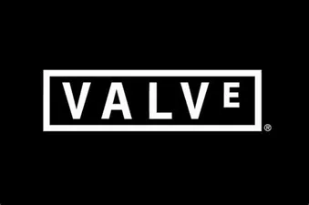
Valve
 | Threats (If we don't change) | Opportunities (If we do change)
 | -Loss of users -Change of trends -Many DLCs that cost a lot preventing people from buying them | -Selling games in packs -By having games for free for a short period of time, they can have more people logging in more often and use steam.
 | -Xbox is the competition, and for them, you only must pay once to get all games, whereas on steam you buy it individually. | -Signing big companies -Having more loyal users -Making more profit
The competitors are Xbox Live and Epic Games as they both sell and let people sell their games there.
Game developers could be dangerous to the business, because if they choose to put their games on a different platform it can pull valve's users away.
Trends constantly changing means that it is harder to keep up and have the right games every time.
Epic games' idea of every week or two to have 2 games for free is a challenge against valve because a lot of people get those games and start playing it.
Short Term
One external factor that can give us an edge is getting to sign contract with big game developers to always launch their games on steam before anywhere else.
Allow for users to buy multiple games in a pack to save money, not just individually.
These are opportunities that can last forever if applied well, however if they don't hurry up, a competition could take them instead.
Long Term
Opportunity
Threats

