Slide 1

Social Media
Instagram
Facebook
Twitter
Snapchat
Business attention and advertisement
Twitch
YouTube

Slide 2
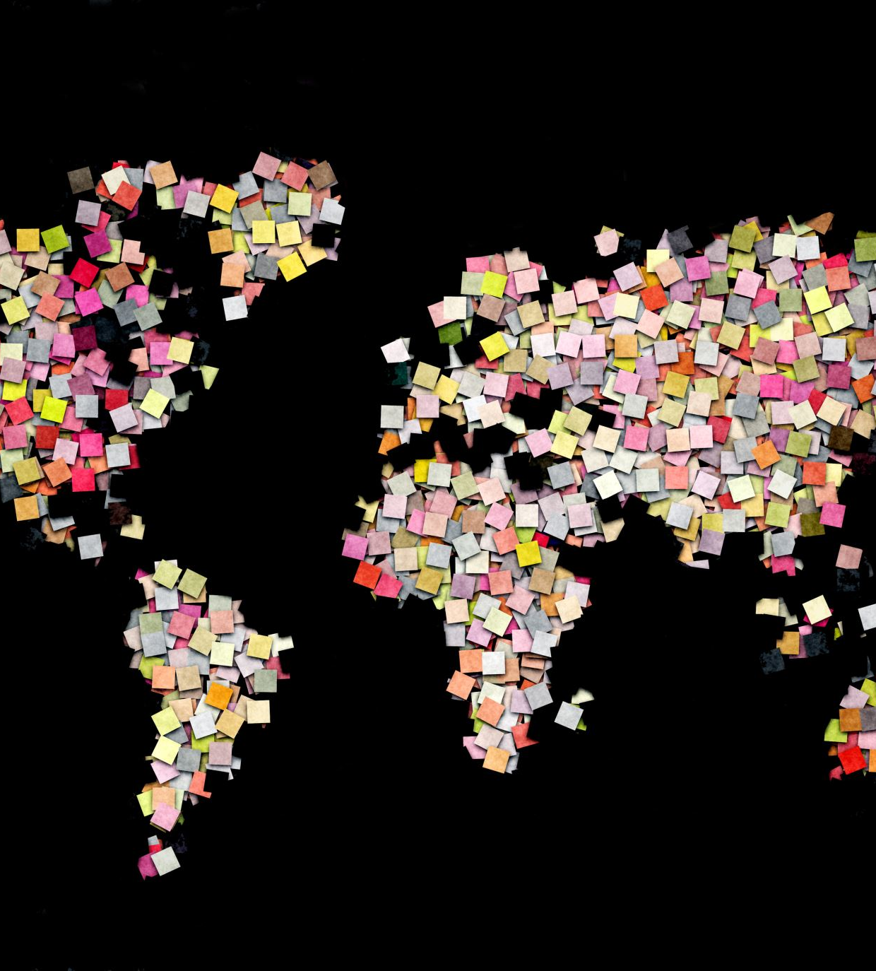
What is Social Media?
+It can be a place for people to post their pictures and life updates, personal opinions, interests, problems.
+A place to keep up with the world and share information.
+There are 4.5 billion people using social media. So it broads around all ages.
So why is it being used?
Entertainment
Communication
Learning
Stress relief
Advertisement

Slide 3
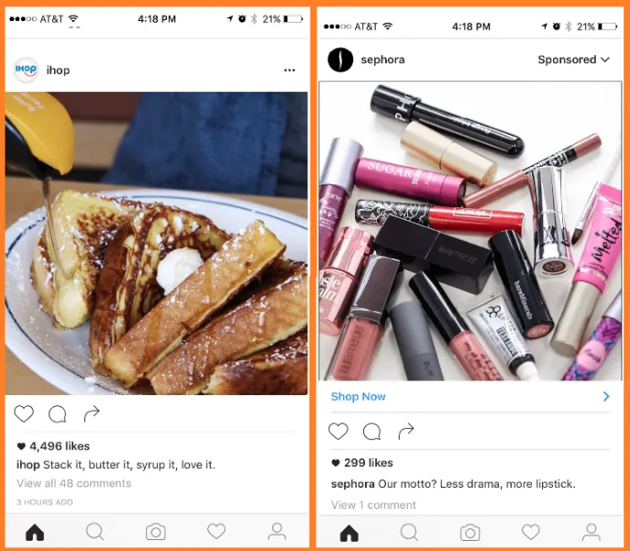
So why would a business use it?
Cost effective and Time effective.
Customer feedback can be easily managed.
Easy to communicate with customers
Easy to target specific groups of people.

Slide 4
So why not other advertisement methods?
Word of Mouth – Would be cheaper and easier. However, it's inefficient.
Billboards – Would be more expensive and is stationary so the position of it is significant.
Tv ad - It would be seen by many people. However, it's expensive.
Social Media

