Slide 1
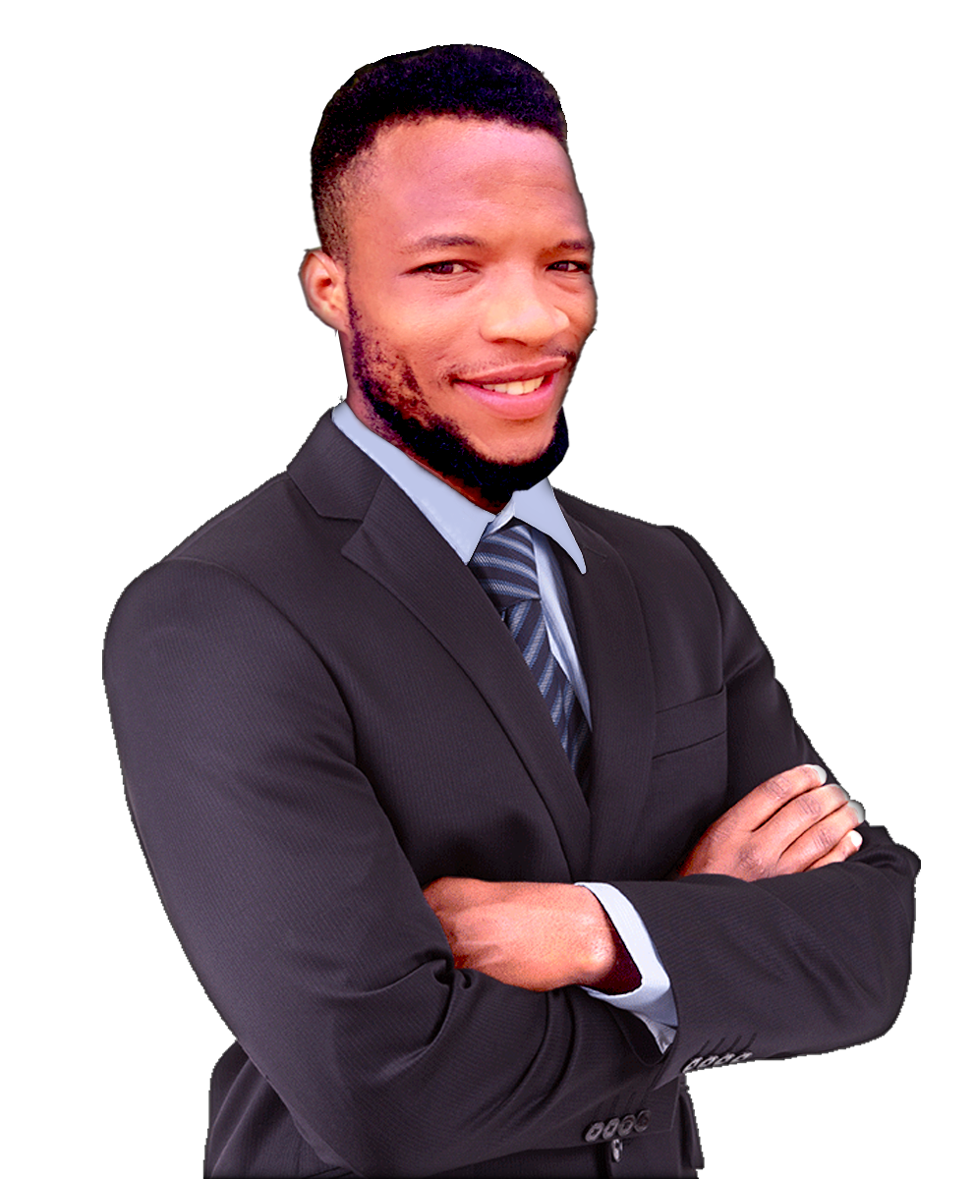
AKINWUMI KEHINDE .D
Technology, Management & Business Consultant
OBJECTIVE
A dedicated and multi-skilled Mechatronics Engineer seeking to contribute to innovative and impactful projects. With a strong foundation in mechanical, electrical, and electronic systems, combined with hands-on experience in fabrication, electrical work, and creative media production, I bring a unique blend of technical and creative abilities. I aim to grow within a dynamic organization where I can apply my knowledge, leadership, and practical experience to solve real-world problems and support team success.
CONTACT
Location:
24 Road, Egbeda, Lagos State
Phone:
(234) 706-505-0846
SKILLS
Email:
Mechatronics system troubleshooting
akinwumikehinde9640@gmail.com
Leadership & Team Work
Strategic Planning & Execution
EDUCATION
Welding and metal fabrication
Customer Service Excellence
Primary
Hospitality & Media Industry Knowledge
Tenidayo Nur & Prim Schl, Ado ekiti
Project & Operations Management
2002 to 2008
Communication & Interpersonal Skills
Secondary
Problem Solving & Decision Making
The Ark Of God, Ibadan
2014 to 2020
Business Consulting
Graphic design (Photoshop, CorelDRAW)
programming
University
ND of Mechatronics
EXPERIENCE
Yabatech, Lagos State
2021 to 2023
Manager at King Ken Studios 2023 - 2024
Mechatronics
Manager at Ehi Hotel 2024 - 2025
Lasustech, Lagos State
Till Date
REFERENCES
Available upon request.

