Slide 1
RESEARCH PRESENTATION · 2026
01 / 14
A STUDY IN VOICE BIOMETRICS
The Effects of Denoising on Speaker Recognition
PRESENTER 01
PRESENTER 02
Donald Robinson
Rhett Wood
THE EFFECTS OF DENOISING ON SPEAKER RECOGNITION
APR 2026
Notes:
Hi everyone — I'm Donald, and with me is Rhett. We spent this project looking at the effects of denoising on speaker recognition. The question sounds simple: if we clean up noisy audio before we try to identify a speaker, does the biometric system work better? The answer turned out to be more interesting than a straight yes or no, and that's what we want to walk through today.

Slide 2
MOTIVATION
02 / 14
MOTIVATION
Voice is a biometric with no controlled sensor.
A fingerprint reader or iris camera captures its signal in a tiny, controlled volume. A microphone has no such luxury — whatever else is happening in the room is captured alongside the voice.
That noise doesn't just look messy; it measurably pulls genuine and impostor scores toward each other, narrowing the separation that any threshold-based biometric relies on.
If you can't control the sensor, can you repair the signal after the fact?
MOTIVATION
02 / 14
Notes:
First, why this matters. Speaker recognition is a behavioral biometric trait — your voice is the signal, just like a fingerprint or an iris pattern is in other systems. It's used for phone banking, smart devices, forensic analysis, and access control. Unlike a fingerprint scanner though, a voice system has no controlled sensor environment — whatever noise is in the room goes into the sample. A small amount of background noise can move genuine and impostor scores closer together, which is exactly the separation biometrics depends on.

Slide 3
MOTIVATION
03 / 14
THE PROBLEM, IN BIOMETRIC TERMS
Background noise compresses the gap between genuine and impostor scores.
01
02
03
Field audio carries traffic, HVAC, crowd, and microphone artefacts on top of the voice.
The features we extract start describing the room alongside the voice.
Two recordings of the same person in different places can look like two different people.
MOTIVATION
03 / 14
Notes:
Before we talk about our pipeline, a quick primer on how a computer sees a voice, because this is where the audio side diverges from the biometric traits most of you worked with. A voice clip is a waveform — a pressure signal over time. But identity doesn't live in the raw waveform; it lives in how the energy is distributed across frequencies. To get at that, we run a short-time Fourier transform, which gives us a spectrogram: time along the x-axis, frequency up the y-axis, color showing how much energy is at each frequency at each moment. The horizontal stripes you'll see in our spectrograms are harmonics — integer multiples of the speaker's pitch — and their spacing plus the broader envelope above them carry most of the speaker-identifying information.

Slide 4
BACKGROUND
04 / 14
BACKGROUND · HOW VOICE IS REPRESENTED
Identity doesn't live in the waveform — it lives in the spectrum.
SPECTROGRAM
MFCCS — OUR FEATURE TEMPLATE
A short-time Fourier transform converts a waveform into a spectrogram — time on the x-axis, frequency on the y-axis, brightness showing energy at each frequency.
We compress that spectrum into 13 MFCCs : the energy in 13 frequency bands, warped to the mel scale — the frequency axis humans actually perceive linearly.
The horizontal stripes are harmonics of the speaker's pitch. Their spacing and the envelope above them carry most of the identifying information.
They discard pitch and keep the spectral envelope that characterizes the voice. They play the same role a minutiae extractor plays for a fingerprint — a compact, comparable template.
BACKGROUND · REPRESENTATION
04 / 14
Notes:
We compress that spectrogram into a compact feature vector using MFCCs — Mel-Frequency Cepstral Coefficients. Don't let the name scare you. The mel scale is just a frequency axis warped to match human hearing — we hear differences at low frequencies much better than at high frequencies, so we give low frequencies more resolution. MFCCs summarize the overall shape of the spectrum in a small number of coefficients — we use thirteen. They're the standard front-end for speaker and speech recognition for decades now because they throw away pitch details while keeping the envelope that characterizes a voice. That's the analog of what a minutiae extractor does for a fingerprint — it turns the raw signal into a compact, comparable template.

Slide 5
BACKGROUND
05 / 14
BACKGROUND · DECISION PIPELINE
A standard biometric pipeline — with audio features as the template.
ENROLLMENT
VERIFICATION
Extract MFCCs from 5 clean clips per speaker.
Extract MFCCs from the incoming clip.
Average them into a single centroid — the reference template for that identity.
Compute Euclidean distance to the stored centroid.
Stored once, per speaker.
Below threshold → accept. Above → reject.
Same decision logic as any threshold-based biometric — only the template is built from sound.
BACKGROUND · PIPELINE
05 / 14
Notes:
Now the biometric pipeline, which should feel familiar. Enrollment: we take five clean-ish clips from the speaker, compute MFCC features on each, and average them into a single reference template — what we call the centroid. Verification: a new clip comes in, we extract its features, and we compare it to the stored centroid using Euclidean distance. Below the threshold, the system accepts; above, it rejects. Threshold-based matching on a distance score — the same decision rule you'd use on any other biometric template.

Slide 6
RESEARCH QUESTION
06 / 14
THE QUESTION
Does cleaning a noisy voice sample before feature extraction improve speaker verification — and does it improve every error rate, or trade one for another?
RESEARCH QUESTION
06 / 14
Notes:
So the research question is: does running a speech denoiser before we extract features actually improve verification performance? And if it helps, does it help uniformly, or does it trade one kind of error for another?

Slide 7
METHODS
07 / 14
METHODS
Same pipeline, two input tracks. Data collected ourselves on campus.
TRACK A · RAW
Noisy audio
→
MFCC template
→
Distance to centroid
→
Raw scores
TRACK B · DENOISED
Noisy audio
→
Denoiser
→
MFCC template
→
Denoised scores
SAMPLES
SPEAKERS
ENROLLMENT
NOISE SITES
80
2
5
7
Total, self-recorded.
Enrolled separately.
Clips per speaker.
5 clips per speaker, each.
Denoiser: pretrained speech enhancement model by Rashadul Hasan Badhon. Threshold held at Euclidean distance = 75 across both tracks.
METHODS
07 / 14
Notes:
Handing off to Rhett for methods.

Slide 8
METHODS
08 / 14
METHODS · EVALUATION
Three rates at a fixed decision threshold.
FAR
FRR
TAR
False Accept
False Reject
True Accept
Impostor passes the threshold. Lower is better.
True speaker is refused. Lower is better.
True speaker is accepted. Higher is better.
Threshold: Euclidean distance < 75.0
METHODS · METRICS
08 / 14
Notes:
Thanks. Our pipeline is deliberately controlled. Every sample is run through feature extraction two ways — raw, and denoised first — then compared to the same enrolled centroid with the same threshold. The only variable is whether denoising happened. For the denoiser we used Rashadul Hasan Badhon's pretrained speech enhancement model, off-the-shelf; we wanted to measure what a practitioner gets by dropping a standard tool in, not the ceiling of a custom-trained model. Data-wise, we collected everything ourselves around campus — two enrolled speakers, eighty samples total: five clips per speaker to enroll, and then five clips per speaker at each of seven different noise locations. So the evaluation set varies by speaker and by acoustic environment.

Slide 9
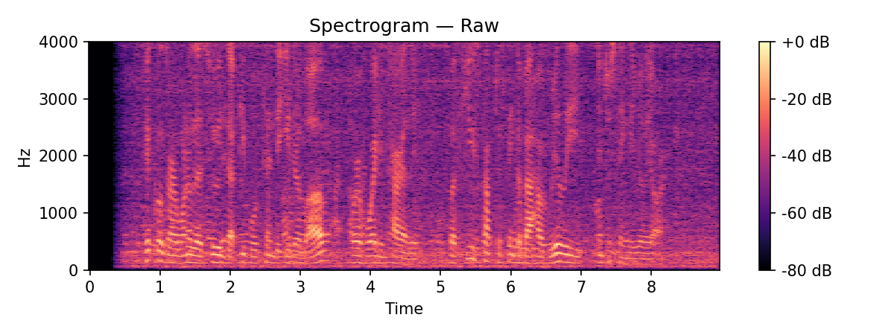

RESULTS
09 / 14
RESULTS · SIGNAL INSPECTION
Denoising visibly sharpens the harmonic structure.
FIG 1 · RAW SPECTROGRAM
FIG 2 · DENOISED SPECTROGRAM
Broad background energy across frequencies.
Harmonic bands sharpen; background attenuated.
RESULTS · SPECTROGRAMS
09 / 14
Notes:
For metrics we report three rates at a fixed threshold of seventy-five Euclidean units. False Accept Rate — how often an impostor slips through. False Reject Rate — how often the true speaker is rejected. True Accept Rate — one minus FRR. Same rates you report for any biometric; nothing audio-specific here.

Slide 10
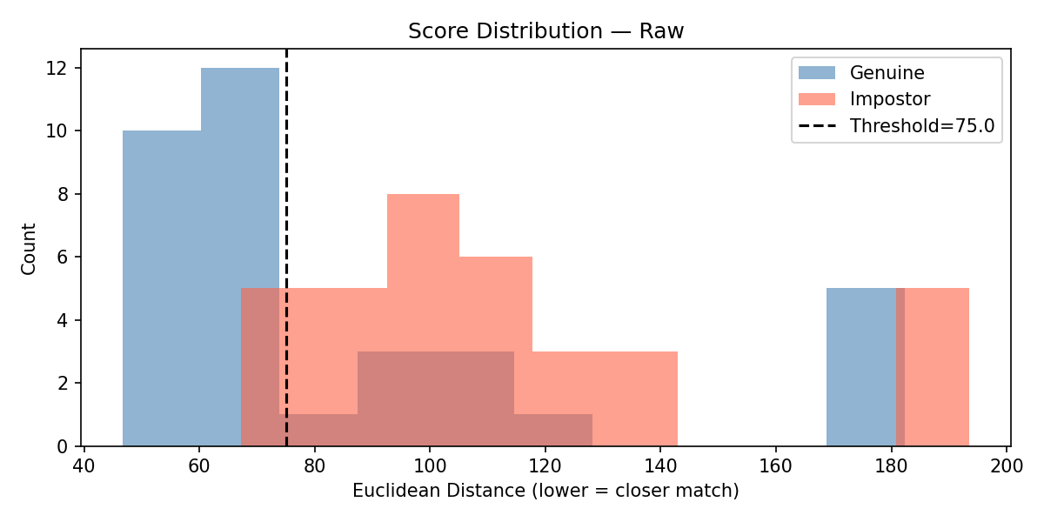
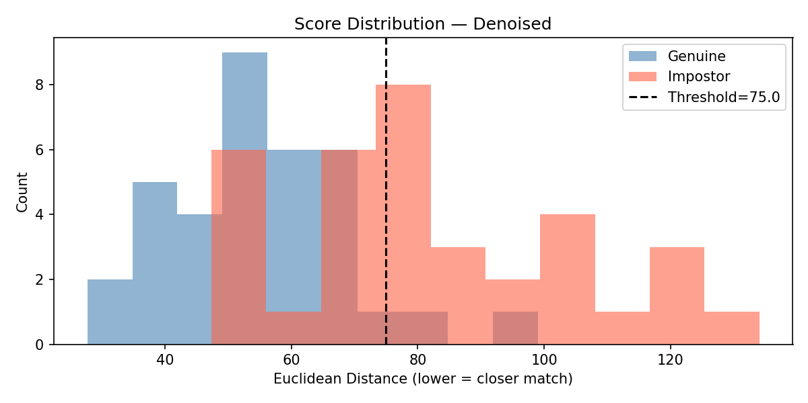
RESULTS
10 / 14
RESULTS · SCORE DISTRIBUTIONS
The distributions did separate — just not by enough.
FIG 3 · RAW
FIG 4 · DENOISED
Genuine (blue) mostly below threshold; impostor (red) mostly above. Heavy overlap around 75.
Genuine and impostor pull apart more than in the raw case — but separation is still incomplete at the fixed threshold.
RESULTS · SCORES
10 / 14
Notes:
Visually, here's what denoising does to a single clip. On the left is the raw spectrogram: harmonic bands of the voice are visible but a lot of diffuse energy fills the background, especially at higher frequencies. On the right, after denoising: the harmonic stripes are sharper, the background haze is knocked down. If you stopped here you'd expect recognition to improve a lot.

Slide 11
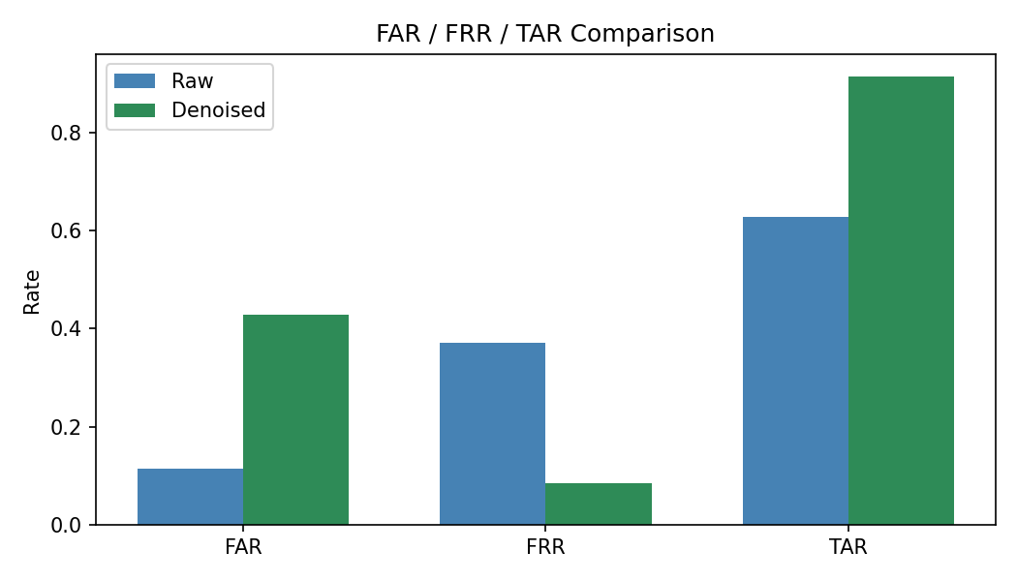
RESULTS
11 / 14
RESULTS · RATE COMPARISON
TAR and FRR improve sharply. FAR rises at the fixed threshold.
TAR · TRUE ACCEPT
FIG 5 · FAR / FRR / TAR, RAW VS. DENOISED
+29 pt
0.63 → 0.92
FRR · FALSE REJECT
−29 pt
0.37 → 0.08
FAR · FALSE ACCEPT
+32 pt
0.11 → 0.43
RESULTS · RATES
11 / 14
Notes:
Here are the score histograms side by side. Blue is genuine — a speaker's own clip against their centroid. Red is impostor. The dashed line is the threshold at seventy-five. On the left, raw audio: heavy overlap through the threshold region — that's where the errors come from. On the right, denoised: the distributions do separate more — genuine shifts a bit lower, impostor shifts higher — but the separation isn't large enough to solve the problem on its own. Denoising helped; it just didn't help enough under this pipeline.

Slide 12
DISCUSSION
12 / 14
DISCUSSION
Denoising helped — just not enough, and not at a fixed threshold.
WHAT IMPROVED
WHAT HELD IT BACK
Genuine and impostor distributions did pull apart. Cleaner spectra let the encoder place a true speaker closer to their own centroid, and TAR climbed accordingly.
The separation isn't large enough under a simple MFCC + centroid front end. We held the threshold fixed at 75 across both conditions — our focus was the score distributions, not tuning the operating point.
Plausible ceiling. A stronger denoiser and a modern neural speaker embedding would likely yield a cleaner, more separable template space — and a threshold tuned for the denoised distribution would recover much of the apparent FAR increase.
DISCUSSION
12 / 14
Notes:
The rates show the same story in another form. Blue is raw, green is denoised. True Accept Rate climbs from sixty-three percent to ninety-two, False Reject Rate falls from thirty-seven to eight — clear wins. False Accept Rate, though, rises from eleven to forty-three. Two things to be clear about here. First, the threshold was held fixed at seventy-five across both conditions; we did not re-tune it, because our focus this study was the distribution of scores, not the operating point. Second, the rates are threshold-dependent; the underlying separability improved, but at this fixed cut the system reads as much more permissive.

Slide 13
CONCLUSION
13 / 14
CONCLUSION
Denoising helped — the score distributions pulled apart. It just didn't help enough, under this pipeline, at a fixed threshold.
WHAT WE'D TRY NEXT
A stronger denoiser and a modern neural speaker embedding. Tune the threshold for the denoised score distribution rather than inheriting the raw one.
CONCLUSION
13 / 14
Notes:
Our interpretation in biometric terms: denoising does increase separability of genuine versus impostor templates — the histograms widen apart — but not by enough to yield a solidly separable template space under a fixed threshold, especially with a simple MFCC-plus-centroid front end. A stronger denoiser or a modern neural speaker embedding would almost certainly give a larger improvement. What we can say confidently is that denoising is real help at the feature level, but if you keep a raw-calibrated threshold, you'll read out more false accepts — the operating point has to move with the processing.

Slide 14
END
14 / 14
QUESTIONS
Thank you.
Denoiser: pretrained speech enhancement model by Rashadul Hasan Badhon. Data collected by the authors on and around campus.
Q&A
14 / 14
Notes:
To wrap up: denoising does help. It sharpens voice structure, it pulls apart genuine and impostor distributions, and it recovers real speakers that raw noise was causing the system to reject. It just doesn't help enough, on its own, to let a fixed threshold carry the day. Better denoising and a stronger recognition back-end would plausibly close the remaining gap. In the meantime, the practical rule of thumb is: if you add denoising to the front of a biometric pipeline, re-tune the threshold for the new score distribution. Thanks — we used Rashadul Hasan Badhon's denoiser, collected our own campus data, and we're happy to take questions.

