Slide 1
The detailed work behind “your grocery list on a budget”
Notes:
Donald: “Hello, how is everyone doing this morning?” For our group project we decided to create an application called Your Grocery List On a Budget”
I would like to introduce our fellow teammates who worked hard behind the scenes. –goes to next slide-

Slide 2

Designing Process:
Sharee Anderson
Taylor Cansler
Notes:
Donald: “The design work, or appearance of the overall application was designed by Sharee Anderson and Taylor Cansler”
-Goes to next slide-

Slide 3
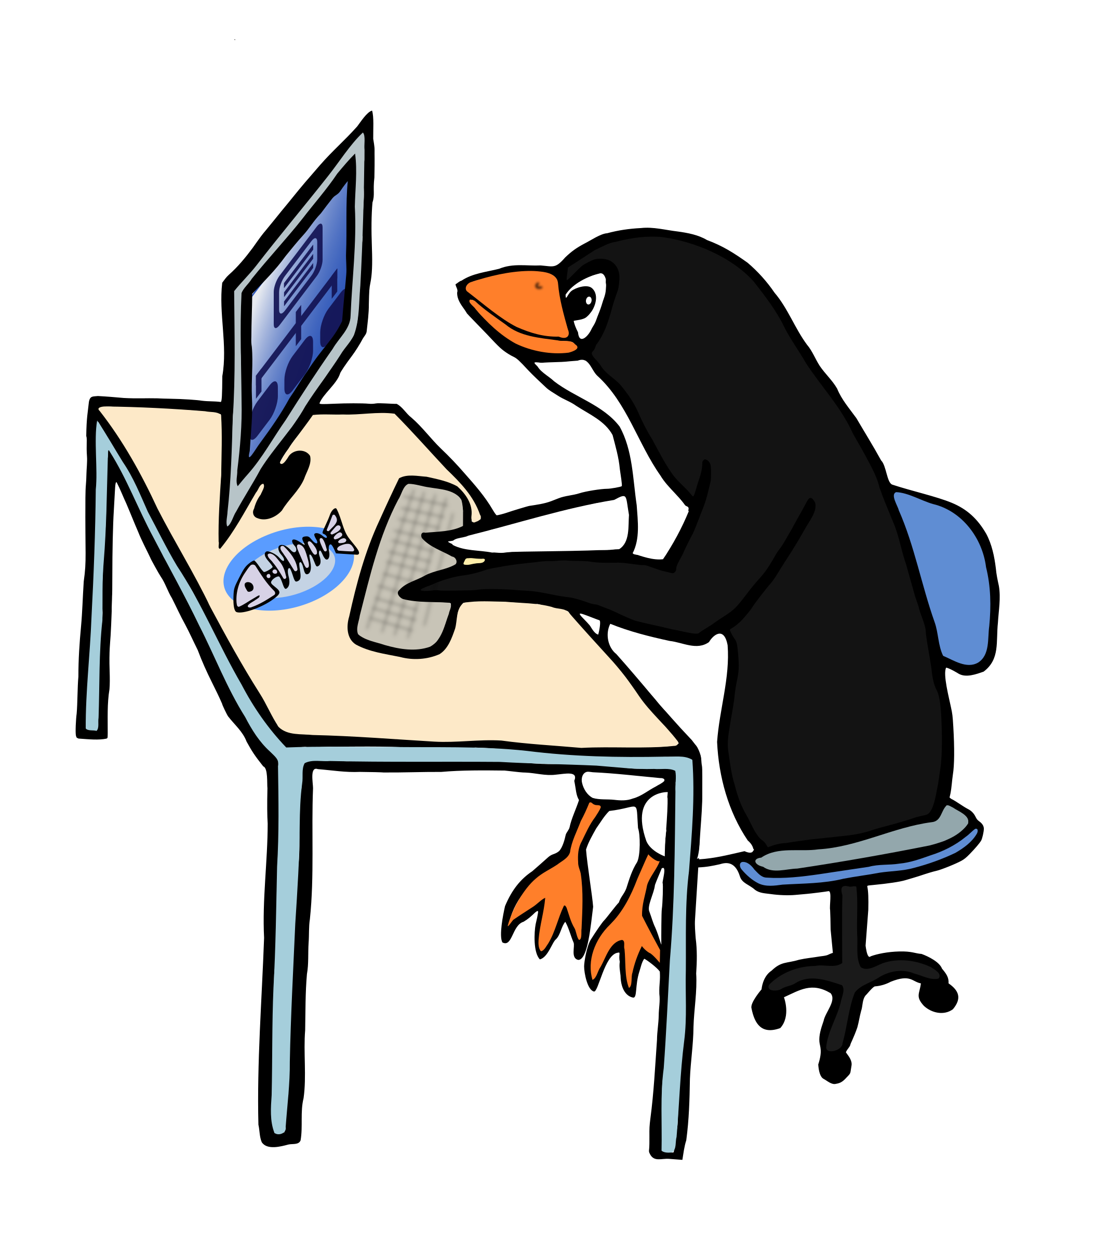
Programming Process:
Kristine Bunnell
Donald Robinson
Notes:
Donald – “The programming process to make the application work included Kristine Bunnell and myself”
-go to next slide-

Slide 4

You’re probably asking yourself “What does Your Grocery List On a Budget do?”
Notes:
Donald – “Now, you’re probably curious as to what our application will do. Your Grocery List On a Budget is an app for your Android phone you can use to set a budget for yourself every time you go to the grocery store.
It’s filled with various parts to help any person get through their grocery shopping easily and efficient. My team members will be expounding on this for you in the next few minutes.
-goes to next slide- “Kristine will explain Why our app is so important.

Slide 5

Why do you need Your Grocery List On a Budget?
Notes:
Kristine – “Why do we need Your Grocery List On a Budget? Have you ever gone to the grocery store and when you’re finally all checked out with your items and the cashier says the total, you realize you’ve spent too much, or maybe said to yourself you could’ve had that slice of cake since you had enough money left? Well, to make your life simpler we created this app so you don’t have to worry anymore.
-goes to next slide- “Sharee (Kristine) will talk about the homepage

Slide 6
Homepage consists of :
Navigational buttons
Notes:
Sharee (or Kristine) – “The very first part you will see is the homepage. Included are navigational buttons to help you to access the rest of the application
**(side note: more to be said after reviewing the actual application)
-goes to next slide- Sharee (or Kristine) will continue to talk about the design

Slide 7
New List :
Add Button
Total of Added Items
Icon
Set Display Budget
Notes:
Sharee (or Kristine) – “Our New List contains the Add Button to add any new items to your list. The total of added items will be the (??? Price of all your items added up), the icon (?? Will be the display image of the item you had in mind to buy), and the set display budget (?? Is the amount you will always want showing to make sure you never go over your budget)
-go to next slide – Sharee (Or Donald) will talk about the Scanning

Slide 8
Scanner:
Add Buttons
Replace Buttons
Put Back
Check Off Button
Drop Down List
Notes:
Sharee (or Donald) – “Moving on to the Scanner part of the app we have additional add buttons to (??), next are the replace buttons (??), you will have the option to put back (??), there is a button to check off(??), and finally a drop down list which will (??)
-go to next slide- “My team member Taylor will be talking more about the design work

Slide 9
Settings:
Zip code
Pop ups
Default Budget
Notes:
Taylor – “The Settings of the app include the zip code ( an area for you to put the location you are at ), Pop ups (??), and your default budget to keep track of the amount of money your wanting to spend for your particular trip that day.
- Go to next slide – Donald will go over the Settings code of the application

Slide 10
SETTINGS SCREENSHOT
Notes:
Donald “ **goes over the various code **
-go to next slide- Taylor will go over the next New List page

Slide 11
New List:
Naming Your List
Setting Your Default Budget
Options For Your Budget Limit
Notes:
Taylor – “The New List will consist of the option to name your list which can be anywhere from “I need my food I’m hungry!” to “My December Food Needs”.. You know, anything you wish to name it. You will then have the option of setting your default budget to anything you choose. If you always want that set amount. Last is the option to set a limit. Whether you want to make this a short cheap visit, or maybe you’ve almost emptied out the entire fridge and are needing a lot without overspending too much. I know how it can be going down each aisle and wanting anything that catches your eye.
- Go to next slide – Taylor continues to speak

Slide 12
NEW LIST CODING SCREENSHOT
Notes:
Taylor “** talks about the code behind the new list”
-go to next slide- Taylor continues to talk

Slide 13
Adding Items:
Search For Items
Designate Quantity
Price Of The Item
Notes:
Taylor “As far as adding any additional items you can search for items, whether it’s looking for a specific type of bread you will want or cereal. After you have searched for any items you have the option to designate the quantity you will want to buy just to make sure if you wanted 3 boxes of the same cereal we could see if the place had it in stock. Next comes the price of the item which will show you if maybe you want to spend that amount on a specific product or perhaps go the cheaper route by getting an off brand.
-go to next slide- “Kristine will talk about the coding behind adding your items”

Slide 14
ADD ITEMS SCREENSHOT
Notes:
Kristine – “** talks about the coding behind**”
-goes to next slide – Taylor will go on to talk a little more about the design

Slide 15
Replacing Items:
Select An Item
Swap For a New Item
Notes:
Taylor “Maybe you decided you didn’t want that particular product in your cart anymore. There’s a simple option to select that item and just swap it for a different item.” ** expound a little more **
-go to next slide – Taylor continues to talk about code behind

Slide 16
REPLACE ITEM SCREENSHOT
Notes:
Taylor “** talks about the code for a little**”
-go to next slide- Donald will talk about some additional code

Slide 17
FileTalker.java SCREENSHOT
Notes:
Donald will go over the code talking about Storing Settings, Loading App, and Loading Saved List Code
- Go to next slide – Kristine will talk about more of the background coding

Slide 18
Table.java screen shot
Notes:
Kristine “**talks about Background class for storing information in the list Code **”
- Go to next slide – Kristine continues to talk

Slide 19

Now, the moment you’ve all been waiting for…
A demonstration of how our application works!
Notes:
Kristine “Now that we’ve gone over how our application was made and the tedious process behind each design and code, we are proud to show everyone how everything came together to produce Your Grocery List On a Budget App.”
-goes to next slide- “ this is where we demonstrate each part of our running app (**after Donald has shown us how the app runs then we can pick who talks about what and demonstrates**”)

