Slide 1
HMI Translator
Translate TIA / WinCC HMI texts in bulk
User guide
Luan van Niekerk
vanniekerk.luan@outlook.com

Slide 2
What it replaces
The manual way
With HMI Translator
1
Export project texts to Excel from TIA / WinCC
1
Open the same Excel export languages detected, or mapped by hand
2
Translate every cell by hand or paste into an online tool, per language
2
Translate with DeepL, then review placeholders protected, over-length flagged
3
Re-import into the project hoping placeholders survived
3
Save a validated copy and re-import original preserved; re-open checks itself
Approved edits are remembered — re-runs never overwrite them and never re-charge for text already translated.
Luan van Niekerk
2

Slide 3
Before you start: a DeepL API key
The app doesn't translate on its own — it drives DeepL. You need a DeepL API key before any translation will run.
API Free
API Pro
500,000 characters / month, no cost
Key ends in “:fx” — free endpoint auto-selected
Plenty for many HMI projects
Paid per character, no monthly cap
Unlocks glossaries (terminology)
Recommended once you standardise terms
Sign up at deepl.com under “DeepL API” (separate from the Translator subscription). Text is sent to DeepL's cloud.
Luan van Niekerk
3

Slide 4
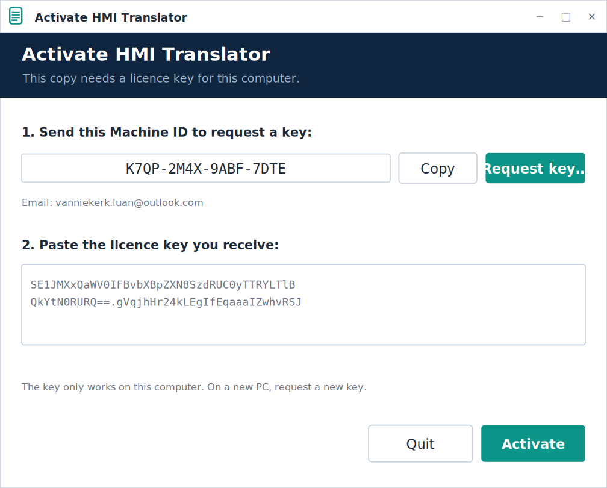
First run: activate your copy
The first time you open HMI Translator on a computer, you'll be asked to activate it. It's quick, and you only do it once per PC.
1. Copy the Machine ID
shown on the activation screen.
2. Request a key
click “Request key…” to email the Machine ID to Luan.
3. Paste the key you receive
and click Activate. The app opens and remembers it next time.
The key is tied to that computer. A new PC or a Windows reinstall needs a fresh key — just request one.
Luan van Niekerk
4

Slide 5
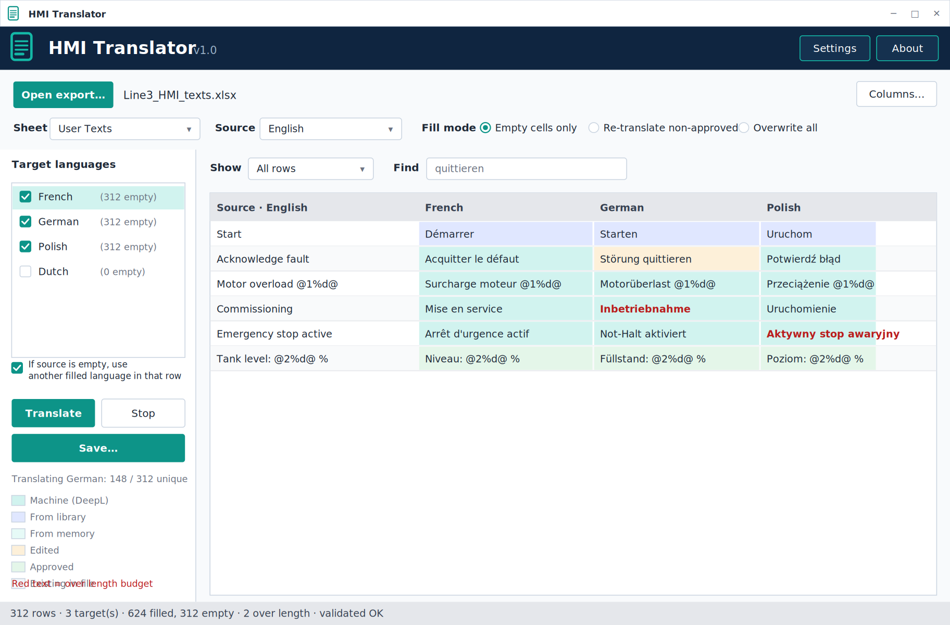
The main window
Control strip Open the export; pick sheet, source, fill mode. Columns… maps columns by hand.
Target languages Tick languages to fill. The checkbox fills an empty source from another language.
Filter & find Narrow a big export to empty, over-length or matching rows while reviewing.
Preview grid Colour-coded by origin; edit in place; red = over length.
Status bar Counts, and “validated OK” after a good save.
Luan van Niekerk
5

Slide 6
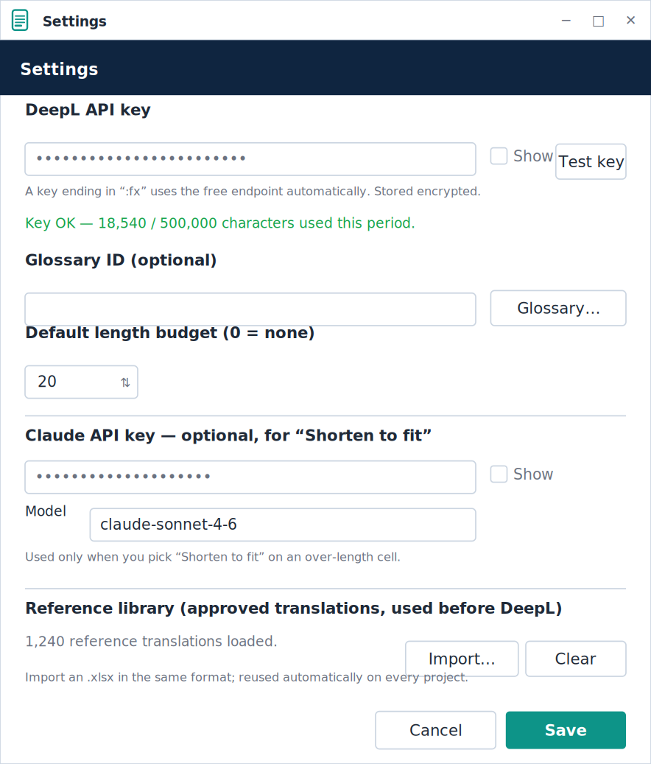
1
Set your API keys
Click Settings (top-right).
Paste your DeepL key and click Test key.
Optionally set a Glossary ID and default length budget.
For “Shorten to fit”, add a Claude API key + model (optional).
Save — keys are stored encrypted for your Windows user.
Luan van Niekerk
6

Slide 7
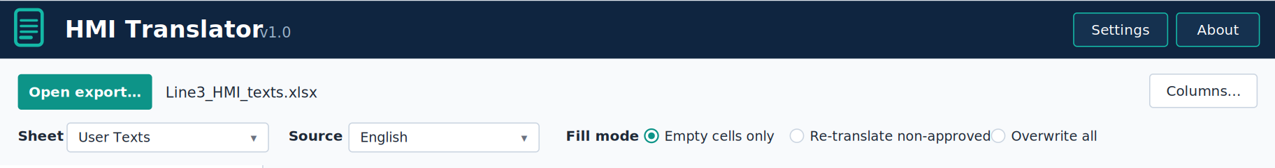
2
Open your export
Export project texts to .xlsx from TIA / WinCC.
Click Open export… and choose the file.
Header row and language columns are detected automatically.
Pick the right sheet if there are several.
The control strip after opening a file:
Luan van Niekerk
7

Slide 8
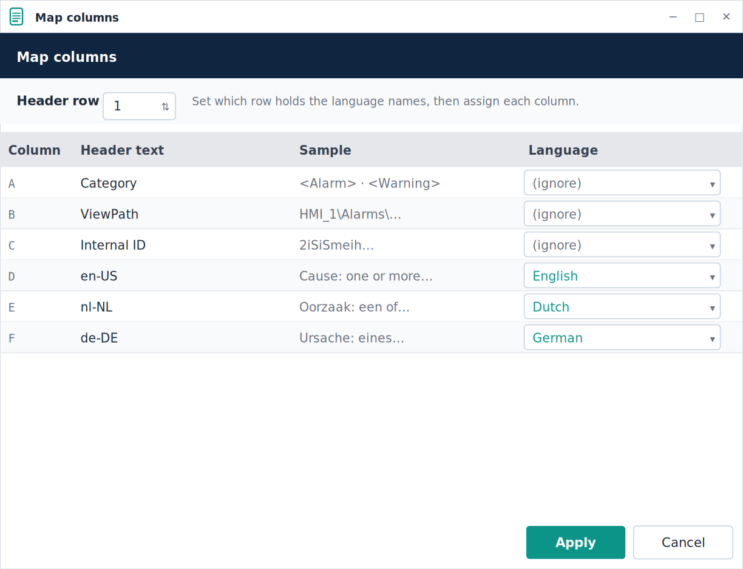
3
If detection misses: map columns
Click Columns… any time.
Set which row is the header.
Assign each column a language (or “ignore”).
Samples and header text help you choose.
Apply — the pickers refresh from your mapping.
Luan van Niekerk
8

Slide 9
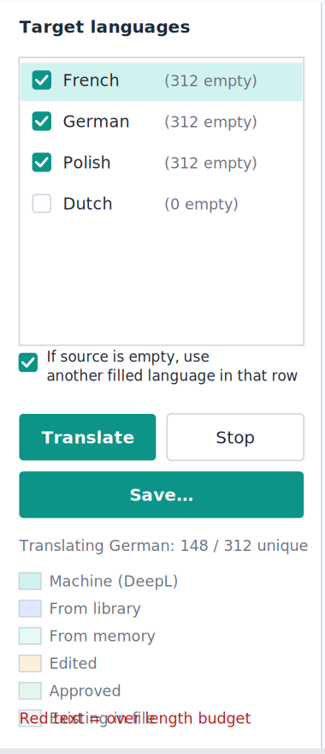
4
Source, targets and the fallback
Set the Source (reference) language.
Tick the Target languages — empties are pre-ticked.
Fill mode: start with Empty cells only.
Fallback: tick it to fill a row from any filled language when its source is blank — e.g. generate English from an existing French.
Luan van Niekerk
9

Slide 10
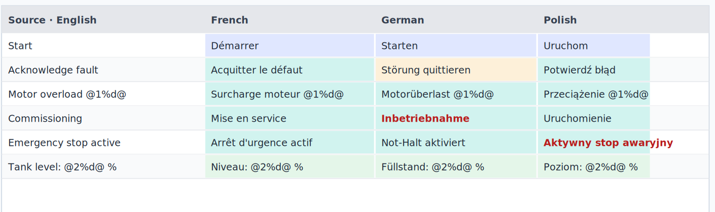
5
Translate and review
Click Translate. Stop cancels and keeps partial results.
Cells are colour-coded by origin.
Red bold = over the length budget.
Edit in place; right-click to Approve.
Use Show / Find to focus the review.
Machine
Memory
Edited
Approved
Existing
Red bold = over length budget
Luan van Niekerk
10

Slide 11
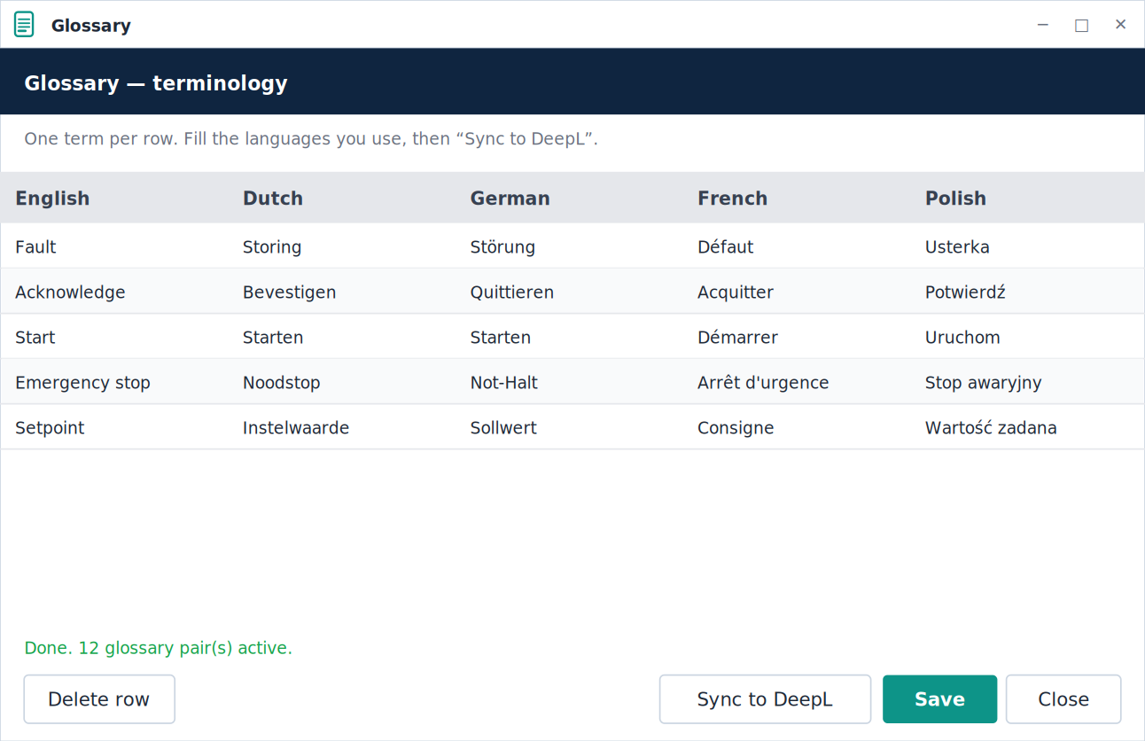
6
Glossary: consistent terminology
Open Settings → Glossary…
Enter your terms across languages, one per row.
Sync to DeepL builds a glossary per language pair.
Translations then use your wording automatically — every project, every direction.
Luan van Niekerk
11

Slide 12
7
Teach it your approved translations
Have a file with your approved wording across languages? Import it once.
Settings → Reference library → Import…
Those translations are stored and used before DeepL — on every project.
Shown as “From library” in the grid, so you see what came from your set.
Placeholders are checked on import; mismatched pairs are skipped.
your_approved_terms.xlsx
Reference library
used before DeepL, every project
Luan van Niekerk
12

Slide 13
8
Shorten over-length text to fit
German runs long and can overflow a field — flagged red.
Right-click a red cell → Shorten to fit (Claude).
Or Shorten all over-length in one pass.
Claude rewrites it within the budget using HMI abbreviations.
Placeholders are preserved and verified; needs a Claude API key.
Before (18 > 14)
Inbetriebnahme läuft
After
IBN läuft
Luan van Niekerk
13

Slide 14
9
Save, validate and re-import
Click Save… — writes a copy “…_translated.xlsx”.
Only target cells change; the rest is preserved byte-for-byte.
The app re-opens the file and validates it before trusting it — if anything is off, it warns you not to import.
A “…_report.txt” audit is written next to the file.
Import the copy back into TIA / WinCC.
✓ Saved and validated
write → re-open → check every cell
Luan van Niekerk
14

Slide 15
What keeps it safe
1
2
3
4
Placeholders
Length budget
Memory & library
Validation
@1%d@, %5.1f, {0}, <tags>, line breaks — shielded from translation and restored exactly.
Over-length flagged in red, never truncated. Shorten-to-fit helps trim to the field size.
Your edits are remembered, and an imported reference library applies approved wording before DeepL on every project.
Every save is re-opened and checked cell-for-cell; a bad write can't reach TIA silently.
Luan van Niekerk
15

Slide 16
Export → translate → review → re-import
Placeholders safe, terms consistent, edits remembered, every save validated.
Luan van Niekerk vanniekerk.luan@outlook.com

