Slide 1

NetSweep
LAN / IP Network Scanner
User Guide
Built with C# + WinForms on .NET 8
Luan van Niekerk

Slide 2






OVERVIEW
What is NetSweep?
A lightweight Windows tool that sweeps your local network - or a remote machine network over VPN - and lists every connected device in seconds.
Parallel scanning
Adapter auto-detect
Vendor lookup
Multi-threaded sweep of a full subnet in seconds.
Fills the IP and subnet from your active network card.
Built-in IEEE database names makers offline - incl. industrial.
Identify over VPN
CSV + PDF export
Single-file build
Names Siemens & Rockwell gear via EtherNet/IP + S7.
One-click spreadsheet or printable report output.
Self-contained .exe - nothing to install or configure.

Slide 3
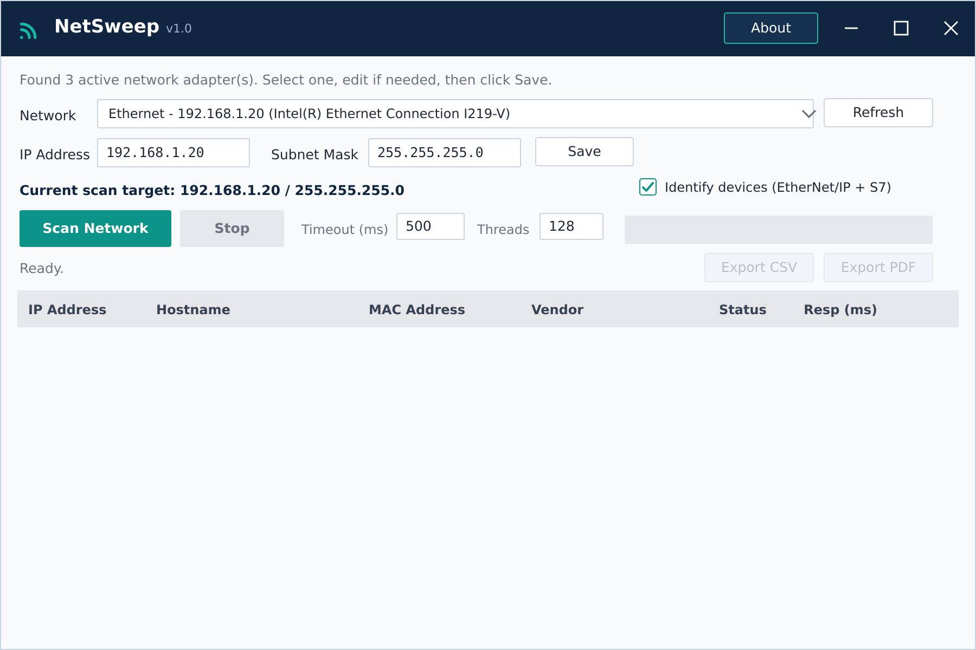
THE INTERFACE
A quick tour
1
1
Title bar App name, version and window controls.
2
3
2
Network + Refresh Pick your active adapter; Refresh re-lists them.
4
6
3
IP / Subnet + Save Auto-filled from the adapter; Save sets the target.
5
4
Scan / Stop + options Start or cancel; tune timeout and thread count.
5
Results grid One row per device that responds.
6
Status + Export Live progress, plus CSV / PDF once a scan finishes.

Slide 4
1
STEP 1
Choose your network
Pick your connection from the Network dropdown - its IP address and subnet mask fill in automatically.
Adjust the IP or Subnet Mask only if you want to scan a different range.
Click Save - the current scan target appears in navy below.
TIP Save sets the range to scan; it never changes your real adapter settings.

Slide 5
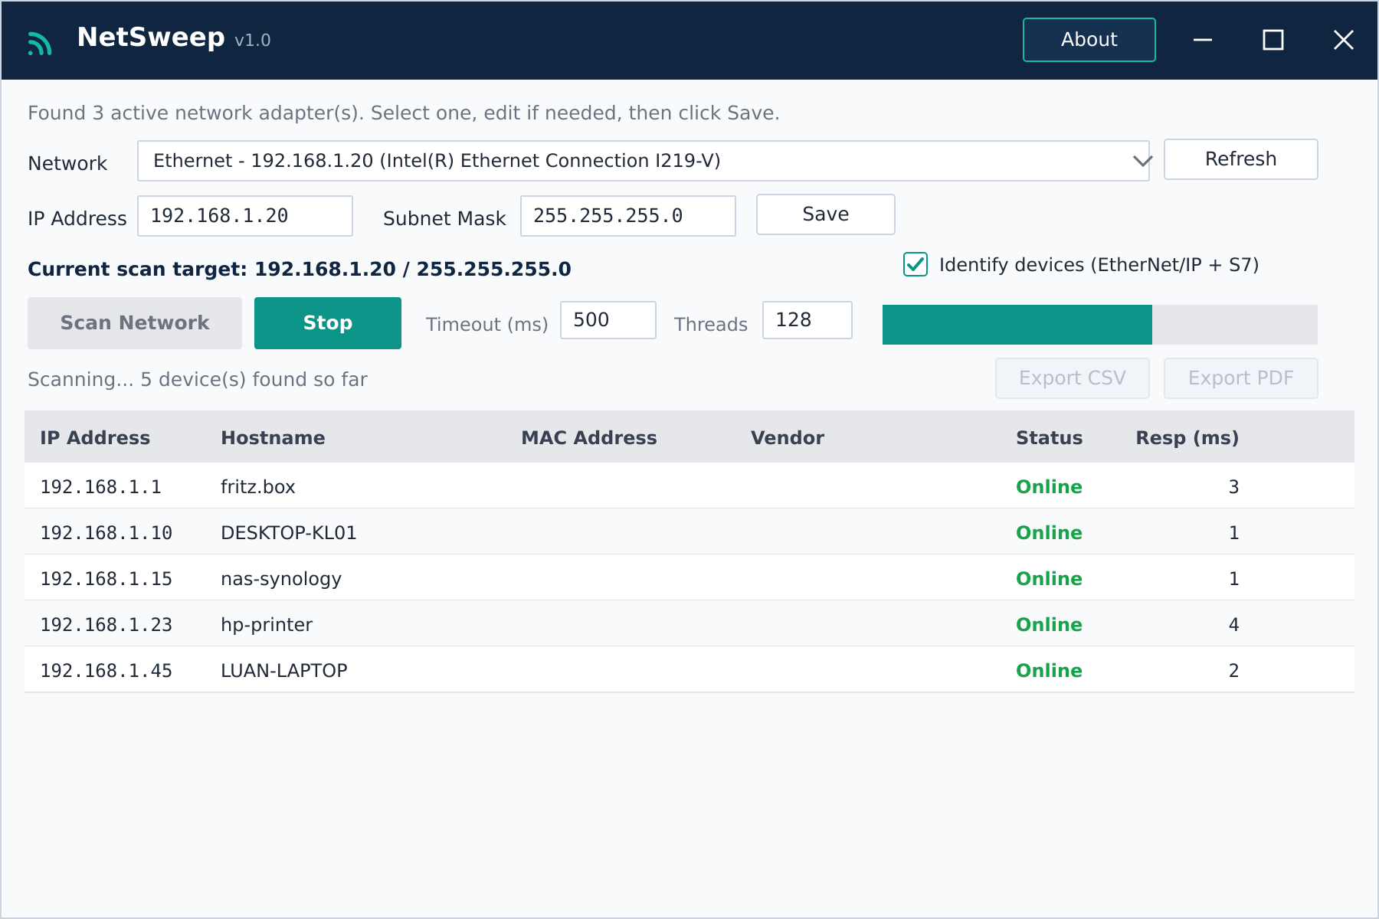
2
STEP 2
Run the scan
Click Scan Network to sweep every host in the subnet.
Probes run in parallel - tune Timeout and Threads to taste.
Rows appear live as devices respond; the teal bar tracks progress.
Click Stop (or press Esc) to cancel a scan at any time.
TIP More threads = faster sweeps on a local network.

Slide 6
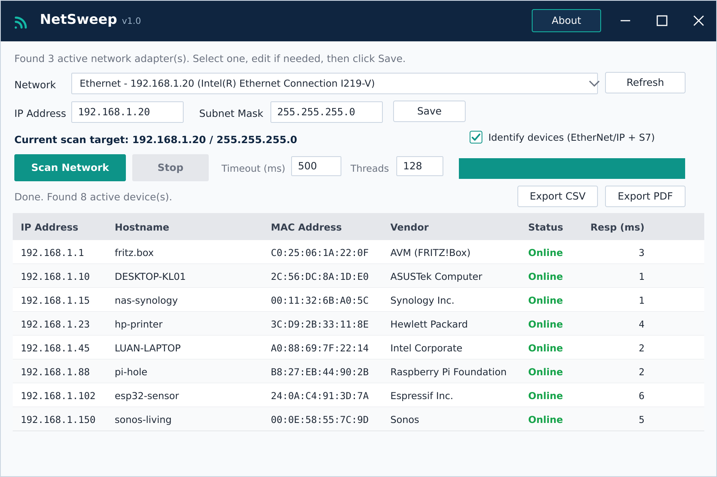
3
STEP 3
Review & export
What each column means
IP Address - The device's address on the network.
Hostname - Friendly network name (or the device's own product name).
MAC Address - Unique hardware identifier (local networks only).
Vendor - Manufacturer, from the MAC or the device itself.
Status - Online - the host responded.
Resp (ms) - Round-trip ping time.
TIP Export CSV and Export PDF unlock once a scan finishes.

Slide 7
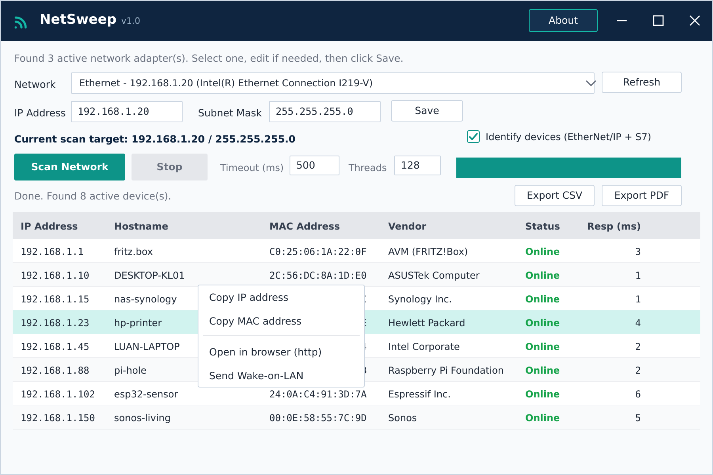
4
STEP 4
Act on a device
Right-click any row (or double-click) for quick actions.
Copy IP address or Copy MAC address to the clipboard.
Open in browser jumps to http://<ip> - handy for routers, printers and NAS boxes.
Send Wake-on-LAN wakes a sleeping device via its MAC.
TIP Double-clicking a row opens its web page in your browser.

Slide 8
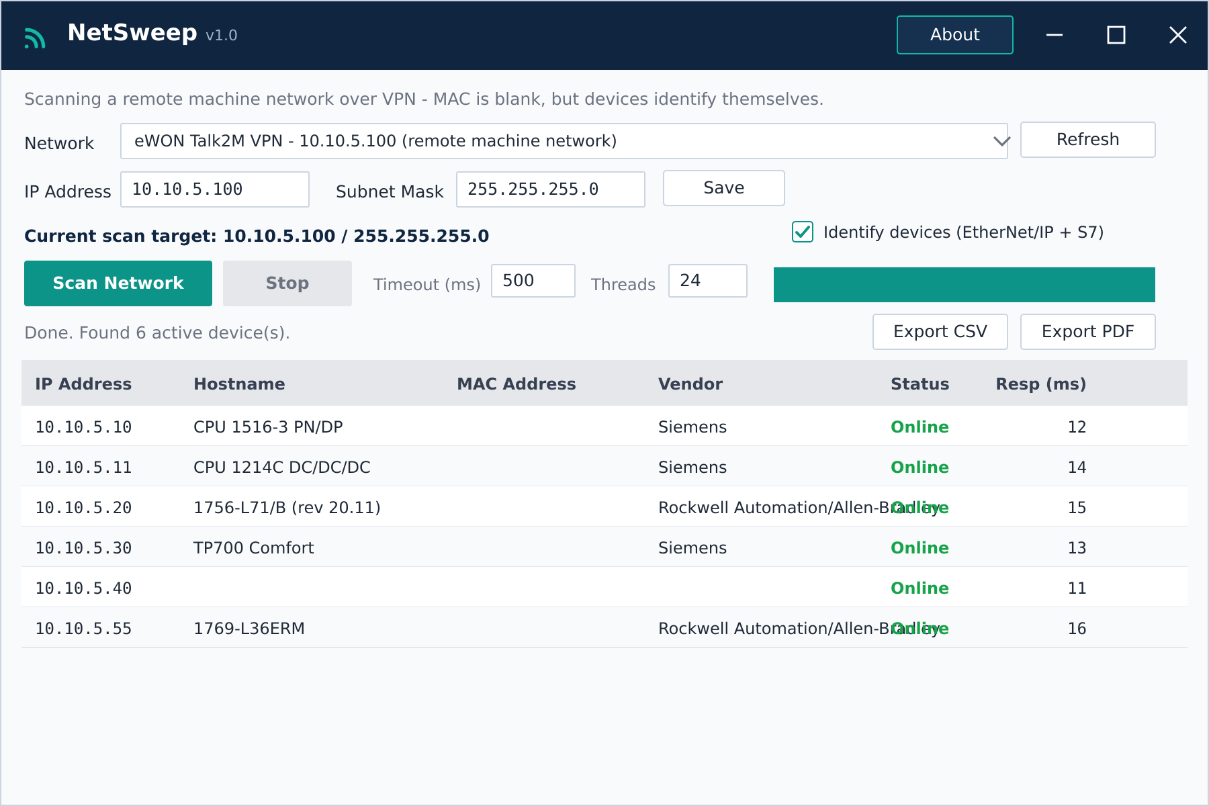
REMOTE ACCESS • WORKS OVER A VPN
Identify devices over a VPN
Through an eWON / IXON tunnel, MAC, vendor and hostname come back blank - ARP can't cross a router.
Tick Identify devices (EtherNet/IP + S7) - on by default - to ask each device directly instead.
EtherNet/IP (UDP 44818): Rockwell / Omron return vendor + product.
S7 (TCP 102): Siemens PLCs & HMIs return their module type or order number.
The maker fills Vendor; the device's own name fills Hostname.
TIP Over a VPN, drop Threads to ~24 so the slow tunnel doesn't drop devices.

Slide 9
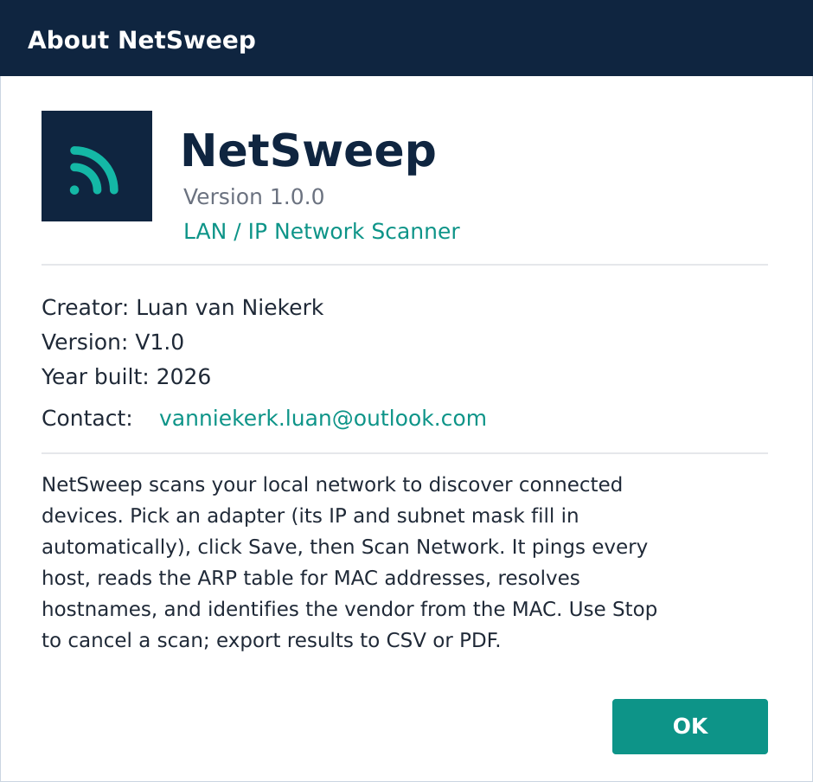
ABOUT
Credits & build info
PRODUCT
NetSweep v1.0.0
TYPE
LAN / IP network scanner
DEVELOPER
Luan van Niekerk
BUILT WITH
C# + WinForms on .NET 8
VENDOR DATA
IEEE OUI database, embedded in the exe
FIND IT UNDER
About button, top-right

Slide 10



Tips & good to know
Run as administrator Gives NetSweep full access to ARP data for reliable MAC and vendor detection on local networks.
Scanning over a VPN Keep Identify ticked and drop Threads to ~24 - slow tunnels drop packets if you flood them.
Vendor data is built in The IEEE database ships inside the exe (industrial makers included). Drop an oui.csv beside it to update.
NetSweep - scan your network in seconds.
Luan van Niekerk

