Slide 1




NETFLIX MOVIES ANALYSES WITH SQL
By
ADEDOKUN ABDULMALIK ADEYEMI

Slide 2
Table of Contents:
Problem Statement
Tool Used
Table / Dataset Description
Project Objectives
Recommendations

Slide 3
Problem Statement:
This project aims to conduct a comprehensive analysis of Netflix Movie using SQL. The database contains 5 tables:
netflix_movies
netflix_movies_directors
netflix_movies_countries
netflix_movies_cast
netflix_movies_categories
The goal is to utilize SQL to create insightful analyses and reports that provide a deeper understanding of Netflix Movie performance, rating, duration, and movies categories. The analysis aims to uncover trends, preferences, and patterns in the data to aid movies uploader and stakeholders in optimizing their Netflix Movie .

Slide 4
Tool Used
PostgreSQL
PostgreSQL is an open-source relational database management system emphasizing extensibility and SQL compliance.
PostgreSQL features transactions with atomicity, consistency, isolation, durability (ACID) properties, automatically updatable views, materialized views, triggers, foreign keys, and stored procedures.

Slide 5

Table Dataset Description:
show_id: Unique identifier for each Netflix Movie.
duration_minutes: Duration of the Netflix Movie.
duration_seasons: Seansons Duration of the Netflix Movie.
type: Netflix Movie type (e.g: TV Show, Movie)
title: Title of the Netflix Movie.
date_added: Date when the Netflix Movie was published.
release_year: the year when the Movie was released.
rating: Netflix Movie type (e.g: PG, TV-Y, PG-13, G, TV-MA, e.t.c )
description: Description provided for the Netflix Movie.
director: the director of each Netflix Movie
country: the originating country of the Netflix movie
movie_cast: the Netflix movie cast
movie_categories: the category of each Netflix movie (e.g: Comedies, Thrillers, Horror, e.t.c)

Slide 6
Project Objectives:
Data Cleaning and Preparation
Exploratory Data Analysis (EDA)
Content, Ratings , Categories Analysis and JOINS
Temporal Trends with ‘CASE’
Movie Cast Engagement Insight
Recommendation

Slide 7
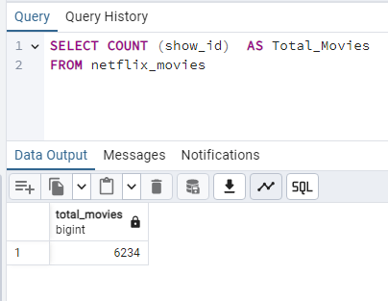
1. How many movies are in the datasets
According to the Netflix_movies table, analyses shows that there are 6,234 movies in the datasets

Slide 8
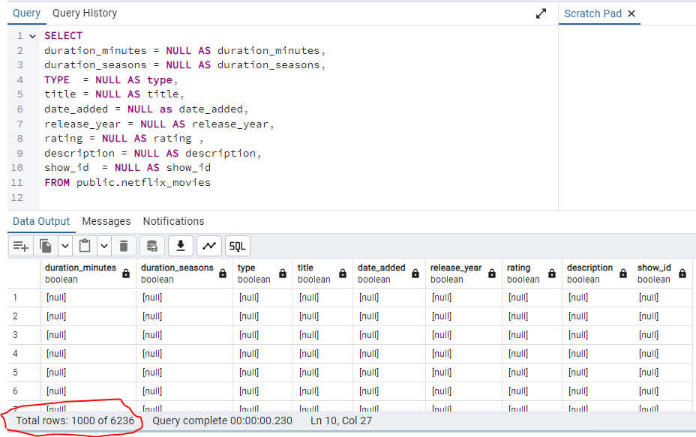
2. Write to check if there are(null values/figures) in the datasets)
By checking the for null values, result shows that there 1,000 missing information out 6,236 information in the database.
Which is crucial for maintaining data integrity and making informed decisions.

Slide 9
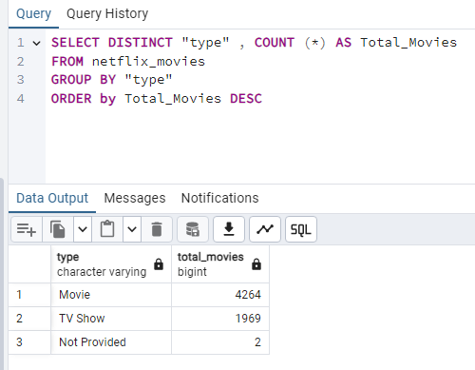
3. Count the total number of movies and TV shows in the dataset
Query result shows that there are 4,264 Movies, 1,969 TV Show and 2 media that was not stated to be Movie or TV Show .

Slide 10
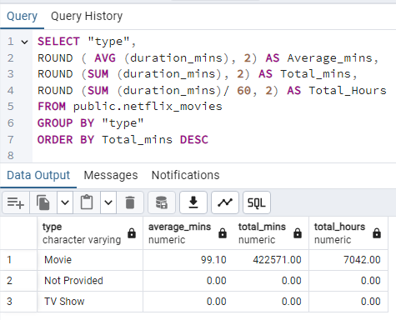
4. Find the total and average duration of movies and TV shows
Analyses shows that MOVIES takes lead of long duration over TV show with the :
Average Mins : 99mins 10sec
Total Mins: 422,571 mins
Which is equivalent to TOTAL HOURS of 7,042hrs

Slide 11
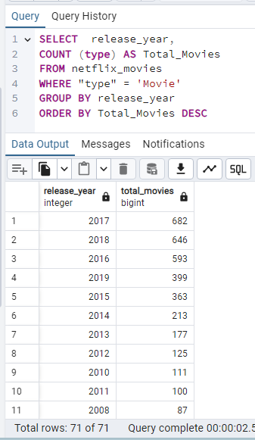
5. Find the number of movies released in each year.
By checking for the number of movies released each year. Query result shows that year 2017 takes an outstanding winning with 682 movies released while year 2018 and 2016 takes the 2nd and 3rd place with 646, 593 respectively.

Slide 12
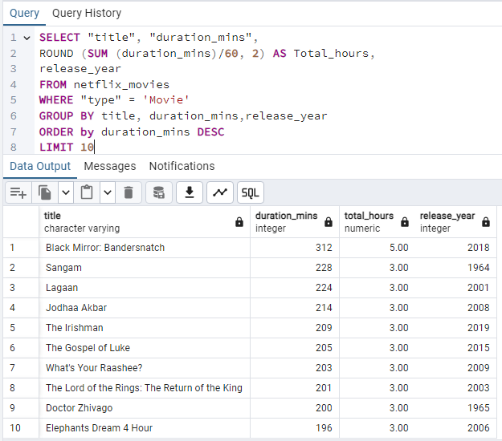
6. List the top 10 longest movies based on duration
Query result shows the TOP 10 longest movies based on their respectful duration.
However, movie titled = Black Mirror: Bandersnatch is the longest movie with 312 mins equivalent to 5 hours and the movie was released in the year 2018.

Slide 13
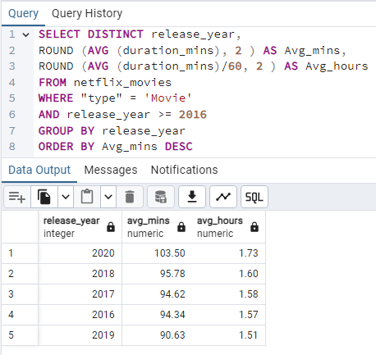
7. Find the average duration of movies released in the last 5 years
Analyses shows that movie released in the last 5 years (assuming the present year is 2020) has the maximum of average duration of 1 hour 73mins and also minimum of average duration is 1 hour 51mins of movies

Slide 14
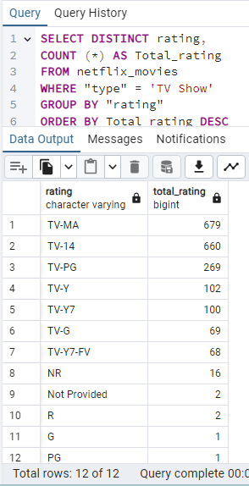
8. Determine the most common rating for TV shows
From the query analyses result, there are 12 different type of ratings for TV shows.
However, result shows that TV-MA rating is the top and most common rating for TV Shows with total of 679 all time counts of rating while TV-14 and TV-PG takes the 2nd and 3rd position with 660 , 269 respectively.

Slide 15
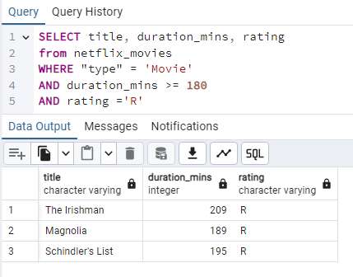
9. List the titles of movies with a duration greater than 180 minutes and a rating of 'R'
Query result shows that there are only 3 movie with a duration greater than 180 minutes and a rating of 'R'

Slide 16
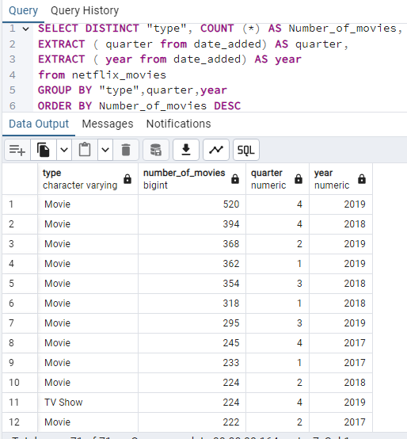
10. Find the number of TV shows added to Netflix in each quarter
Analyses shows certain number of movies published on Netflix in each quarter.
Further queries result shows that year 2019 Q4 has the highest number movies published which is 520 movies follow by year 2018 Q4 and 2019 Q2 with total of 394, 368 movies respectively.

Slide 17
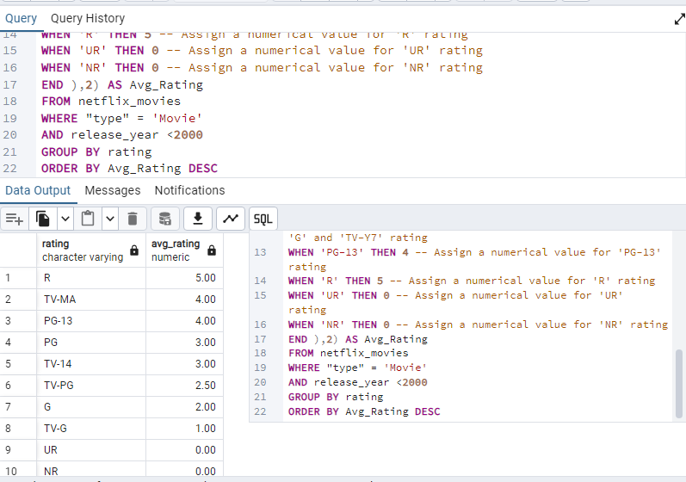
11. Calculate the average rating for movies released before 2000.
Query result display all types of Rating for Movies released before 2000.
However, ‘R’ ratings takes the lead with the highest average rating before year 2000 with 5.00 while ‘TV-G’ ratings has the least average rating of 1.00.
Moreso, ‘UR and NR’ ratings has none with 0.00 average rating before 2000.

Slide 18
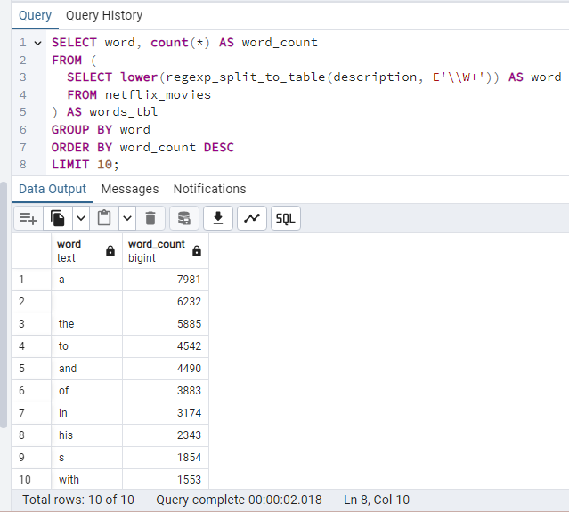
12. Determine the top 5 most frequently occurring words in the description column.
SQL data mining techniques was used to ascertain the most common word used in the description column.
Analyses show that ‘a’ is the most common character word used with total occurrence of 7,981 followed by space ‘ ‘ character and ‘the’ with total occurrence of 6,232 , 5885 respectively.

Slide 19
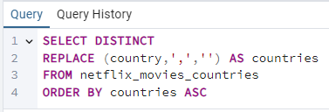
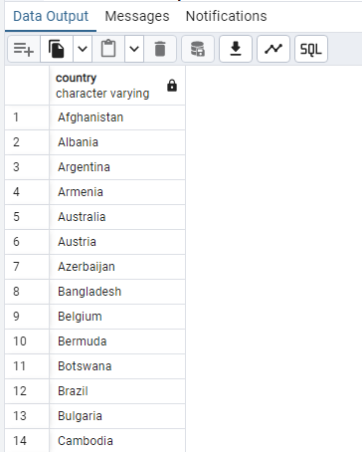
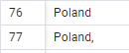
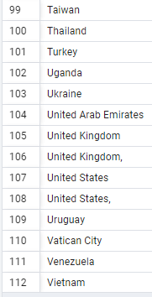
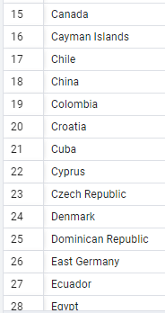
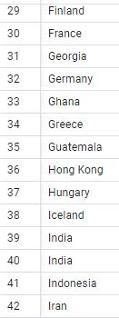
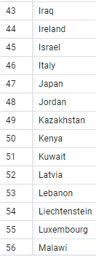
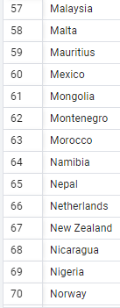
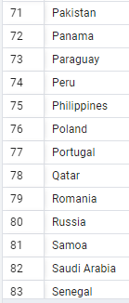
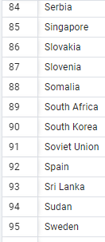
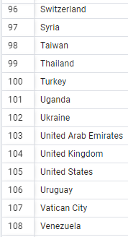
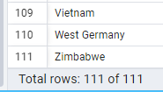
13. Find and display all Countries in the dataset
Query analyses shows that there are total number of 111 countries in the dataset. An anomalies was observed that Poland, United States and United Kingdom appears to be duplicate with comma (,) sign at the suffix.

Slide 20
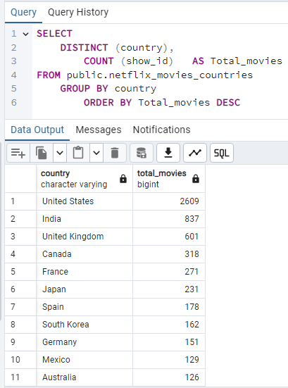
14. Find the Country with the highest Netflix Movies
Analyses shows that United States has the highest number of movie with 2,609 movies while India and United Kingdom has 837, 601 movies respectively.

Slide 21
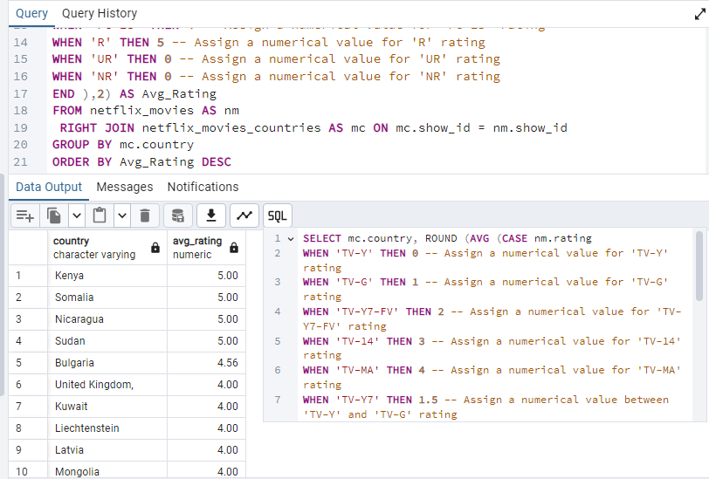
15. Country with the highest Average Rating
Sequel to the query result which shows that Kenya, Somalia, Nicaragua, Sudan takes top place with 5.00 avg. rating

Slide 22
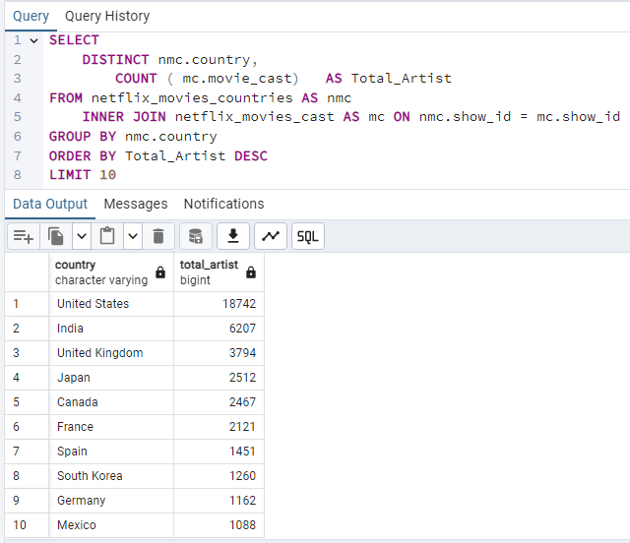
16. Find the Top 10 Countries with the highest number of artist
Query result shows the TOP 10 Countries with the highest number of artist in the dataset.
However, as seen that United States takes the lead which have the highest number of artist with 18,742 artist in the dataset.

Slide 23
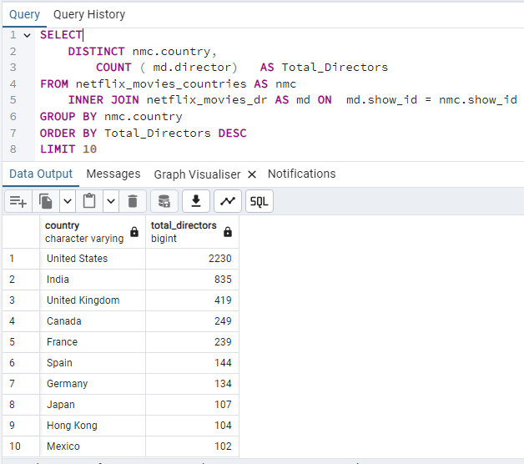
17. Find the Top 10 Countries with the highest number of directors
Sequel to the query result showing the Top 10 countries with highest number of directors, it shows that United State produced the highest number of director of movies on Netflix which takes the top position with 2,230 total number of directors.

Slide 24
Recommendations
Movies publisher are advice to use popular tags, attractive titles, clear descriptions, sharp graphics cover design and high quality thumbnails to improve discoverability and attract viewers.
Producers are encourage to produce and publish movie within the Average Mins : 99mins 10sec to attracting more viewers and build a strong community.
Movies publisher should published Movie with the TV-MA rating to maximize views and engagement.
Producers are encourage to produce movies & TV shows mostly at the last quarter of the year, since insight shows that users engagement are high during the last quarter (oct,nov,dec).
Movie crew should ensure good audio and Movie quality, create valuable contents, knowledgeable contents engaging the audience (users) .
Respectively, countries should invest more in the movie industry as insight shows that US-United States has the highest number of artists and directors of movies on NETFLIX. Thus, other countries should invest and develop their movie industry.
Movies publisher should ensure data accuracy that is data inputted are free from error at the time of uploading. For instance, that Poland, United States and United Kingdom appears to be duplicate with comma (,) sign at the suffix. (see page 19)
Regularly review Netflix Analytics to understand what works and refine your content strategy accordingly.

Slide 25
THANK YOU
NETFLIX MOVIES ANALYSES WITH SQL
By
ADEDOKUN ABDULMALIK ADEYEMI

