Slide 1
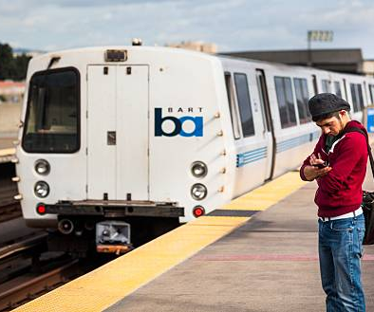
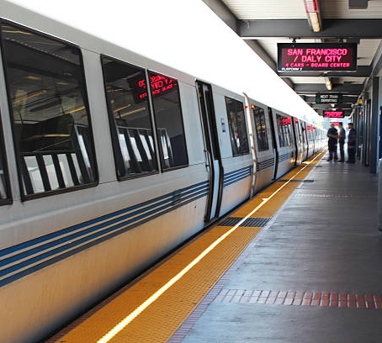
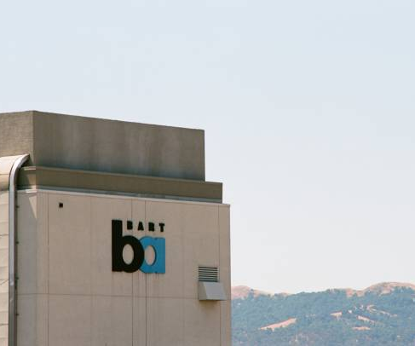
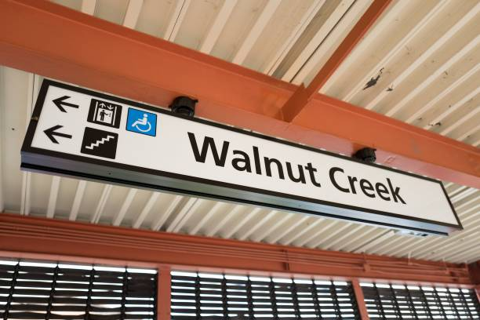
BART MANAGEMENT
SYSTEM
Written by:
Melanie Olisah(19767)
Aditi Vaidya (19598)
Adebodun Adeleye(19747)
Professor:
Dr. Bhaskar, Vidhyacharan
Notes:
By providing a cheap and convenient means to access jobs

Slide 2
Agenda
Introduction
List of Entities and Attributes
Schemas
Enhanced Entity Relationship model
EER Diagram
EER Diagram explanation
Queries
Create table and insert values
Select Queries
Alter and update queries
Nested Queries
Join Queries
Mathematical notation
Notation and its explanation
Conclusion

Slide 3
Introduction
BART stands for Bay Area Rapid Transit. It has served the San Francisco Bay Area since 1957.
Bart management system is a web-based system that manages all the activities within the BART.
It maintains records of all passengers, drivers and trains.
It keeps track of the fares and ensures that passengers pay the right fare at their various destinations.
It keeps track of the duration from one station to another.

Slide 4
List of Entities and Attributes
TRAIN | T_id T_type Seating_capacity Line_color
PASSENGER | Passenger_id Passenger_name Address Phone Email Trip_id
STATIONS | Station_id Station_name

Slide 5
List of Entities and Attributes
YELLOW_LINE | Station_id Station_name T_id
ORANGE_LINE | Station_id Station_name T_id
GREEN_LINE | Station_id Station_name T_id

Slide 6
List of Entities and Attributes
RED_LINE | Station_id Station_name T_id
TRIP | Trip_id Start_station_id End_station_id Fare Time_duration
DRIVER | D_id D_name Salary D_ssn T_id

Slide 7
VIEWS
All_Lines - Station_id, Connecting_stations
Blue_Green_Lines - Station_id, Connecting_stations, Blue_line_train_id, Green_line_train_id
Blue_Yellow_Lines - Station_id, Connecting_stations, Blue_line_train_id, Yellow_line_train_id
Yellow_Green_lines - Station_id, Connecting_stations, Yellow_line_train_id, Green_line_train_id
Yellow_Orange_Lines - Station_id, Connecting_stations, Yellow_line_train_id, Orange_line_train_id
Yellow_Red_Lines - Station_id, Connecting_stations, Yellow_line_train_id, Red_line_train_id
STATIONS - Station_id, Station_name, Train_id
END_STATIONS - End_station_id, End_station
START_STATIONS - Start_station_id, Start_station
Notes:
-explains the connecting lines.
All lines- empty set
Stn - union of all lines

Slide 8
Schema Diagrams
TRAIN
PASSENGER
BLUE_LINE, ORANGE_LINE, RED_LINE, YELLOW_LINE, GREEN_LINE
TRIP
T_id | T_type | Seating_capacity | Line_color
Passenger_id | Passenger_name | Address | Phone | Email | Trip_id
Station_id | Station_name | T_id
Trip_id | Start_station_id | End_station_id | Fare | Time_duration

Slide 9
Schema Diagrams
DRIVER
D_id | D_name | Salary | D_ssn | T_id

Slide 10
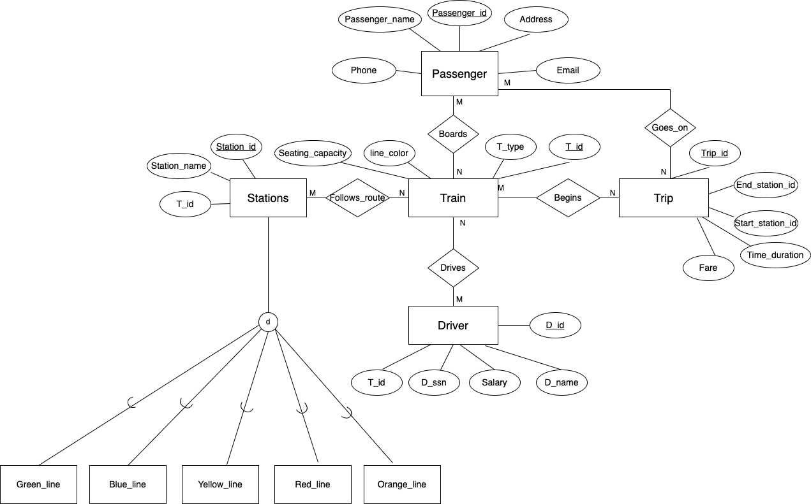
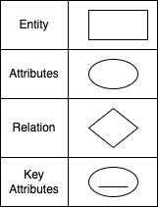
Enhanced Entity Relationship Model

Slide 11
Relationship and its Cardinality ratio
Passenger - Trip - Many to many relationship
Passenger - Train- Many to many relationship
Train - Trip - Many to many relationship
Train - Driver - Many to many relationship
Train - Stations- Many to many relationship

Slide 12
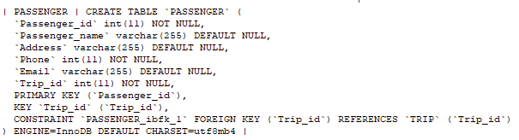
Basic queries - CREATE, INSERT

Slide 13
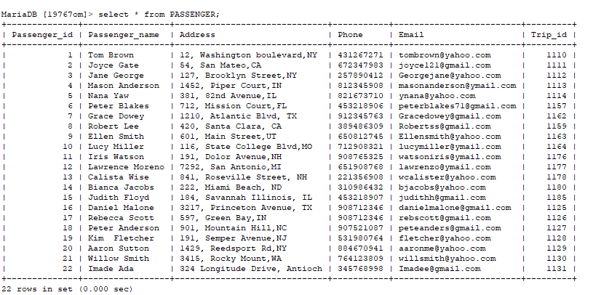
Basic queries - SELECT

Slide 14
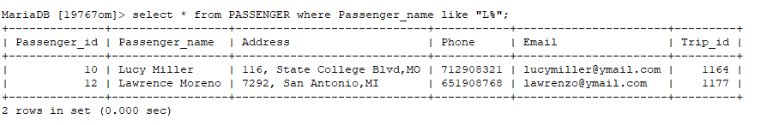
Basic queries - WHERE

Slide 15


Queries - Update, Drop, Alter

Slide 16
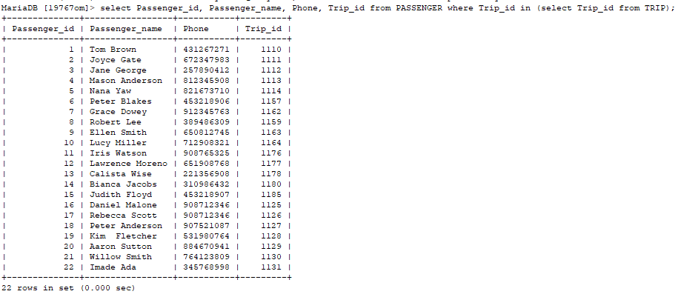
Nested queries
Retrieve the name of passengers and their trip ID

Slide 17
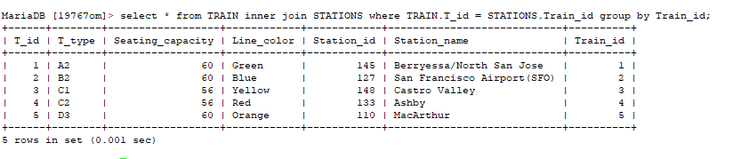
Joins - Two way
Retrieve some stations, showing their routes and the trains that ply those routes

Slide 18
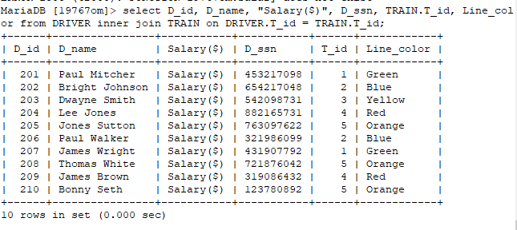
Joins - Two way
Retrieve the name of drivers, show the routes they take

Slide 19
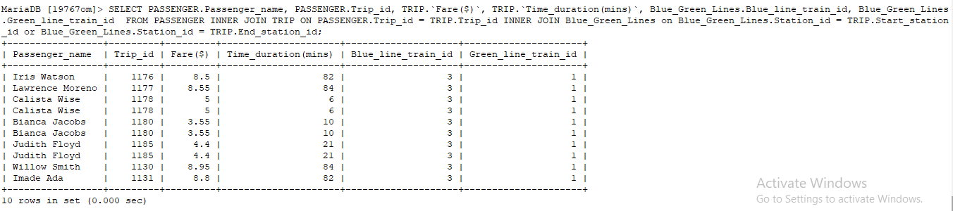
Joins - Three way
Retrieve the names of passengers, show their trip and connecting trains

Slide 20
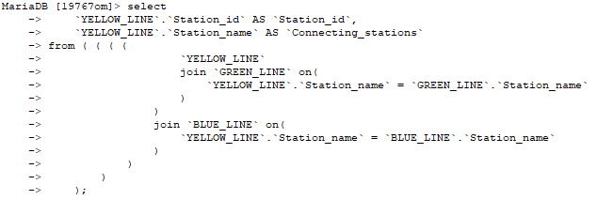
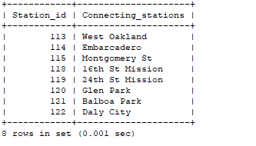
Joins - Three way
Show connecting routes for 3 line; Yellow, Green, & Blue

Slide 21
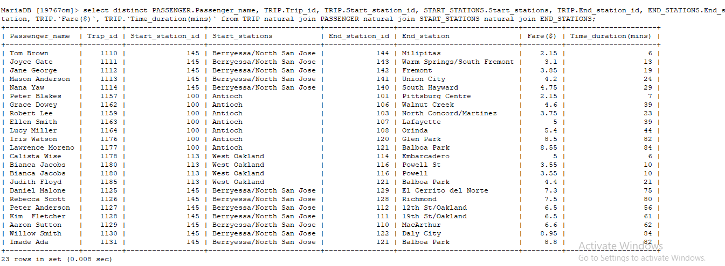
Joins - Multiple Joins
Show all passengers and their trips, detailing their departure and arrival stations

Slide 22
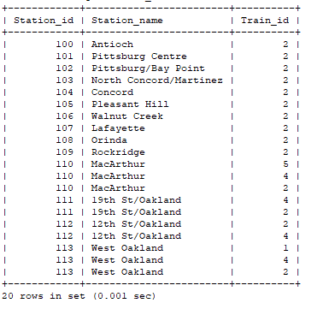
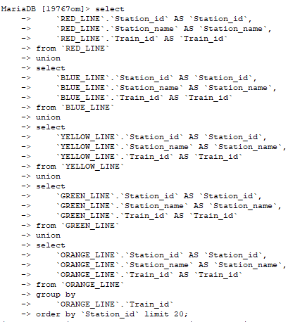
Join - Multiple Joins

Slide 23
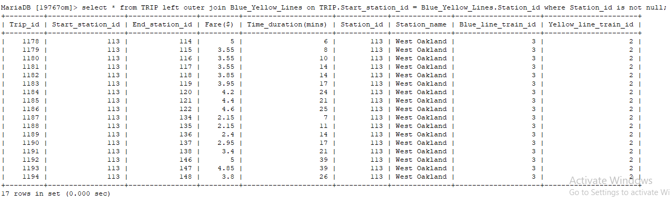
Joins - Left outer join
Retrieve trips that have 2 connecting rides; Blue and Yellow

Slide 24
Mathematical Notation
Retrieve the name of drivers, show the routes they take
DRIVER_INF ← 𝜋D_id, D_name, Salary, D_ssn(DRIVER)
TRAINS_INF← 𝜋 T_id, Line_color(TRAIN)
DRIVER_ROUTE ← (DRIVER _{⋈ T_id = T_id}TRAIN)
RESULT← 𝜋D_id, Dname, Salary, D_ssn, T_id, Line_color(DRIVER _{⋈ T_id = T_id}TRAIN)

Slide 25
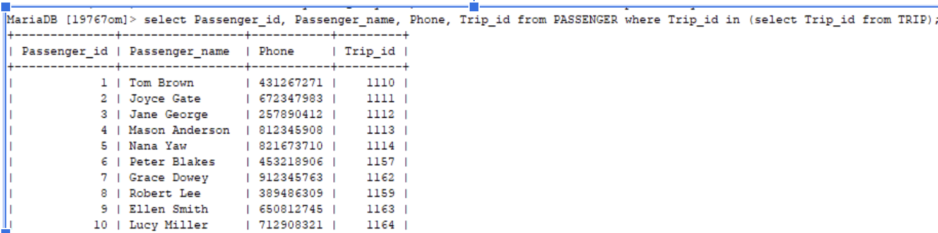
More Mathematical Notation
Retrieve the name of passengers and their trip ID.
Table 1← 𝜋Passenger_id, Passenger_name, Phone, Trip_id(PASSENGER)
Table 2 ← _{𝜎} PASSENGER Trip_id = Trip_id(TRIP)
RESULT← 𝜋Passenger_id, Passenger_name, Phone, Trip_id(𝜎 PASSENGER _{Trip_id = Trip_id}TRIP)

Slide 26
Conclusion
The BART management system exists to shed more light on the relations between trains, passengers, stations and drivers.
This was achieved by understanding the entities, their attributes and relationships.
BART system provides the optimal solution for cost effective and easy commute.

Slide 27
Thank you!

