Slide 1
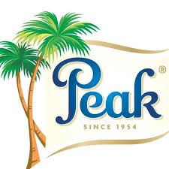
BRAND AUDIT - PEAK MILK
Name: Melanie Olisah
Course: MKT552 Brand Management and Marketing
Instructor: Dr. James Nysather
Year: 2023
“Reach for your Peak”

Slide 2
Topics
Introduction
Brand Elements
List of Products
Brand Attributes
Brand Concept Map
Brand Perceptual Map
Marketing Campaigns
Competitors
Audit Summary

Slide 3
Introduction
History and Background:
Parent company established in 1954
Peak milk Nigeria local production started in 1975.
Key Products Offered:
Peak milk offers a diverse range of dairy products, including milk powders, evaporated milk, yogurts, and condensed milk.
Market Presence in Nigeria:
Peak milk holds a significant market share in Nigeria's dairy industry.
The brand's extensive distribution network ensures its products are widely available across urban and rural areas, catering to diverse consumer segments.

Slide 4
Mission Statement
Mission Statement
"To nourish Nigeria with quality dairy nutrition."

Slide 5
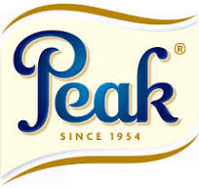
Logo and Color
These colors (Blue, White and Gold) are typically employed to evoke a sense of trust, reliability, and purity while ensuring visibility and readability of the brand's identity and messaging.
Slogan: Reach for your peak

Slide 6
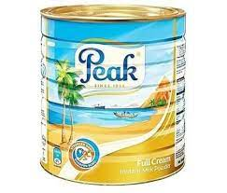
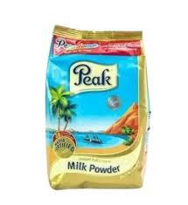
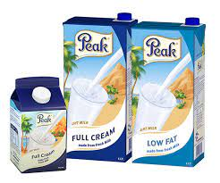
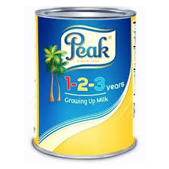
List of products

Slide 7
Brand Attributes
Heritage: Emphasizing the brand's longstanding presence and heritage in the Nigerian dairy market.
Quality: Signifying the high standards and consistency in delivering quality and highly nutritious dairy products.
Trust: Fostering trust among consumers through reliability and consistent quality.
Value: Offering value for money while maintaining quality and nutrition.
Reliability: Consistently meeting consumer expectations and readily accessible.

Slide 8
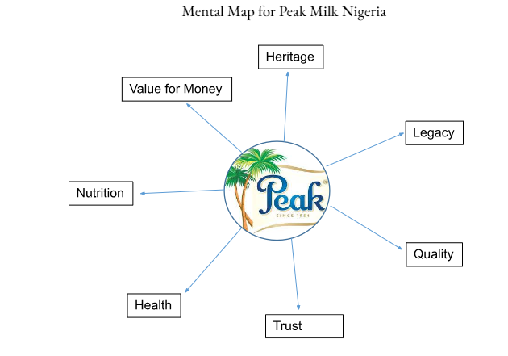
Mental Map

Slide 9
Brand Concept Map
Diverse Products
Varying Recipes
Colorful
Varying Texture
Great Taste
Family Value
Peak
Catchy Ads
Top Quality
Affordable
Supreme Reign

Slide 10
Brand Perceptual Map
Peak milk Nigeria
Three Crowns Milk
Cowbell Milk
High Quality
Low Price
High Price
Low Quality

Slide 11




Marketing Campaigns

Slide 12
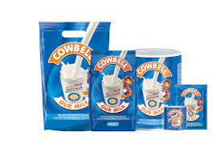

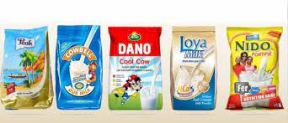
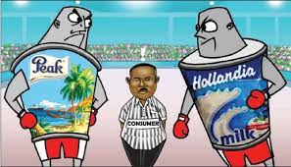
Competitors

Slide 13
Audit Summary
Strengths Identified:
Heritage and Legacy: Peak milk embodies a rich heritage, fostering a strong emotional connection with consumers, contributing to its longevity and trustworthiness in the market.
Perceived Quality: Consumers associate Peak milk with high-quality dairy products, emphasizing its reliability, consistency, and nutritional value.
Consumer Trust: The brand has garnered significant consumer trust, positioning itself as a dependable and reputable choice in the dairy market in the Nigerian markets.

Slide 14
Audit Summary (Cont’d)
Consumer Perceptions:
Consumers perceive Peak milk as a brand that offers value for money, consistent quality, and a sense of reliability, enhancing its positioning in the market.

Slide 15
Recommendations
Community Development Involvement:
Unlike its competitor, Cowbell, Peak Milk has almost zero noticeable involvement in community development.
Emphasize Storytelling and Heritage:
Incorporate storytelling in marketing campaigns to evoke emotions and connect with consumers. eg. Papilo
Target Gen-Z Market:
Increase Social Media presence and Sponsor more TV shows and Influencers.

Slide 16
Conclusion

