Slide 1
Metrics 1.3.6
E-Portfolio by Marco Mueller

Slide 2
Outline
The Main Idea and the goal
Metrics 1.3.6
Explanation of some Metrics
Metrics 1.3.6 Demo

Slide 3

Metrics – The Main Idea
defining Quality of Code isn‘t easy by just looking on it
try to explain quality through numbers
“software quality metric: A function whose inputs are software data and whose output is a single numerical value that can be interpreted as the degree to which software possesses a given attribute that affects its quality.”
– IEEE Standard 1061, 1998
Notes:
„Eine Softwarequalitätsmetrik ist eine Funktion, die eine Software-Einheit in einen Zahlenwert abbildet, welcher als Erfüllungsgrad einer Qualitätseigenschaft der Software-Einheit interpretierbar ist.“

Slide 4
Goal of Metrics
Important for a good program:
Maintainability
Extensibility
Comprehensibility
Using Metrics helps you to become an overview over your project and see where to improve it.
It won‘t show you correctness or how exactly to improve it!
Notes:
Wartbarkeit
Erweiterbarkeit
Verständlichkeit

Slide 5
Metrics 1.3.6
Eclipse-Addon
shows metrics for whole projects, packages and classes
auto-generated Numbers
easy setup

Slide 6
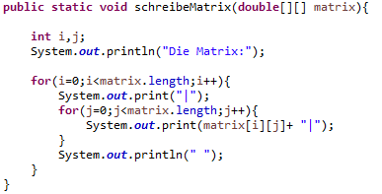
Metrics – Lines of Codes
Different ways to count:
Lines of Code: Count everything
Source Lines of Code: Count without blank lines and comments
Non-Comment Lines of Code: Count without blank lines, comments and header/footer
(method line of codes)
Notes:
LOC 13
SLOC 11
NCLOC 9 (method), 11 (class)

Slide 7
Metrics – Efferent & Afferent Coupling
the number of data types a class knows about
parameter types
variable types
also: exceptions, implementations like interfaces
“Efferent – The number of classes inside a package that depend on classes outside the package”
“Afferent – The number of classes outside a package that depend on classes inside the package”
- Definition in Metrics 1.3.6

Slide 8
Metrics - Instability
Changing a package → impact on other packages
calculated number which shows the effort to do this
I = Ce / (Ca + Ce)
Normally: range between 0.0 to 1.0 (0.0 means max. stable)
Choose between stable or unstable (intentionally)

Slide 9
Metrics - Abstractness
= Abstract classes/concrete classes (in one package)
„The number of abstract classes (and interfaces) divided by the total number of types in a package“
- Definition of Abstractness in Metrics 1.3.6
Compared with Instability value Abstractness becomes useful

Slide 10
Metrics – Distance from the Main Sequence
D = | A + I – 1 |
Ideal value: „0“
Max. stable (I = 0) and max. abstract (A = 1) is good
Min. stable (I = 1) and min. concrete (A = 0) is also good
D should be as near to „0“ as possible for a good package structure

Slide 11
Metrics – Specialization Index
different formulas
In Metrics 1.3.6:
Number of Overriden Methods * Depth of Inheritance Tree / Number of Methods

Slide 12
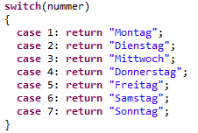
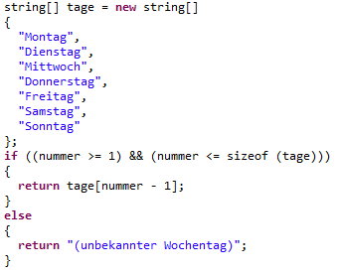
Metrics - McCabe
Counting the „ways“ through the code
Imagine the code as a graph with nodes and edges will help to count calculate the value:
V(Graph) = Edges – Nodes + 2*disconnected components (normally 1)
Both examples do the same, but looking only at the value will lead to different unterstandings of complexity
Notes:
Ein interessanter Rückschluss von McCabe war es auch, dass mit Hilfe des erstellten Graphen eine Bewertung des Programmierstils erfolgen könne, und dadurch sogar der Programmierer der betrachteten Software zu identifizieren wäre.

Slide 13
Literature
"Object-Oriented Metrics, measures of Complexity“ by Brian Henderson-Sellers
"OO Design Quality Metrics, An Analysis of Dependencies“ by Robert Martin

