Slide 1
CSI3131 – Lab 2
Part A - InterProcess Communication with Pipes
Part B – Java Threads

Slide 2
Objective of the lab – Part A
In Part A of the lab, you will revise the mon.c program to create mon2.c to explore the use of pipes.
A new program “filter” has been added to the set of the files from lab 1 (please use the new version of all programs – some minor changes were made to the original software).
A template for mon2.c has been provided.
  You will be able to port much of the code from mon.c to mon2.c
The mon2 program should add the following features to the original mon program:
  Create a pipe.
  Create a third process to run filter (filter is a program that reduces the number of lines output from procmon)
  The pipe should be attached to the standard output of the process running procmon and the standard input of the process running filter
The next slide provide a diagram of all processes expected to run when mon2 is executed.

Slide 3
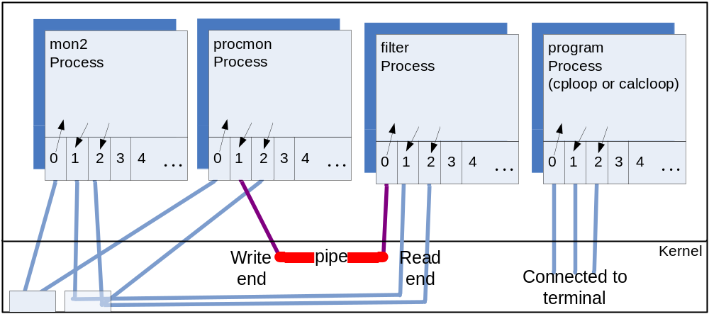
Terminal

Slide 4
Objective of the lab – Part B
In the second part of the lab, you will experiment with Java Threads
  This part of the lab can be completed using the Java SDK (version 6) on the lab PCs
    Use you preferred development environment: Dr Java, Eclipse, or even “javac”
  Code has been provided to fill in a image in a window that reflects the MandleBrot set (see the next slide)
    The image is created in the Window by painting small rectangles separately
    The provided code uses a recursive method to determine the size of the small rectangles to paint (see MBCanvas.java).
      Each rectangle is painted using a separate call to a method.
    You will change the code so that each rectangle is painted by a separate thread.
    This will allow you to visually see the execution of threads.
    You will also experiment with a thread pool.

Slide 5
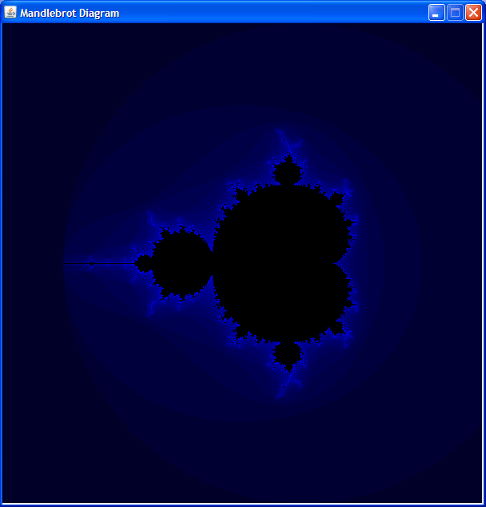

Slide 6
You have this week and next week to complete the lab, so take your time to understand what you are doing.
  Follow the instructions in the lab writeup.
  The TAs shall circulate in the room to help answer any questions
Good luck.

