Slide 1

CURRICULAR DEVELOPMENT ACTIVITY
Programmatic Control of SDR Hardware
for GNSS Signal Transmission
Gabriel Matias Falcão
Bachelor in Computer Science — NOVA FCT | Initial curricular stage + continuation at GMV
March 11 — July 17, 2026

Slide 2



CONTEXT
Why GNSS signal simulation matters
GNSS constellations
Signal simulators
SDR as the transmission layer
GPS, Galileo, GLONASS, BeiDou — satellites broadcasting positioning signals to receivers worldwide.
Reproduce satellite signals on the ground, enabling controlled, repeatable receiver testing without waiting on real satellites.
Pre-computed I/Q samples are streamed through Software-Defined Radio hardware to produce realistic RF signals.
GMV — SDR Control & PPP over RS-232
1

Slide 3


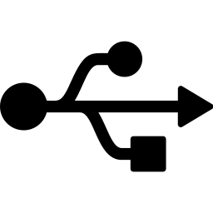
PROBLEM
A gap between hardware and high-level intent
DTAPI is low-level
Configuring DekTec SDR hardware requires precise call sequencing, manual state management, and direct handling of FIFO/DMA details.
No bridge to open-source tools
No existing solution connects open-source GNSS I/Q generators to professional-grade SDR hardware.
RS-232 is only a physical link
The serial interface solves transport at the electrical level, but a robust high-level control path still has to be carried across it.
GMV — SDR Control & PPP over RS-232
2

Slide 4
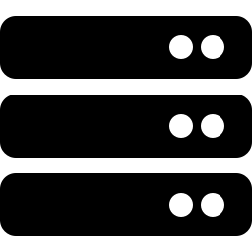


PROPOSED WORK
Three phases, one goal: programmatic control
Phase 1
Phase 2
Phase 3
SDR Control
Parameter Management
RS-232 Connectivity
C++ abstraction over the DTAPI for device management, signal transmission and synchronisation.
A configuration system to manage SDR transmission parameters without low-level API calls.
A serial connectivity layer for integrating external equipment and exposing the control plane across that link.
GMV — SDR Control & PPP over RS-232
3

Slide 5

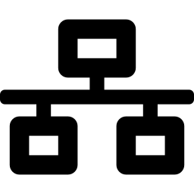
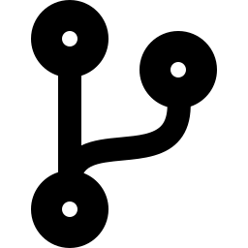
SCOPE EVOLUTION
Requirements rarely stay fixed
RS-485 to RS-232
PPP replaced custom serial protocol
Continuation at GMV
The proposal mentioned RS-485, but the real equipment used RS-232 from the outset. This was identified early and had minimal design impact.
A bespoke RS-232 application protocol was dropped in favour of PPP over the serial link, so the existing gRPC control plane could run over IP unchanged.
Some final architectural decisions were completed after the curricular stage, once the work continued directly under GMV.
GMV — SDR Control & PPP over RS-232
4

Slide 6
SDR CONTROL SYSTEM
Client-server architecture over gRPC
CLI Client
Server
app + dt_facade
DTAPI
DTA-2115B /
DTA-2116
user-facing
gRPC
DTAPI wrapper
vendor SDK
PCIe cards
.proto contract — stub & skeleton autogenerated by protoc from the same source
Why gRPC?
Reliability & performance — proven in production systems
Strongly-typed contract between server and client
Reflection — debugging, config parsing, command discovery for free
GMV — SDR Control & PPP over RS-232
5

Slide 7



DESIGN DECISIONS
Consistent principles across both systems
Errors as values
CMake build system
Reuse standard stacks
std::expected<T,E> instead of exceptions or C-style codes — explicit, compile-time checked error handling.
Easier integration with surrounding toolchains, test workflows, and packaging in a conventional C++ environment.
PPP over RS-232 creates an IP link, allowing the same gRPC interface to be reused instead of maintaining a second custom protocol.
GMV — SDR Control & PPP over RS-232
6

Slide 8
SDR CONTROL DEMO
Live demonstration of the SDR control system
GMV — SDR Control & PPP over RS-232
7

Slide 9
RS-232 INTERFACE
PPP over RS-232 carrying an IP channel
gRPC Client /
Server
Core ideas
RS-232 is kept as the physical transport only
PPP creates a point-to-point IP link over the serial byte stream
The existing gRPC control plane then runs unchanged over that link
Less duplicated protocol logic, easier testing and debugging
IP Stack
PPP Endpoint
RS-232 Serial
Port
GMV — SDR Control & PPP over RS-232
8

Slide 10

TESTING
External tester and unit tests
External tester
Unit tests
Simulates the remote receiver over PPP on top of RS-232, exercising the serial link, IP transport and gRPC control path end-to-end.
Verify smaller pieces of logic in isolation, making regressions easier to catch and debug during development.
Covers the full path in a realistic setup, so integration problems appear before deployment.
Together with the external tester, they provide both component-level confidence and end-to-end validation.
GMV — SDR Control & PPP over RS-232
9

Slide 11

CHALLENGES FACED
Where the hard problems actually were
DTAPI quirks
Serial driver & wiring
DTAPI documentation isn't always accurate; some functions have unexpected side effects. Some don't show complete error information.
Generic 8250 driver was insufficient for the WCH CH382 card; replaced with the vendor driver. A missing null-modem adapter caused two DTE devices to transmit into each other's TX line.
GMV — SDR Control & PPP over RS-232
10

Slide 12

CONCLUSION
Two systems, one consistent engineering approach
SDR Control System — a clean, remotely accessible, gRPC-based abstraction over the DTAPI.
RS-232 Interface — PPP over serial providing a standard IP channel for the same gRPC control plane.
Lesson: extensibility paid off for external, unpredictable change — but generality pursued ahead of need had a real cost.
GMV — SDR Control & PPP over RS-232
11

Slide 13

Thank you
Questions & Discussion

