Slide 1
Data Preparation
Preparing Data is the main part of making the Model.
There are two types of output in data preparation:
Data (eg: Audio files in data/train)
We have to concentrate on the types and format of audio files
Type - wav
Audio should match to transcript perfectly.
Data prepare by using Audacity
Select an audio and split it into each words
convert it into 16KHz project rate and mono
Then save the file
Language (eg: Lexicon, phone set)
They can be generated with many tools.
We have to manually create some files.

Slide 2
Files we have to create
data/train/text
<utterance_id> <transcription>
Eg : The list of speaker-ids extracted from the utt2spk file is the same as the string sorted order
data/train/wav.scp
<recording-id> <extended-filename>
Utt2spk
<utterance-id> <speaker-id>
This says, for each utterance, which speaker spoke it.

Slide 3
Files you don't need to create yourself
data/train/spk2utt
Format - utils/utt2spk_to_spk2utt.pl data/train/utt2spk > data/train/spk2utt
Command - utils/utt2spk_to_spk2utt.pl data/train/utt2spk > data/train/spk2utt
data/train/feats.scp
<utterance-id> <extended-filename-of-features>
Command - steps/make_mfcc.sh --nj 20 --cmd "$train_cmd" data/train exp/make_mfcc/train $mfccdir
which is invoked by the top-level "run.sh" script
If the files are having issues with formats (eg : if they are not sorted) this file will not be created.
data/train/cmvn.scp
contains statistics for cepstral mean and variance normalization, indexed by speaker.
Command - steps/compute_cmvn_stats.sh data/train exp/make_mfcc/train $mfccdir

Slide 4
What is Lexicon?
A lexicon is simply a set of words with their pronunciations broken down into phonemes, i.e. units of word pronunciation
Lexicon is used is to refer to the finite state transducer which results from the lexicon preparation, called “L.FST” which maps the word symbols to their respective pronunciations
FST with probability of transitioning between word phoneme states.
One state to each phoneme
Probabilities of transitioning between states are specified by phoneme likelihoods, usually computed from some large corpus.
In practical, the length of a fixed phone can vary by up to 40-130 times.
So 3 states per phone + ’blank’

Slide 5
Importance of Lexicon
Discriminating between different pronunciations and spellings of words.
“ough” as in through, dough, cough, rough, bough, thorough, enough, etc.
N UR UL or N Y UR UL depending on which part of the country
“accented” is pronounced without the T during rapid speech (AE K S EH N IH D)

Slide 6
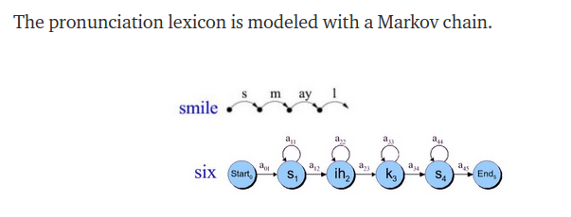
How Lexicon used
Taking the lexicon pronunciation HMM and adding to it the cepstral feature vectors computed from the raw audio file.
P(O|W) - Acoustic
P(O|W) conjunction P(W) – > P(W|O) using some algorithms.

Slide 7

Lang directory
2 directory - phones and topo

Slide 8
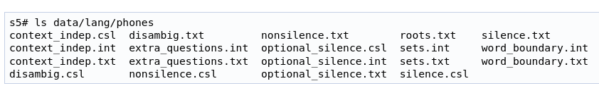
phones

Slide 9
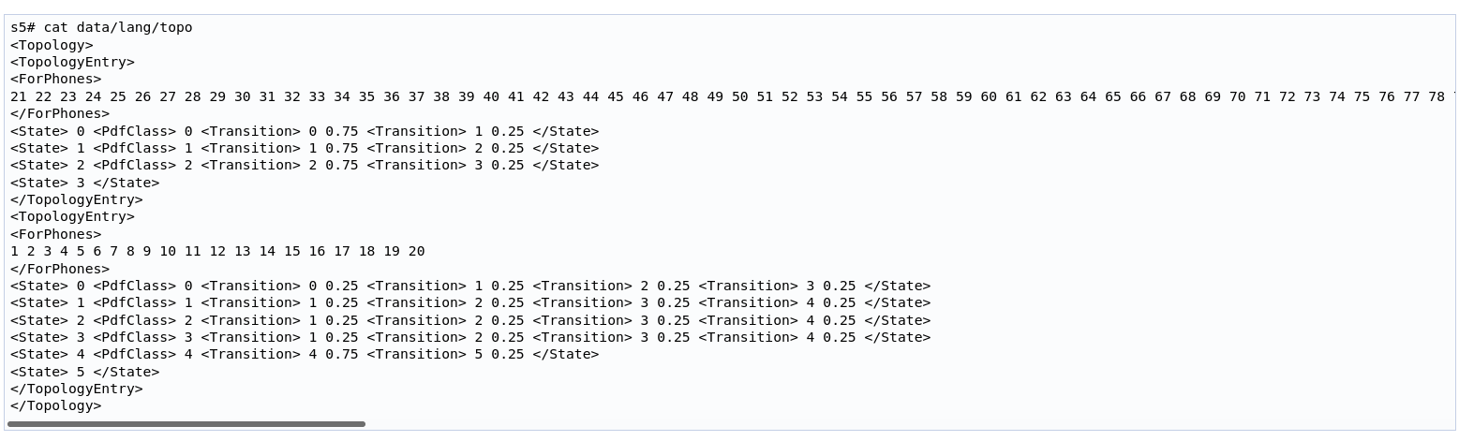
topo
Topology of HMM we use - Bakis Model

Slide 10
Lexicon resources
CMUdict
4 files
A set of 39 phone (phoneme) symbols as defined in ARPABET
A file containing the assignment of these symbols to their type (“vowel”, “fricative”, “stop”, or “aspirate”)
A file giving pronunciations of various punctuation marks
And then the core dictionary giving pronunciations of standard English word
Example data - abalone : AE2 B AH0 L OW1 N IY0

Slide 11
Language Model
A probability distribution over words or word sequences.
A language model gives the probability of a certain word sequence being “valid”.
Valid means not grammatical
Types of Language Models
N- gram model
HMM

Slide 12
N Gram Model
An N-gram is a sequence of N tokens (or words).
An N-gram language model predicts the probability of a given N-gram within any sequence of words in the language
If we have a good N-gram model, we can predict p(w | h) – what is the probability of seeing the word w given a history of previous words h – where the history contains n-1 words.
Eg : 3 gram model
Eg: She likes icecream. But on afternoons, she likes pudding.
The probability that She likes icecream 1/2

Slide 14
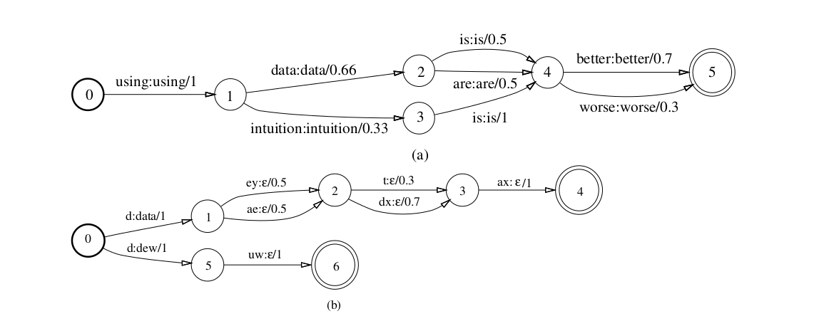
Decoding
Decoding in Kaldi done by Weighted Finite State Transducers

Slide 15
WFST
The transducers used in Kaldi HCLG = H o C o L o G.
G is an acceptor (i.e. its input and output symbols are the same) that encodes the grammar or language model.
L is the lexicon; its output symbols are words and its input symbols are phones.
C represents the context-dependency: its output symbols are phones and its input symbols represent context-dependent phones,
H contains the HMM definitions; its output symbols represent context-dependent phones and its input symbols are transition-ids, which encode the pdf-id and other information

Slide 16
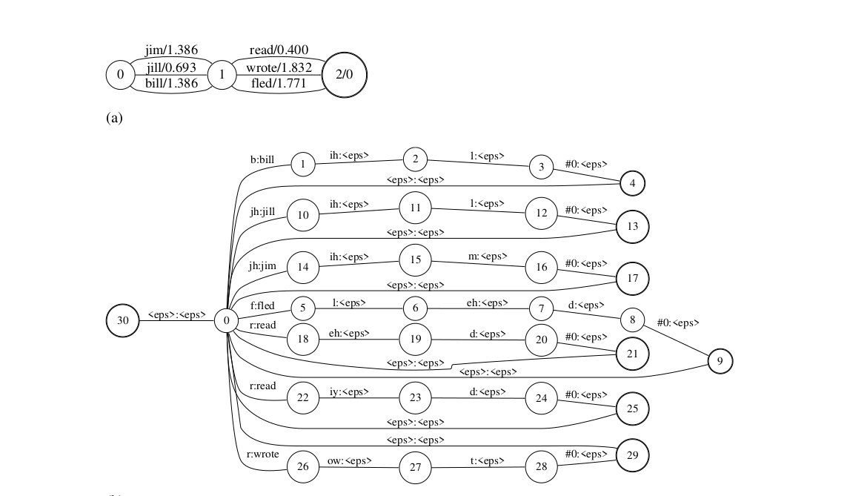
G and L WFST

Slide 17
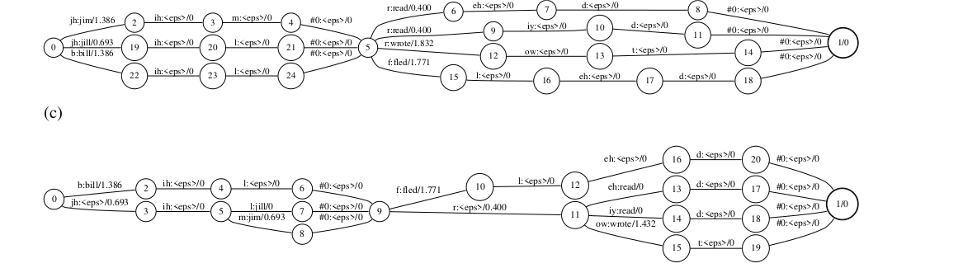
L o G and det(L o G) WFST

Slide 18
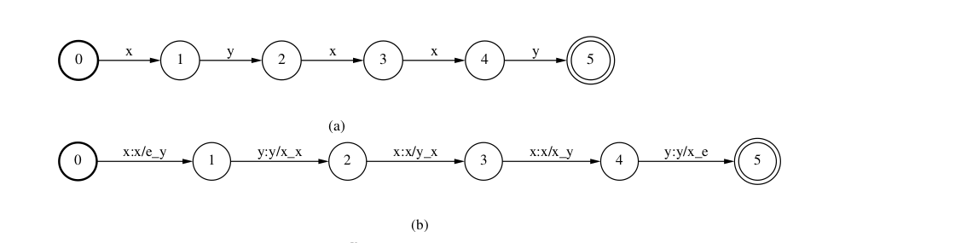
C WFST
Context independent string represented by single path acceptor
Composed with context dependent transducer where input context_ind labels and output context dependent labels

Slide 19
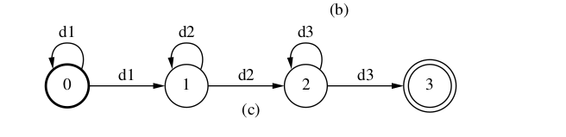
H Transducer
The kleen closure of union of individual HMM as above form a HMM transducers

Slide 20
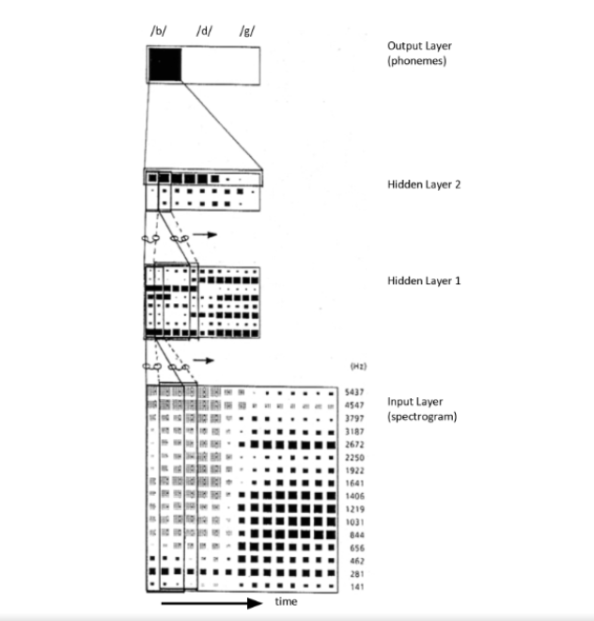
Time Delay Neural Network(TDNN)
Each time step represented by a column vector of acoustic frequency as each row
8 kernels used with stride 1 and frame range of 3 used in first hidden layer
3 kernels used with stride 1 and range of 5 frames used in second hidden layer

Slide 21
#!/bin/bash
start_num_iters=20
end_num_iters=40
start_totguass=1000
end_totguass=2000
filename=$1 #exp/mono0a1/decode_*/wer_*
wer_mono=($($(cut -d " " -f 1-3 $filename) | $(grep "WER") |$(cut -d " " -f 2 )))
count=0
while[[ $start_num_iters -le $end_num_iters && $start_totguasss -le $end_totguass ]];do
mid_num_iters=$(($start_num_iters + (($end_num_iters + $start_num_iters)/2)))
mid_totguass=$(($start_totguass + (($end_totguass + $start_totguass)/2)))
#give the mid_num_iters and mid_totguass as 4th and 5th aurgument
if[[ $wer_mono -ge 10.0]];do
start_num_iters=$mid_num_iters+1
done
if[[ $wer_mono_valid -le 1.0 ]];do
end_num_iters=$(($end_num_iters-$mid_num_iters +1))
done
if[[ count%2 -ne 0 ]];do
if[[ $wer_mono -ge 10.0]];do
start_toguass=$mid_totguass+1
done
if[[ $wer_mono_valid -le 1.0]];do
end_totguasss=$(($end_toguass-$mid_totguass+1))
done
done
count=$count + 1
done

