Slide 1
Final Project Presentation
Overview and Suggestions
See the file attached to the Dropbox for complete details

Slide 2



Some Project Themes
Project is done in 2 person teams
You may work with the partner of your choice.
If this is the option that you choose, notify me by email as soon as possible.
I will then assign teams before the week of Oct 11th.
Decide on a topic. Make sure you both understand it or 1 person understands it and can explain it well.
Meet weekly to review progress. See the timeline in the next several slides.
Animal care/training
Entertainment/Sports
Selling concessions at Dayton Dragons games
Managing a team
Catholic school soccer coach
Tech/IT support
Gaming
Tracking characters and their tokens
AFB related
Managing flight schedules or plane maintenance
Restaurant management
pizza, subs, Italian food
Tracking orders, inventory, sales
Healthcare Management
Trucking/Shipping
Book resellers
Daycare
Music label management
Law Firm
Car Dealership
Online Jewelry Sales
Online Shoe Store
Aquarium Management
Hotel Management

Slide 3
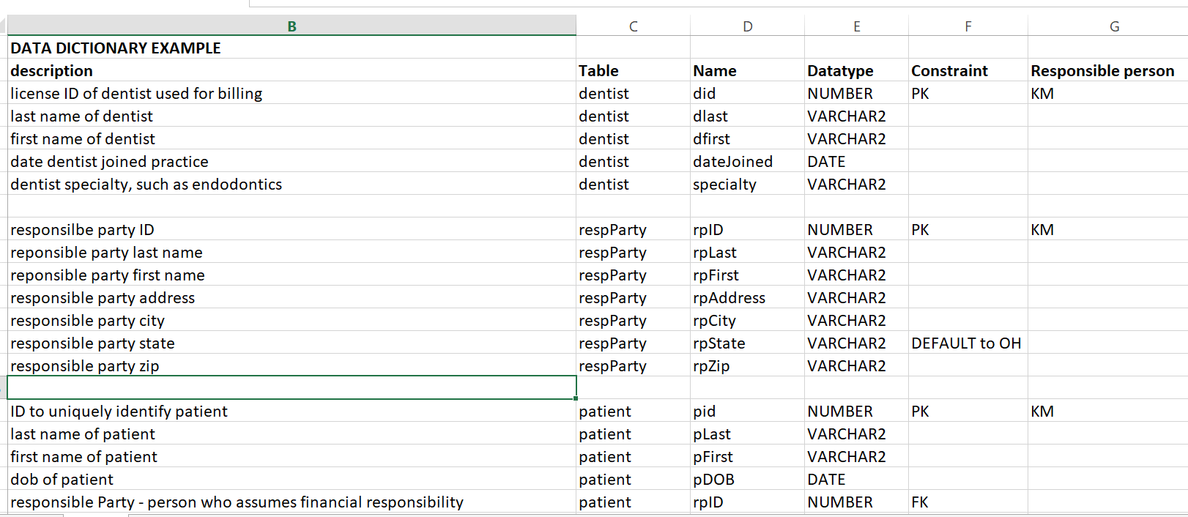

Part I, October 18th – 22nd
Together: Draft ERD, Begin data dictionary(can divide and conquer after draft of ERD is made)
Remember to consult project requirements to be able to build requirements into design
Write a summary of your project so the readers will get enough information to understand what entities will be created as well as the relationships between the entities
Data dictionary – format using example given in Solutions module, import or copy image into Word master file
ERD
Fit on 1 page/slide
Logical – not physical
Professional looking
Lines with elbows
Lines should not cross each other
Use Barker notation to start, then convert to Engineering

Slide 4



Parts II, III, IV
October 23rd – Nov 7th (2 weeks) Work in coordination with your partner
*remember all code is to be written in a script and saved. The includes the code to create tables and sequence(s), insert data, select statements, PL/SQL code, etc.
Person 1:
-Create ERD in Data Modeler
-Create DDL using Modeler or you may write the code manually using the CREATE TABLE commands AFTER Person 2 defines schema.
-Insert data into 4 tables(use script)
Person 2:
-Refine project summary and find logo
-Prepare normalized relational schema
-Insert remaining data(use script)
* Each student should select project sections that build on your strengths
SCHEMA
Discuss where sequence(s) are used constraints are planned. Make sure that the notation is correct
Make sure that the tables are normalized to 3NF
During presentation, peers will look for problems and ask questions

Slide 5
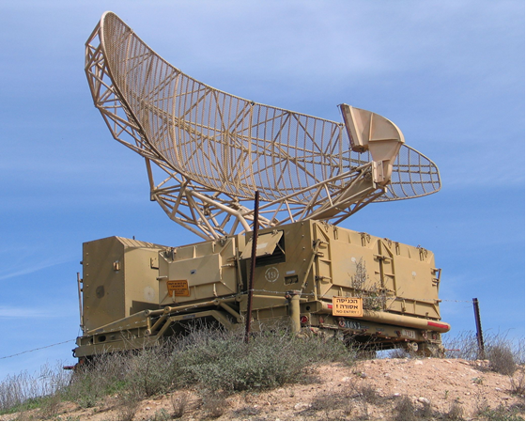

November 8th – 21st
Mission Control
Implement Other requirements as listed in Part V
Divide and conquer
Queries, PL/SQL and View
-Add comments to explain the purpose of each task below - written before the statement.
-Write a query to demonstrate a 3 table inner join with a restriction.
-Use PL/SQL to automate a task such as inserting or updating data, generating totals, etc.
-Write a query using a group or statistical function and a single row function that requires a minimum of 2 tables.
-Write a query to create a materialized view. Explain the purpose of the view.
-Create a nested subquery that contains 2 subqueries and 1 main query.

Slide 6


Prepare for Presentation November 22nd – 28th
Bonus points on final exam are based on presentations.
-Title slide with student names, project name and logo.
-Include a project description (abstract) that summarizes and describes your project. Do not get into tables required, etc but write it from a user point of view.
-Include the E-R diagram from Data Modeler. Explain your design during the presentation. Include the normalized, relational schema on 1 slide.
-Include your best SQL statement, view or PL/SQL procedure. Write the question in English, show the statement and the output.
-Give 1 lesson learned.
-Include at least 1 question for the class based on your project or as a review for the final exam.
~ 1 slide for each item listed above.
PRESENT WEEK OF 11-29 to 12-3
Multi-Player Video Game Database
Notes on Grading the Project:
For Part V, to earn maximum points, students need to implement features, of your choosing, that go above and beyond what we have done in previous assignments or examples used in class. These are WOW Points. If your project implements the part V requirements based on examples used in class, you may earn up to 90 % of the total points.

