Slide 1
COVID-19 India

Slide 2
Introduction
The purpose of this Project aims to create an analysis and visualization to help provide information to local people who must be alerted to go out of the house from the distribution of the COVID-19 case in India within their specific states and union territories. Also, to better visualize the clustering of our neighbourhood, we will be creating a custom function that we call ‘regioncolors’ that will assign a colour to each area within a 500-meter radius of our proposed facility firmly signifying their safety. It also aims to provide information on the states or union territories that are most needed for a lot of mask distribution, according to population density and number of increasing cases in that area.

Slide 3
Data acquisition and cleaning
1. A few Identified factors that influence our decision are:
Covid-19 cases per state or union territory.
Total population in states or union territories.
10 most population cities per state or union territory.
Hospitals and Nursing Homes for treatment of covid-19

Slide 4
2. The following data sources are needed to extract/generate the required information:
Processed covid-19 positive case data collection.
The distribution of mask sales based on the population in the India.
The distribution of mask sales based on 5 states or union territories with the most densely populated populations.
New datasets (to be created) that contains state or union territory, active cases, along with their latitudes and longitudes.

Slide 5
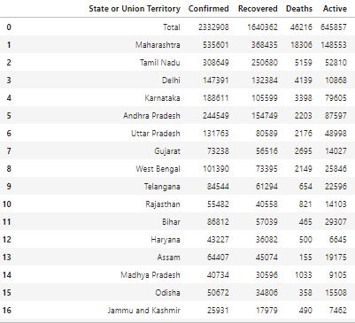
Methodology
First, we create a new dataset of only cases from the Covid-19 Case table.

Slide 6
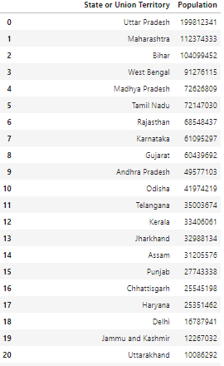
Show the total population data in India.

Slide 7
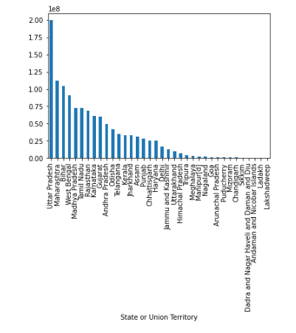
The chart below show the population density in India

Slide 8
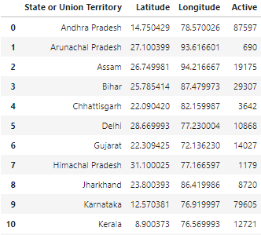
Get the latitude and longitude:

Slide 9
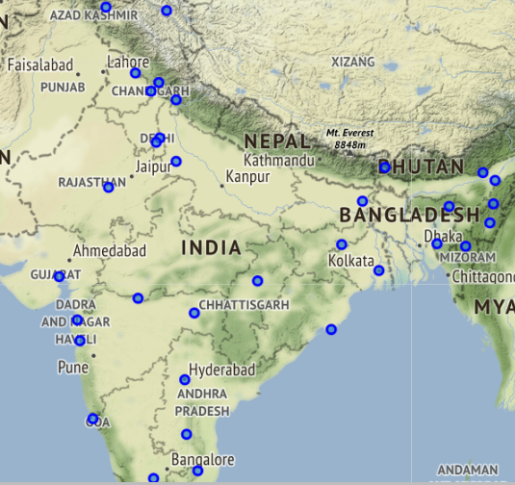
We have downloaded all the required dependencies earlier, and now we are ready to use the FOLIUM API service as follows:

Slide 10
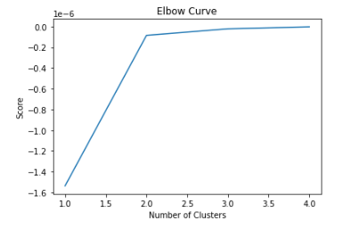
To start, we need to decide the best K-value for our analysis.

Slide 11
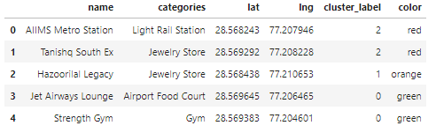
Based on the results generated by the FOURSQUARE API, we can locate the business site around AIIMS Hospital and identify affected business locations in the red zone.

Slide 12
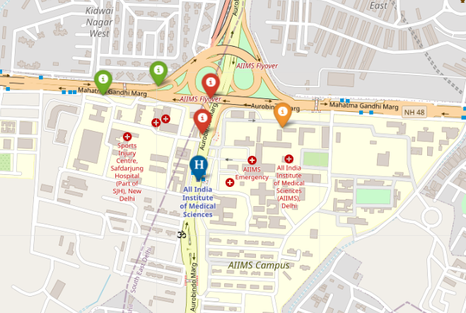
Next, we can then visualize our clustering analysis to a Folium map to see how all of these venues are geographically distributed within the 500-meter radius that we specified surrounding the proposed facility.

Slide 13
Conclusion and future directions
This project helps mask sellers to understand potential distribution areas according to population density in different states or union territories of India. It also helps the distribution of medical devices for corona care to hospitals that are estimated to have a large number of patients or even helps analyzing which hospitals need additional medical personnel (doctors and nurses).
It will also provide awareness to help business owners who run businesses surrounding the adjacent clusters to be better informed, with the density of people within the business neighbourhood.

